Slide 1

Helpmewithmymood
With social–media health analysis and display engine(SHADE)

Slide 2

Services- used
IBM Watson Tone Analyser.
Twitter API
Technology Used
Python 3

Slide 3
PROBLEM EXEPECTATION:
1.Develop a mobile/desktop app that will Get a person’s social contents (e.g. tweets) for a duration (e.g. past 24 hours).
2.Perform sentiment analysis using IBM Watson on the above content.
3. Display the person name and his/her most prominent sentiment.
4.Suggest measures to soothe or calm down the mood of the person by suggesting some curated playlist of songs based on his interest or something similar that you can imagine.

Slide 4
OUR idea:
Ask the user to enter the twitter screen name.
Retrieve data from twitter API .
Fetch last 30 tweets.
Clean fetched data i.e. removal of emoji’s and URL's using ‘re’ and ‘emoji’ modules of python3.
Tone analysis using IBM Watson tone analyser on the cleaned data.
Fetch the prominent emotion/sentiment from sentence level analysis.
Use this emotion to work accordingly.
Display the window showing the person screen name and his/her mood.
Providing him/her a play option to play the curated YouTube music playlist in the default web browser of the user.
i.e. cheer up/boost up music playlist for the person depressed or upset.

Slide 5
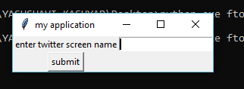
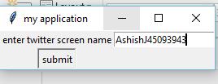
First window : where the user will be asked to enter the twitter screen name to know the sentiments of the person

Slide 6
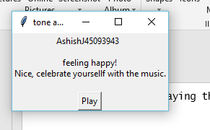
SECOND WINDOW :
Displaying the mood by analysing using submitted screen name.

Slide 7
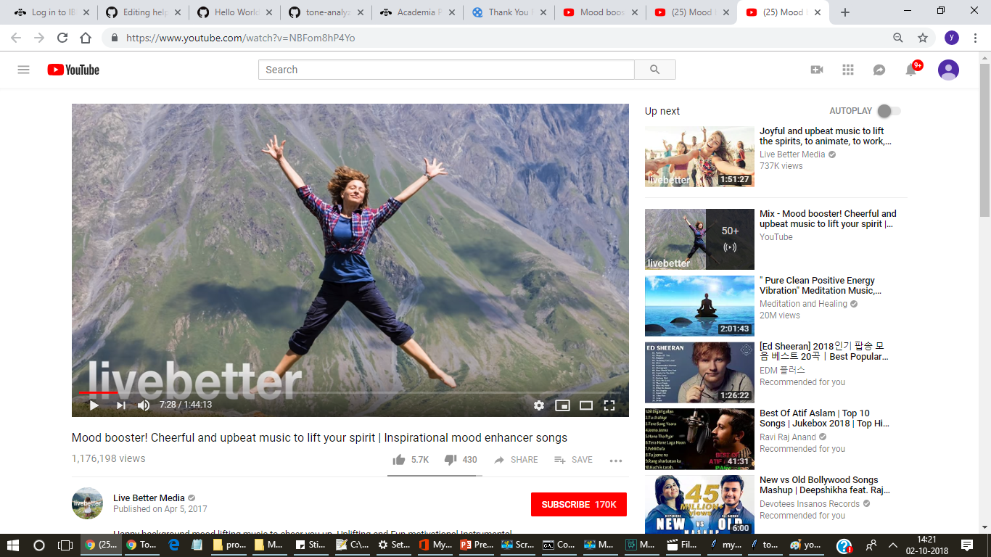
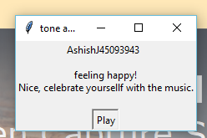
Video played after suggestion(as user click on the suggested play button

Slide 8
Business value derived-outcome of work in simple terms.:
Beside the lifesaving purpose, the app can also be used for business.
It can be used by various customer caring franchises to improve their service quality and hence to increase the market value.
The application can be used by the restaurants to know the most prominent mood of the most customers and can play the curated playlist of songs accordingly.
This will increase the number of customers as obviously the customer can feel more comfortable and can relax themselves there, and hence will love to spend more time in a place which can analyse their emotion and can help them to calm down and to soothe their mood.
The user need only to register his/her twitter screen name and by analysing emotion the curated playlist will be played.
By doing slight changes in the current desktop application that will be made by us, it can be made to be a good profitable app for this purpose that is for business purpose.
As it is obvious not all have same emotions at same time, but we can analyse the most common prominent emotion of customers present and will help them to increase the business.
Can be used for the same job at Airline services, railways or another customer caring services.

Slide 9


Thank You
Priya Khandelwal
Yashshavi kashyap
yashshavikashyap@gmail.com

