Slide 1



MACHINE LEARNING
CYBERSECURITY
BANKING
Bank Login Risk Classification Using Machine Learning
AI-Powered Login Risk Classification
Notes:
1

Slide 2
(INTRODUCTION)
The Problem with Traditional Authentication
Digital banking is growing rapidly — and so are cyber threats. Static password-based authentication can no longer keep pace with increasingly sophisticated attack vectors.
Digital Banking Growth
Rising Cyber Threats
Online and mobile banking adoption has surged, expanding the attack surface for malicious actors.
Credential stuffing, brute force, and automated attacks are becoming more frequent and harder to detect.
Password Limitations
Intelligent Detection
Traditional passwords alone provide no contextual risk assessment, leaving systems vulnerable to misuse.
An intelligent, ML-driven approach can evaluate login context and flag suspicious activity in real time.
Notes:
2

Slide 3
OBJECTIVES & STACK
Project Objectives & Technology Stack
Detect Suspicious Logins
Classify Login Risk
Identify potentially malicious login attempts using contextual input features.
Categorize each attempt as low, medium, or high threat for actionable response.
Real-Time Prediction
Easy Web Deployment
Deliver instant risk assessment with a trained ML model and Flask backend.
Lightweight, responsive web interface for quick integration and testing.
Technology Stack
Python & Flask
HTML & CSS
Backend logic and web routing
Responsive frontend interface
Pandas & NumPy
Scikit-learn & Joblib
Data preprocessing and manipulation
Model training, inference, and persistence
Notes:
3

Slide 4
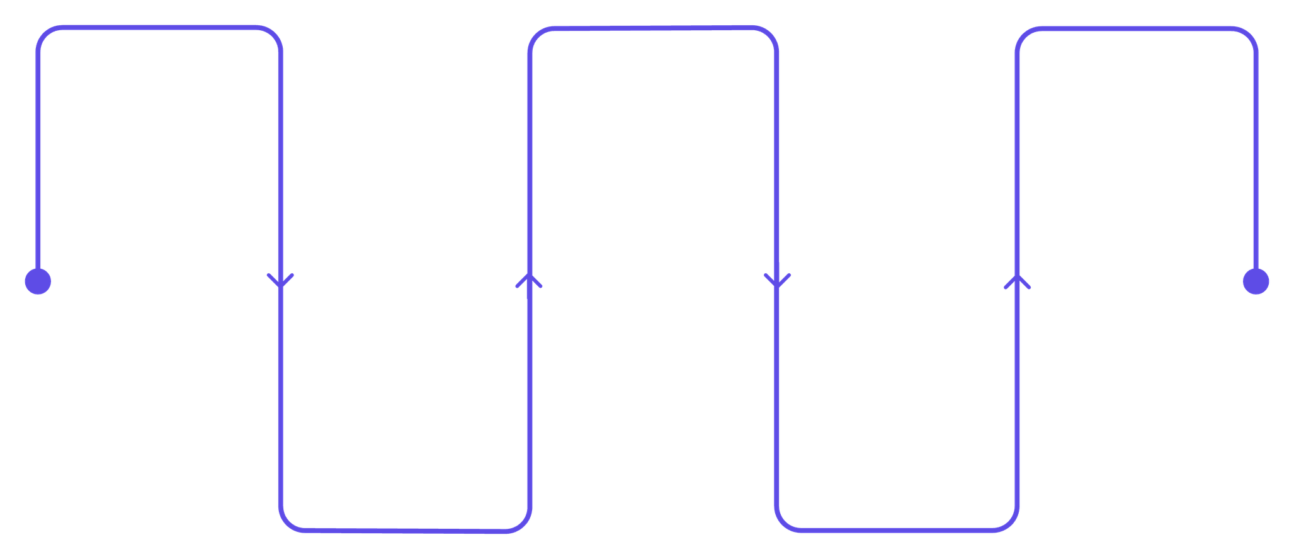
ARCHITECTURE
System Architecture
A clean, linear pipeline from user interaction to threat classification — each stage handled by a dedicated component.
User
Flask Backend
Machine Learning Model
Initiates request via UI
Routes requests and logic
Processes features for scoring
HTML Frontend
Input Validation
Collects and sends input
Sanitizes and verifies data
The architecture follows a straightforward request-response pattern: the user interacts with the HTML frontend, which forwards data to the Flask backend for
validation and model inference, then returns a classified risk result.
Notes:
4

Slide 5
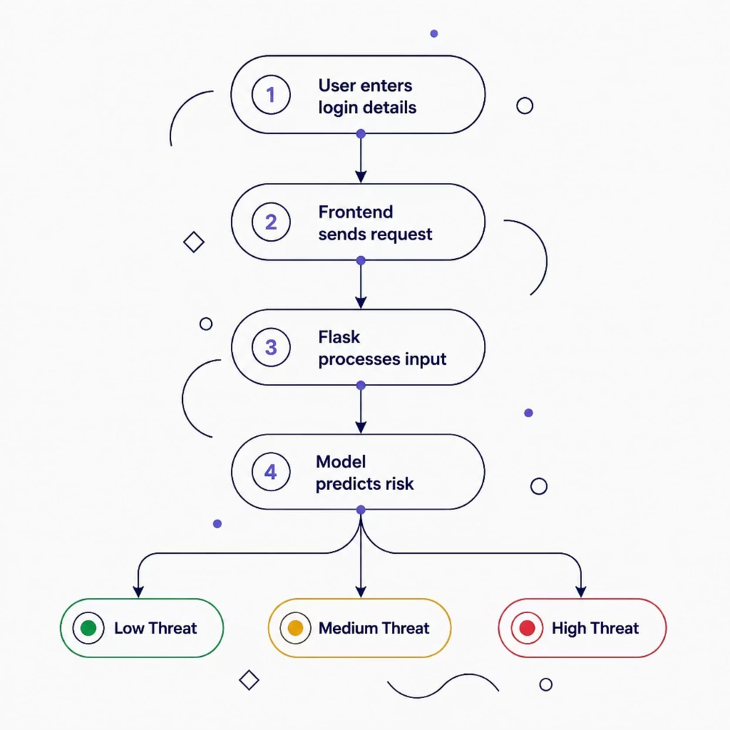
METHODOLOGY
Working Methodology
User Input Features
Login Hour
Device Type
Browser
Failure Reason
Authentication Type
IP Category
The frontend sends these inputs to Flask, which
preprocesses and passes them to the trained ML model
for real-time risk classification.
Notes:
5

Slide 6

BACKEND & ML
Backend & Machine Learning Pipeline
Flask Backend
Machine Learning
Flask routing and form handling
Dataset preprocessing and cleaning
Model loading using Joblib
Label Encoding for categorical features
Data preprocessing and transformation
Feature selection and model training
Prediction logic and response generation
Prediction on live user input
The trained model is persisted with Joblib and loaded at runtime, enabling fast inference without retraining on each request.
Notes:
6

Slide 7
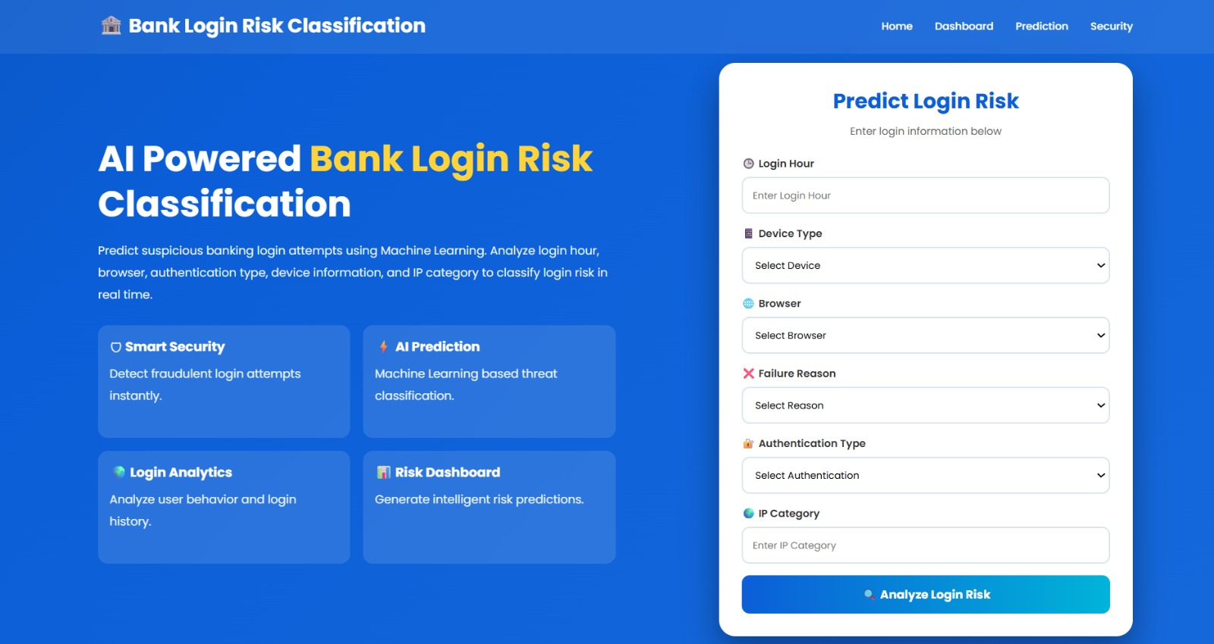
FRONTEND UI
Frontend & User Interface
The responsive HTML interface provides a streamlined experience for evaluating login risk in real time.
Input Form
Dropdown Selections
Validation & Prediction
Result Display
Structured fields for login hour, device, browser, and more.
Predefined options ensure valid, consistent input data.
Client-side validation before triggering the ML model.
Clear, color-coded threat level shown instantly.
Notes:
7

Slide 8
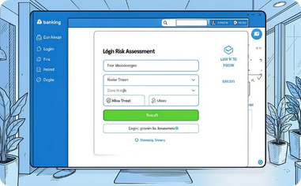
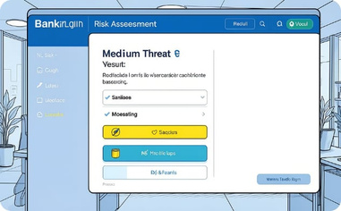
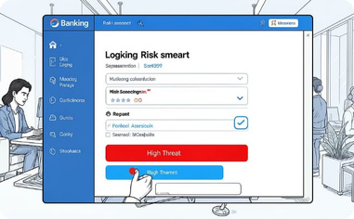
DEMO & RESULTS
Application Demo & Results
The web application classifies each login attempt into one of three threat levels based on the submitted input features.
🟢 Low Threat
🟡 Medium Threat
🔴 High Threat
Normal login patterns with expected device, browser, and timing.
Unusual combinations of inputs that warrant additional scrutiny.
Suspicious login characteristics indicating a likely malicious attempt.
Notes:
8

Slide 9

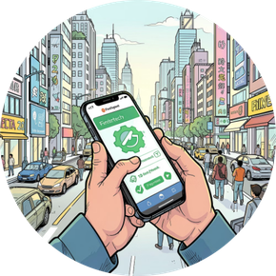

Advantages, Applications & Future Scope
Advantages
Applications
Future Scope
Real-time prediction, ML-based detection, improved security, fast response, and easy deployment.
Banking, FinTech, digital payments, fraud detection, and enterprise authentication systems.
Multi-factor authentication, behavioral biometrics, geo-location analysis, cloud deployment, and mobile apps.
Notes:
9

Slide 10

CONCLUSION
Project Summary
Successfully developed an AI-powered banking login risk classification system.
Integrated Flask with a trained Machine Learning model for real-time inference.
Built a responsive web application for instant threat prediction.
Improved banking security through intelligent, context-aware authentication.
THANK YOU
Notes:
10

