Slide 1
File Handling Cheat Sheet in Python
_{File Handling}

Slide 2
File Handling Cheat Sheet in Python
File Handling
____| |_______
location, it is stored in hard disk. Its all about how to handle file means
File handling in Python requires no importing of modules.
I.e., whenever you tries to read/write file, don‘t need to import any library.
Pytho consist file object which is used to read, write or manipulate the files. We can get this file object by first use of the built-in key function open() to get a file object.

Slide 3
File Handling Cheat Sheet in Python
Key Function in Python
Key function :open(file, mode=' ' , buffering=-1, encoding=none, errors=none, newline=None, closedfd=True, opener=None) |
|
|
|
|____________ "r" -> Read
"a" -> Append
"w" -> Write (overwrite any existing content)
"x" -> Create
“ r+ “, for both reading and writing
additional modes: "t" --> Text tile
"b" --> Binary files (like images)
NOTE:
The default encoding is platform dependent. In windows, it is ‘cp1252’ but ‘utf-g’ in linux. |  |  | :: Unicode Transformation Format.-7,8,16,32
It is recommended to specify the encoding type:
>>> f = open("pytube1.py", mode = "r", encoding = 'utf-8') |  | ::The '8' means it uses 8-bit blocks to represent a character.

Slide 4
File Handling Cheat Sheet in Python
Mode | Description
‘r’ | Open a file for reading. (default)
‘w’ | Open a file for writing. Creates a new file if it does not exist or truncates the file if it exists.
‘x’ | Open a file for exclusive creation. If the file already exists, the operation fails.
‘a’ | Open for appending at the end of the file without truncating it. Creates a new file if it does not exist.
‘t’ | Open in text mode. (default)
‘b’ | Open in binary mode.
‘+’ | Open a file for updating (reading and writing)

Slide 5
Open()
File Handling Cheat Sheet in Python
This small script, will open the (hello.txt) and print the content.
This will store the file information in the file object "filename".
filename = "hello.txt" file = open(filename, "r") for line in file: print line,
PLAY WITH FOR LOOP
Examples:
>>> f = open("abc.txt", "r") || f = open("abc.txt", "rt")
>>> f = open("color3.jpg", "r+b") | # read and write in binary mode

Slide 6
File Handling Cheat Sheet in Python
Read functions
Read ()
The read functions contains different methods, read(), readline() andreadlines()
read() #return one big string
readline() #return one line at a time
readlines () #returns a list of lines
Write ()
Write functions
This method writes a sequence of strings to the file.
write () #Used to write a fixed sequence of characters to a file
writelines() #writelines can write a list of strings.

Slide 7
File Handling Cheat Sheet in Python
Append()
The append function is used to append to the file instead of overwriting it.
To append to an existing file, simply open the file in append mode ("a"):
Close()
When you’re done with a file, use close() to close it and free up any system resources taken up by the open file

Slide 8
File Handling Cheat Sheet in Python
EXAMPLES

Slide 9
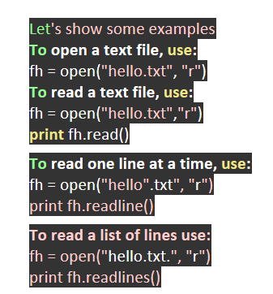
File Handling Cheat Sheet in Python
EXAMPLES

Slide 10
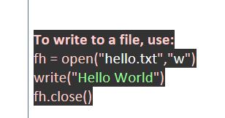
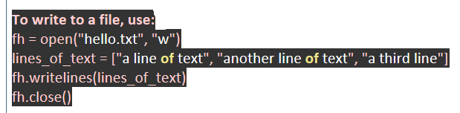
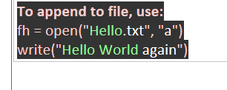
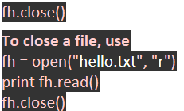
File Handling Cheat Sheet in Python
EXAMPLES
Continue …

Slide 11
File Handling Cheat Sheet in Python
_{with() function}
# we can use with() fun with both read() adn write() method
example:
# Python code to illustrate with() | # Python code to illustrate with() alongwith write()
with open("file.txt") as file: | with open("file.txt", "w") as f:
data = file.read() | f.write("Hello World!!!")
# do something with data |
NOTE: Don‘t need to use the close() method if you are using with() .
Because With() statement itself ensure proper realese of resources.
Also provide clear syntax
split() funtion
example: >>> f = open('kk.txt')
>>> for i in f:
print(i.split())
NOTE: this split the words is there is single line in file and append to the list.

Slide 12
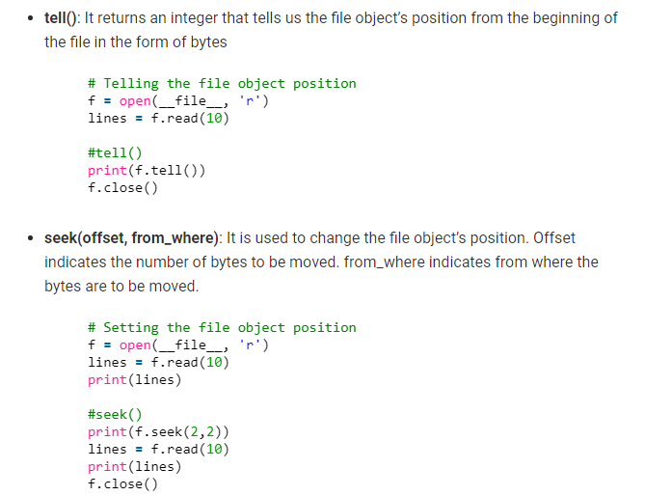
File Handling Cheat Sheet in Python

Slide 13
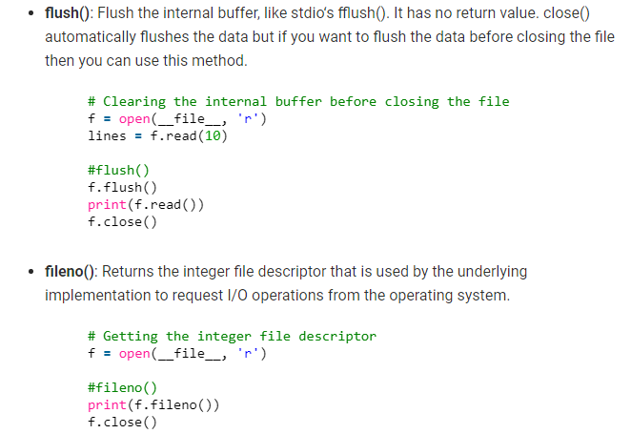
File Handling Cheat Sheet in Python

Slide 14
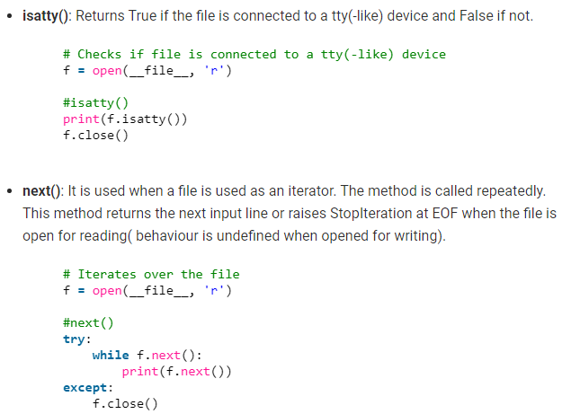
File Handling Cheat Sheet in Python

Slide 15
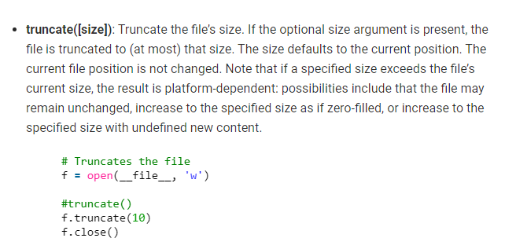
File Handling Cheat Sheet in Python

Slide 16
File Handling Cheat Sheet in Python
Note:
Most files that you use during your normal computer use are actually binary files, not text.
That’s right, that Microsoft Word .doc file is actually a binary file, even if it just has text in it.
Other examples of binary files include:
#Image files including .jpg, .png, .bmp, .gif, etc.
#Database files including .mdb, .frm, and .sqlite
#Documents including .doc, .xls, .pdf, and others.
That’s because these files all have requirements for special handling and require a specific type
of software to open it. For example, you need Excel to open an .xls file, and a database program
to open a .sqlite file.

Slide 17
File Handling Cheat Sheet in Python
r: Opens the file in read-only mode. Starts reading from the beginning of the file and is the default mode for the open() function.
rb: Opens the file as read-only in binary format and starts reading from the beginning of the file. While binary format can be used for different purposes, it is usually used when dealing with things like images, videos, etc.
r+: Opens a file for reading and writing, placing the pointer at the beginning of the file.
w: Opens in write-only mode. The pointer is placed at the beginning of the file and this will overwrite any existing file with the same name. It will create a new file if one with the same name doesn't exist.
wb: Opens a write-only file in binary mode.
w+: Opens a file for writing and reading.
wb+: Opens a file for writing and reading in binary mode.
a: Opens a file for appending new information to it. The pointer is placed at the end of the file. A new file is created if one with the same name doesn't exist.
ab: Opens a file for appending in binary mode.
a+: Opens a file for both appending and reading.
ab+: Opens a file for both appending and reading in binary mode.

Slide 18
THANK YOU
File Handling Cheat Sheet in Python

