Slide 1
SETS
Python Programming
B.TECH_1stYr

Slide 2
What is Set?
A set is a collection which is unordered and unindexed.
In Python sets are written with curly brackets.
thisset = {"apple", "banana", "cherry"}
print(thisset)
{'banana', 'cherry', 'apple'}
Note: Sets are unordered, so you cannot be sure in which order the items will appear.

Slide 3
Access Items
You cannot access items in a set by referring to an index, since sets are unordered the items has no index.
Access Items sing For Loop:
Example
Loop through the set, and print the values:
thisset = {"apple", "banana", "cherry"} for x in thisset: print(x)
apple banana cherry

Slide 4
Change Items
Once a set is created, you cannot change its items, but you can add new items.

Slide 5
Add Items
To add one item to a set use the add() method.
To add more than one item to a set use the update() method.
EXAMPLE
Add an item to a set, using the add() method:
thisset = {"apple", "banana", "cherry"} thisset.add("orange") print(thisset)
{'apple', 'orange', 'cherry', 'banana'}

Slide 6
Add multiple items to a set, using the update() method:
Example
thisset = {"apple", "banana", "cherry"} thisset.update(["orange", "mango", "grapes"]) print(thisset)
{'apple', 'banana', 'grapes', 'mango', 'orange', 'cherry'}
Get the Length of a Set:
To determine how many items a set has, use the len() method.
Example
Get the number of items in a set:
thisset = {"apple", "banana", "cherry"} print(len(thisset))

Slide 7
Remove Item
To remove an item in a set, use the remove(), or the discard() method.
Example
Remove "banana" by using the remove() method:
thisset = {"apple", "banana", "cherry"} thisset.remove("banana") print(thisset)
Note: If the item to remove does not exist, remove() will raise an error.
{'apple', 'cherry'}
Example
Remove "banana" by using the discard() method:
thisset = {"apple", "banana", "cherry"} thisset.discard("banana") print(thisset)
Note: If the item to remove does not exist, discard() will NOT raise an error.

Slide 8
You can also use the pop(), method to remove an item, but this method will remove the last item. Remember that sets are unordered, so you will not know what item that gets removed.
The return value of the pop() method is the removed item.
Example
Remove the last item by using the pop() method:
thisset = {"apple", "banana", "cherry"} x = thisset.pop() print(x) print(thisset)
Note: Sets are unordered, so when using the pop() method, you will not know which item that gets removed.
banana {'apple', 'cherry'}

Slide 9
Example
The clear() method empties the set:
thisset = {"apple", "banana", "cherry"} thisset.clear() print(thisset)
set()
The del keyword will delete the set completely:
thisset = {"apple", "banana", "cherry"} del thisset print(thisset)
The set() Constructor
set() constructor is use to make a set.
Example
Using the set() constructor to make a set:
thisset = set(("apple", "banana", "cherry")) # note the double round-brackets print(thisset)
{'apple', 'banana', 'cherry'}

Slide 10
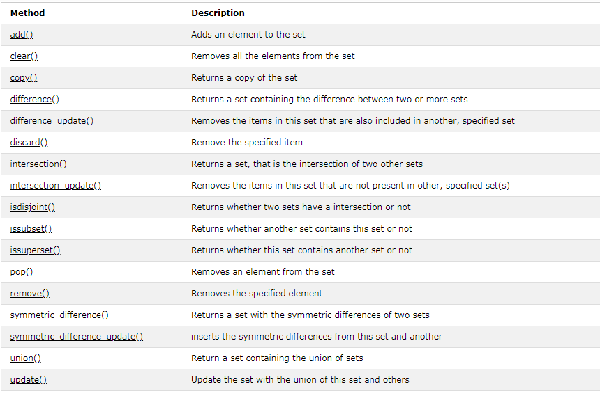
Built-in Set Methods

Slide 11
THANK
YOU

