Slide 1
Python Programming-BCSG0001
Priya Agrawal (Technical Trainer)
Department of Training & Development (TND)

Slide 2
AGENDA ?

Slide 3
Introduction
A Question (common but important)

Slide 4
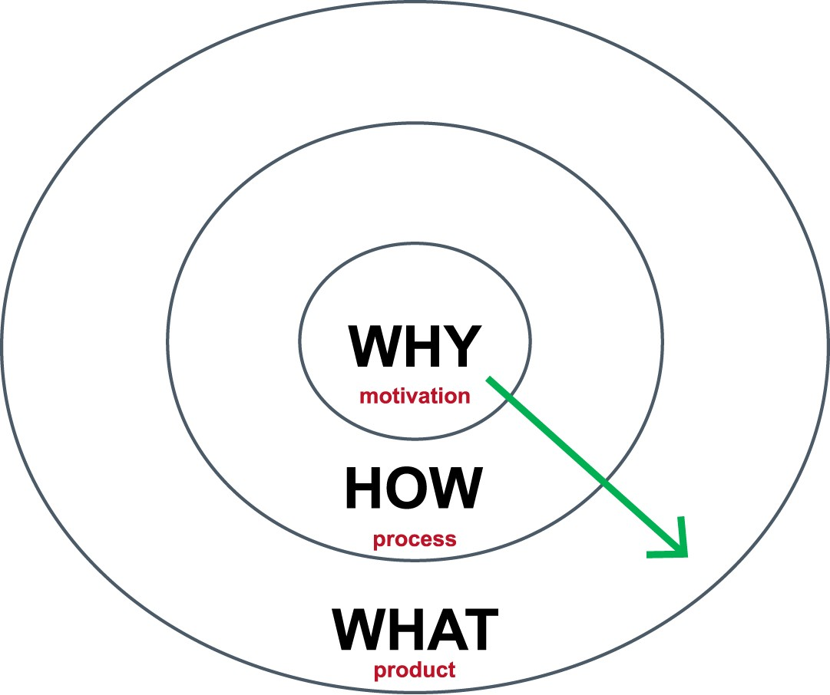


ASK WHY, NOT WHAT

Slide 5
Why of Programming
Flow of doing any Task – Algorithms
Logical Thinking (makes you effective + efficient)
Companies Projects (After placement)
AI (Artificial Intelligence)

Slide 6
AIML = Artificial Intelligence & Machine Learning

