Slide 1
Linux
Systemd
CONFIDENTIAL | © 2021 EPAM Systems, Inc.

Slide 2
Introduction
systemd is an array of system components for Linux-based operating systems
systemd's primary component is a "system and service manager"—an init system used to bootstrap user space and manage user processes.
It also provides replacements for various daemons and utilities, including device management, login management, network connection management, event logging, container management and a bootloader.
Notes:
“Как говорилось ранее, система инициализации – одна из важнейших компонент дистрибьютива Линукс.
Здесь мы расскажем про наиболее популярную на данный момент с.и. – systemd.
Systemd – это набор взаимосвязанных компонент, обеспечивающих возможность управления системой. В нее входят systemd-boot - загрузчик, сам init, udev – сервис, отвечающий за инициализацию железа, journald - система журналирования, logind – обеспечивающий логин пользователям и ряд прочих менее критичных компонент.

Slide 3
systemd’s history
Initially developed in 2010 by two RedHat engineers: Lennart Poettering and Kay Sievers
Originally inspired by MacOS’s launchd
The idea was to create an integrated set of crucial system components, which could:
Dynamically react to changes in both hardware and software – event-driven approach, e.g. starting bluetoothd when Bluetooth dongle is plugged in
Keep track of services and the processes started by them – no more rogue processes not killed by service stop xxx
Parallelize everything – system and service startup, etc
Get rid of using shell in boot-up process – shell is quite slow
Have declarative syntax instead of turing-full shell scripts
All of that was not possible with the existing solutions (by that time most popular init system was sysVinit, followed by Upstart)
By 2021, systemd is the default init system for most Linux distributions
Notes:
SysVinit застрял в развитии – в его основе лежали выполняющиеся по порядку shell-скрипты. Порядок определялся номером в имени файла скрипта – и за ней приходилось следить как разработчикам дистрибутива, так и конечным пользователям. Впоследствии в SysVinit был добавлен ряд улучшений – простенькая параллелизация процесса загрузки, заголовки с зависимостями и прочее – но возможности SysVinit по прежнему были скромны. Для того что бы получить рабочую систему приходилось добавлять в нее cron – для запуска приложений по расписанию, monit – для перезапуска упавших сервисом, xinetd – для активации сервисов по сокетам, rsyslog – для сбора логов, и то не всех – за логи ранней загрузки ядра, раннего userspace и userspace после смены рута отвечали разные демоны.

Slide 4
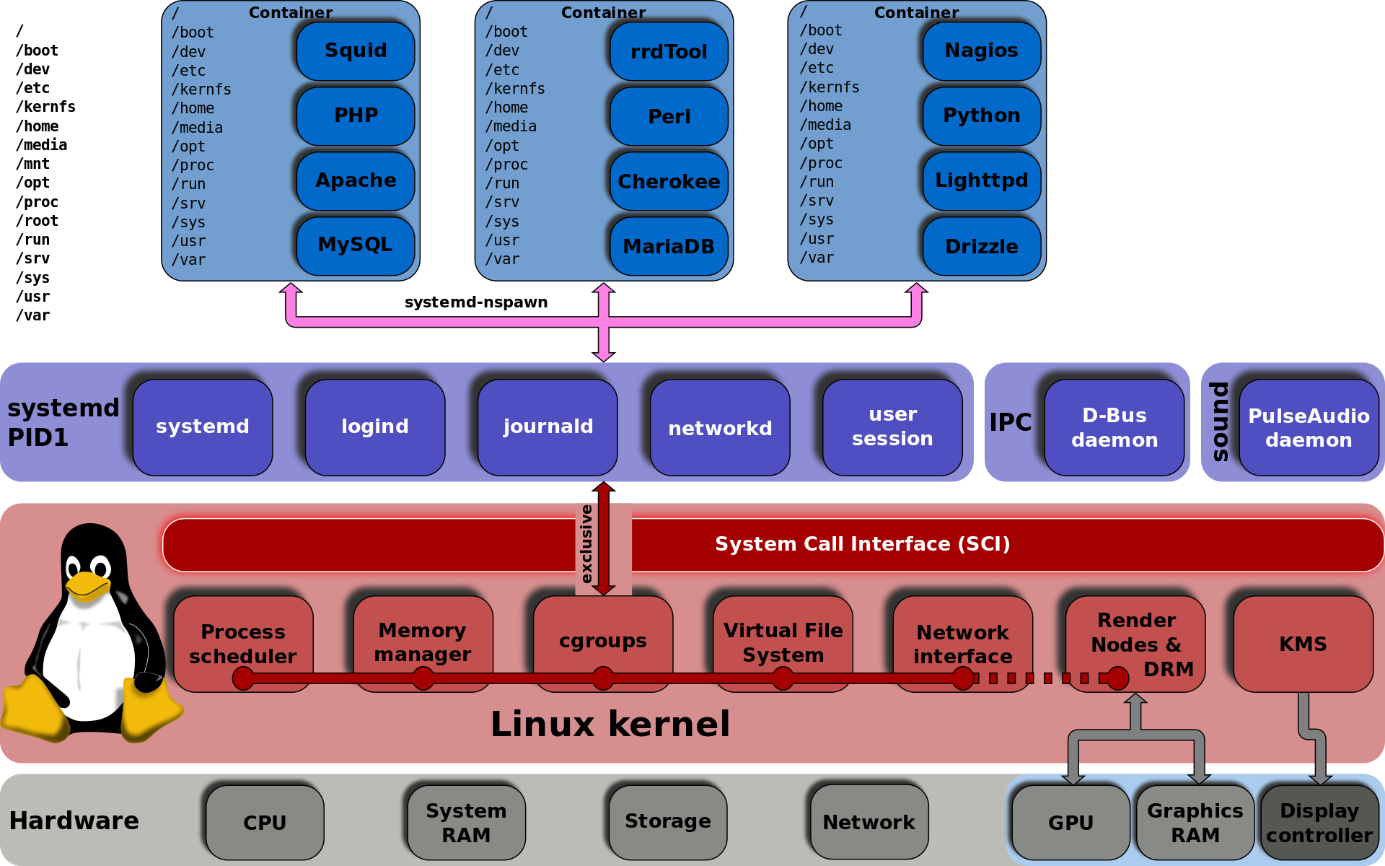
systemd’s architecture (with satellite services)
Notes:
Часть сервисов – essential для любой системы с systemd (сам systemd, logind, journald). Остальные – сателлиты, которые можно не использовать. Однако, они весьма полезны, и хотя бы ознакомиться с их возможностями точно стоит

Slide 5
Init system component
Is the first process executed by the kernel during the booting of a system (pid 1).
Responsible for bringing up rest of userspace, e.g.
Mounting “real’ root filesystem and all other filesystems
Starting and managing services
Handling timers, sockets, other events – hardware cold/hotplug, path change, d-bus activations.
…
Reparents orphan processes
Relies on cgroups for service supervision and control of services execution environment

Slide 6
cgroups trivia
Abbreviated from control groups
Linux kernel feature, which is:
A way to hierarchally group and label processes
A way to then apply resource limits to these groups
Also used by docker, LXC, other containerization software.

Slide 7
cgroups and systemd
Each service runs in its own cgroup
That allows for:
Tracking all processes created by a service – including spawned ones and double-forks
Per-service resource monitoring and limitation
Also isolates user sessions – each session gets its own cgroup
Using cgroups removes the need for hacky solutions with race conditions (PID files)

Slide 8
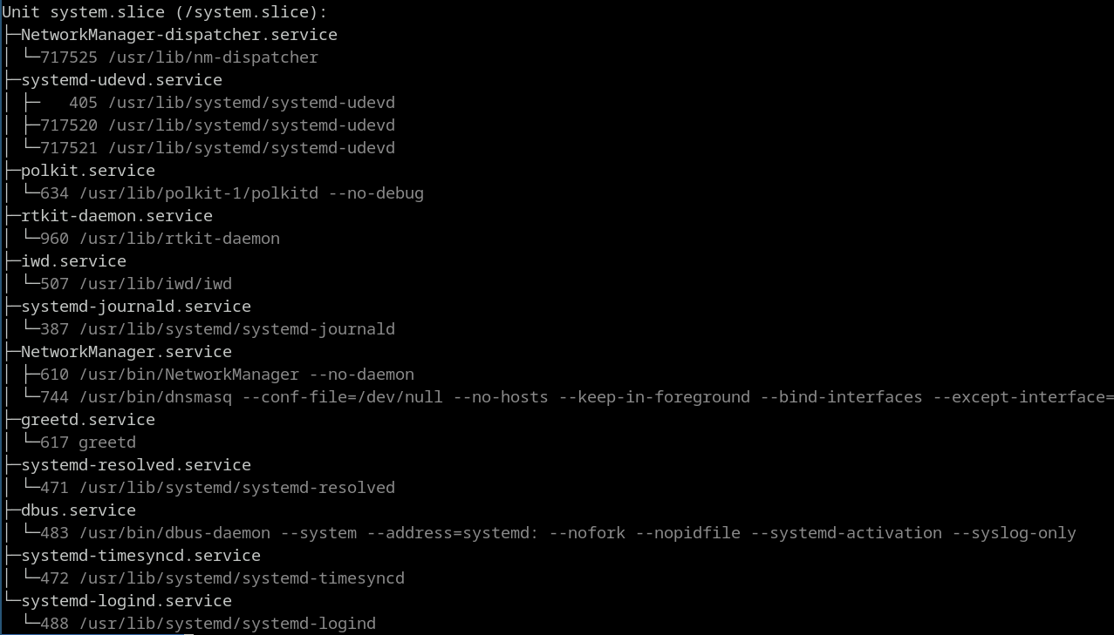
systemd-cgls: cgroup hierarchy visualized

Slide 9
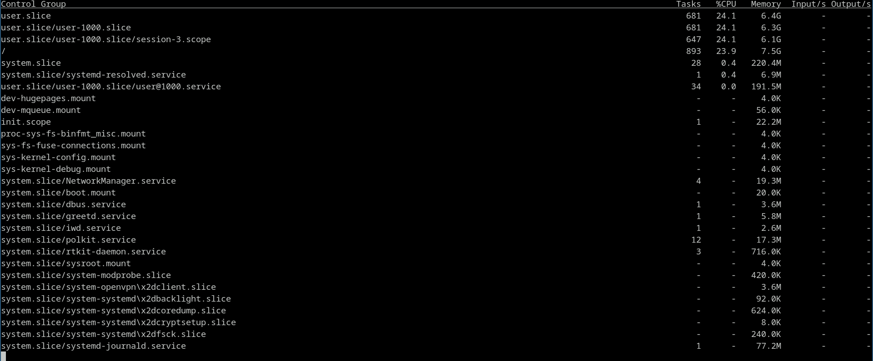
systemd-cgtop: per-group resource usage

Slide 10
Essential services: systemd-logind
Manages user logins. Is responsible for:
Keeping track of user processes using cgroups – that also allows to limit the resources available to them
Device access management (e.g. true multiseat)
Handling power/sleep hardware keys and idling (e.g. running a lock screen after some minutes)
Providing applications with an ability to inhibit sleep/shutdown (e.g. video player)
Providing polkit-based access for operations such as sleep or shutdown
loginctl command is used for controlling it – e.g. loginctl list-sessions to show active login sessions.
Notes:
Multiseat – 2 набора клава/моник/мышь, один комп, два одновременно работающих пользователя. На ConsoleKit такое было невозможно.

Slide 11
Satellite services
Non-essential services include:
systemd-networkd, which manages network-related configuration.
systemd-timesyncd: simple SNTP client, used for syncing time from the network.
systemd-resolved: recursive DNS server, used to provide caching and per-interface DNS resolution
systemd-homed: manager for portable home directories
systemd-oomd: userspace OOM killer
Notes:
Завершить надо чем-то в духе «а сейчас вернемся к системе инициализации и поговорим об управлении сервисами»

Slide 12
systemctl: managing units
Unit is something that systemd can control: services (.service), sockets (.socket), mountpoints (.mount and .automount), targets (.target), etc
By default, systemctl assumes that you are trying to control a service (systemctl start foo is the same as systemctl start foo.service)
Several units can be specified in one command (e.g. systemctl start i2pd nginx)
Basic commands:
Command | Effect
systemctl start foo | Tries to start foo.service
systemctl stop foo | Tries to stop foo.service
systemctl restart foo | Tries to restart foo.service (equivalent to stop followed by a start)
systemctl reload foo | Asks units to reload their configuration (Works only if .service file defines a command for it)
systemctl enable foo | Enables the unit to be auto-started (for example, on boot)
systemctl disable foo | Disables auto-start of a unit

Slide 13
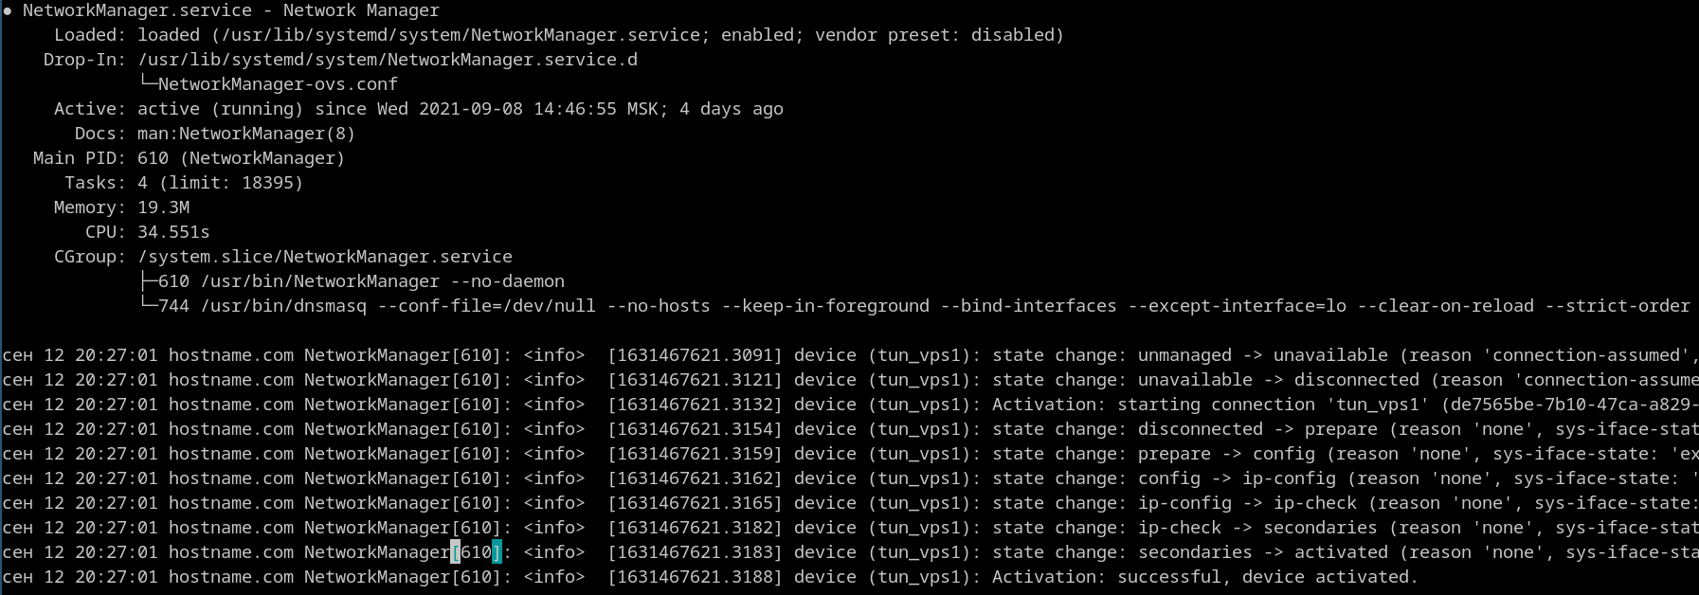
systemctl: checking system state
List units with systemctl list-units (or just systemctl)
List only failed units: systemctl –failed
List only services: systemctl --type=service
System status overview: systemctl status
Can also be used on any unit: systemctl status foo.service:
Notes:
Список информации:
Общий статус юнита – запущен ли, какой главный пид, метрики cpu/ram
Конфиг-файлы, включая оверрайды
Cgroups
Последние логи из journald

Slide 14
Unit files: basics
Declarative syntax - .ini file format with few additions
Parts of a unit file (or even entire unit) can be overridden (check systemd-delta utility)
systemd-cat can be used to get unit’s config file
systemctl edit can be used to edit these
Alternatively, look in:
/lib/systemd/system/ - for distribution-provided services
/etc/systemd/system/ - for local overrides and custom units

Slide 15
Example: named
# /usr/lib/systemd/system/named.service
[Unit]
Description=Internet domain name server
After=network.target
[Service]
ExecStart=/usr/bin/named -f -u named
ExecReload=/usr/bin/kill -HUP $MAINPID
[Install]
WantedBy=multi-user.target

Slide 16
Unit files: options
Can be found in man pages for systemd.unit ([Unit] section), systemd.service ([Service] section) and systemd.exec (execution-related documentation)
systemctl show: allows you to show all options that are applied to a unit
Some commonly used options:
[Unit] section:
Description: human readable description
Docs: link to a documetation
Dependencies (before/after, etc): used to configure ordering dependencies. For example, named will only be started after network has been initialized
[Service] section:
ExecStart: what to execute on service start. Could be any executable.
ExecReload: which command to use when asking service to reload its configuration
[Install] section:
WantedBy: which target to attach this unit to when it’s being enabled.

Slide 17
Unit file: options (2)
Some very useful options:
Restarting a crashed service:
Restart=on-failure
Sourcing environmental variables from a file:
EnvironmentFile=/etc/sysconfig/sshd
Run unit as a non-root user/group:
User=nobody and Group=nobody
Setting working directory for a service:
WorkingDirectory=/etc/openvpn/client
Limit the amount of file descriptors (files, sockets, etc) service can open simultaneously:
LimitNOFILE=128
Disallow service that needs to be run as root to access parts of a system it doesn’t need:
ProtectHome=yes
ProtectSystem=strict
… and many others

Slide 18
Timer units: basics
Cron, which has all the power of systemd – dependencies, execution environment configuration, etc
Realtime timers: calendar events, similar to cron
They use format described in systemd.time(7)
Example: every minute (*-*-* *:*:00), every hour (*-*-* *:00:00) every day (*-*-* 00:00:00)
If a timer’s activation was missed (for example, system was shut down) and option Persistent=true was used, the timer will be started as soon as the system is booted up.
Monotonic timers, relative to a point in time
5 minutes after system startup: OnBootSec=5m
1 hour after the last service activation: OnUnitActiveSec=1h (should be combined with OnBootSec to ensure that it runs after a reboot)

Slide 19
Timer units: example (1)
# /usr/lib/systemd/system/shadow.timer
[Unit]
Description=Daily verification of password and group files
[Timer]
OnCalendar=daily
AccuracySec=12h
Persistent=true

Slide 20
Timer units: example (2)
# /usr/lib/systemd/system/shadow.service
[Unit]
Description=Verify integrity of password and group files
After=systemd-sysusers.service
[Service]
Type=simple
# Always run both checks, but fail the service if either fails
ExecStart=/bin/sh -c '/usr/bin/pwck -r || r=1; /usr/bin/grpck -r && exit $r'
Nice=19
IOSchedulingClass=best-effort
IOSchedulingPriority=7

Slide 21
Timer management
List all timers:
systemctl list-timers
Start timer at boot:
systemctl enable myscript.timer
Start timer right now:
systemctl start myscript.timer

Slide 22
Instantiated services
Allows user to create multiple instances of one service with different parameters
For example: multiple instances of an openvpn process, each with different configuration file used
Unit files of instantiated services must end with @.service (For example – openvpn-client@.service)
Each instance is a unit, which means:
Each instance can be managed individually (e.g. systemctl start/stop/restart openvpn-client@vps1.service)
Logging is separate
Any instance can be overridden - creating /etc/systemd/system/openvpn-client@vps4.service will affect only vps4 instance
Using instantiated services requires user to set some variables:
%i – escaped instance name: systemd doesn’t allow special character in unit names
%I – unescaped service name: for documentation and human-readable descriptions
To get the full list of variables, check man for systemd.unit(5)

Slide 23
Instantiated services: example
# /usr/lib/systemd/system/openvpn-client@.service
[Unit]
Description=OpenVPN tunnel for %I
After=syslog.target network-online.target
Wants=network-online.target
[Service]
WorkingDirectory=/etc/openvpn/client
ExecStart=/usr/bin/openvpn --suppress-timestamps --nobind --config %i.conf
User=openvpn
[Install]
WantedBy=multi-user.target

Slide 24
Socket-activated services
systemd creates a socket for the application, and passes pending connections once the service is ready
Benefits:
Other services don’t need to wait for socket-activated service to get ready
They can instantly try to access it; the attempt will block until the service is ready to accept connections
Services can be started on-demand, they don’t need to be constantly running
That synergizes well with instanced services – for example, a user can spawn a script per connection
Socket service consists of two parts: .socket and .service (or @.service, if you want to create an instance per connection)

Slide 25
Socket-activated services: example .socket
# sshd.socket
[Unit]
Description=SSH Socket for Per-Connection Servers
[Socket]
ListenStream=22
Accept=yes
[Install]
WantedBy=sockets.target

Slide 26
Socket-activated services: example @.service
# sshd@.service
[Unit]
Description=SSH Per-Connection Server
[Service]
ExecStart=-/usr/sbin/sshd -i
StandardInput=socket

Slide 27
Socket-activated services: checking state
There’s one instance of sshd@.service per connection:
$ systemctl --full | grep ssh
sshd@172.31.0.52:22-172.31.0.4:47779.service loaded active running SSH Per-Connection Server
sshd@172.31.0.52:22-172.31.0.54:52985.service loaded active running SSH Per-Connection Server
sshd.socket loaded active listening SSH Socket for Per-Connection…

Slide 28
systemd-journald
Collects log messages from a variety of sources:
Kernel log messages (via kmsg)
Syslog messages sent via syslog function (e.g. via logger command)
Standard output and error streams of service units
Native Journal API
Audit records from kernel audit subsystem
journald also forwards everything collected to system’s syslog server – for further processing and remote collection
Stores them in an indexed binary format under /var/log/journal (by default)
Rotation is handled automatically and trasparently based on configured free space thresholds
Also stores metadata with the logs – for example PID, timestamp and systemd unit from which the log message was sent
journalctl is used to control the daemon

Slide 29
Systemd-journald: example message in JSON
{
"__CURSOR" : "s=c4ee459c883148549d114c566bc0b979;i=12b782;b=6c92864cbcc64a5fabebe04147953894;m=42d22604a2;t=58bc87981a1f5;x=8daf632187
"__REALTIME_TIMESTAMP" : "1561068031812085",
"__MONOTONIC_TIMESTAMP" : "286993548450",
"_BOOT_ID" : "6c92864cbcc64a5fabebe04147953894",
"SYSLOG_FACILITY" : "3",
"_UID" : "0",
"_GID" : "0",
...
"UNIT" : "apache2.service",
"CODE_LINE" : "2039",
"CODE_FUNCTION" : "unit_notify",
"MESSAGE" : "apache2.service: Unit entered failed state.",
"_SOURCE_REALTIME_TIMESTAMP" : "1561068031809136"
}

Slide 30
Practice
View the full log: journalctl
Since last boot: journalctl --boot
For a time interval: journalctl --since=today or journalctl --until=yesterday
Filter by unit name: journalctl --unit=sshd
Continuously tail the output: journalctl -f
Show 100 last entries: journalctl -n 100

Slide 31
Useful links
Control Groups vs. Control Groups - http://0pointer.net/blog/projects/cgroups-vs-cgroups.html
systemd for Administrators, Part XVII - http://0pointer.net/blog/projects/journalctl.html

Slide 32
Thank you

