Slide 1
Amazon Advanced Storage Services
2022

Slide 2
What Is AWS EFS?
AWS Elastic File System (EFS) is one of three main storage services offered by Amazon. It is a scalable, cloud-based file system for Linux-based applications and workloads that can be used in combination with AWS cloud services and on-premise resources. EFS offers a choice between two storage classes, Infrequent Access and Standard access, depending on your needs. Standard access storage is designed for frequently accessed files while Infrequent Access is intended for storing long-lived but less used files at a lower cost.
EFS uses the NFSv4 protocol for its file system structure, which mirrors a standard on-premise structure and simplifies transferring and accessing your files. It can be used in combination with Elastic Cloud Compute (EC2) instances or as a stand-alone file system. EFS does not require storage provisioning and is pay-for-use allowing you to scale services as needed.

Slide 3
EFS’ key features
Shared Storage Files are accessible from AWS services as well as from on-premise. They can be simultaneously accessed by up to a thousand EC2 instances within the cloud or via VPN or AWS Direct Connect, making EFS good for hybrid solutions. File access is possible across multiple AWS Availability Zones (AZs) and Regions, for easier collaboration and global remote work.
Scalable Performance EFS is designed for low latency with IOPS and throughput that scale with usage and the number of attached instances, meaning that as storage size grows, performance increases. At peak performance, it offers 10 GB/sec throughput and 500k IOPS. EFS scales automatically as data is moved in or out, minimizing fears of running out of space or paying for storage you aren’t using. Learn more about how file sharing impacts cloud scalability and agility.
Secure and Compliant EFS allows multiple layers of security and relies on your existing security infrastructure. It can be used with Amazon's Identity and Access Management (IAM) roles as well as VPC security groups and allows you to define individual file permissions using POSIX. EFS has built-in compliance with common regulatory standards, including PCI DSS, HIPAA, and SOC with the ability to meet others if necessary. Learn more about best practices for secure cloud file sharing.

Slide 4
AWS EFS Backup Solutions
Since a storage solution is only really useful when it can be backed up, you should be aware of your backup options with EFS. Keep in mind, other ways exist if you want to use third-party products integrated with AWS. Also, learn more about general considerations for backup and archiving in the cloud.

Slide 5
Amazon Backup Service
AWS Backup is a fully managed service that allows you to create, manage, and automate incremental backups according to a schedule you define through a central location. This system is PCI and ISO compliant and HIPAA eligible, to ensure that your compliance needs are covered. It is possible to use AWS Backup whether your system has a cloud-native, hybrid, or on-premise configuration.
This solution is easy to implement, and incremental backups help keep your costs low but requires manually pausing the applications and processes being backed up and only allows backups to be stored on EFS.

Slide 6
EFS to EFS Backup
There is no built-in EFS backup, and EFS does not have a native snapshot mechanism. So, before AWS Backup was released, backups had to be done using a template in AWS CloudFormation. This involves using scripts to access the AWS Data Pipeline, from which you must transfer data between multiple services before finally storing the backed-up data in EFS. With this process, you are still able to control backup schedules and life cycles as with the AWS Backup Service.
The main downsides of this option are that it does require some programming knowledge and is not easily monitored. Additionally, if you are not careful to change time constraints according to the amount of data you are backing up, your process can fail.

Slide 7
Backing Up to Amazon S3
Backing up your data to S3 is another option you might consider and one that can help decrease your storage costs. This process begins the same as the EFS to EFS backup but rather than moving the incremental backups from S3 to EFS at the end of the process, they are simply left in S3.
Like EFS to EFS, you can schedule your backups and manage life cycle length but you must also have some programming ability and be familiar with the use of scripts for automating processes.

Slide 8
Amazon EFS Encryption
EFS offers the ability to encrypt data at rest and in transit.
Encryption keys are managed by the AWS Key Management Service (KMS).
Encryption in transit:
Data encryption in transit uses Transport Layer Security (TLS) 1.2 to encrypt data sent between your clients and EFS file systems.
Encryption in transit is enabled when mounting the file system.
Encryption at rest:
Enable encryption at rest in the EFS console or by using the AWS CLI or SDKs.
Encryption at rest MUST be enabled at file system creation time.
Data encrypted at rest is transparently encrypted while being written, and transparently decrypted while being read.
Encryption of data at rest and of data in transit can be configured together or separately.

Slide 9
Amazon EFS Access Control
When you create a file system, you create endpoints in your VPC called “mount targets”.
When mounting from an EC2 instance, your file system’s DNS name, which you provide in your mount command, resolves to a mount target’s IP address.
You can control who can administer your file system using IAM (user-based and resource-based policies)
You can control the NFS clients that can access your file systems (resource-based policies).
You can control access to files and directories with POSIX-compliant user and group-level permissions.
POSIX permissions allow you to restrict access from hosts by user and group.
EFS Security Groups act as a firewall, and the rules you add define the traffic flow.

Slide 10
Monitoring and Reporting
The Amazon EFS console shows the following monitoring information for your file systems:
The current metered size.
The number of mount targets.
The lifecycle state.
Amazon EFS reports metrics for Amazon CloudWatch. A few useful metrics are:
TotalIOBytes – use the daily Sum statistic to determine throughput.
ClientConnections – use the daily Sum statistic to track the number of connections from EC2 instances.
BurstCreditBalance – monitor the burst credit balance.

Slide 11
DEMO

Slide 12
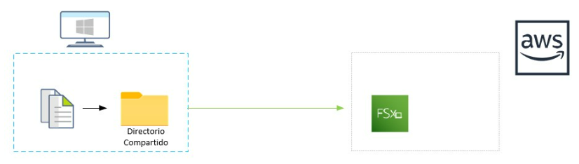
Amazon FSx for Windows File Server
Amazon FSx is a fully managed cloud file storage service that offers a high degree of reliability and scalability. Amazon FSx for Windows is based on Windows Server and allows integration with Microsoft Active Directory, allowing you to create standard Windows ACLs for detailed access control at the file and folder level, all with access via the Server Message Block (SMB) protocol.

Slide 13
Supported clients
Amazon FSx supports connecting to your file system from a wide variety of instances and operating systems. For it, it allows access through the Server Message Block (SMB) protocol, versions 2.0 to 3.1.1.
The operating systems supported as a client are the following: Windows from 2008 and Windows Vista. Also, Linux systems with CIFS-UTILS. At the instance level, it supports a large number of AWS types such as EC2, ECS, Workspaces and AppStream.

Slide 14
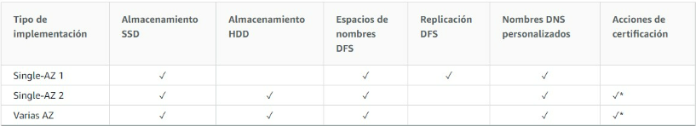
Availability
One of the great advantages of Amazon FSx is its availability. Amazon FSx supports Single-AZ or Multi-AZ.
In Single-AZ, Amazon FSx automatically replicates data within an Availability Zone (AZ) to protect against component failure. AWS continuously monitors for hardware failures and automatically replaces infrastructure components in the event of a failure. Single-AZ2 is the latest generation and supports both SSD and HDD storage. In Single-AZ1 the file systems support SSD storage, Microsoft Distributed File System Replication (DFSR), and the use of custom DNS names.
Multi-AZ enables all the availability and durability features of Single-AZ file systems. Multi-AZ services are designed to provide continuous data availability, even when an Availability Zone is unavailable. In a Multi-AZ deployment, Amazon FSx automatically provisions and maintains a standby file server in a different availability zone so that in the event of a particular availability zone going down, you will still have access to the data. Any changes written to the file system disk are synchronously replicated across availability zones in standby mode.
The features enabled according to availability from AZ are summarized below.

Slide 15
Functionalities
Integration with Active Directory
Amazon FSx works with Microsoft Active Directory (AD) to integrate with its existing Microsoft Windows environments both on-premise and in the cloud. The 80% of organizations today use Active Directory, which is Microsoft's directory service used to authenticate, authorize and manage the different network objects. When a file system is created with Amazon FSx, it can be joined to its Active Directory domain to provide user authentication and access control at the file and folder level. Users can use their existing user identities in Active Directory to authenticate and access the Amazon FSx file system.

Slide 16
Security
Encryption - Amazon FSx for Windows allows encryption of data at rest and in transit as forms of encryption for our file system. Data in transit encryption is available with SMB 3.0 or later protocol automatically encrypting data in transit without the need to modify any applications. Data-at-rest encryption, meanwhile, is automatically enabled upon creation.
ACL (File and Directory Level Access Control) - Amazon FSx supports identity-based authentication through SMB and Active Directory.
Access control with VPC - Amazon FSx supports connection through the Elastic Network Interface, which allows us to connect from a VPC or another network connected to the VPC by Peering or by AWS Direct Connect.

Slide 17
Data protection
Amazon FSx enables data protection through backup, snapshots, and replication. Amazon FSx backups are incremental regardless of their type, automatic daily, user-initiated, or with AWS Backup.
The windows volume shadow copy service allows you to take durable backups of your file system on a daily basis and store them in an Amazon S3 bucket.
Amazon FSx allows you to periodically replicate your file system to a second file system.

Slide 18
Use cases
Windows file server. Many organizations have local file servers to maintain shared resources for different work teams, as well as home directories for hundreds of users. Amazon FSx enables a fully managed service that offers the opportunity to migrate and replace these on-premises servers to a service, reducing the cost of operation and infrastructure.
Windows applications. There are organizations that have Windows-based applications such as ERP, CRM or custom applications which require storage based on an NTFS file system and SMB protocol. With Amazon FSx you can migrate these applications in lift and shift mode to AWS without having to modify the applicative.
Web services. Microsoft has its own web service called Internet Information Services (IIS) which in many cases uses shared file storage when several of them need access to the same files.
Highly available Microsoft SQL Server deployments on AWS as Amazon FSx provides highly available, fully managed file storage. Amazon FSx automatically manages data replication and failover, simplifying shared storage to host your database deployments while lowering cost.
Media workflows. Amazon FSx provides a high-performance, low-latency shared file system required by multimedia application workflows such as media transcoding, rendering, and streaming.

Slide 19
What Is FSx for Lustre?
Amazon FSx for Lustre helps organizations run, launch and scale popular high-performance file systems.
The open-source Lustre file system is for the use of Linux-based applications that demand large scale and fast storage—when you need your storage to keep pace with your compute. Lustre was designed to deal with the issue of speedily and cheaply processing large data sets. It is widely used in super computing and HPC projects, including many of the 500 most powerful computing clusters in the world.
Amazon FSx for Lustre is a fully managed service that makes Lustre easily accessible. It lets organizations use Lustre for workloads on the AWS cloud, where storage speed is important. Amazon FSx for Lustre avoids the traditional complexity of managing and setting up high-performance Lustre file systems. It lets you spin up, scale, and run a reliable high-performance file system in minutes. You can also use its multiple deployment features to optimize costs for your organization’s requirements.
Amazon FSx for Lustre integrates with Amazon S3, so you can process cloud data sets with the Lustre high-performance file system. When connected to an S3 bucket, an FSx for Lustre file system transparently shows S3 objects as files and lets you write data modified by Lustre back to S3.

Slide 20
When Should You Use Amazon FSx for Lustre?
Machine Learning
Machine learning workloads rely on massive volumes of training data. These workloads tend to use shared file storage, because multiple compute instances must process training datasets simultaneously. Therefore, FSx for Lustre is suitable for machine learning workloads, providing shared file storage with consistent, low latency, and high throughput. FSx for Lustre is integrated with Amazon SageMaker, letting you speed up your training tasks.
High Performance Computing
High Performance Computing (HPC) lets engineers and scientists solve compute-intensive, intricate problems. HPC workloads like genome analysis and oil and gas discovery process huge volumes of data, requiring very fast access by multiple compute instances.
FSx for Lustre is suitable for scientific computing workloads and HPC. It is a file system optimized to reduce cost and improve performance for high-performance workloads, which can be accessed by thousands of EC2 instances. FSx for Lustre integrates with AWS Batch and AWS ParallelCluster, which makes it simpler to employ with HPC workloads.

Slide 21
When Should You Use Amazon FSx for Lustre?
Media Processing and Transcoding
Media data processing workflows, such as visual effects, video rendering, and media production, require storage and compute resources to deal with the large amounts of data being generated. FSx or Lustre offers the low latencies and high performance required for distributing, analyzing and processing digital media files.
Autonomous Vehicles
Organizations creating autonomous vehicle systems generally test models by running training and simulations on huge amounts of camera and vehicle sensor data. This helps ensure the safety of the vehicles. FSx for Lustre lets you access that data concurrently from thousands of high-performance nodes. This lets you accelerate model development and run simulations at scale.
Big Data and Financial Analytics
Big data analytics use cases, such as financial analysis and SAS Grid workloads, generate large volumes of data that drive data-intensive applications. This data requires high-performance storage, while processing the growing amounts of data can be complicated and costly. Amazon FSx for Lustre is able to process big amounts of data at scale and is cost and performance-optimized.
Electronic Design Automation
EDA is used to simulate failures and performance in the design stage of the silicon chip production process. It is a high-performance application. FSx for Lustre gives you the flexibility and performance to design and evaluate new products, innovate more quickly, and scale to fulfil demand.

Slide 22
How Does Amazon FSx for Lustre Work?
Amazon FSx for Lustre, based on Lustre, is a high-performance file system. It has scale-out performance, which increases linearly according to a file system’s size. Lustre file systems scale horizontally over multiple disks and file servers.
This scaling provides each client with access to the data retained on each disk, which removes many of the bottlenecks of traditional file systems. Amazon FSx for Lustre extends Lustre’s scalable architecture to allow for high levels of performance over large amounts of clients.
Each Amazon FSx for Lustre file system is made up of the file server which clients communicate with, and a series of disks connected to each file server that retains your data. Each file server uses a fast, in-memory cache to optimize performance for the most regularly accessed data.

Slide 23
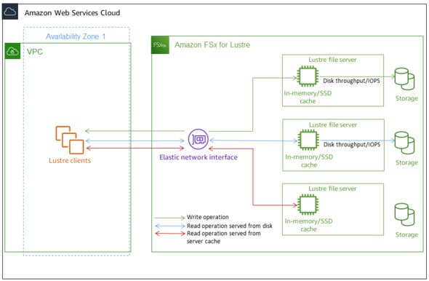
How Does Amazon FSx for Lustre Work?
HDD-based file systems may be provisioned using an SSD-based read cache to enhance performance further, for the data that is accessed most often. When a client retrieves data that is stored in the SSD or in-memory cache, the file server isn’t required to read it from disk. This minimizes latency and increases the total throughput.
The diagram below demonstrates the paths of a read operation served from a disk, a write operation, and a read operation served from SSD or in-memory cache:

Slide 24
How Does Amazon FSx for Lustre Work?
When you read data that is retained on the file server’s SSD or in-memory cache, file system performance is subject to the network throughput. When you read data that is not stored on the in-memory cache, or write data to your file system, file system performance is affected by lower disk throughput and network throughput.

Slide 25
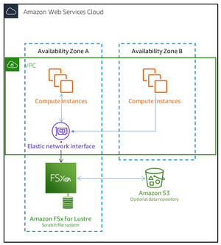
Amazon FSx for Lustre Deployment Options
Scratch File Systems
These are designed for shorter-term processing of data and for temporary storage. In the event that a file server fails, data does not persist and is not replicated. Scratch file systems have high burst throughput of as much as six times the baseline throughput of 200 MBps per TiB of storage potential.
When should you use it? Use scratch file systems when you require cost-effective storage for processing-heavy, short-term workloads.

Slide 26
Amazon FSx for Lustre Deployment Options
Persistent File Systems
These are designed for longer-term workloads and storage. The file servers remain highly available and data is automatically replicated in the same Availability Zone (AZ) as the file system. The data volumes connected to the file servers are replicated separately from the file system they are attached to.
When should you use it? Use persistent file systems for long-term or indefinite workloads, which could be sensitive to changes in availability.
Amazon FSx for Lustre monitors persistent file systems for hardware failures, on an ongoing basis, and automatically changes infrastructure components if there is a failure. If a file server is unavailable on a persistent file system, it is automatically replaced in just minutes. During this time, client requests for data on the server keep trying to be transparent and ultimately succeed once the file server is replaced. The data stored on persistent file systems is replicated on disks and all failed disks are transparently and automatically replaced.
When you develop a new file system, you decide the file system deployment type through the AWS Management Console, the Amazon FSx for Lustre API, or the AWS CLI.

Slide 27
Thank you for listening

