Slide 1
Scaling, Load Balancing & High-Availability
2022

Slide 2
What is the AWS Global Infrastructure?
The AWS Global Infrastructure consists of multiple geographical locations which are called Regions. AWS Regions are divided up in Availability Zones which consist of one or more psychically separated data centers. These Regions and Availability Zones provide a way to build highly available, fault tolerant, and scalable infrastructures.
All Availability Zones (AZs) are connected through low latency, high throughput, and highly redundant networking. AZs are physically separated by an unknown minimum distance to ensure availability of the network even in the event of catastrophic events like extreme weather. As of April 2020, AWS spans 70 Availability Zones within 22 Regions around the world.

Slide 3
Points of Presence
Another part of the AWS Global Infrastructure are Points of Presence (POP). The POPs are used for both AWS CloudFront to deliver content to end users at high speeds, and Lambda@Edge to run Lambda functions with the lowest possible latency. As of April 2020, there are 216 Points of Presence in 84 cities across 42 countries.

Slide 4
Designing for failure
Using the AWS Global Infrastructure, it’s easy to design fault tolerant infrastructure. We can achieve this by having multiple EC2 instances in different Availability Zones or even Regions. In the unlikely event of an Availability Zone or entire Region failing, your applications are not impacted. Other services like Relational Database Service (RDS) can achieve fault tolerance because they have Multi-AZ deployment models built-in. Of course, there is always extra cost involved when having your servers and data stored in multiple AZs.
Using Regions, you can also scale out your applications to make sure they are as close to your end-users as possible. If, for example, you have customers in both Europe and the United States you can easily replicate your infrastructure by launching it in a different region.

Slide 5
VPC Peering
VPC networks in different regions can be tied together using VPC Peering. Instances in either VPC can communicate with each other as if they are in the same private network. You can create VPC peering connections between your own VPCs, with a VPC in another AWS account, or with a VPC in a different AWS region. It is neither a gateway nor a VPN connection and doesn’t need physical hardware, mitigating the need for maintenance.

Slide 6
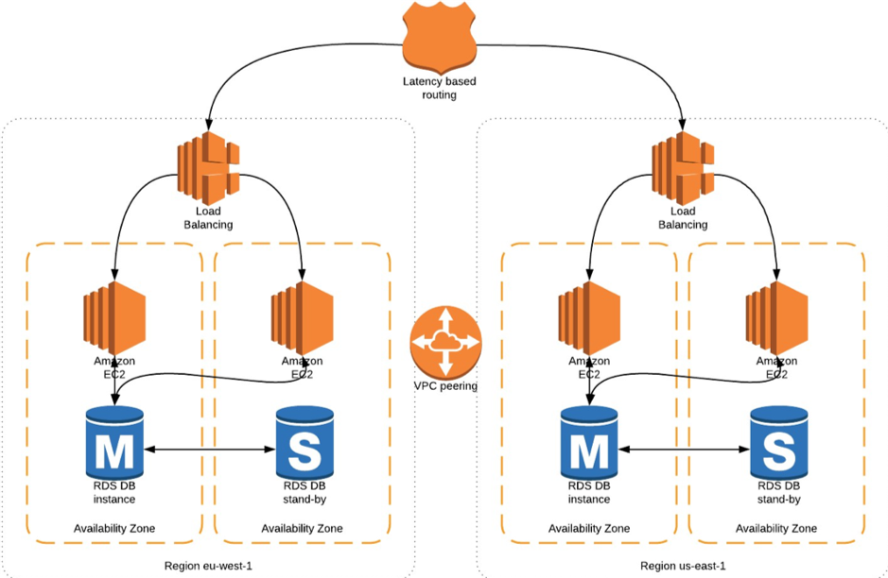
Example architecture
The following example is a simplified depiction of a fault tolerant architecture leveraging the AWS Global Infrastructure. In this example 2 Regions with 2 Availability Zones each are used to load balance traffic to EC2 instances. Using VPC peering we can replicate the database to a different region.

Slide 7
Elastic Load Balancing (ELB)
Elastic Load Balancing (ELB) is a load-balancing service for Amazon Web Services (AWS) deployments. ELB automatically distributes incoming application traffic and scales resources to meet traffic demands.
ELB helps an IT team adjust capacity according to incoming application and network traffic. Users enable ELB within a single availability zone or across multiple availability zones to maintain consistent application performance.
Historically, load balancing divides the amount of work that a computer has to do among multiple computers so that users, in general, get served faster. ELB offers enhanced features including:
Detection of unhealthy Elastic Compute Cloud (EC2) instances.
Spreading instances across healthy channels only.
Flexible cipher support.
Centralized management of Secure Sockets Layer (SSL) certificates.
Optional public key authentication.
Support for both IPv4 and IPv6.

Slide 8
High availability
The most well-known service that relies on ELB is Amazon's EC2, as ELB performs a health check to ensure an instance is still running before sending traffic to it. When an instance fails or is unhealthy, ELB routes traffic to the remaining healthy EC2 instances. If all EC2 instances in a particular availability zone are unhealthy, ELB can route traffic to other availability zones until the original instances restore to a healthy state.
A developer can integrate Amazon Route 53 and domain name system (DNS) failover to further boost application resiliency. Route 53 can route traffic to another healthy ELB and fail over across AWS regions.

Slide 9
Automatic scaling
A developer can use AWS' Auto Scaling feature to guarantee he or she has enough EC2 instances running behind an ELB. The developer sets Auto Scaling conditions, and when a condition is met, a new EC2 instance can spin up to meet the desired minimum. A developer can also set a condition to spin up new EC2 instances to reduce latency.

Slide 10
Security
ELB supports applications within an Amazon Virtual Private Cloud for stronger network security. An IT team can specify whether it wants an internet-facing or internal load balancer. The latter option enables a developer to route traffic through an ELB using private IP addresses. A developer could also route traffic between different tiers of an application by using multiple internet-facing and internal load balancers; this approach allows an IT team to use a security group along with private IP addresses while exposing only the web-facing tier and its public IP addresses.
In addition to certificate management, ELB allows SSL/Transport Layer Security (TLS) decryption.

Slide 11
Types of load balancers
ELB offers two different load balancer features, which help provide scalable cloud computing capacity. The Application Load Balancer handles advanced traffic routing from other services or containers at the application level, while the Classic Load Balancer spreads app or network traffic across EC2 instances.
Other vendors also offer tools to load balance workloads. ScaleBase offers an ELB solution with real-time elasticity, which simplifies the ability to scale the MySQL relational database management system (RDBMS) without requiring infrastructure changes or taking services offline.

Slide 12
Difference between Application load balancer (ALB) and Network load balancer (NLB)
Both Application Load Balancer and Network Load Balancer are designed from the ground up for the modern paradigm of dynamic port configurations as commonly seen in containerized deployments. Picking which load balancer is right for you will depend on the specific needs of your application, such as whether or not network traffic is HTTP, whether you need end to end SSL/TLS encryption, and whether or not you want host and path based traffic routing.
If you are deploying docker containers and using a load balancer to send network traffic to them EC2 Container Service provides a tight integration with ALB and NLB so you can keep your load balancers in sync as you start, update, and stop containers across your fleet.

Slide 13
Application Load Balancer (ALB)
This is the distribution of requests based on multiple variables, from the network layer to the application layer. It is context-aware and can direct requests based on any single variable as easily as it can a combination of variables. Applications are load balanced based on their peculiar behavior and not solely on server (operating system or virtualization layer) information.
This is feature fulled Layer-7 load balancer, HTTP and HTTPS listeners only. Provides the ability to route HTTP and HTTPS traffic based upon rules, host based or path based. Like an NLB, each Target can be on different ports. Even supports HTTP/2. Configurable range of health check status codes (CLB only supports 200 OK for HTTP health checks).
With ALB, it is a requirement that you enable at least two or more Availability Zones.

Slide 14
Network Load Balancer (NLB)
This is the distribution of traffic based on network variables, such as IP address and destination ports. It is layer 4 (TCP) and below and is not designed to take into consideration anything at the application layer such as content type, cookie data, custom headers, user location, or the application behavior. It is context-less, caring only about the network-layer information contained within the packets it is directing this way and that.
This is a TCP Load Balancer only that does some NAT magic at the VPC level. It uses EIPs, so it has a static endpoint unlike ALB and CLBs (by default). Each Target can be on different ports.
With NLB, Elastic Load Balancing creates a network interface for each Availability Zone that you enable.

Slide 15
Key Differences
Application Load Balancer (as the name implies) works at the Application Layer (Layer 7 of the OSI model, Request level). Network Load Balancer works at Transport layer (Layer 4 of the OSI model, Connection level). NLB just forward requests whereas ALB examines the contents of the HTTP request header to determine where to route the request. So, application load balancer is performing content based routing.
NLB cannot assure availability of the application. This is because it bases its decisions solely on network and TCP-layer variables and has no awareness of the application at all. Generally a NLB determines availability based on the ability of a server to respond to ICMP ping, or to correctly complete the three-way TCP handshake. ALB goes much deeper, and is capable of determining availability based on not only a successful HTTP GET of a particular page but also the verification that the content is as was expected based on the input parameters.
When considering the deployment of multiple applications on the same host sharing IP addresses (virtual hosts in old school speak), NLB will not differentiate between Application A and Application B when checking availability (indeed it cannot unless ports are different) but ALB will differentiate between the two applications by examining the application layer data available to it. This difference means that NLB may end up sending requests to an application that has crashed or is offline, but ALB will never make that same mistake.

Slide 16
What is a Launch Template?
A launch template is merely a group of all of the configurations that create and configure an EC2 instance. Likely, you would have already walked through creating one EC2 instance using that EC2 wizard. And that’s wonderful for making your first instance, but if you have to create thousands of instances? Do you really enjoy to be going through that wizard every single time? I don’t, and you probably don’t want to either.
So what the launch template does is step through that wizard and effectively just save the results, creating a template with all configurations in a single place, so when we need that to create a new instance again, we can just push that button. The instance is created precisely as we’ve defined it in that template. If you’ve touched on auto-scaling before, you might think that this launch template looks a lot like a launch configuration. And it’s.
The launch templates are more recent, practical, quicker, and powerful options. It’s just the most suitable. It doesn’t imply that you’re technically incorrect if you’re utilizing a launch configuration. It’s just AWS has released the launch templates, and they deliver us extra flexibility and instruments that the launch configuration didn’t. So the launch templates, as we’ll notice in the table above, are for more than only auto-scaling. This permits us to operate that template at any moment, compared to those launch configurations, which are just for auto-scaling those EC2 instances. Also, the launch templates support versioning. This indicates that we can efficiently design unique versions, new revisions, or perhaps we have got new user_data, a fresh AMI image, and it’s all held in one single location.

Slide 17
Launch templates versioning
To use the launch template versioning, we can just pick which version of that template we would like to apply. And from another side, the launch configuration, it’s unchangeable and doesn’t track changes. But the Launch templates support versioning. So versioning just implies whenever we want to modify it, such as a new image AMI, instance type, new user data, configuration related to network, and after all changes you have done, we still have that in history. So in a quick summary, we prefer to use launch templates and not configurations.

Slide 18
EC2 Auto Scaling Groups
An EC2 auto scaling group is a logical collection of several Amazon EC2 instances used for management and scaling purposes. Auto scaling groups let you use core features of the EC2 Auto Scaling service, including health checks, minimum/maximum instances and scaling policies.
EC2 Auto Scaling functionality mainly centers around maintaining a specified amount of instances in a group, or automatically increasing and decreasing the size of a group according to different aspects, such as application loads or predetermined schedules.
EC2 Auto Scaling is offered as part of the general AWS Auto Scaling service, which can help you scale multiple Amazon services, including ECS and RDS.

Slide 19
How Do Auto Scaling Groups Work?
The size of your auto scaling group is maintained according to a pre-defined number of instances, which you configure as the required capacity. You can use manual or automatic sizing to resize groups according to application requirements.
Initially, an auto scaling group launches enough instances to reach the required capacity. By default, it maintains this amount of instances by performing regular health checks, identifying unhealthy instances, terminating them and launching other, replacement instances.
Beyond this basic functionality, you can use a scaling policy to dynamically change group size, using policies for the following jobs:
Manual scaling
Maintain a fixed, pre-defined number of instances
Tracking a target for a specific load metric
Step scaling based on multiple thresholds of a load metric
Simple scaling (changes capacity by fixed increment)
Scaling jobs based on SQS queues
Scheduled scaling

Slide 20
How Do Auto Scaling Groups Work?
When a policy is active, the auto scaling group changes the amount of instances dynamically, keeping the number between the maximum and minimum values defined for your group.
Auto scaling groups use launch templates to define which new instances will be launched. You can define a specific instance type, or several types of instances, in a launch template. You can also set different launch templates for different EC2 resources.

Slide 21
Auto Scaling Groups and Availability Zones
You can span auto scaling groups across multiple availability zones (AZ) in a Region. The next step is to attach a load balancer, which distributes incoming traffic equally across all of your chosen AZs.
Once an AZ becomes unavailable or unhealthy, Auto Scaling launches and adds new instances to the AZ with the least amount of instances. If or when these attempts fail, Auto Scaling tries to launch these instances in other AZs and continues this process until it succeeds.
When you need to expand the availability of your application, you can add an AZ to your auto scaling group. Remember to enable the AZ for the relevant load balancer. After the new AZ is enabled, the load balancer starts routing traffic, in an equal manner, across all enabled AZs.
Note that while auto scaling groups can contain instances from multiple AZs, all AZs must be located in the same Region. This functionality does not support the use of multiple Regions.
Here are other limitations you might want to consider when choosing AZs:
When enabling an AZ for your load balancer, you need to define one subnet from that AZ. However, you can select a maximum of one subnet per each AZ.
Any subnets specified for Internet-facing load balancers must have at least eight available IP addresses.
Application load balancers need at least two enabled AZs.
It is not possible to disable any enabled AZs for network load balancers. What you can do is enable additional AZs.
Gateway load balancers do not support any changes to AZs or subnets that were added when the load balancer was created.

Slide 22
EC2 Auto Scaling Groups with Multiple Instance Types
Auto scaling groups let you launch a fleet composed of on-demand EC2 instances and spot instances. There are multiple ways to get discounted rates for instances while auto scaling:
Spot instances which are EC2 spare capacity offer a discount of up to 90% compared to on-demand instances.
You can also use reserved instances or Amazon savings plans within an auto scaling group, to get discounted rates for on-demand instances.
Mixing different types of instances also improves availability:
Deploying applications across multiple availability zones (AZ).
Scale an application using more than one instance type, which reduces the chance that the specific instance type you selected will not be available in your selected AZ.
By combining on-demand instances and spot instances there is always at least a base of available on-demand instances. For spot instances, if there is insufficient capacity, EC2 Auto Scaling looks to other spot instance pools, making it more likely you can use low-cost spot instances. If there are none available, those instances will not run until spot instances become available.

Slide 23
Allocation Strategies
There are several allocation strategies used by auto scaling groups to add specific types of instances to a group:
On-demand instances—this allocation policy looks at the instance types defined in your launch template, in the order they are listed. It fulfills the on demand capacity of the auto scaling group by adding the first type of instance listed, and if it isn’t available, the second, third, etc.
Capacity-optimized spot instances—this allocation policy adds instances from a spot instance pool that are likely to provide optimal capacity over time. It looks at real-time data about spot instance capacity to predict which instances will be available for the longest time.
Lowest price spot instances—this allocation policy adds spot instances from a certain number of spot instance pools you define, or other pools which have a lower price at the time the group is scaled. You can define which instance types and which availability zones you want the spot instances to be drawn from.

Slide 24
Spot Instance Interruption and Rebalance
Even though spot instances can be mixed up with on-demand instances in an auto scaling group, the spot instances can still be interrupted. When a Spot instance is at high risk of interruption, EC2 provides an instance rebalance recommendation.
Amazon explicitly warns that it will not always send this recommendation in advance, and it may arrive together with the spot instance interruption notice, which gives you two minutes to move workloads off the instance before it is interrupted.
Once you receive a rebalance recommendation or an interruption notice, you can choose to:
Move your workload to another spot instance which is not at risk of interruption
Move the workload to a higher-cost on-demand instance
You can enable an option called Capacity Rebalancing for an EC2 auto scaling group. This means that Auto Scaling will automatically attempt to replace a spot instance that received a rebalance recommendation, with another instance that has not received this warning. Alternatively, you can create a lifecycle hook to perform any other action when the warning is received.

Slide 25
Elastic Load Balancing and Auto Scaling Groups
When an auto scaling group is attached to a load balancer, all incoming requests go to the load balancer, and it routes the traffic to one of the instances in the group. It is important to realize that instances added to or removed from the auto scaling group need to be explicitly registered or deregistered from the load balancer.
Once you've attached a load balancer to an auto scaling group, you can configure the group to scale based on ELB metrics, such as the number of requests per target. You can also use health checks performed by the load balancer to trigger scaling events.
You can use the following types of load balancers with EC2 auto scaling groups:
Application Load Balancer—supports routing and load balancing of HTTP / HTTPS traffic, as well routing based on path. Only supports virtual private cloud (VPC).
Classic Load Balancer—performs routing and load balancing of TCP/SSL or HTTP/HTTPS traffic. Supports both regular EC2 and VPC.
Network Load Balancer—routes traffic at TCP/UDP layer 4, based on TCP packet address information.
Gateway Load Balancer—distributes traffic to groups of instances or appliances like firewalls and introduction prevention/detection systems. Supports the GENEVE protocol which is used by many appliances.
Your load balancer and auto scaling group need to be in the same region. Additionally, your load balancer target must be an instance and not an ip, in order to connect to an auto scaling group.

Slide 26
ASG Scaling Policies
Amazon’s EC2 Auto Scaling provides an effective way to ensure that your infrastructure is able to dynamically respond to changing user demands. For example, to accommodate a sudden traffic increase on your web application, you can set your Auto Scaling group to automatically add more instances. And when traffic is low, have it automatically reduce the number of instances. This is a cost-effective solution since it only provisions EC2 instances when you need them. EC2 Auto Scaling provides you with several dynamic scaling policies to control the scale-in and scale-out events.

Slide 27
Simple Scaling
Simple scaling relies on a metric as a basis for scaling. For example, you can set a CloudWatch alarm to have a CPU Utilization threshold of 80%, and then set the scaling policy to add 20% more capacity to your Auto Scaling group by launching new instances. Accordingly, you can also set a CloudWatch alarm to have a CPU utilization threshold of 30%. When the threshold is met, the Auto Scaling group will remove 20% of its capacity by terminating EC2 instances.
When EC2 Auto Scaling was first introduced, this was the only scaling policy supported. It does not provide any fine-grained control to scaling in and scaling out.

Slide 28
Target Tracking
Target tracking policy lets you specify a scaling metric and metric value that your auto scaling group should maintain at all times. Let’s say for example your scaling metric is the average CPU utilization of your EC2 auto scaling instances, and that their average should always be 80%. When CloudWatch detects that the average CPU utilization is beyond 80%, it will trigger your target tracking policy to scale out the auto scaling group to meet this target utilization. Once everything is settled and the average CPU utilization has gone below 80%, another scale in action will kick in and reduce the number of auto scaling instances in your auto scaling group. With target tracking policies, your auto scaling group will always be running in a capacity that is defined by your scaling metric and metric value.
A limitation though – this type of policy assumes that it should scale out your Auto Scaling group when the specified metric is above the target value. You cannot use a target tracking scaling policy to scale out your Auto Scaling group when the specified metric is below the target value. Furthermore, the Auto Scaling group scales out proportionally to the metric as fast as it can, but scales in more gradually. Lastly, you can use AWS predefined metrics for your target tracking policy, or you can use other available CloudWatch metrics (native and custom).

Slide 29
Target Tracking
Predefined metrics include the following:
ASGAverageCPUUtilization – Average CPU utilization of the Auto Scaling group.
ASGAverageNetworkIn – Average number of bytes received on all network interfaces by the Auto Scaling group.
ASGAverageNetworkOut – Average number of bytes sent out on all network interfaces by the Auto Scaling group.
ALBRequestCountPerTarget – If the auto scaling group is associated with an ALB target group, this is the number of requests completed per target in the target group.

Slide 30
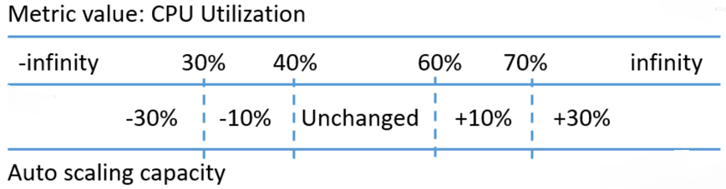
Step Scaling
Step Scaling further improves the features of simple scaling. Step scaling applies “step adjustments” which means you can set multiple actions to vary the scaling depending on the size of the alarm breach.
When a scaling event happens on simple scaling, the policy must wait for the health checks to complete and the cooldown to expire before responding to an additional alarm. This causes a delay in increasing capacity especially when there is a sudden surge of traffic on your application. With step scaling, the policy can continue to respond to additional alarms even in the middle of the scaling event.
Here is an example that shows how step scaling works:

Slide 31
Step Scaling
In this example, the Auto Scaling group maintains its size when the CPU utilization is between 40% and 60%. When the CPU utilization is greater than or equal to 60% but less than 70%, the Auto Scaling group increases its capacity by an additional 10%. When the utilization is greater than 70%, another step in scaling is done and the capacity is increased by an additional 30%. On the other hand, when the overall CPU utilization is less than or equal to 40% but greater than 30%, the Auto Scaling group decreases the capacity by 10%. And if utilization further dips below 30%, the Auto Scaling group removes 30% of the current capacity.
This effectively provides multiple steps in scaling policies that can be used to fine-tune your Auto Scaling group response to dynamically changing workload.

Slide 32
Amazon EC2 Auto Scaling Lifecycle Hooks
As your Auto Scaling group scale-out or scale-in your EC2 instances, you may want to perform custom actions before they start accepting traffic or before they get terminated. Auto Scaling Lifecycle Hooks allow you to perform custom actions during these stages.
For example, during the scale-out event of your ASG, you want to make sure that new EC2 instances download the latest code base from the repository and that your EC2 user data has completed before it starts accepting traffic. This way, the new instances will be fully ready and will quickly pass the load balancer health check when they are added as targets. Another example is this – during the scale-in event of you ASG, suppose your instances upload data logs to S3 every minute. You may want to pause the instance termination for a certain amount of time to allow the EC2 to upload all data logs before it gets completely terminated.
Lifecycle Hooks give you greater control of your EC2 during the launch and terminate events. The following diagram shows the transitions between the EC2 instance states with lifecycle hooks.

Slide 33
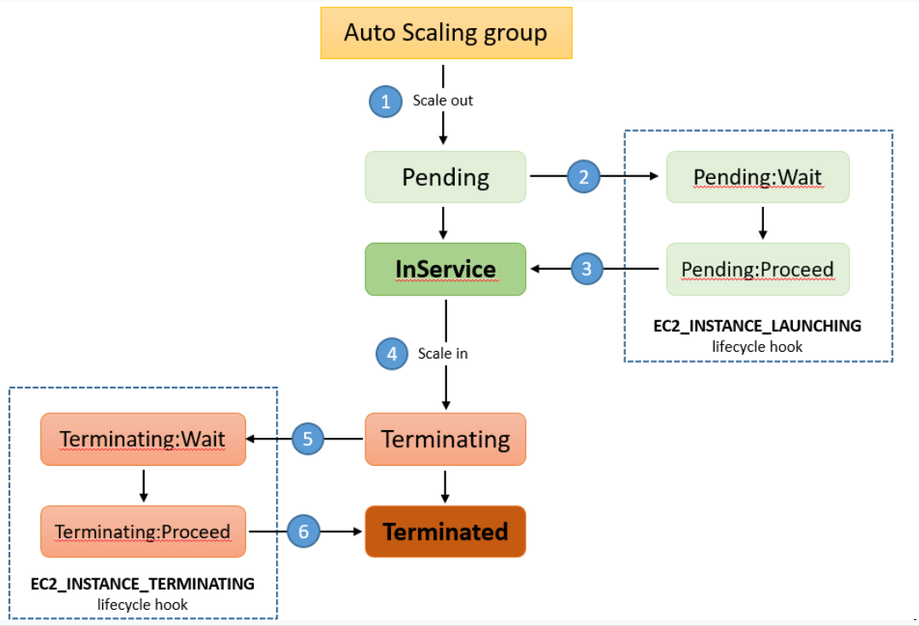
Amazon EC2 Auto Scaling Lifecycle Hooks
1. The Auto Scaling group responds to a scale-out event and provisions a new EC2 instance.
2. The lifecycle hook puts the new instance on Pending:Wait state. The instance stays in this paused state until you continue with the “CompleteLifecycleAction” operation or the default wait time of 3600 seconds is finished. For example, you can create a script that runs during the creation of the instance to download and install the needed packages for your application. Then the script can call the “CompleteLifecycleAction” operation to move the instance to the InService state. Or you can just wait for your configured timeout and the instance will be moved to the InService state automatically.
3. The instance is put to InService state. If you configured a load balancer for this Auto Scaling group, the instance will be added as targets and the load balancer will begin the health check. After passing the health checks, the instance will receive traffic.
4. The Auto Scaling group responds to a scale-in event and begins terminating an instance.
5. The instance is taken out of the load balancer target. The lifecycle hook puts the instance on Terminating:Wait state. For example, you can set a timeout of 2 minutes on this section to allow your instance to upload any data files inside it to S3. After the timeout, the instance is moved to the next state.
6. Auto scaling group completes the termination of the instance.

Slide 34
Amazon EC2 Auto Scaling Lifecycle Hooks
During the paused state (either launch or terminate), you can do more than just run custom scripts or wait for timeouts. CloudWatch Events receives the scaling action and you can define a CloudWatch Events Target to invoke a Lambda function that can perform a pre-configured task. You can also configure a notification target for the lifecycle hook so that you will receive a message when the scaling event occurs.

Slide 35
Thank you for listening

