Slide 1
git
version control system

Slide 2
diff and patch
diff file1 file2 > file2.patch
patch file2 file2.patch
https://linuxacademy.com/blog/linux/introduction-using-diff-and-patch/

Slide 3
Version Control Software
Local:
Revision Control System RCS
Source Code Control System SCCS
Client-Server:
Concurrent Versions System (CVS)
Subversion (SVN)
Distributed:
BitKeeper
Git
Mercurial

Slide 4
git
influenced by BitKeeper
started by Linus Torvalds 2005
distributed version control system (each repository copy contains full history)
Git is fundamentally a content-addressable filesystem with a VCS user interface written on top of it

Slide 5
Protocols
local
ssh
ftp – rarely used
http
https

Slide 6
git commands: configuration
git config
git config --global user.name "John Doe”
git config --global user.email johndoe@example.com
git config --global core.editor emacs
git config --list
git config user.name
configuration files
/etc/gitconfig – system global
~/.gitconfig – user global
$PWD/.git/config – local for this repository stored in CurrentWorkingDirectory

Slide 7
git commands: get repository
git clone https://github.com/orasul/bash-scripts - http/https
git clone git@github.com:orasul/bash-scripts - ssh
git clone file:///Users/rasul/workspace/bash-scripts - local file protocol
git init #New repository will be created in current working directory

Slide 8
git commands: commit
Edit file
Add file to Staged (prepare for commit)
Commit (create snapshot)
echo “Hello” > file
git add file
git commit
git status
git log

Slide 9
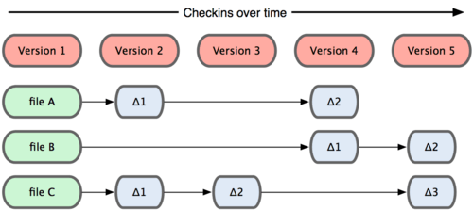
svn cvs diff:

Slide 10
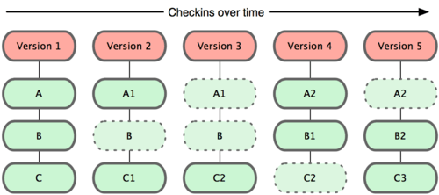
git snapshots

Slide 11

Three stages (trees)
HEAD – last commit snapshot (parent for the next commit)
Index – proposed next commit snapshot (added, tracked files + HEAD)
Working Directory – unpacked HEAD snapshot + changed and not tracked files, sandbox
Page 251

Slide 12
git commands: sync
git push – share latest snapshot
git pull
git fetch – download latest snapshot
git remote –v
git remote add backup-repo file://…...
git remote rm antoher-repo
git remote rename another-repo main
git pull == git fetch && git merge

Slide 13
git commands: modify last commit
git commit -m “Added feature”
git add my_file
git commit --amend
git add .
git reset HEAD my_file
git checkout -- my_file

Slide 14
git log commands
git log
git log –p
git log --oneline
git log --oneline --decorate --graph –all
git log --pretty=format:"%cn committed %h on %cd”
git log -3
git log -- script.py random.py

Slide 15
git merge
Automerge
git merge <%= branchname %>
(master) git merge development
(development) git merge master

Slide 16
git commands: cherry-pick vs revert
git cherry-pick 33436653b2f0a799c5f9cd67def148175d385e02
git revert e2ce4d14fe0f992255b6f25fb47e16ccac13ad2d
git revert -m 1 HEAD

Slide 17
git commands: checkout specific snapshot
git checkout 33436653b2f0a799c5f9cd67def148175d385e02
Move HEAD to specific snapshot

Slide 18
git branches
git branch
git branch -a
git checkout -b <new-branch-name>
git branch <new-branch-name>
git branch -d <do-not-need-this-branch-any-more>

Slide 19
git feature branch
git checkout -b feature-42
git add ; git commit ; git add ; git commit
git checkout master
git merge feature-42
git -d feature-42

Slide 20
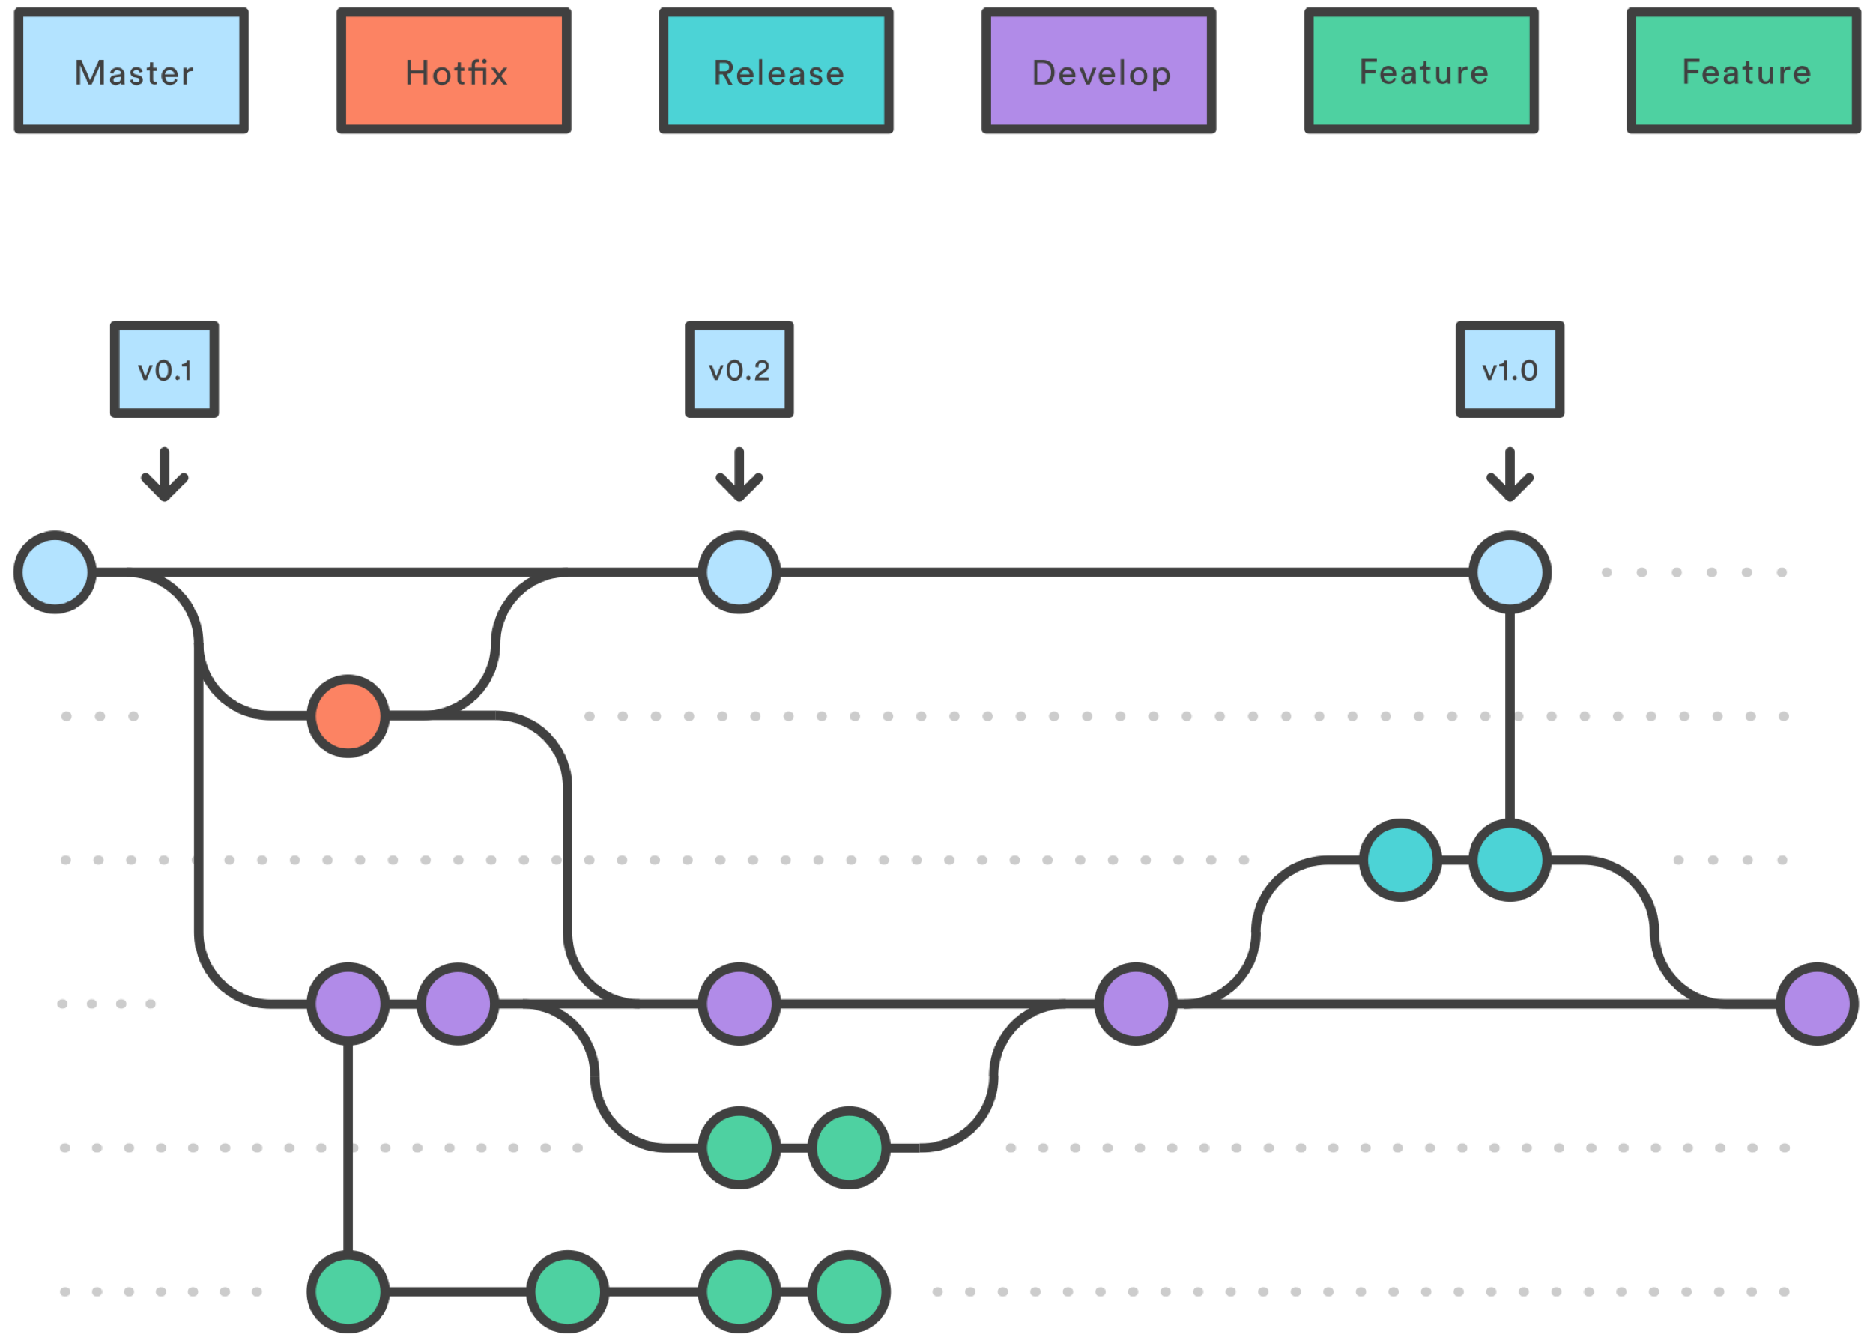
git feature branch; hotfix from master
git checkout -b feature-42
git add ; git commit ; git add ; git commit
git merge master ; git add ; git commit ; git add ; git commit
git checkout master
git merge feature-42
git -d feature-42

Slide 21
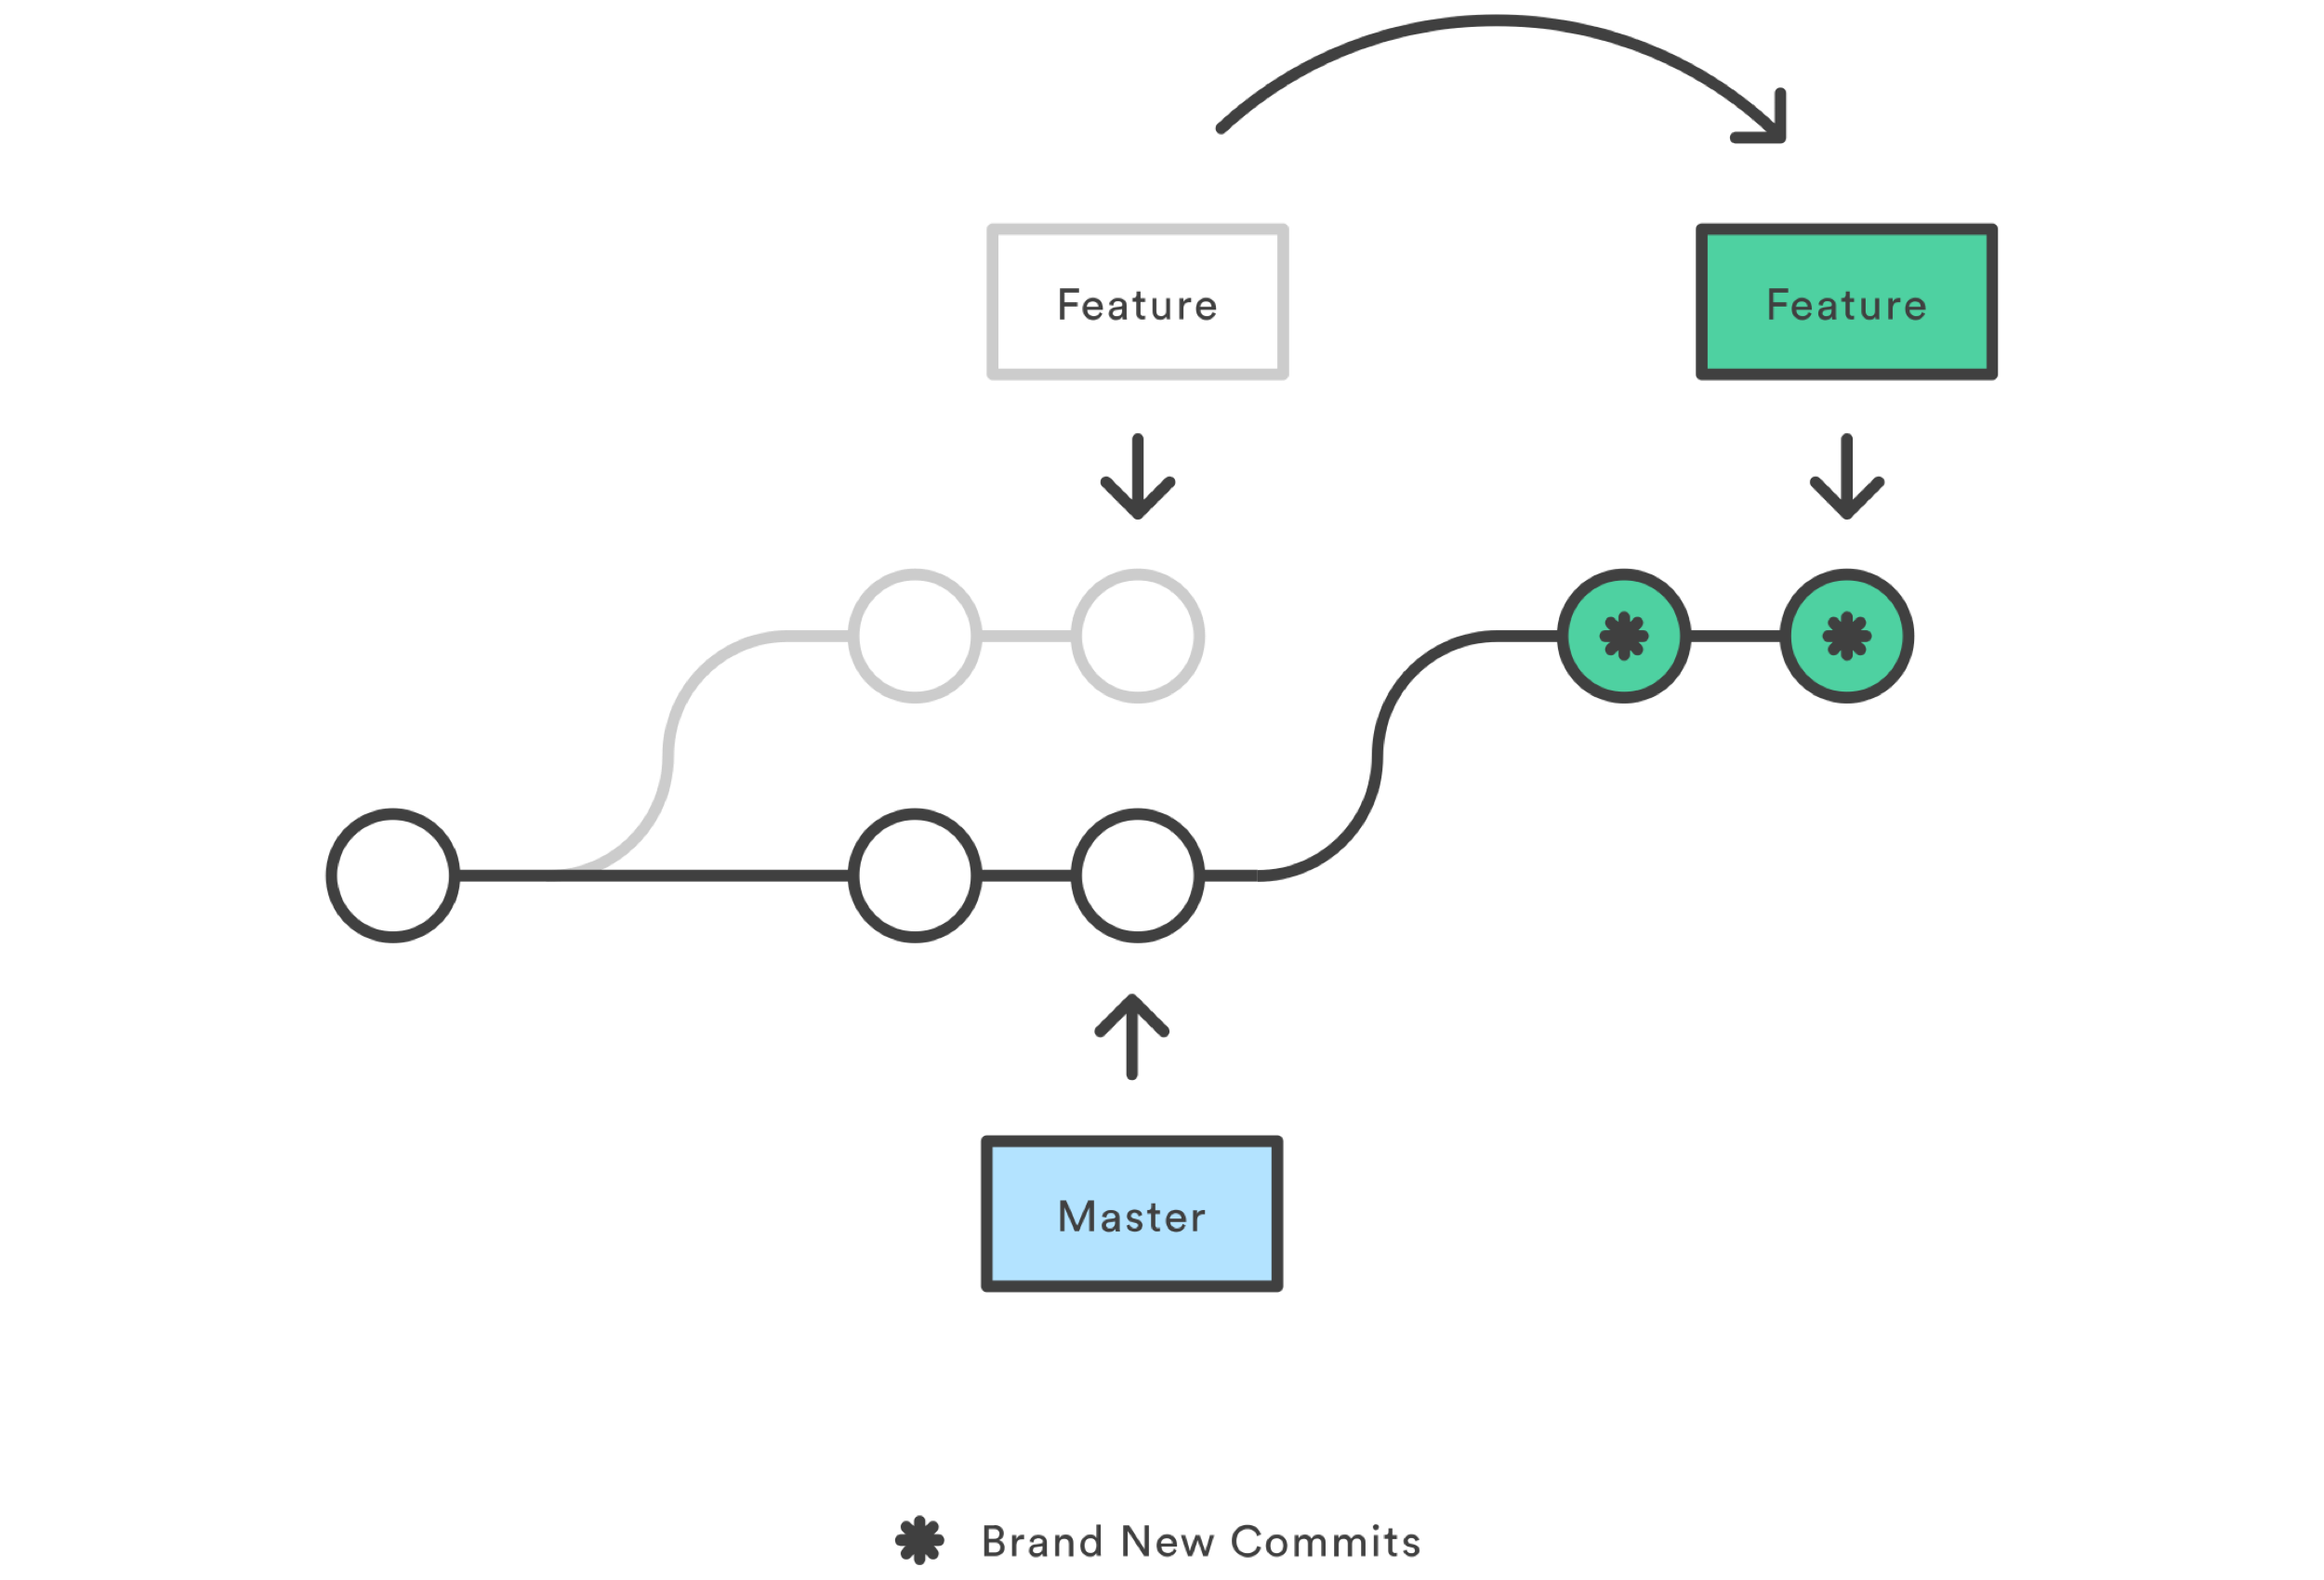
git rebase
git checkout -b feature_branch master
git commit -a -m "Adds new feature”
git rebase master
git rebase --onto <newbase> <oldbase>
git rebase --onto master featureA feature

Slide 22
git branching strategies
Git Flow
GitHub Flow
GitLab Flow
One Flow

Slide 23
git hooks
pre-commit
prepare-commit-msg
commit-msg
post-commit
post-checkout
pre-rebase

Slide 24
GIT hostings
https://bitbucket.org
https://github.com
https://gitlab.com

Slide 25
The End.

