Slide 1
Linux Architecture
Shell, Command Interpreter Programming
CONFIDENTIAL | © 2022 EPAM Systems, Inc.

Slide 2
Following links – will help to introduce bash programming
https://www.youtube.com/watch?v=x2U9TsqSKmw – Youtube D. Ketov Polytechnical University (Russian Language) https://www.youtube.com/watch?v=WVHC5Ggl7k4 – Youtube D. Ketov Polytechnical University (Russian Language)
https://linuxconfig.org/bash-scripting-tutorial - Beginners tutorial
https://www.datacamp.com/courses/introduction-to-bash-scripting - DataCamp shell intro (Paid)
https://www.youtube.com/playlist?list=PLS1QulWo1RIYmaxcEqw5JhK3b-6rgdWO_ - for beginners
https://tldp.org/LDP/Bash-Beginners-Guide/html/ - comprehensive Guide with samples
https://github.com/orasul/bash-scripts - some pure bash scripts
https://github.com/dylanaraps/pure-bash-bible - lot’s of pure bash scripts

Slide 3
Plan
Basic shell programming (vars, loops, statements, options, etc.)
Best practicies, redirrections, parallel executions, jobs, etc.
Tools: grep, regex, find, xargs, curl, jq, CoreUtils, UtilLinux, etc.

Slide 4
Shell Bash execution, command line
Interpreter | Shell | Cli interface | Programming Language
command line interface
what is executed?
PATH
full path ; relative path
alias
builtin ; keyword - https://askubuntu.com/questions/445749/whats-the-difference-between-shell-builtin-and-shell-keyword
type

Slide 5
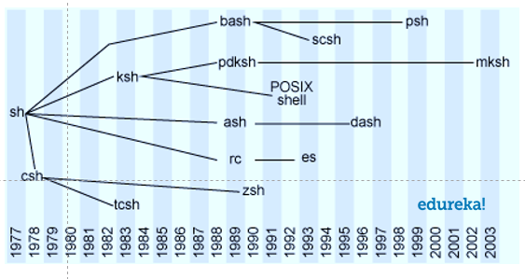
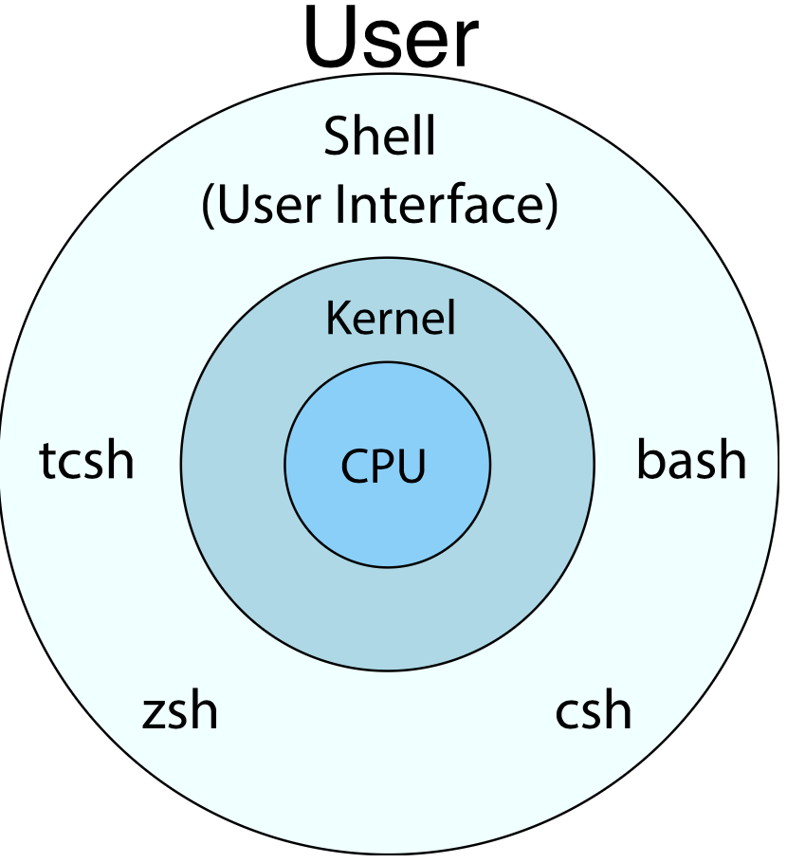
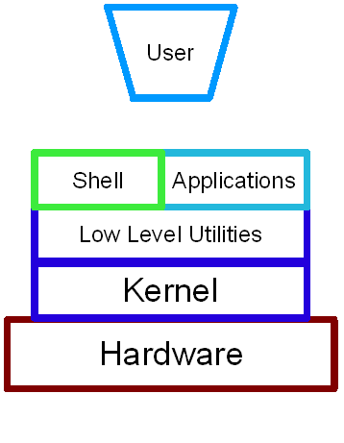
Shells
UNIX, linux, xBSD
Windows, Mac OS

Slide 6
How to run script ?
/bin/bash -c "echo Hello | grep -o ell"
/bin/bash my_script.sh
Relative or absolute path: ./my_script.sh
Shebang - https://en.wikipedia.org/wiki/Shebang_(Unix)
Don’t forget to make script executable /bin/chmod +x my_script.sh
eval
exec
expr

Slide 7
Variables and Types
VARIABLE=value
echo $VARIABLE
https://linux.die.net/Bash-Beginners-Guide/sect_10_01.html
declare OPTION(s) VARIABLE=value
Option | Meaning
-a | Variable is an array.
-f | Use function names only.
-i | The variable is to be treated as an integer; arithmetic evaluation is performed when the variable is assigned a value.
-p | Display the attributes and values of each variable. When -p is used, additional options are ignored.
-r | Make variables read-only. These variables cannot then be assigned values by subsequent assignment statements, nor can they be unset.
-t | Give each variable the trace attribute.
-x | Mark each variable for export to subsequent commands via the environment.
readonly TUX=penguinpower
local

Slide 8
Variables and Substitution
${parameter}
${parameter-default}, ${parameter:-default}
${parameter=default}, ${parameter:=default}
${parameter+alt_value}, ${parameter:+alt_value}
${parameter?err_msg}, ${parameter:?err_msg}
${#var}
${var#Pattern}, ${var##Pattern}
${var%Pattern}, ${var%%Pattern}
${var:pos:len}
${var/Pattern/Replacement}
${var//Pattern/Replacement}
https://tldp.org/LDP/abs/html/parameter-substitution.html
https://www.shell-tips.com/bash/math-arithmetic-calculation/

Slide 9
Loops
for VARIABLE in file1 file2 file3 do command1 on $VARIABLE command2 command done
for ((i=0;i<=3;i++)) do command1 on $I command2 command done
until command do echo a a=a+1 echo ok done
while command do echo a a=a+1 echo ok done

Slide 10
Functions
function_name () { commands }
function function_name { commands; }

Slide 11
export ; source
export var1
export var2=value2
# After export variables are available in child processes
source script.sh ; “source” == “.”
# source equivalent to run each command from script in current shell
# login program sources /etc/profile ; /etc/bashrc ; ~/.bashrc files for current bash session

Slide 12
Conditional Statements
command1 && truecommand || falsecommand
if [ conditional expression1 ] then statement1 statement2 elif [ conditional expression2 ] then statement3 statement4 else statement5 fi

Slide 13
Conditional Statements
case "$1" in start) start ;; stop) stop ;; status) status anacron ;; restart) stop start ;; condrestart) if test "x`pidof anacron`" != x; then stop start fi ;; *) echo $"Usage: $0 {start|stop|restart|condrestart|status}” exit 1 esac
Following are the key points of bash case statements:
Case statement first expands the expression and tries to match it against each pattern.
When a match is found all of the associated statements until the double semicolon (;;) are executed.
After the first match, case terminates with the exit status of the last command that was executed.
If there is no match, exit status of case is zero.
https://www.thegeekstuff.com/2010/07/bash-case-statement/

Slide 14
Arguments
Available in functions and in scripts.
$1, $2, $n
$*, $@
$#
i=1; j=$#; while [ $i -le $j ] do echo "Username - $i: $1"; i=$((i + 1)); shift 1; done

Slide 15
/bin/bash scripts variables, options
./script.sh -a 4 -n5 --file-name myfile.txt --verbose
./script.sh -a 4 -n5 myfile.txt
./script.sh --help
./script.sh -v
./script.sh --version
./java -verision
getopts
shift
$1 $2 $N
$#
$* $@

Slide 16
Options
getopts optstring name [args]
getopts is used by shell procedures to parse positional parameters. optstring
contains the option characters to be recognized; if a character is followed by a
colon, the option is expected to have an argument, which should be separated
from it by white space. The colon and question mark characters may not be used
as option characters. Each time it is invoked, getopts places the next option
in the shell variable name, initializing name if it does not exist, and the
index of the next argument to be processed into the variable OPTIND. OPTIND is
initialized to 1 each time the shell or a shell script is invoked. When an
option requires an argument, getopts places that argument into the variable
OPTARG. The shell does not reset OPTIND automatically; it must be manually
reset between multiple calls to getopts within the same shell invocation if a
new set of parameters is to be used.
while getopts ":ht" opt
do case ${opt} in h ) # process option h ;; t ) # process option t ;; \? ) echo "Usage: cmd [-h] [-t]” ;; esac done

Slide 17
trap
tempfile=/tmp/tmpdata trap "rm -f $tempfile" EXIT function cleanup() { # ... } trap cleanup EXIT https://www.linuxjournal.com/content/bash-trap-command https://opensource.com/article/20/6/bash-trap

Slide 18
read
https://www.computerhope.com/unix/bash/read.htm

Slide 19
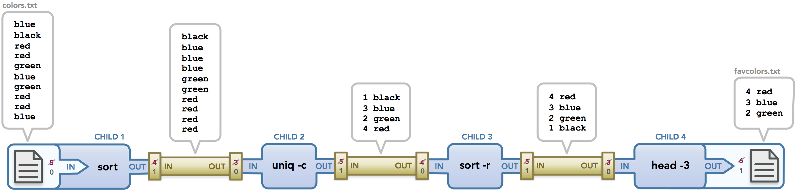
parallel executions /dev/fd/[012]
command1 | command2 | command3 >stdoutfile 2>stderrfile
| pipe to pipe
> pipe to file < file to pipe
>> - noclobber

Slide 20
redirrections
exec 3<>/dev/tcp/www.google.com/80 echo -e "GET / HTTP/1.1\r\nhost: http://www.google.com\r\nConnection: close\r\n\r\n" >&3 cat <&3
cat </dev/tcp/time.nist.gov/13
cat <<EOF >>brightup.sh #!/bin/sh # Created on $(date # : <<-- this will be evaluated before cat;) echo "\$HOME will not be evaluated because it is backslash-escaped" EOF

Slide 21
exec
exec – replaces current process with specified command: exec bash If you run exec by itself, without a command, it will simply make the redirections apply to the current shell. You probably know that when you run command > file, the output of command is written to file instead of to your terminal (this is called a redirection). If you run exec > file instead, then the redirection applies to the entire shell: Any output produced by the shell is written to file instead of to your terminal.
exec 3<>/dev/tcp/www.google.com/80 echo -e "GET / HTTP/1.1\r\nhost: http://www.google.com\r\nConnection: close\r\n\r\n" >&3 cat <&3
cat </dev/tcp/time.nist.gov/13

Slide 22
select
calculate () { read -p "Enter the first number: " n1 read -p "Enter the second number: " n2 echo "$n1 $1 $n2 = " $(bc -l <<< "$n1$1$n2") } PS3="Select the operation: ” select opt in add subtract multiply divide quit; do case $opt in add) calculate "+";; subtract) calculate "-";; multiply) calculate "*";; divide) calculate "/";; quit) break;; *) echo "Invalid option $REPLY";; esac done

Slide 23
Brackets { [ ( [[ ((
${variable} – variable invocation
$[ ] => $(( )) – arithmetic expansion
`` => $( ) - shell evaluation (eval)
[ ] – test
[[ ]] – bash test
(( )) – compund command
( 1 2 3 ) – array (declare -a)
<( ) – command execution stdout
() – functions
{ – start of the function;
} – end of the function;
{1..8} <==> seq 1 8
fork bomb : () { : | : }

Slide 24
Redirrections: > >> >>>, < << <<<
cat file > file2 # rewrite file2 completely
cat file >> file2 # append data to file2
>>> # doesn’t work
cat < file2 # open file2 and throw it on stdin for the process
cat <(grep root /etc/passwd) # extract stdout of the command and throw it on stdin for the process
cat <<EOF # start capturing text from EOF symbol till EOF symbol and throw it on stdin for the process
cat <<< “any text” # throw text on stdin for the process
cat <<< "any text" >> file3
cat <<EOF >> file3
several lines text
second line
EOF

Slide 25
jobs sessions
jobs
bg
fg
ctrl+Z
&
disown
kill %

Slide 26
shell bash
[[ is not available in sh (only [ which is more clunky and limited). See also Difference between single and double square brackets in Bash
sh does not have arrays.
Some Bash keywords like local, source, function, shopt, let, declare, and select are not portable to sh. (Some sh implementations support e.g. local.)
Bash has many C-style syntax extensions like the three-argument for((i=0;i<=3;i++)) loop, += increment assignment, etc. The $'string\nwith\tC\aescapes' feature is tentatively accepted for POSIX (meaning it works in Bash now, but will not yet be supported by sh on systems which only adhere to the current POSIX specification, and likely will not for some time to come).
Bash supports <<<'here strings'.
Bash has *.{png,jpg} and {0..12} brace expansion.
~ refers to $HOME only in Bash (and more generally ~username to the home directory of username).This is in POSIX, but may be missing from some pre-POSIX /bin/sh implementations.
Bash has process substitution with <(cmd) and >(cmd).
Bash has Csh-style convenience redirection aliases like &| for 2>&1 | and &> for > ... 2>&1
Bash supports coprocesses with <> redirection.
Bash features a rich set of expanded non-standard parameter expansions such as ${substring:1:2}, ${variable/pattern/replacement}, case conversion, etc.
Bash has significantly extended facilities for shell arithmetic (though still no floating-point support). There is an obsolescent legacy $[expression] syntax which however should be replaced with POSIX arithmetic $((expression)) syntax. (Some legacy pre-POSIX sh implementations may not support that, though.)
Magic variables like $RANDOM, $SECONDS, $PIPESTATUS[@] and $FUNCNAME are Bash extensions.
Syntactic differences like export variable=value and [ "x" == "y" ] which are not portable (export variable should be separate from variable assignment, and portable string comparison in [ ... ] uses a single equals sign).
Many, many Bash-only extensions to enable or disable optional behavior and expose internal state of the shell.
Many, many convenience features for interactive use which however do not affect script behaviour.

Slide 27
/bin/bash options
https://tldp.org/LDP/abs/html/options.html
Abbreviation | Name | Effect
-B | brace expansion | Enable brace expansion (default setting = on)
+B | brace expansion | Disable brace expansion
-C | noclobber | Prevent overwriting of files by redirection (may be overridden by >|)
-D | (none) | List double-quoted strings prefixed by $, but do not execute commands in script
-a | allexport | Export all defined variables
-b | notify | Notify when jobs running in background terminate (not of much use in a script)
-c ... | (none) | Read commands from ...
checkjobs |  | Informs user of any open jobs upon shell exit. Introduced in version 4 of Bash, and still "experimental." Usage: shopt -s checkjobs (Caution: may hang!)
-e | errexit | Abort script at first error, when a command exits with non-zero status (except in until or while loops, if-tests, list constructs)
-f | noglob | Filename expansion (globbing) disabled
globstar | globbing star-match | Enables the ** globbing operator (version 4+ of Bash). Usage: shopt -s globstar
-i | interactive | Script runs in interactive mode
-n | noexec | Read commands in script, but do not execute them (syntax check)
-o Option-Name | (none) | Invoke the Option-Name option
-o posix | POSIX | Change the behavior of Bash, or invoked script, to conform to POSIX standard.
-o pipefail | pipe failure | Causes a pipeline to return the exit status of the last command in the pipe that returned a non-zero return value.
-p | privileged | Script runs as "suid" (caution!)
-r | restricted | Script runs in restricted mode (see Chapter 22).
-s | stdin | Read commands from stdin
-t | (none) | Exit after first command
-u | nounset | Attempt to use undefined variable outputs error message, and forces an exit
-v | verbose | Print each command to stdout before executing it
-x | xtrace | Similar to -v, but expands commands
- | (none) | End of options flag. All other arguments are positional parameters.
-- | (none) | Unset positional parameters. If arguments given (-- arg1 arg2), positional parameters set to arguments.

Slide 28
NON bash things: xargs, regex, etc.
xargs : vs for
find ; find –exec
grep ; egrep; sed; awk
curl ; jq; gron
CoreUtils
UtilLinux

Slide 29
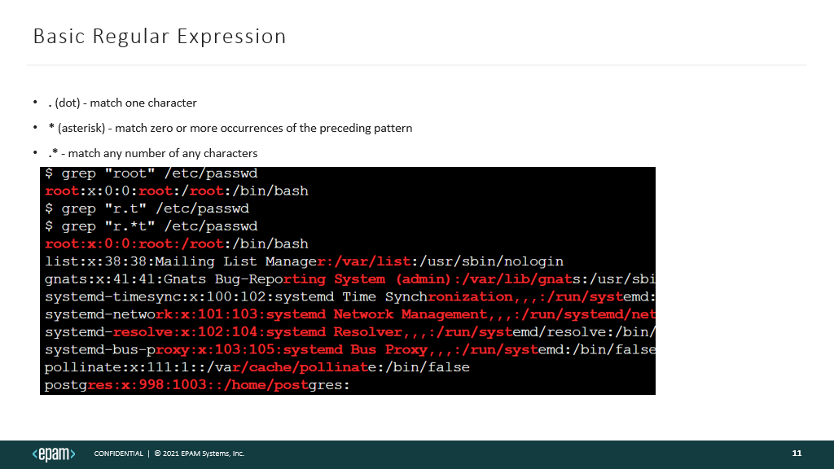
Links
https://www.youtube.com/watch?v=x2U9TsqSKmw – Youtube D. Ketov Polytechnical University https://www.youtube.com/watch?v=WVHC5Ggl7k4 – Youtube D. Ketov Polytechnical University
https://github.com/orasul/bash-scripts - some pure bash scripts
https://github.com/dylanaraps/pure-bash-bible - lot’s of pure bash scripts

Slide 30
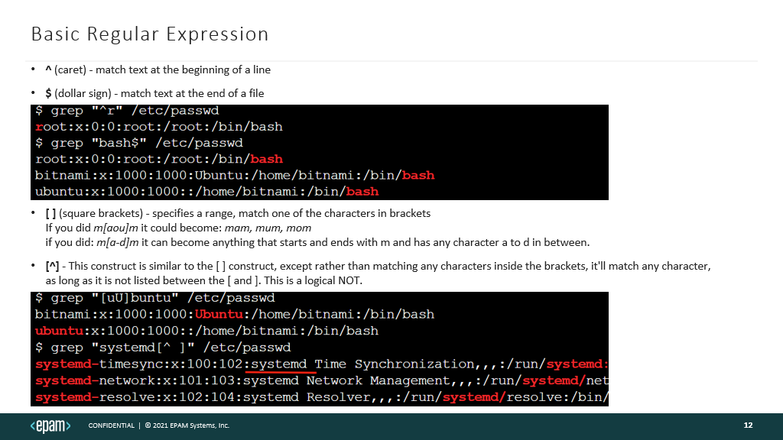
Links
https://www.youtube.com/watch?v=x2U9TsqSKmw – Youtube D. Ketov Polytechnical University https://www.youtube.com/watch?v=WVHC5Ggl7k4 – Youtube D. Ketov Polytechnical University
https://github.com/orasul/bash-scripts - some pure bash scripts
https://github.com/dylanaraps/pure-bash-bible - lot’s of pure bash scripts

Slide 31
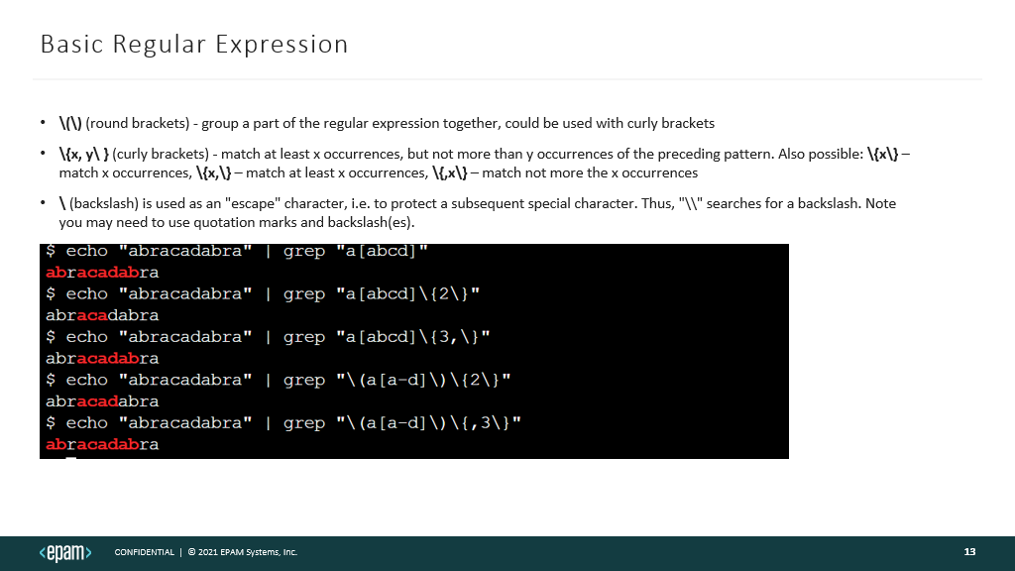
Links
https://www.youtube.com/watch?v=x2U9TsqSKmw – Youtube D. Ketov Polytechnical University https://www.youtube.com/watch?v=WVHC5Ggl7k4 – Youtube D. Ketov Polytechnical University
https://github.com/orasul/bash-scripts - some pure bash scripts
https://github.com/dylanaraps/pure-bash-bible - lot’s of pure bash scripts

Slide 32
The End

