Slide 1
Structuring before coding
C-36
Presented By: Priya Chadha

Slide 2
TARGET
To create a form- having a text box and a button.
To display the name on the screen after button click.
Count no. of players added.
Update game state in database.

Slide 3
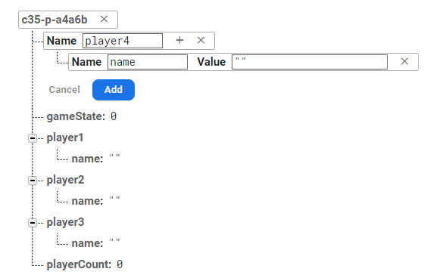
Database Structure be like..
Database Structure
gameState: 0
playerCount: 0
Player1:
Name: “ “
Player2:
Name: “ “
Player3:
Name: “ “
Player3:
Name: “ “
*Note: Copy-paste API code inside index.html (please refer to video on how to do it)

Slide 4
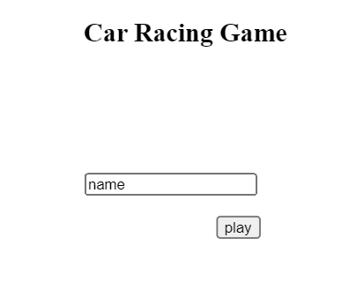
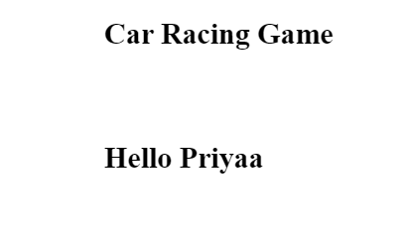
Creating a Form..
Heading
Car Racing Game
createElement()
Input Box
Enter your Name
createInput()
Button
Click on Play
createButton()
Greeting
Hello Name
createElement()

Slide 5
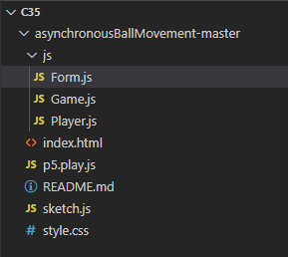
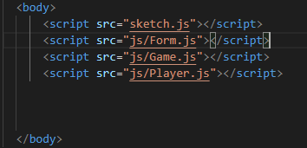
Pre-requisites
Create a new folder named js.
Add 3 files inside it- Form.js, Game.js, Player.js
Remember to update these in index.html as well(this time using folderName/fileName

Slide 6
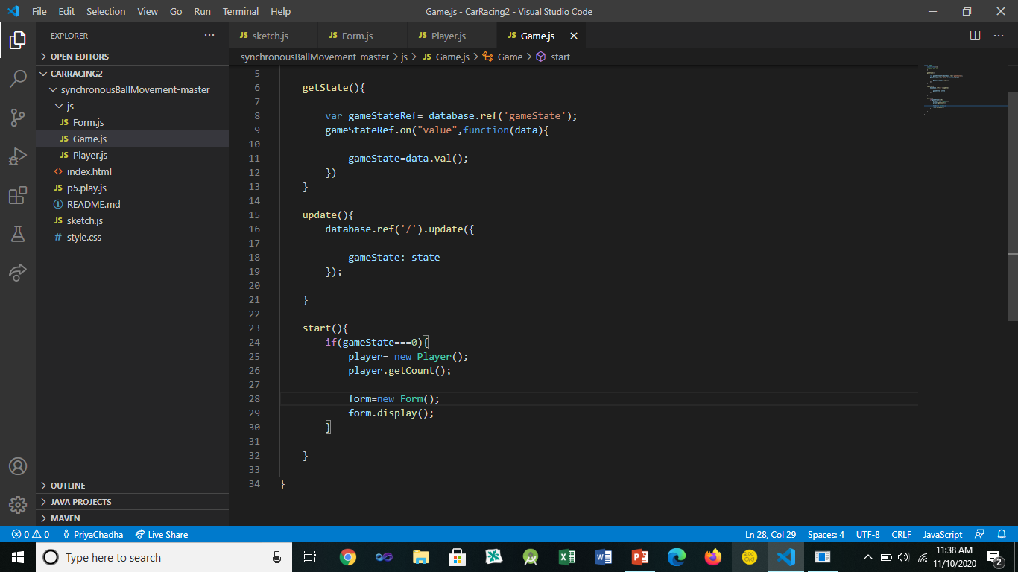
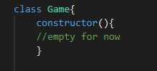
Game.js
constructor()
getState()
update()
Start()

Slide 7
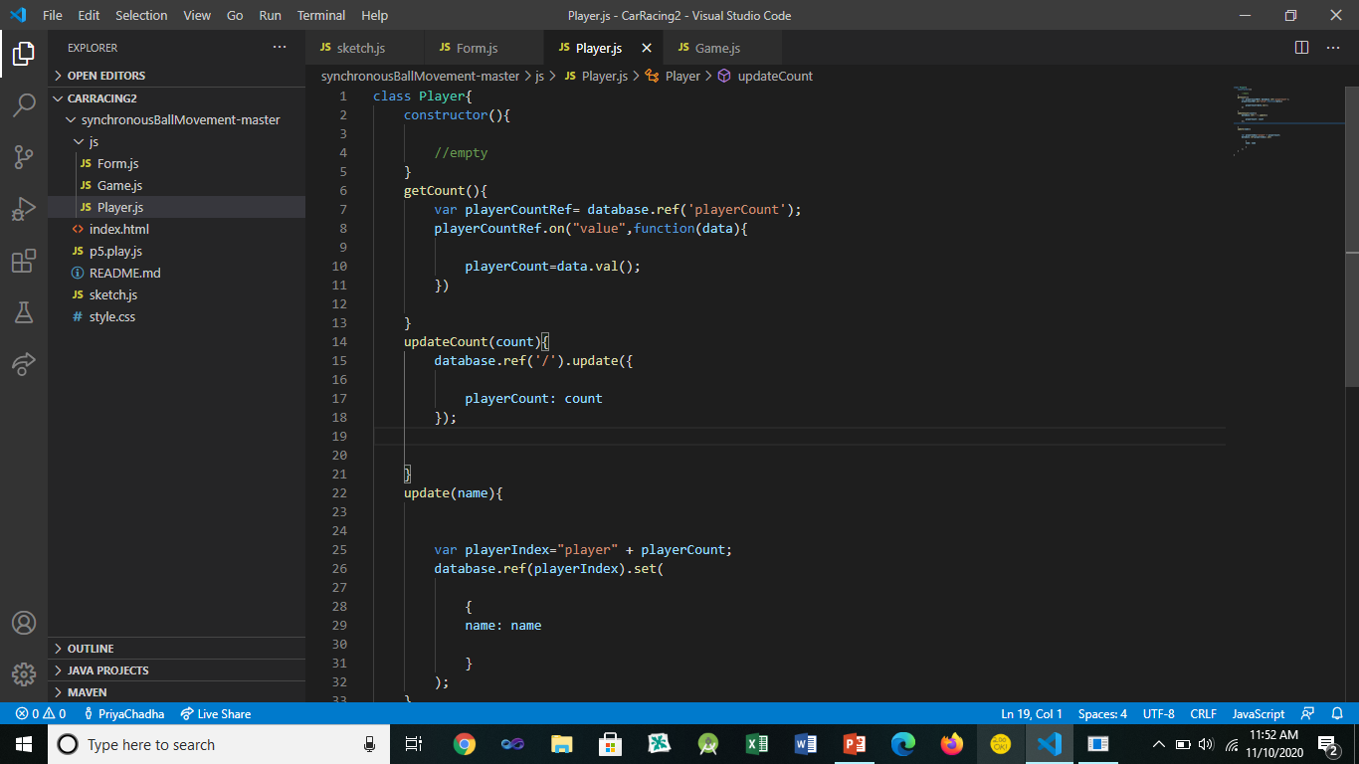
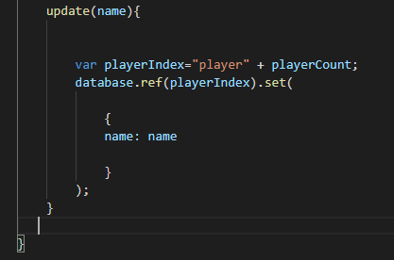
Player.js
constructor()
getCount()
updateCount()
update

Slide 8
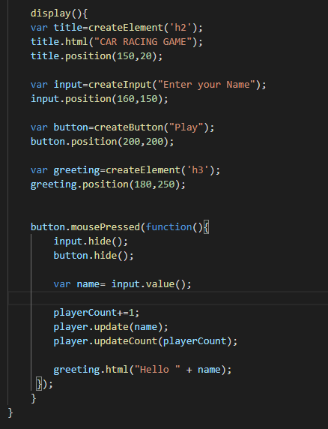
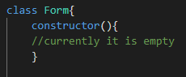
Form.js
constructor()
display()
button.mousePressed()

Slide 9
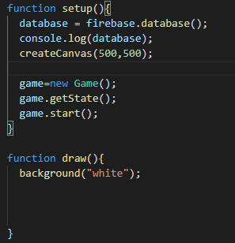
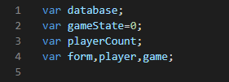
Sketch.js
Variables
function setup()
Function draw()

Slide 10
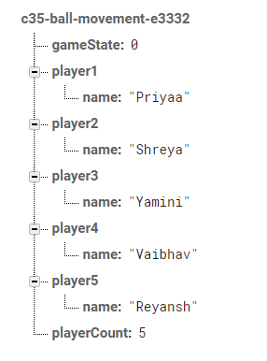
Final Output you can check by opening the real time database from firebase console.
If all values are updated here, you can consider your program as a successful implementation

Slide 11

Thanks for understanding with full DEDICATION. Try it yourself NOW. All the BEST.

