Slide 1
Capstone Project - 1
PlayStore App Review Analysis
Team Members
Priya Debrani Vikash Kumar

Slide 2

Let’s Start Analysis
Defining problem statement
Data Pre-processing
EDA
Data Visualization
Conclusion
Business Approach

Slide 3

Content :
Introduction
Problem definition
Description of Dataset
Data cleaning
Data Analysis & Visualization
Important points get after Data visualization
Work on Sentiment Analysis (2nd Data Set)
Conclusion

Slide 4
Data Pipeline
Data processing-1: In this first part we’ve removed unnecessary features.
Since there were nearly many columns with all null values.
Data processing-2: In this part, we manually go through each features selected from part 1, And encoded the categorical features ,changed the columns containing date time values .
EDA: In in this part, we do some exploratory data analysis (EDA) on the features selected in part-1 and 2 to see the trend.
Create a model: Finally, In this last but not the last part, we create models. Creating a model is also not an easy task. It’s also an iterative process. we show how to start with a with a simple model, then slowly add complexity for better performance.

Slide 5
Data Summary
There are two dataset: PlayStore Data & User Review data
1. Play Store Data:
App : The name of the app
Category : The category of the app
Rating : The rating of the app in the Play Store
Reviews : The number of reviews of the app
Size : The size of the app
Install : The number of installs of the app
Type : The type of the app (Free/Paid)
Content Rating :The appropriate target audience of the app
Genres : The genre of the app
Last Updated : The date when the app was last updated
Current Ver : The current version of the app
Android Ver : The minimum Android version required to run the app

Slide 6
Data Summary
2. User Review Data:
App : An app name
Sentiment : Sentiment given to an app by users ( i.e Positive,Neutral, Negative)
Sentiment Polarity :The polarity of sentiment measures how negative or positive the context is. In the data we have, the polarity ranges from +1(Positive) to -1(Negative).
Sentiment Subjectivity :The subjectivity of a sentiment is how likely that sentiment is to be based on data or factual information, versus personal opinions or public notions.

Slide 7
Variable Summary:-
App : The name of the app
Category : The category of the app
Rating : The rating of the app in the Play Store
Reviews : The number of reviews of the app
Size : The size of the app
Installs : The number of installs of the app
Type : The type of the app (Free/Paid)
Price : The price of the app (0 if it is Free)
Content Rating :The appropriate target audience of the app
Genres : The genre of the app
Last Updated : The date when the app was last updated
Current Ver : The current version of the app
Android Ver : The minimum Android version required to run the app

Slide 8
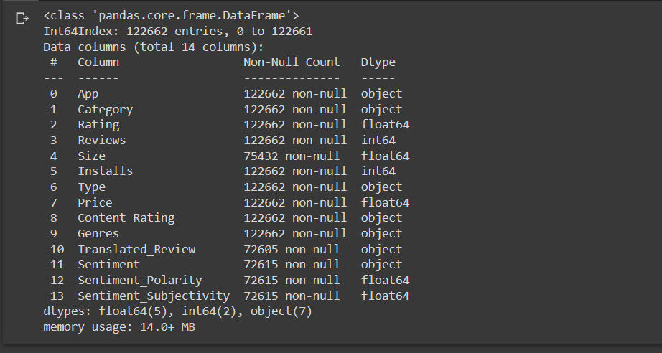
Dataset Info & Selection

Slide 9
Data Cleaning
Data cleaning is not just a case of removing erroneous data, although that's often part of it. The majority of work goes into detecting rogue data and (wherever possible) correcting it.
Data Cleaning Step:
Removing unwanted observation : Duplicate/redundant or irrelevant values deletion.
Missing Data handling : Fixing issue of unknown missing values.
Structural error solving : Fixing problems with mislabeled classes classes, datatype names of features, same attribute with different name etc.

Slide 10
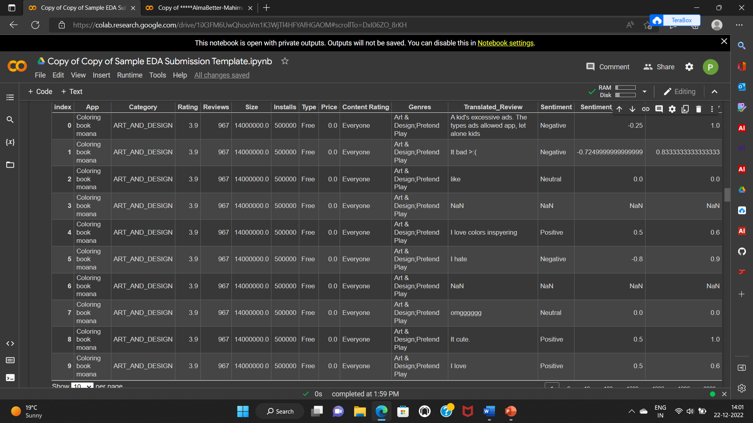
Preparing dataset for modeling

Slide 11
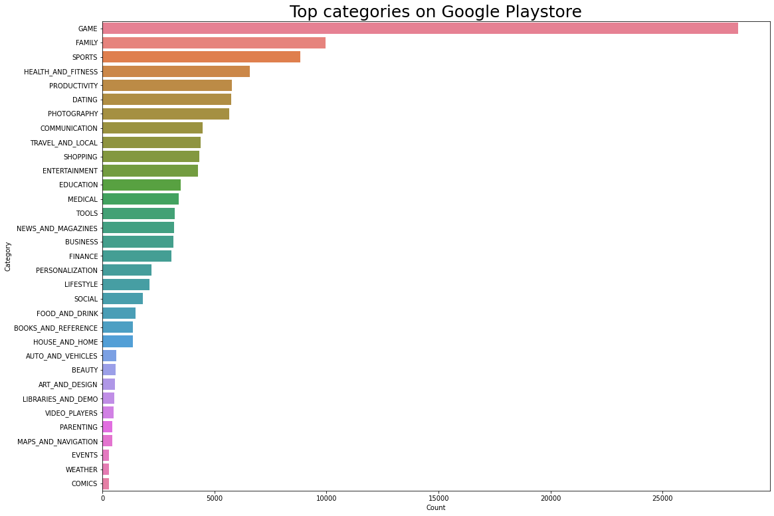
Top categories on google playstore
Insights:
There are all total of 33 categories in the dataset from the above output we can come to the conclusion that in the play store most of the apps are under Game & Family category and least are of Events, Weather & Comics Category.

Slide 12
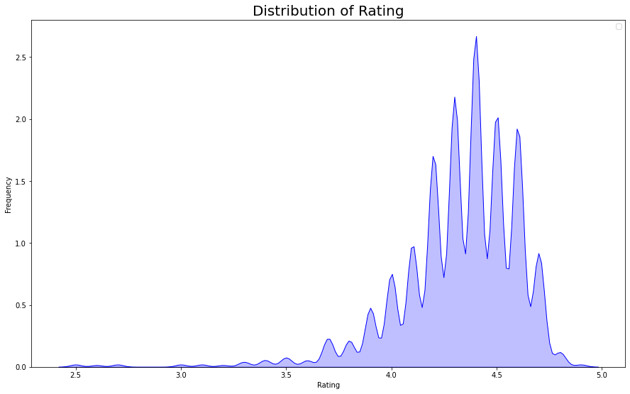
Distribution Rating:-
Insight :
we can come to the conclusion that most of the apps in the google play store are rated between 3.8 to 4.5.

Slide 13
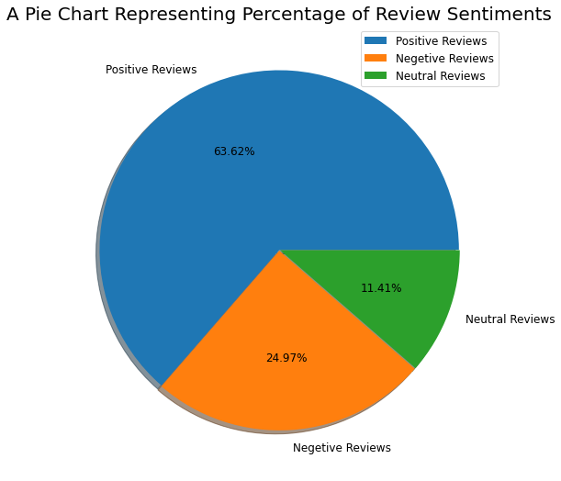
Insights :
The insights found from the above chart is that 63.62% reviews are positive reviews, 24.97% are negative reviews and 11.41% are neutral reviews.

Slide 14
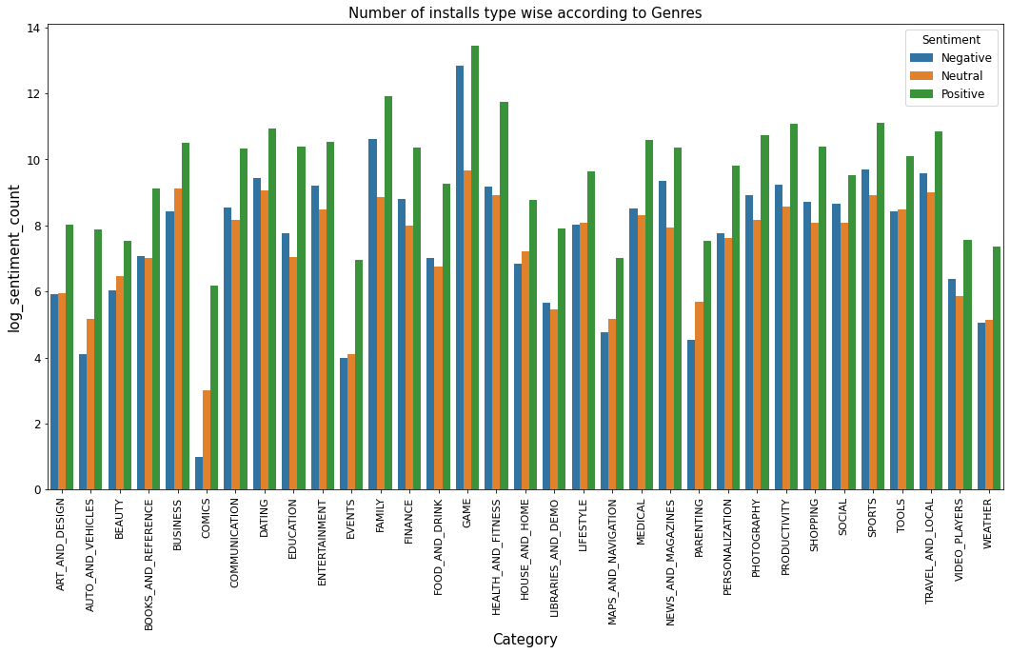
Number Of Installs Type Wise:-
Insights :
It can be concluded that the number of free applications installed by the user are high when compared with the paid ones.

Slide 15
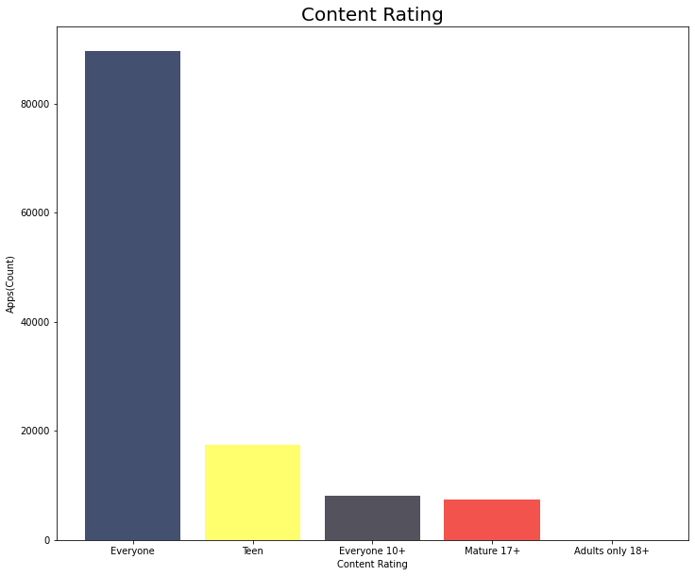

Slide 16
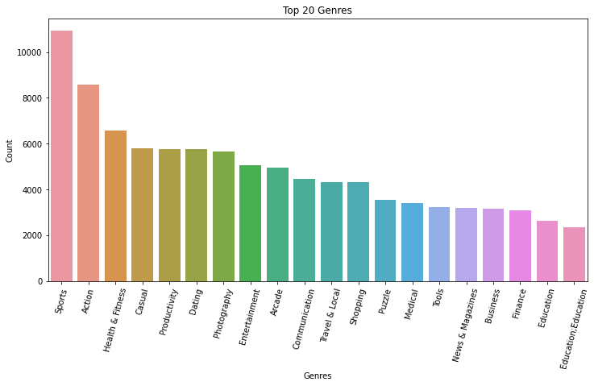
Top 20 Genres according to categories:-
Insights :
we can see that in the Sports, Action,Health & Fitness and Causal has the highest installs. In the same way by passing different category names to the function, we can get the top 20 installed apps.

Slide 17
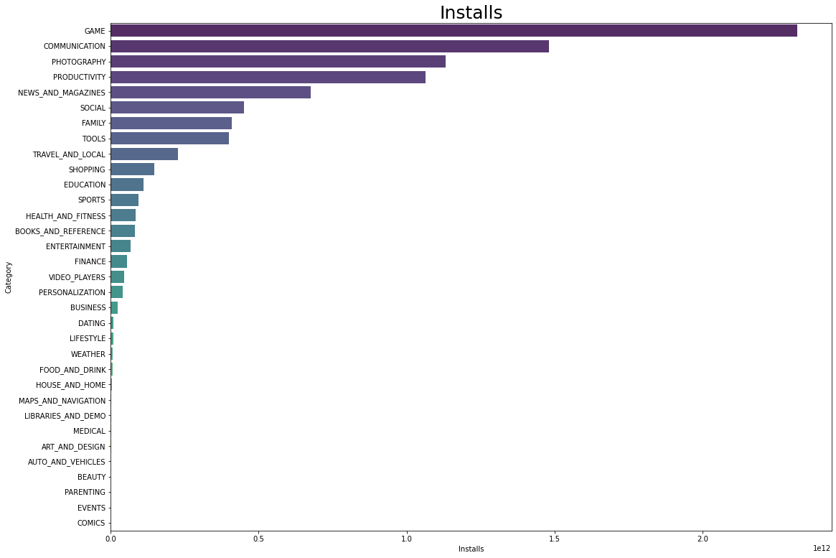
Top Installs:-
Insights :
It can be interpreted that the top categories with the highest installs are Game, Communication,Photography, Productivity News & Magazines, & Social.

Slide 18
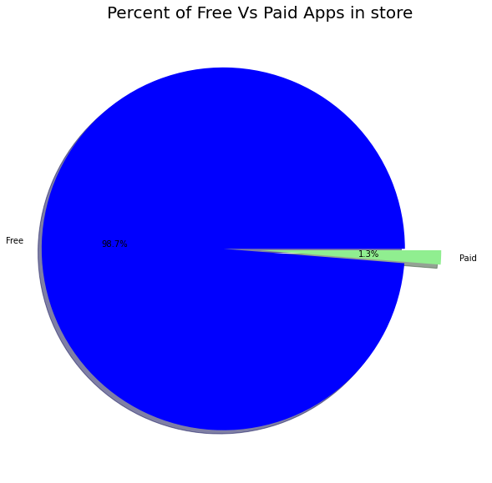
Percent of Free Vs Paid Apps:-
Insights :
we can see that 98.7%(Approx.) of apps in the google play store are free and 1.3%(Approx.) are paid.

Slide 19
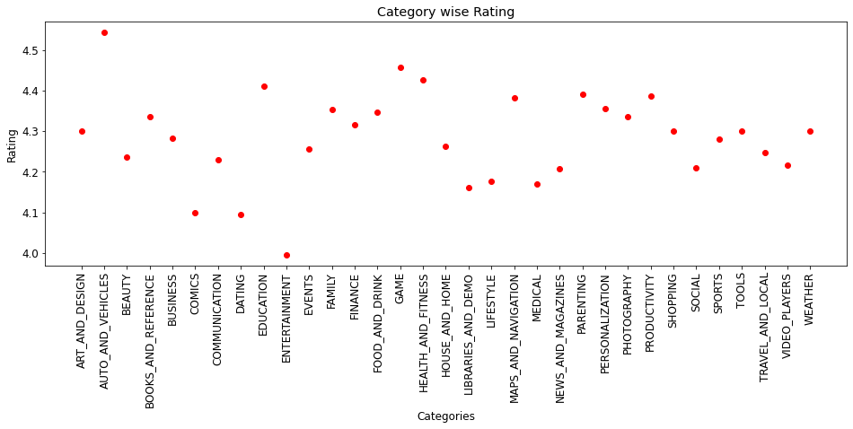
Category Wise Rating:-
Insights:
The insights found from the above data is that Auto_and_vehicles and Games category has gotten the best ratings.

Slide 20
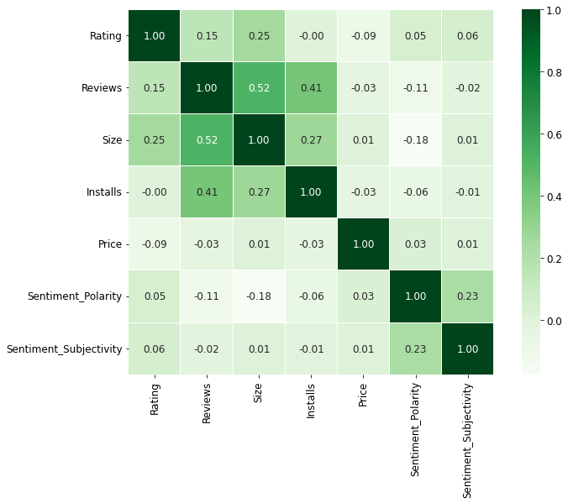
Heatmap
Insights :
A moderate positive correlation of 0.52 exists between the number of reviews and Size. This means that customers tend to download a given app more if it has been reviewed by a larger number of people. This also means that many active users who download an app usually also leave back a review or feedback. So, getting your app reviewed by more people maybe a good idea to increase your app's capture in the market!

Slide 21
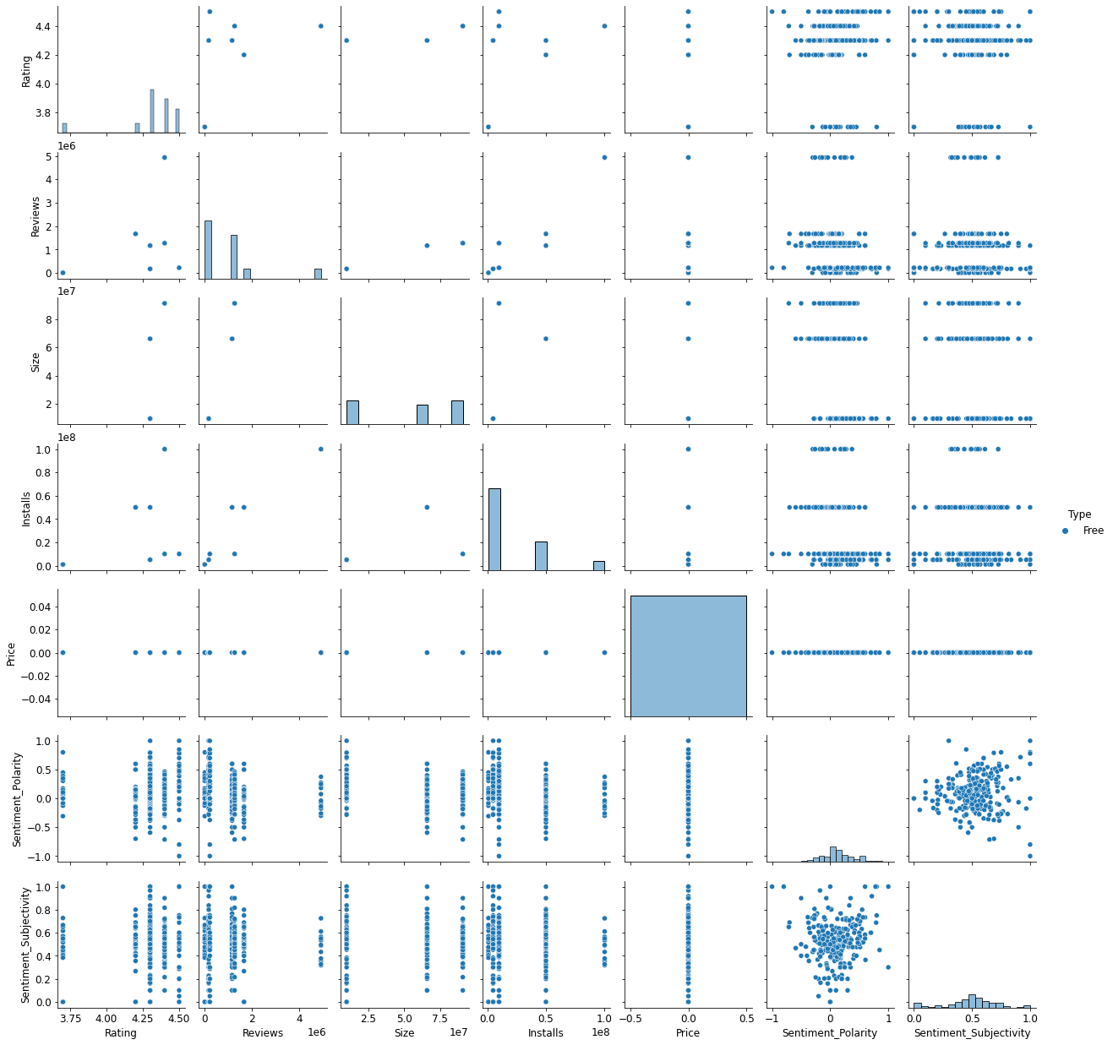
Pairplot

Slide 22
Conclusion
The Google Play Store Apps report provides some useful details regarding
he trending of the apps in the play store. As per the graphs visualizations
shown above, most of the trending apps (in terms of users' installs) are from
the categories like GAME, COMMUNICATION, and TOOL even though the
amount of available apps from these categories are twice as much lesser
than the category FAMILY but still used most.
The trending of these apps are most probably due to their nature of being able to entertain or assist the user. Besides, it also shows a good trend where we can see that developers from these categories are focusing on the quality instead of the quantity of the apps
Other than that, the charts shown above actually implies that most of the apps having good ratings of above 4.0 are mostly confirmed to have high amount of reviews and user installs.

Slide 23
The size and price shouldn't reflect that apps with high rating are mostly big in size and pricey as by looking at the graphs they are most probably are due to some minority. Furthermore, most of the apps that are having high amount of reviews are from the categories of SOCIAL, COMMUNICATION and CAME like Facebook, WhatsApp Messenger, Instagram, Messenger — Text and Video Chat for Free, Clash of Clans ,google apps etc. Even though apps from the categories like GAME, SOCIAL, COMMUNICATION and TOOL of having the highest amount of installs, rating and reviews are reflecting the current trend of Android users, they are not even appearing as category in the top 5 most expensive apps in the store . As a conclusion, we learn that the current trend in the Android market are mostly from these categories which either assisting, communicating or entertaining apps.

Slide 24
Some important points we get:
Average rating of (active) apps on Google Play Store is 4.17.
If we see individually app wise the communication app like facebook and
whatsapp get highly reviewed app it shown that people regularly active on
that and give their feedback also on that.
Medical and Family apps are the most expensive and even extend up to 80$.
Users tend to download a given app more if it has been reviewed by a large number of people.
More than half users rate Family, Sports and Health & Fitness apps positively. Apps for games and social media get mixed reviews, with 50 percent positive and 50 percent negative responses.

