Slide 1


SMART INDIA HACKATHON 2024
TITLE PAGE
Problem Statement ID - 1637
Problem Statement Title - Mobile App for Direct Market Access for Farmers
Theme - Agriculture, FoodTech & Rural Development
PS Category- Software
Team ID -
Team Name - NEXARIZE

Slide 2
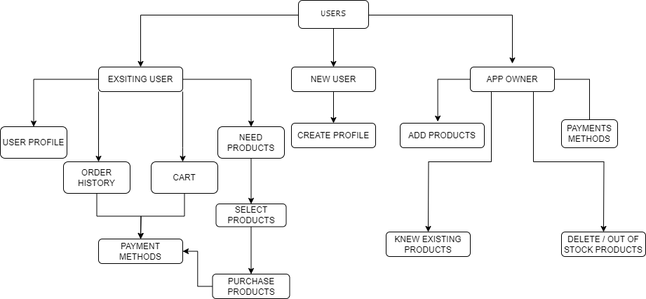
IDEA TITLE
NEXARIZE
It
It
A user friendly application for farmers and consumers that allows direct connectivity
Allows farmers to sell products without middle-man.
Consumers can buy products at fair enough price.
Simple User Interface can be used by anyone.
Direct communication and connection between the users through in-app chat / call option. Also Negotiating facility available.
Payments can be done via C.O.D / UPI / QR securely.

Slide 3
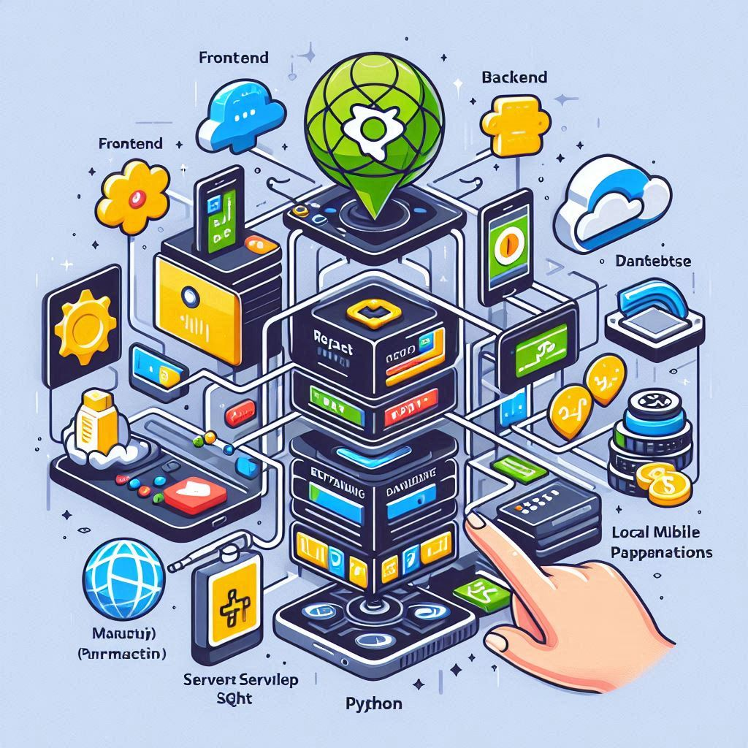
TECHNICAL APPROACH
NEXARIZE
It
It
TECHNOLOGY STACK
Frontend: React Native, Flutter or Kotiln.
Backend: Java (SpringBoot) or Python (Django) for handling server-side logic.
Database: MySQL or SQL for storing user data, product listings, and transaction records.
Payment Integration: Google Pay or local mobile payment solutions.
Real-Time Communication: WebSocket for real-time chat and notifications.

Slide 4
FEASIBILITY AND VIABILITY
NEXARIZE
It
It
FEASIBILITY
VIABILITY
Payment Integration: Integration of secure payment gateways like Stripe, PayPal, or local options (depending on the region) is crucial for handling transactions between farmers and consumers.
Internet Connectivity: The app should work efficiently in areas with limited or unstable internet connections. Offline features might be necessary.
Language Support: Local language support is essential to cater to farmers who may not be fluent in major languages.
User Engagement: The app's success depends on regular and active use by farmers. Features like real-time price information, direct access to buyers, and market insights can drive user engagement.
Customer Support: Offering robust customer support, particularly for farmers who may require assistance with using the app, will be necessary to ensure smooth operations.
Technological Risks: Assess potential risks related to technology adoption, such as low internet penetration in rural areas, cybersecurity threats, and technology obsolescence.

Slide 5
IMPACT AND BENEFITS
NEXARIZE
It
It
IMPACT
Reducing Inequalities: The app ensures all farmers, regardless of their background, have equal access to market opportunities, reducing social inequalities.
Community Engagement: The app enhances rural community collaboration by encouraging knowledge sharing and mutual support in using new technology.
Sustainable Showcase: The app boosts demand for eco-friendly products by highlighting farmers' organic and sustainable practices.
BENEFITS
Attracting Youth: The app makes farming profitable and digitally advanced, drawing younger generations back to agriculture, reducing rural-urban migration.
Boosting Local Economy: Direct purchases from farmers support small farms and strengthen rural communities.
Healthier Communities: Increased access to fresh, nutritious food can improve overall community health, reducing the incidence of diet-related health issues.

Slide 6
RESEARCH AND REFERENCES
NEXARIZE
React Native Official Documentation: https://reactnative.dev/
Flutter Official Documentation: https://docs.flutter.dev/
Kotlin Official Documentation: https://kotlinlang.org/docs/home.html
Spring Boot Official Documentation: https://spring.io/projects/spring-boot
Django Official Documentation: https://docs.djangoproject.com/en/5.1/
MySQL Official Documentation: https://dev.mysql.com/doc/
SQL Tutorial: https://www.w3schools.com/sql/
Benefits of Direct-to-Consumer Agricultural Apps: https://www.appsierra.com/blog/mobile-apps-for-agriculture
E-Commerce Application for Agricultural Products : www.ijariie.com

