Slide 1
REDUX
PriyaDHARSHINI

Slide 2
REDUX – CORE CONCEPTS
Redux is a predictable state container for JavaScript apps.
Three core concepts of Redux
  Store – holds the state of your application
  Action – describes the changes in the state of application
  Reducer-ties store and actions together

Slide 3
REDUX – PRINCIPLES
Three principles of Redux
  The state of your application is stored in an object tree within a single store.
  The only way to change the state is to emit an action, an object describing what happened.
  To specify how the state tree is transformed by actions, you write pure reducers.

Slide 4
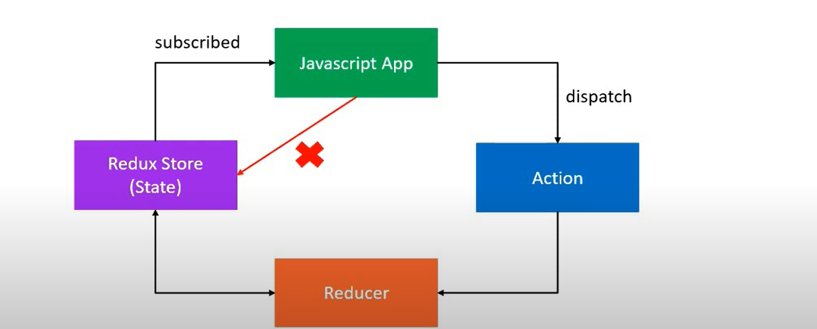

Slide 5
ACTIONS
Actions are plain javascript objects
It should have a type property which indicates the type of action begin performed
Action is the only way our application can interact with store

Slide 6
REDUCERS
It is a functions with accepts state and action as arguments and returns the next state of the application
  (PerviousState,action) => newState

Slide 7
STORE
dispatch(action) – To update a state .
getState() - returns the current state of the store.
subscribe(listener) - registers a function to be called on state changes

Slide 8
SUMMARY
Core concepts
Principles
Action
Reducer
Store
Multiple Reducer
Middleware(Redux-thunk)

