Slide 1

Data Visualization And Dashboard with Tableau
Priya Ganesan January 2024

Slide 2

PROJECT GOAL
"Leverage Tableau to conduct a comprehensive analysis of Canada's real estate landscape over the last 40 years, addressing key questions and providing valuable insights using graphs. Utilize appropriate visualizations to showcase trends, comparisons, and correlations within the data. Ensure accuracy in unit consistency and focus on extracting meaningful patterns, trends."

Slide 3
PROCESS OVERVIEW
Step 1: Leverage Excel and Python to explore and clean the data (remove null, remove special characters after JSON extract, etc)
Step 2: Import the Cleaned dataset into Tableau
Step 3: Developing visualizations and trends to explore the dataset to answer the questions

Slide 4
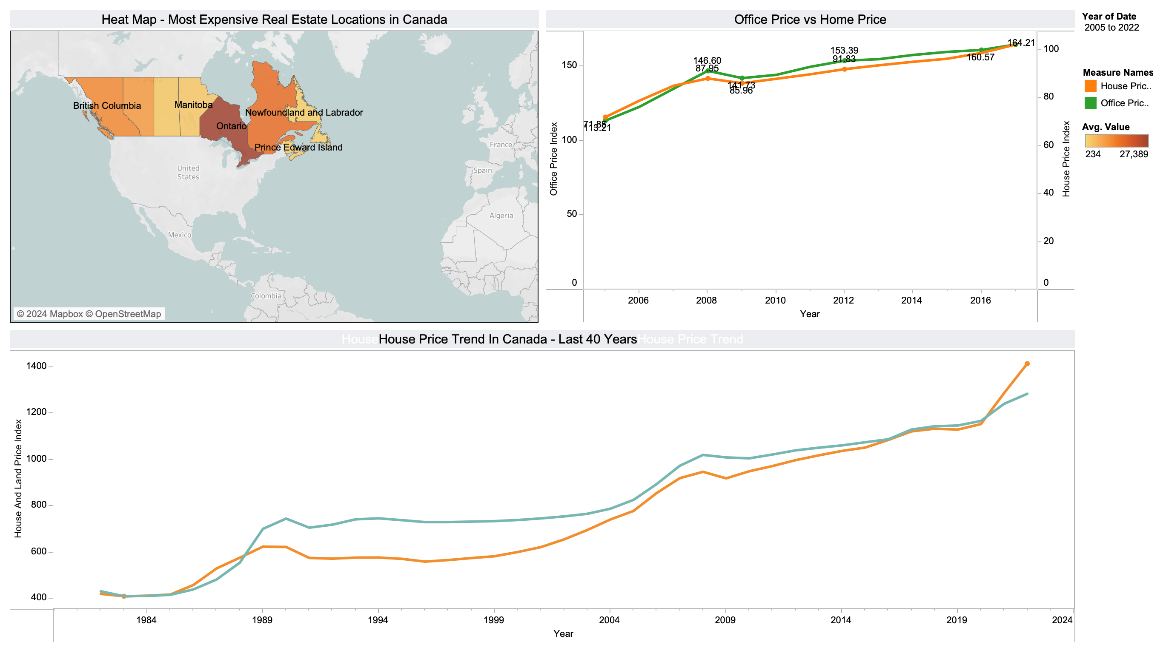
RESULTS
Geo Heat Map shows
Ontario, Newfoundland, and British Columbia lead in real estate with higher property values. Office spaces have been pricier than houses, with housing prices slowly catching up from 2016.
Housing Price Trend shows fluctuations, with significant increases in housing price in the 1980s to 1990s and from 2004-2010.

Slide 5
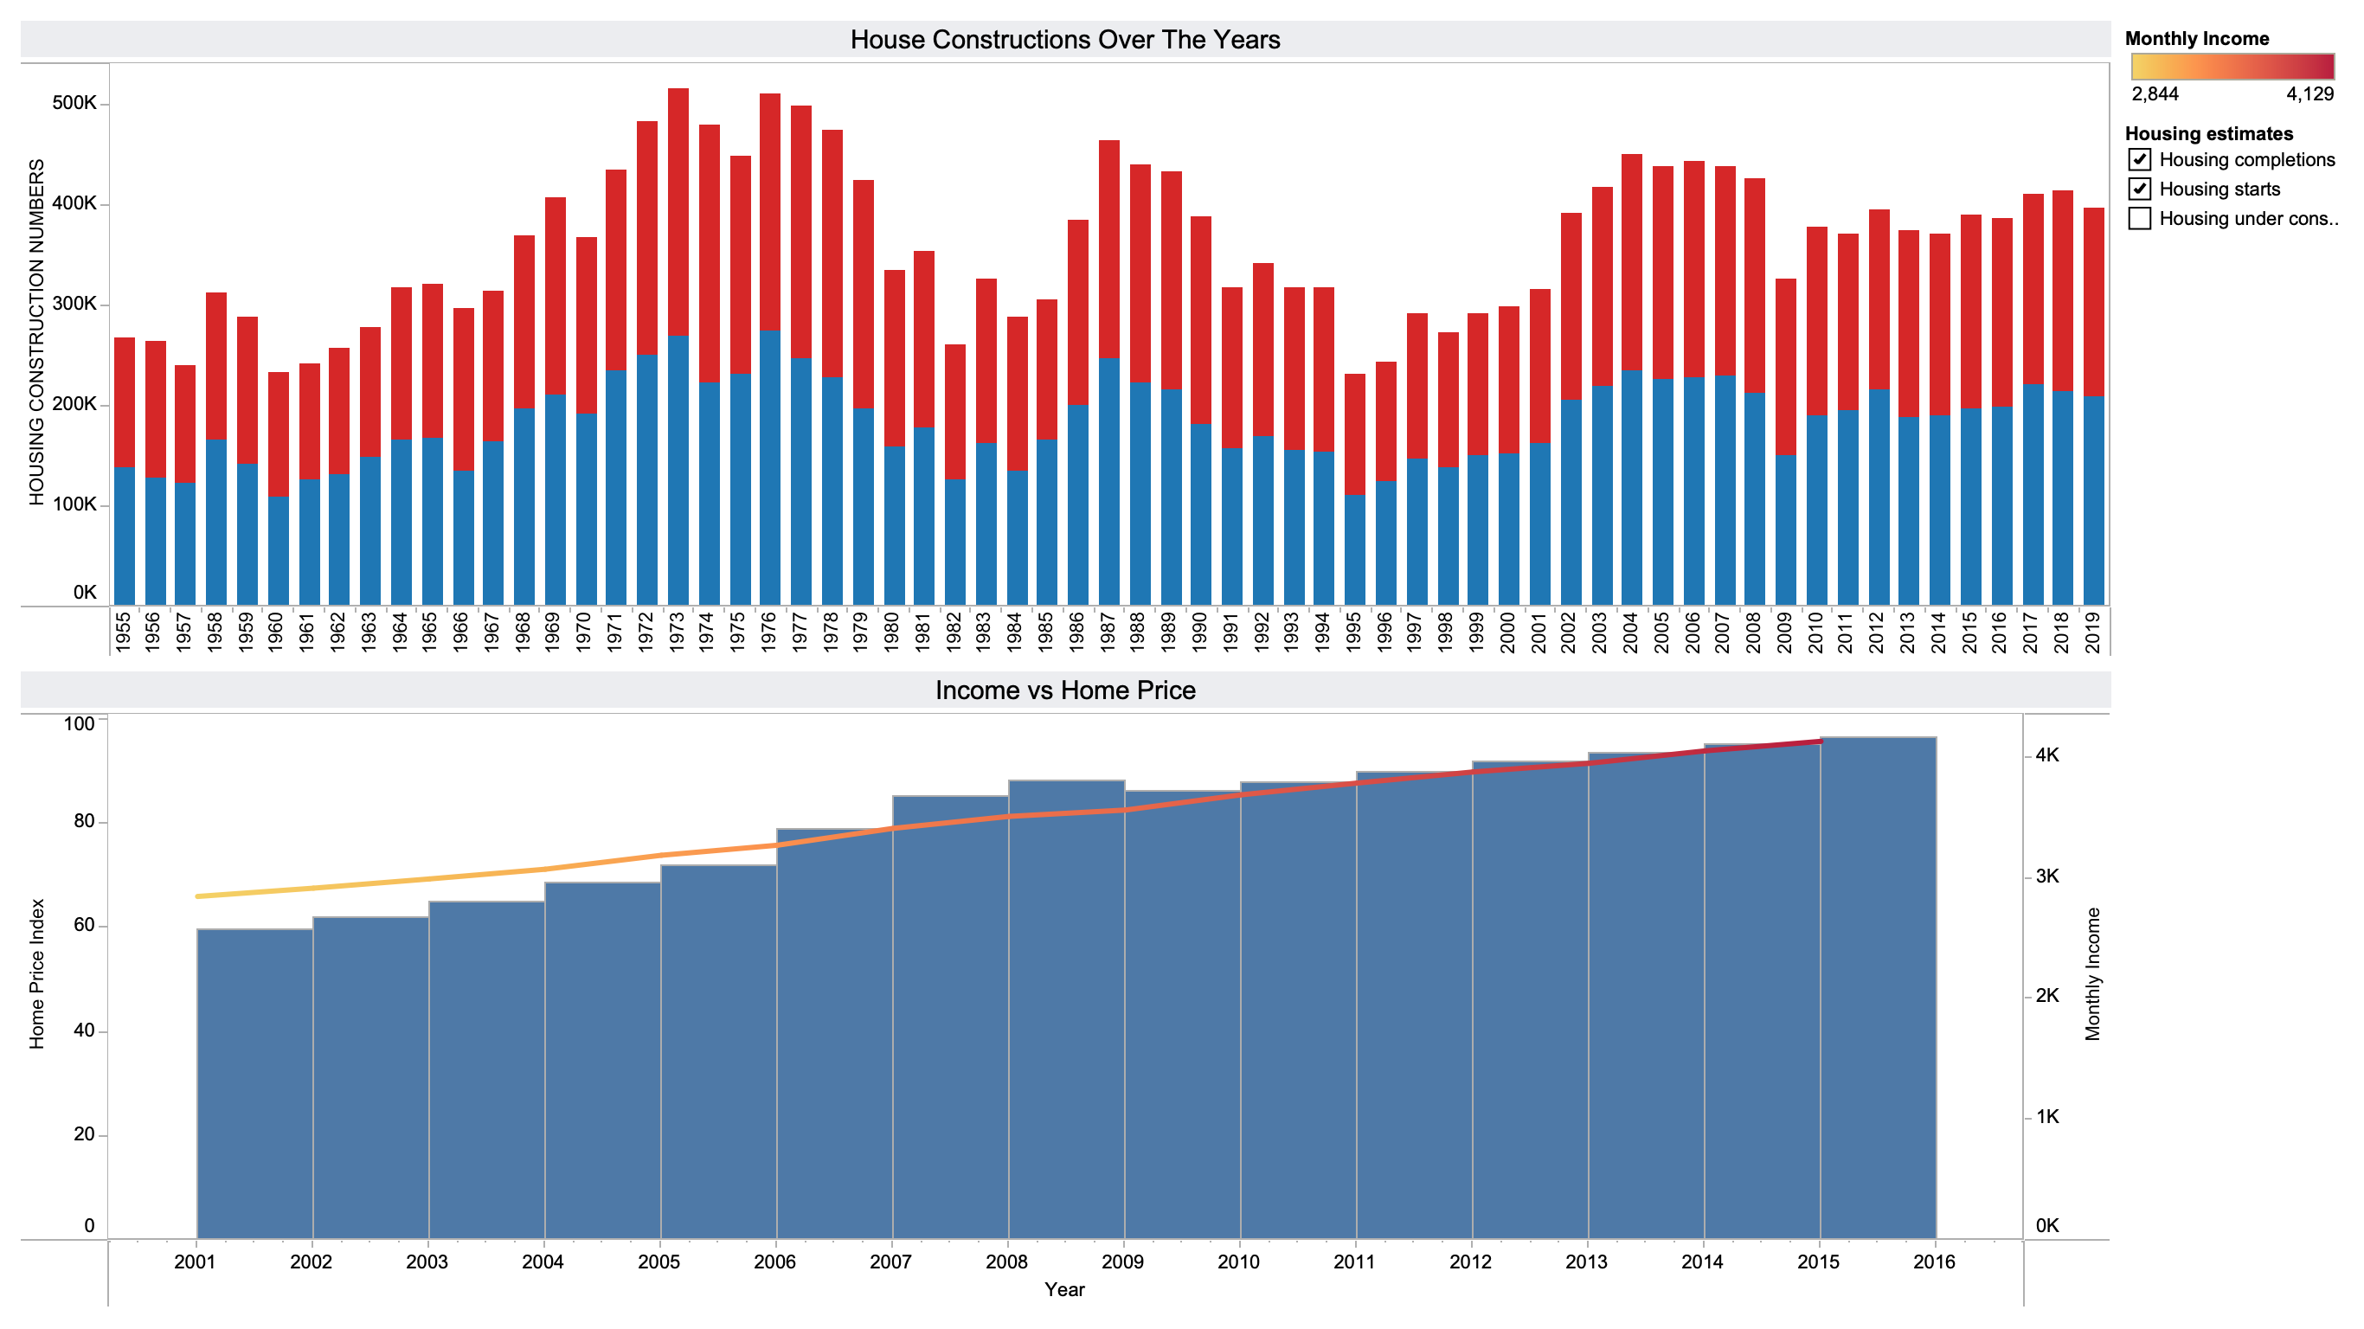
RESULTS
Housing Construction
1960s to the early 1980s, there is a noticeable rise in housing construction and completed projects.
House Affordability
declined after 2006, with a consistent increase in housing prices.

Slide 6
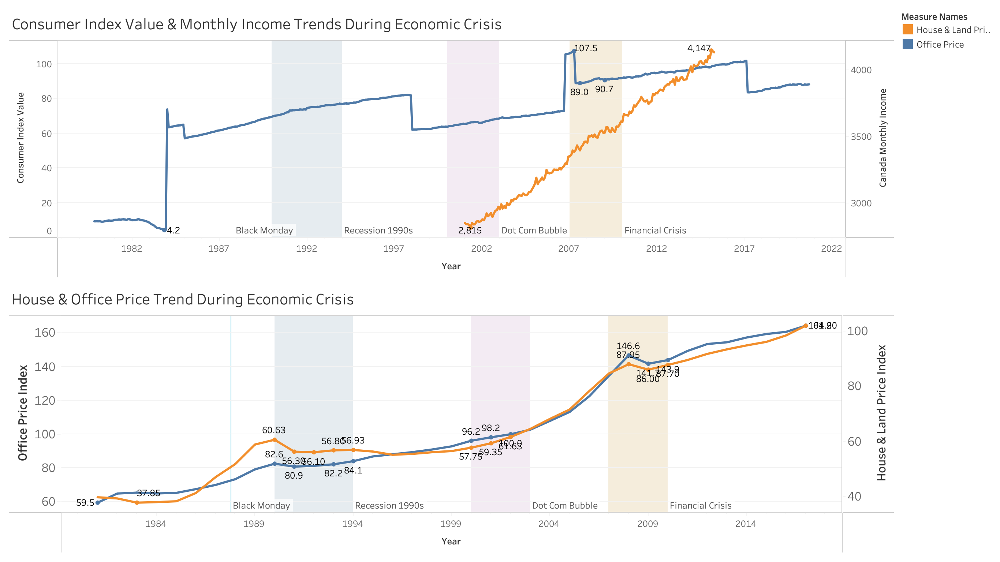
RESULTS
Impact of key economic crises in the last 40 years.
Real estate prices experienced a drop during the 1990 recession and the financial crisis.
Additionally, we can see a dip in Consumer Price Index during the financial crisis.

Slide 7
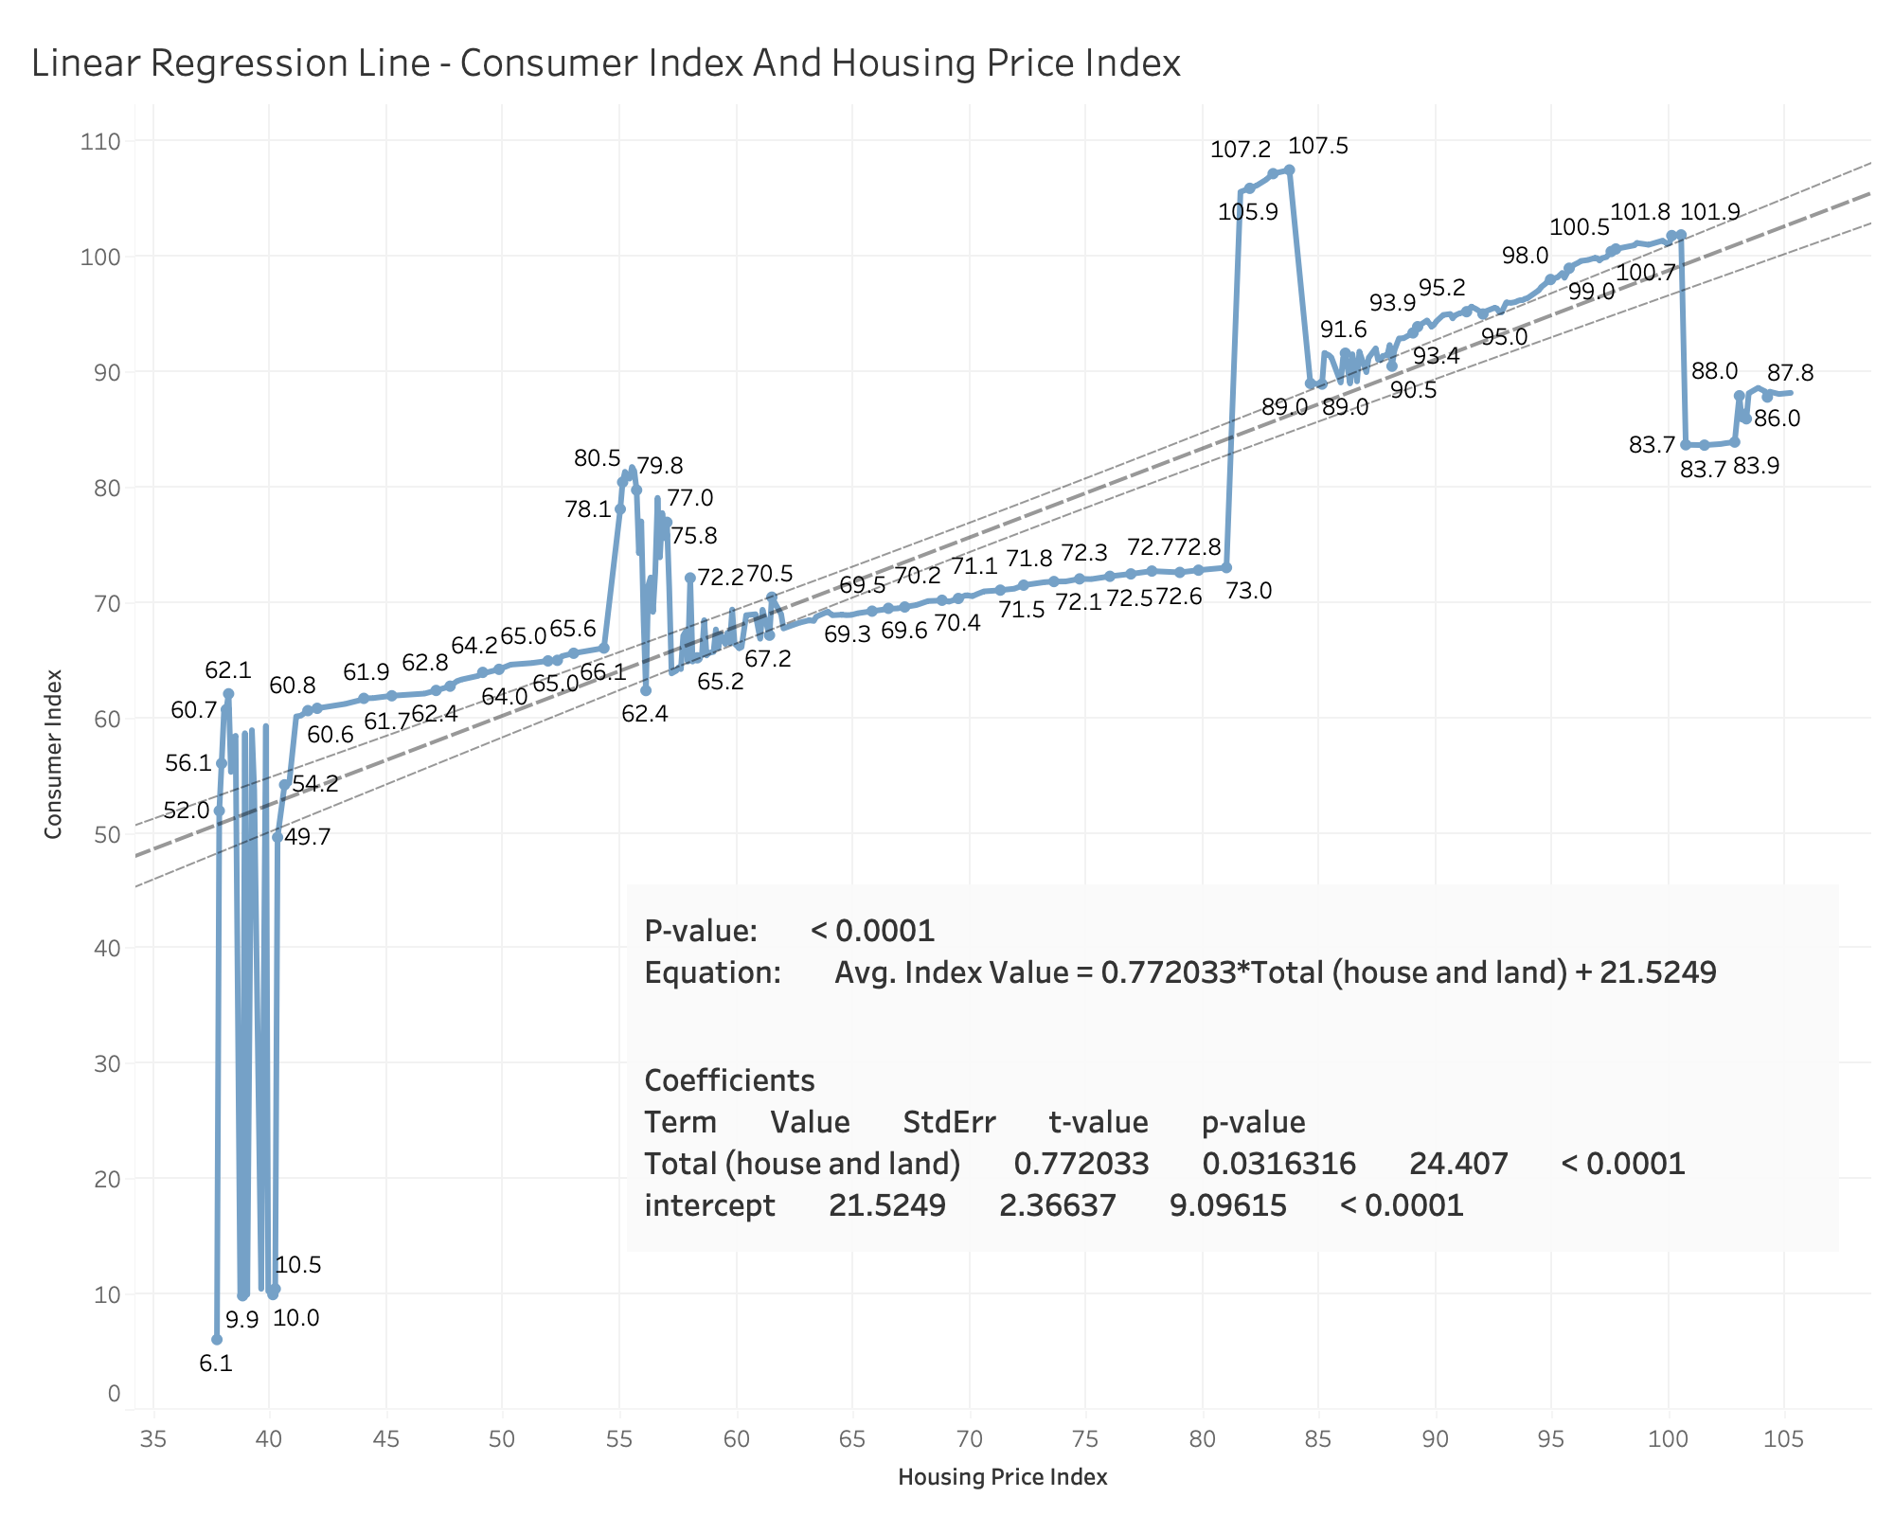
RESULTS
Tableau for model analysis
The trend line shows strong correlation, emphasizing the significance of Housing Price in predicting the Consumer Price Index Value(CPI)
Linear trend involving Housing Price and Consumer Price Index exhibited a significant correlation (p < 0.0001), with an R-Squared value of 0.70.

Slide 8
Challenges
Graph
Selecting appropriate visualization graph to convey the intended message
Data
Making sense of data, especially in the consumer index table

Slide 9
Future Goals
Demographic Impact: Investigate how factors such as population growth, age, and immigration patterns influence real estate trends
Comparative Analysis with Global Markets: Conduct analysis of real estate trends in Canada with other global markets and identify patterns.

Slide 10
Thank you for watching this presentation!

