Slide 1


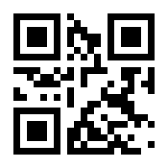
Having Technical Issues Nearby??
ScanAway
Report it to someone who can will help you
Scan One of these to Send Feedback on this Project Room

Slide 2
Having Technical Issues Nearby??
ScanAway
Report it to someone who can will help you
Scan One of these to Send Feedback on this Project Room

