Slide 1
PREDICTIVE ANALYSIS
OF ONLINE
NEWS POPULARITY
Predicting Social Network Popularity by Estimating the Number of Shares

Slide 2
PRESENTED BY: DATA DRIFTERS
SAI PRIYA MALLAMPATI
MOHAN ANANTA VENKATA PAVAN GAMIDI
AFRAH SHAIK
JAYAPRAKASH MAKKENA
GOWTHAM LEKKALA
HEMA EDAVALAPATI

Slide 3
TABLE OF CONTENTS
Business question
How could Business Analytics solve this problem
Our approach towards the problem
Exploratory Data Analysis highlights
Conclusion

Slide 4
BUSINESS QUESTION

Slide 5

•What factors most significantly influence the popularity of online news articles, and how can we predict and improve the number of shares these articles receive on social networks?
•How do different content channels affect audience engagement, and what strategies can we adopt to enhance sharing in these categories?
•Which types of articles or topics are more likely to be shared, and how can we align our content creation with these trends?

Slide 6
HOW COULD BUSINESS ANALYTICS SOLVE THE PROBLEM?

Slide 7
Business analytics can help identify the most influential factors affecting the popularity of online news articles, such as content quality, headlines, timing, and audience demographics. This analysis guides decision-making for content creators and marketers.
By leveraging data analytics, we can develop predictive models that estimate the number of shares an article is likely to receive. This aids in optimizing content creation strategies and resource allocation.
Business analytics can reveal how different content channels impact audience engagement. Analyzing these insights, we can develop tailored strategies to enhance sharing in each category.
Business analytics helps determine which article types or topics are more shareable, enabling content creators to align their strategies with popular trends, ultimately increasing the reach and impact of their content.

Slide 8
DATA SOURCE
The data is obtained from UCI Machine Learning Repository, and the data was meticulously curated by a team of four.
This dataset provides a comprehensive collection of attributes related to online articles published by Mashable over a span of two years.

Slide 9
OVERVIEW
Entries
There are 39,644
Entries in the dataset
Features
There are 61 Features and 1 Target variable
Target Variable
Column ‘Shares Category’.
Levels: ‘low’ or ‘moderate’ or ‘high’ or ‘viral’
Goal
Predictingthe popularity of the online news articles

Slide 10
OUR APPROACH

Slide 11
1. Data Preprocessing and Inspection: The dataset was initially subjected to data preprocessing, which involved cleaning and preparation to ensure data quality. Additionally, a thorough inspection of the dataset was conducted.
2. Categorical Transformation: The target variable was discretized into categorical classes to facilitate modeling.
3. Data Partitioning: The dataset was partitioned into separate training and testing sets, ensuring the integrity of the model evaluation process.
4. Imbalanced Data Mitigation: The class imbalance issue was addressed using the Synthetic Minority Over-sampling Technique (SMOTE) to balance the representation of classes in the dataset.

Slide 12
5. Model Fitting: Various classification models were trained and optimized to capture the underlying patterns within the data.
6. Performance Evaluation: Classification reports were generated for each model, providing comprehensive insights into their predictive capabilities.
7. Model Selection: The most suitable model was identified based on a thorough assessment of the classification reports and model performance metrics.

Slide 13
EXPLORATORY DATA ANALYSIS HIGLIGHTS

Slide 14

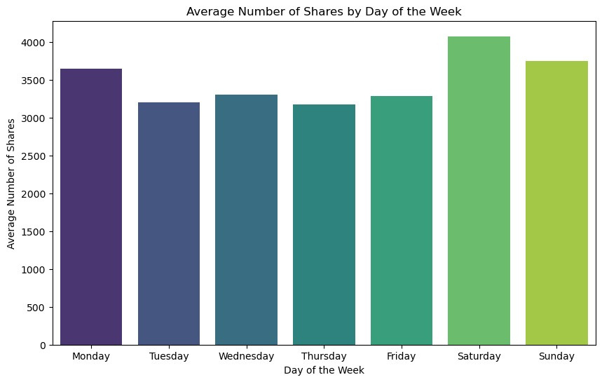
Average Number of Shares by Day of the Week
The day with the highest average number of shares is saturday .
There is a wide range of average number of shares across the different days of the week.
The variations in average number of shares for each day of the week may be due to several factors, such as news releases, people's behavior, and day-specific events.
The graph provides a useful overview of the average number of shares for each day of the week.
This information can be used to inform decisions about how to schedule content releases and how to promote content to ensure that it reaches the widest possible audience.

Slide 15
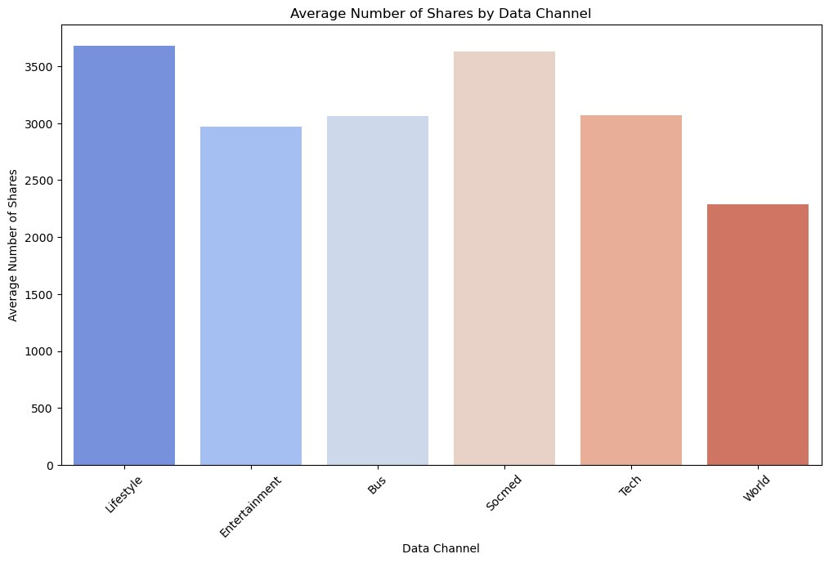
Average Number of Shares by Data Channel
The data channel with the highest average number of shares is Lifestyle , followed by Socmed.
The data channels with the lowest average number of shares are world .
There is a wide range of average number of shares across the different data channels.
There may be some factors related to the data channels that are influencing the average number of shares.
The graph provides a useful overview of the average number of shares for each data channel.
This information can be used to inform decisions about how to allocate resources and how to create content that is more likely to be shared.

Slide 16
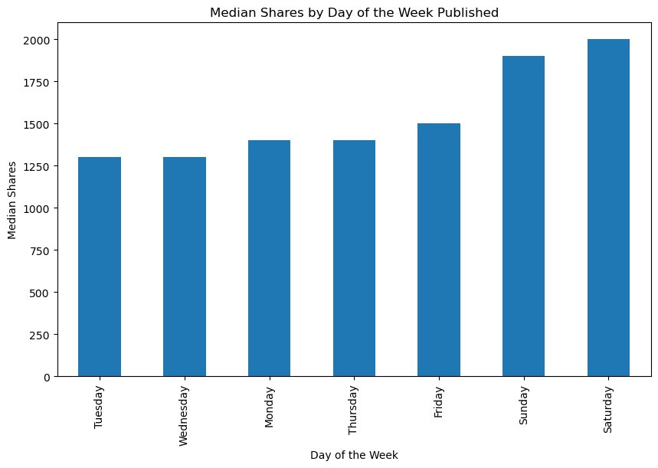
Median Shares by Day of the Week Published
The median number of shares is highest for articles published on Saturday.
There are a few possible reasons why the median number of shares is higher for articles published on weekends. One possibility is that people are more likely to share articles on weekends because they are more likely to be online and checking social media on that day. Another possibility is that articles published on weekends are more likely to be about trending topics or breaking news, which are more likely to be shared than articles about other topics.
Overall, this graph is a useful tool for understanding how the day of the week an article is published can affect the number of shares it receives.
By understanding this relationship, publishers can optimize their content strategy to maximize the chances of their articles being shared.

Slide 17
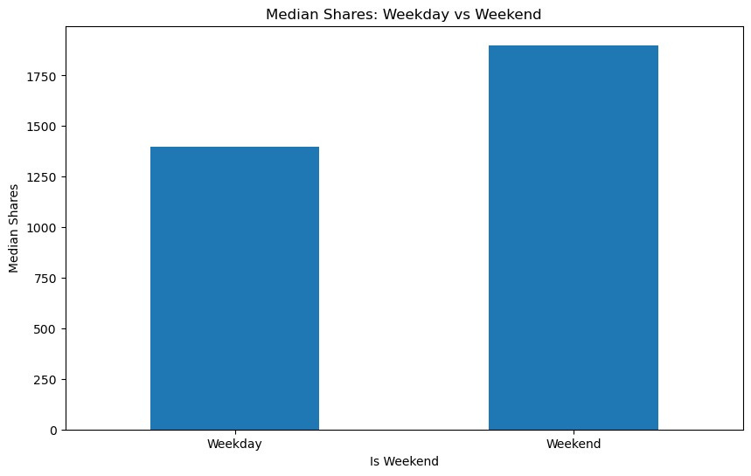
Median Share: Weekday vs Weekend
Articles published on weekends have a higher median number of shares than articles published on weekdays.
The median number of shares for articles published on weekends is over 1,750.
The median number of shares for articles published on weekdays is under 1,500.
Overall, the results suggest that articles published on weekends are more likely to be shared than articles published on weekdays.

Slide 18
Distribution and Boxplots of Top Positively Correlated Features With Shares

Slide 19
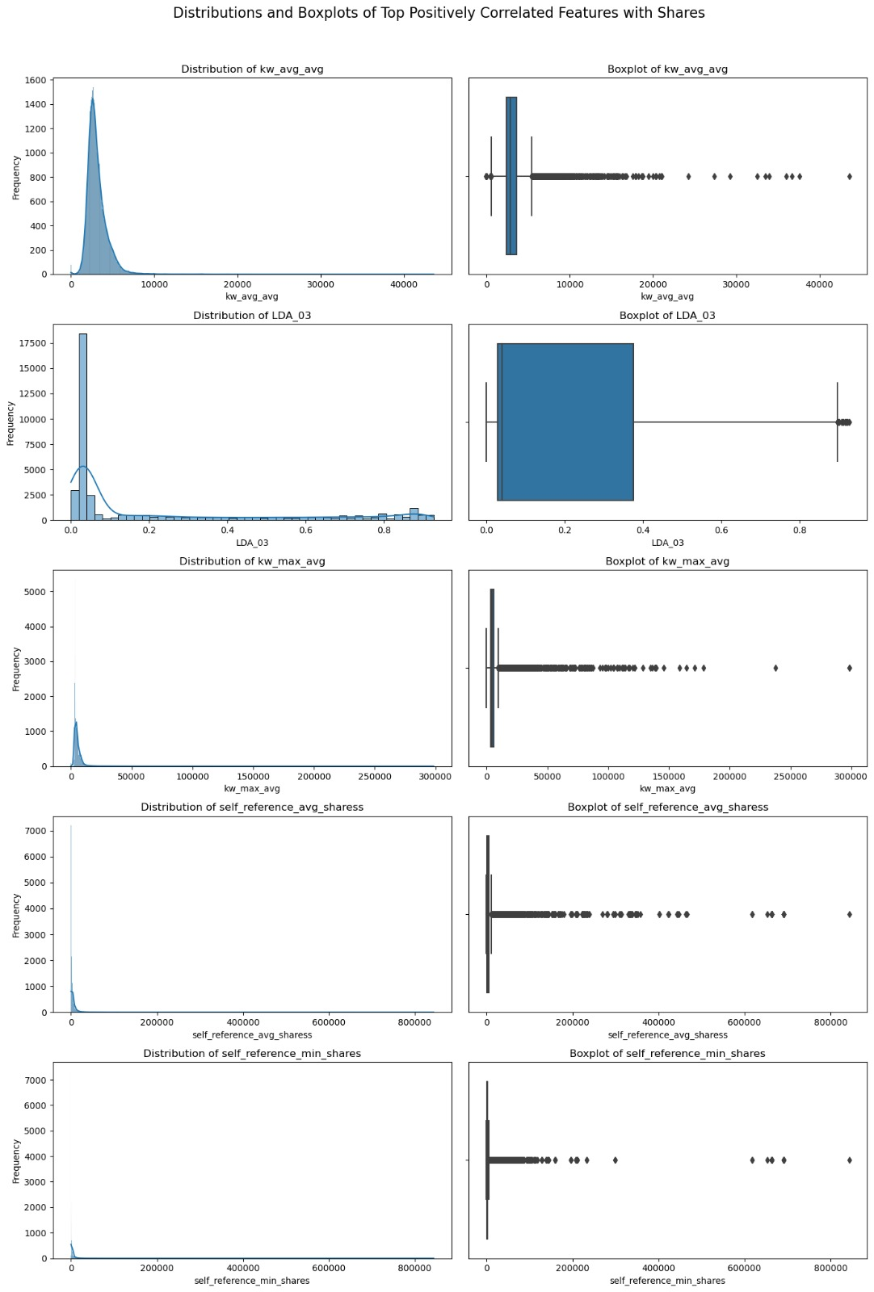

Slide 20

Models Implemented
Random Forest is an ensemble machine learning approach that combines numerous decision trees to create more accurate predictions for classification and regression tasks. It combines techniques such as bagging and feature randomization to improve model stability and reduce overfitting.
Random Forest
Predicting the likelihood of a binary result can be done statistically using logistic regression. This kind of supervised machine learning technique is applied to tasks involving classification.
Logistic
A decision tree is a graphical depiction of a succession of options or decisions used in machine learning to classify data or predict outcomes. It's similar to a flowchart that assists a model in making decisions based on input features.
Decision Tree
KNN is a machine learning technique that classifies or predicts data points in the training dataset based on the majority class or average of their "k" nearest neighbors' values.
KNN
Support Vector Classification algorithm is a supervised machine learning technique that can be applied to classify data. Being a type of kernel method, SVC converts the input data into a higher-dimensional space using a kernel function.
SVM

Slide 21
RESULTS
RANDOM FOREST
Accuracy : 50.3%
Precision : 48%
Recall : 50%
F1 Score : 47%
LOGISTIC REGRESSION
Accuracy : 44.5%
Precision : 44%
Recall : 45%
F1 Score : 44%

Slide 22
DECISION TREE
Accuracy : 40%
Precision : 39%
Recall : 39%
F1 Score : 40%
SUPPORT VECTOR CLASSIFIER (Linear kernel)
Accuracy : 26.2%
Precision : 7%
Recall : 26%
F1 Score : 11%
SUPPORT VECTOR CLASSIFIER (RBF kernel)
Accuracy : 47%
Precision : 45%
Recall : 47%
F1 Score : 45%
K NEAREST NEIGHBOUR
Accuracy : 41.4%
Precision : 41%
Recall : 41%
F1 Score : 41%

Slide 23
CONCLUSION

Slide 24
KNN Classifier (Accuracy: 0.414): The KNN model has relatively low accuracy. It struggles to distinguish between classes, especially the "Moderate" class. The precision, recall, and F1-scores for all classes are relatively low.
Decision Tree (Accuracy: 0.4): The Decision Tree model performs similarly to the KNN model, with low accuracy and relatively low precision, recall, and F1-scores for all classes.
Logistic Model (Accuracy: 0.445): The logistic regression model performs slightly better than KNN and Decision Tree, with higher accuracy. It shows better performance in classifying "Low" but struggles with the "Moderate" class.
Random Forest (Accuracy: 0.503): The Random Forest model, tuned using grid search, improves the accuracy compared to the previous models. It provides better precision, recall, and F1-scores for all classes compared to KNN, Decision Tree, and Logistic Regression.
Random Forest (Accuracy: 0.505): The Random Forest model, tuned using random search, achieves a similar level of performance as the grid search-tuned model, with slightly higher accuracy. It still provides the best performance among the models tested.
Linear Kernel (Accuracy: 0.262): The SVM model with a linear kernel performs poorly, with very low accuracy. It only classifies instances into the "Low" class and misclassifies all others.

Slide 25
RBF Kernel (Accuracy: 0.47): The SVM model with an RBF kernel, tuned using grid search, has improved accuracy compared to the models with lower performance. It shows reasonable performance in classifying all three classes.
Based on the provided accuracy and classification reports, it appears that the Random Forest model and the SVM model with an RBF kernel are the best-fit models among those tested. These models provide the highest accuracy and better precision, recall, and F1-scores for all classes compared to the other models.
However, to determine the best-fit model, it's essential to consider other factors such as the specific goals of the classification task, the importance of precision and recall for each class, and computational efficiency.

Slide 26
THANK
YOU

