Slide 1

ROCKBUSTER STEALTH
A strategy for the online video rental service
By Priya Patel

Slide 2
Agenda
Background and Objective
Analysis Findings
Overview of current movie rental service
Statistics of film rental
Sales figures vary between geographic regions
Customer presence by country
Customer count by payment
Top 5 customer by payment
Analysis by film category
Recommendation
By Priya Patel

Slide 3

Background and Objective
Rockbuster Stealth LLC is a movie rental company that used to have stores around the world.
Facing stiff competition from streaming services such as Netflix and Amazon Prime, the Rockbuster Stealth management team is planning to use its existing movie licenses to launch an online video rental service in order to stay competitive.
In the meeting we have been asked to answer some crucial business questions that we will try to address in this presentation.
By Priya Patel

Slide 4
Overview of Current Movie Rental Service
Our movie rental service company currently offer a selection of 1000 films exclusively in the English language, across 17 different categories in 109 country.
All films are released in 2006.
By Priya Patel

Slide 5
Statistics of Film Rental
Average
Rental Rate - $2.98
Rental Duration - 5 days
Film Length - 115.3 min
Replacement Cost - $19.98
Minimum
Rental Rate - $0.99
Rental Duration - 3 days
Film Length - 46 min
Replacement Cost - $9.99
Maximum
Rental Rate - $4.99
Rental Duration - 7 days
Film Length - 185 min
Replacement Cost - $29.99
By Priya Patel

Slide 6
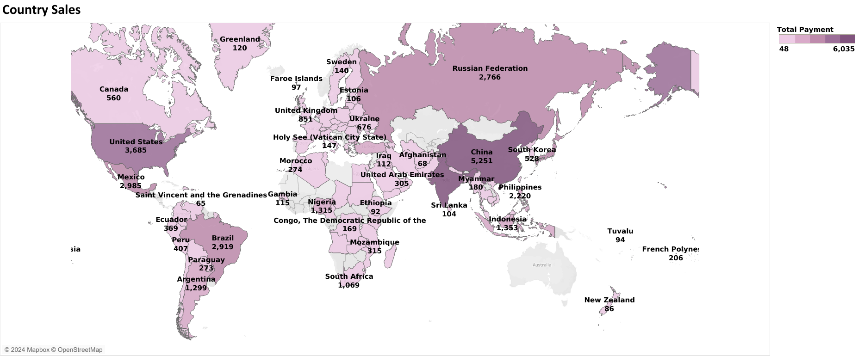
Sales Figures vary between Geographic Regions
Sales shown variation across different geographic regions.
High figures observed in certain countries within Asia and America.
By Priya Patel

Slide 7
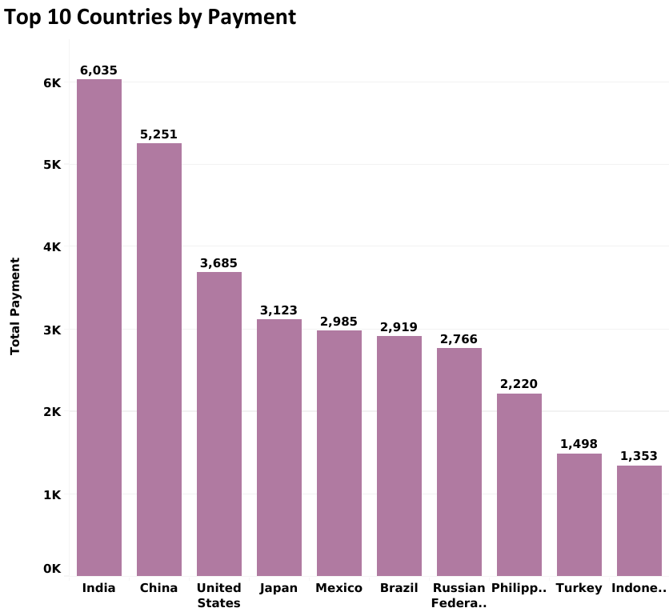
Customer Presence by Country
Our current rental service has the largest market base in India and China.
Expanding our movies selection to include local languages in India and China.
By Priya Patel

Slide 8
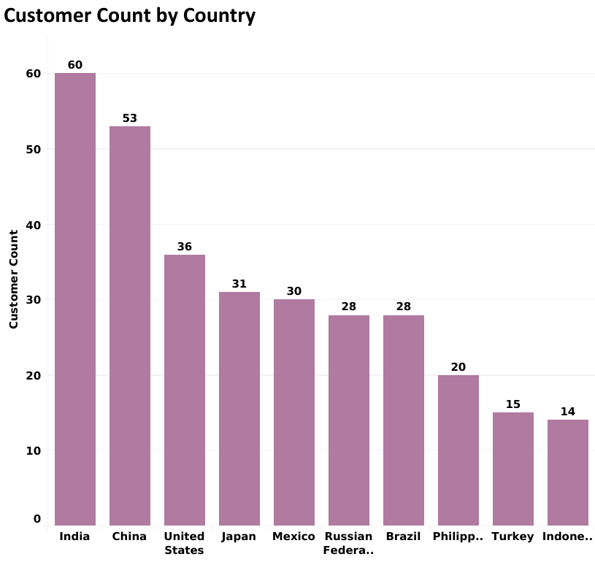
Customer Count by Payment
Our current rental service has the highest customer in India and China.
India and China customers make highest revenue.
By Priya Patel

Slide 9
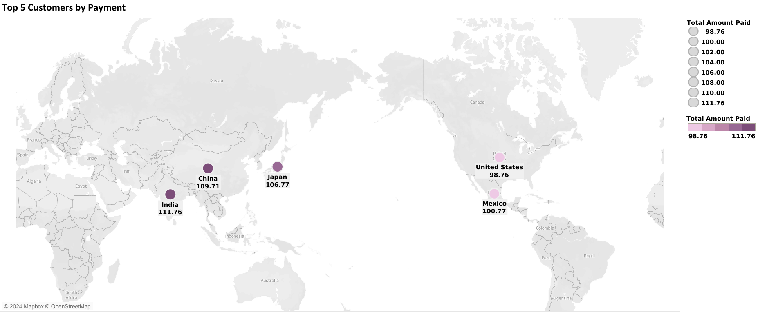
Top 5 Customer by Payment
These are the top 5 customers from the top two countries, India and China.
Asia has highest customers.
By Priya Patel

Slide 10
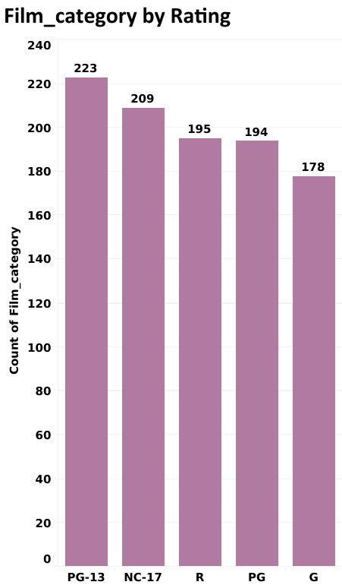
Analysis by Film Category
PG-13 contributed the most to the revenue.
PG-13 has the most popular film rating.
By Priya Patel

Slide 11
Recommendation
India, China, and America which the largest customer bases.
Expanding our movie selection to include local languages in India and China, has the potential to broaden our customer base in these two countries.
These results suggest the allocating more marketing resources to Asia and America.
These results suggest focusing film selection and marketing resources on the genres, along with the PG-13 rating.
To reduce costs on movie licenses, consider discontinuing current movies with minimal or no rental history. This approach ensures a more efficient allocation of resources by focusing on movies that have a higher rental demand.
By Priya Patel

Slide 12
THANK YOU!
By Priya Patel

