Slide 1
Category review: Chips
June 2020
Retail Analytics
Brand note: If client logo is not required, use alternate title page layout right click slide thumbnail > Layout > Title

Slide 2
Notes:
To view Privacy video explaining how important data privacy is to Quantium, please click here: https://www.youtube.com/watch?v=Zq1QDAkoRzU
or here Q:\Company Reference\Brand & Design\Brand videos\Q Privacy.mp4
At Quantium, we believe that data is the behavioural footprint of humanity and that it has to be treated with the utmost care and responsibility.
Histories, attitudes, indeed lives are stored within it in ways that aren’t always apparent – and that’s what makes its potential so powerful.
To work with it responsibly, sensitively, we set ourselves the highest data privacy protection and governance standards.
We have spent 17 years perfecting privacy-by-design and secure-by-design principles. Central to this is not holding any personally identifiable information about people –
we neither receive it, and put the necessary protections in place to be unable to decipher it.
Every aspect of handling data is safeguarded: from its de-identification, to its encryption – data security is paramount and of the highest grade.
We pride ourselves on gaining the trust of iconic organisations around the world through years of securely working with their data,
and in turn the trust that builds with their stakeholders.

Slide 3
Executive summary
01
Task 1
The sales increase in the month of December before the Christmas (except the day itself). So, these are the crucial times.
Kettle is the most popular brand followed by Smiths, Doritos and Pringles. So, they need to be in stock. Also 175 gram packets are the most sold.
Mainstream young singles/couples, retirees are the most common customers and also account for a great share of chips sale.
Budget older families have the maximum contribution to sales.
02
Task 2
One control store was selected for each trial store and the values of metrics were compared in trial and pre trial period.
The results for trial stores 77 and 88 during the trial period show a significant difference in at least two of the three trial months but this is not the case for trial store 86.

Slide 4
01
Customer Analysis

Slide 5
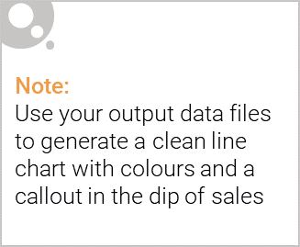
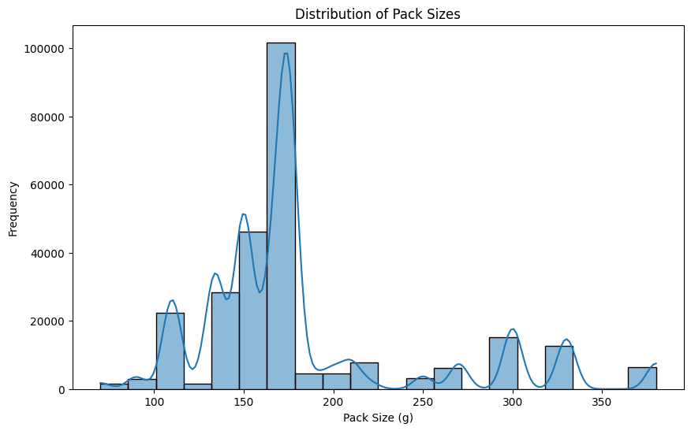
Distribution of Packet size
The sales have a sudden hike n the month of December before the Christmas (except the day itself). Whereas there is no sales on 25^{th.}

Slide 6
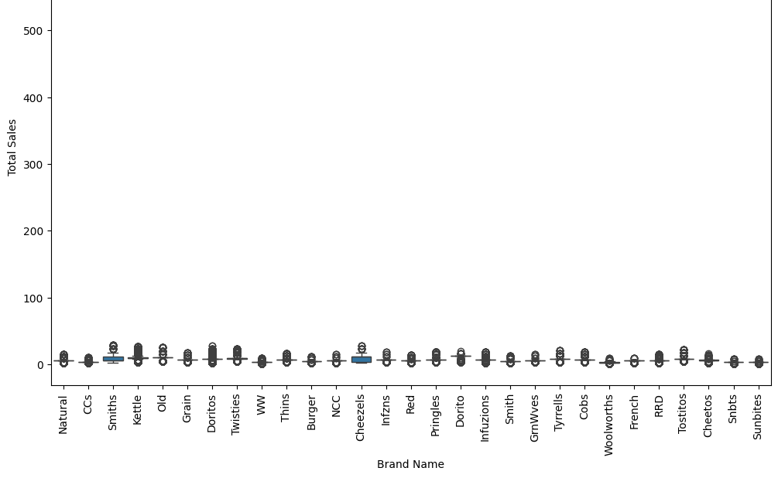
Total Sales by brand name

Slide 7
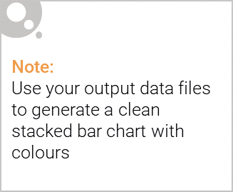
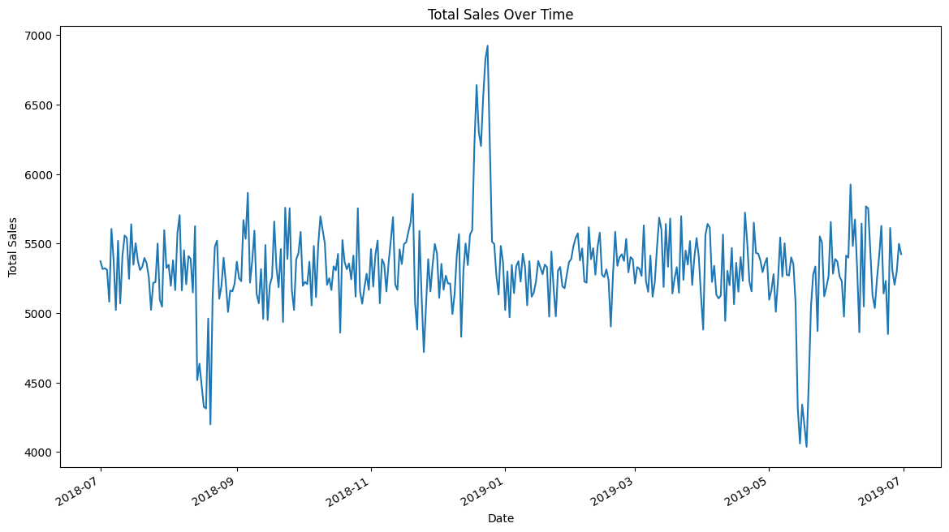
Editable (delete this)
Total Sales Over Time:
It can be clearly visualized that mainstream young singles/couples, retirees are customers contributing the most

Slide 8
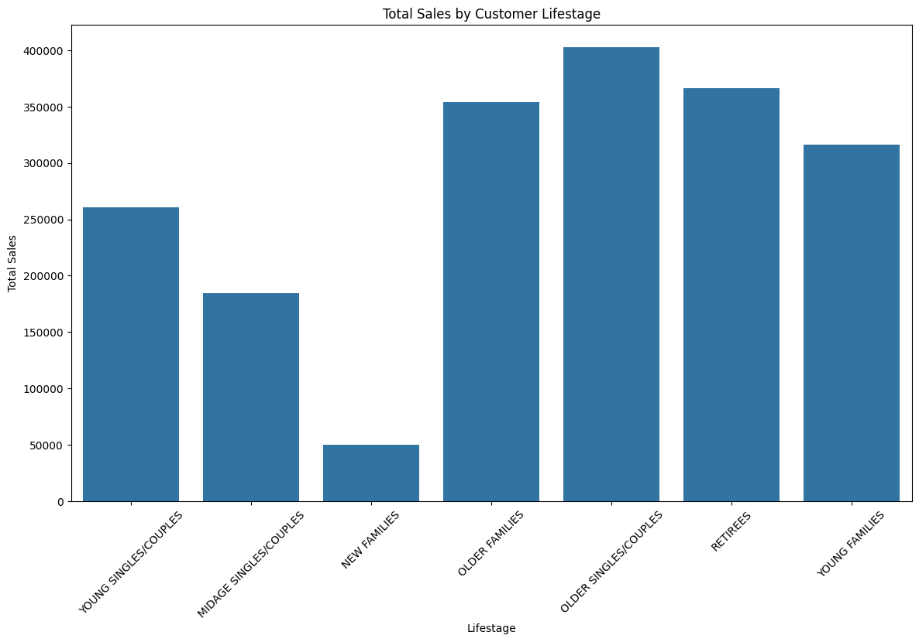
Total Sales By customer Lifestage
It can be seen that retirees, young singles/couples, retirees are the most common customers

Slide 9
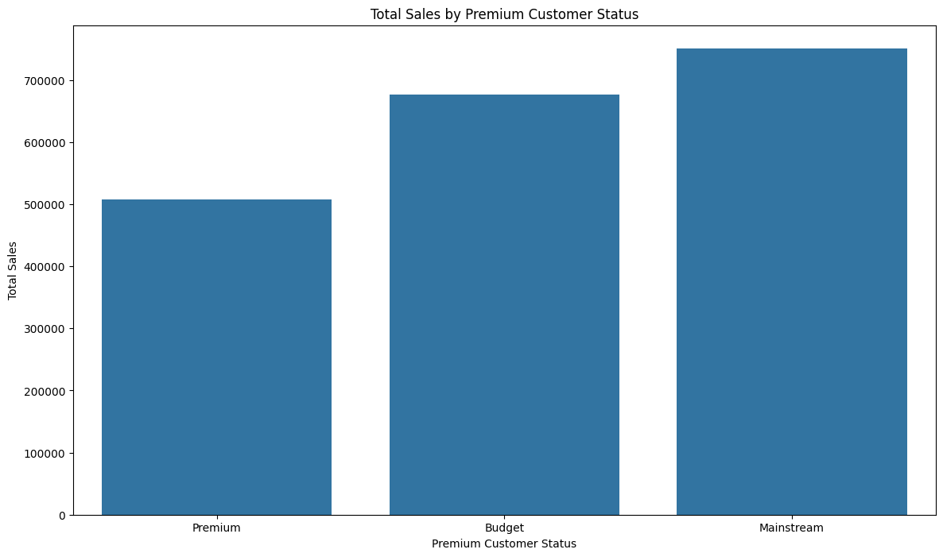
Total Sales by Premium Customer Status
mainstream young singles/couples also spend the most

Slide 10
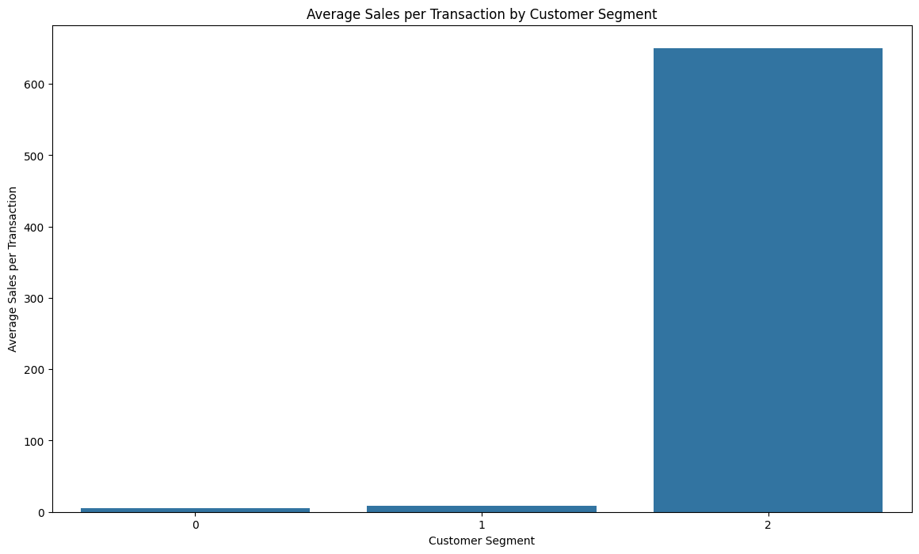
Average Sales per Transaction by Customer Segment
Kettle is the most popular brand followed by Smiths, Doritos and Pringles.

Slide 11
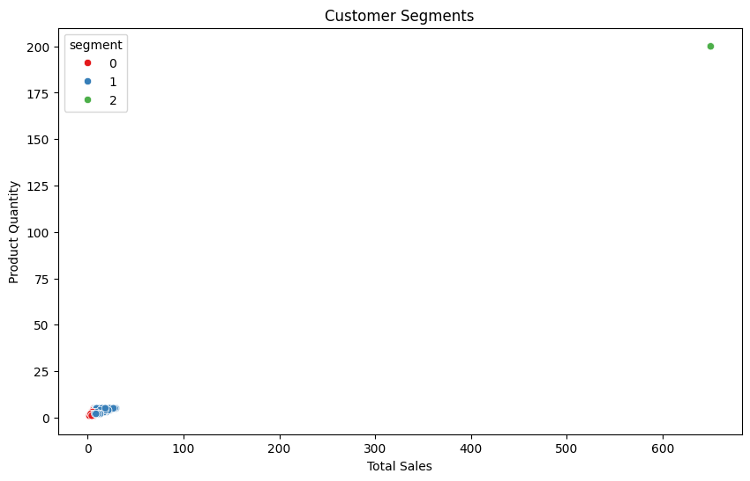
Customer Segment
Kettle is the most popular brand followed by Smiths, Doritos and Pringles.

Slide 12
02
Trial store performance

Slide 13
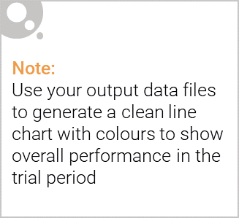
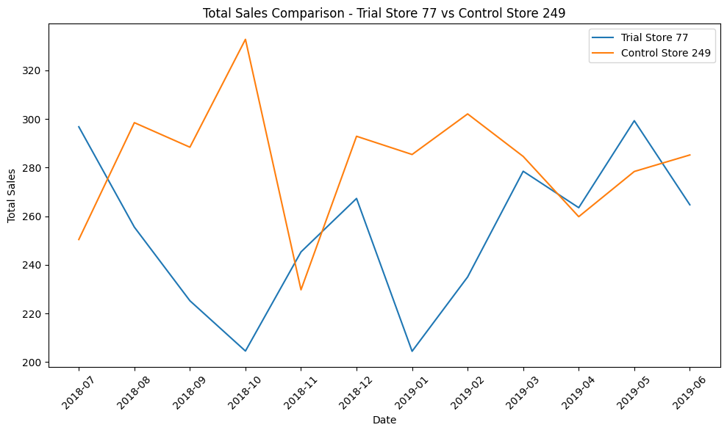
Total Sales Comparison – Trial Stores 77 Vs Control Store 249

Slide 14
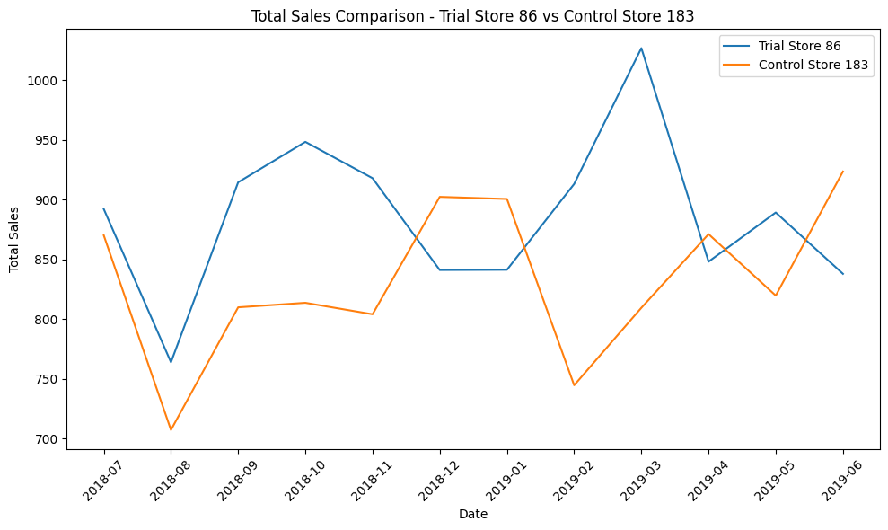
Total Sales Comparison – Trial Stores 86 Vs Control Store 183

Slide 15
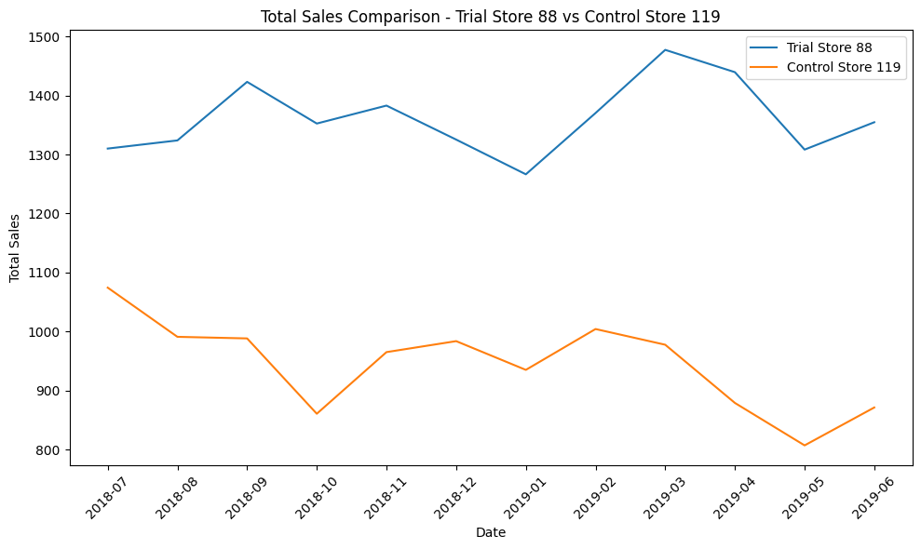
Total Sales Comparison – Trial Stores 88 Vs Control Store 119

