Slide 1
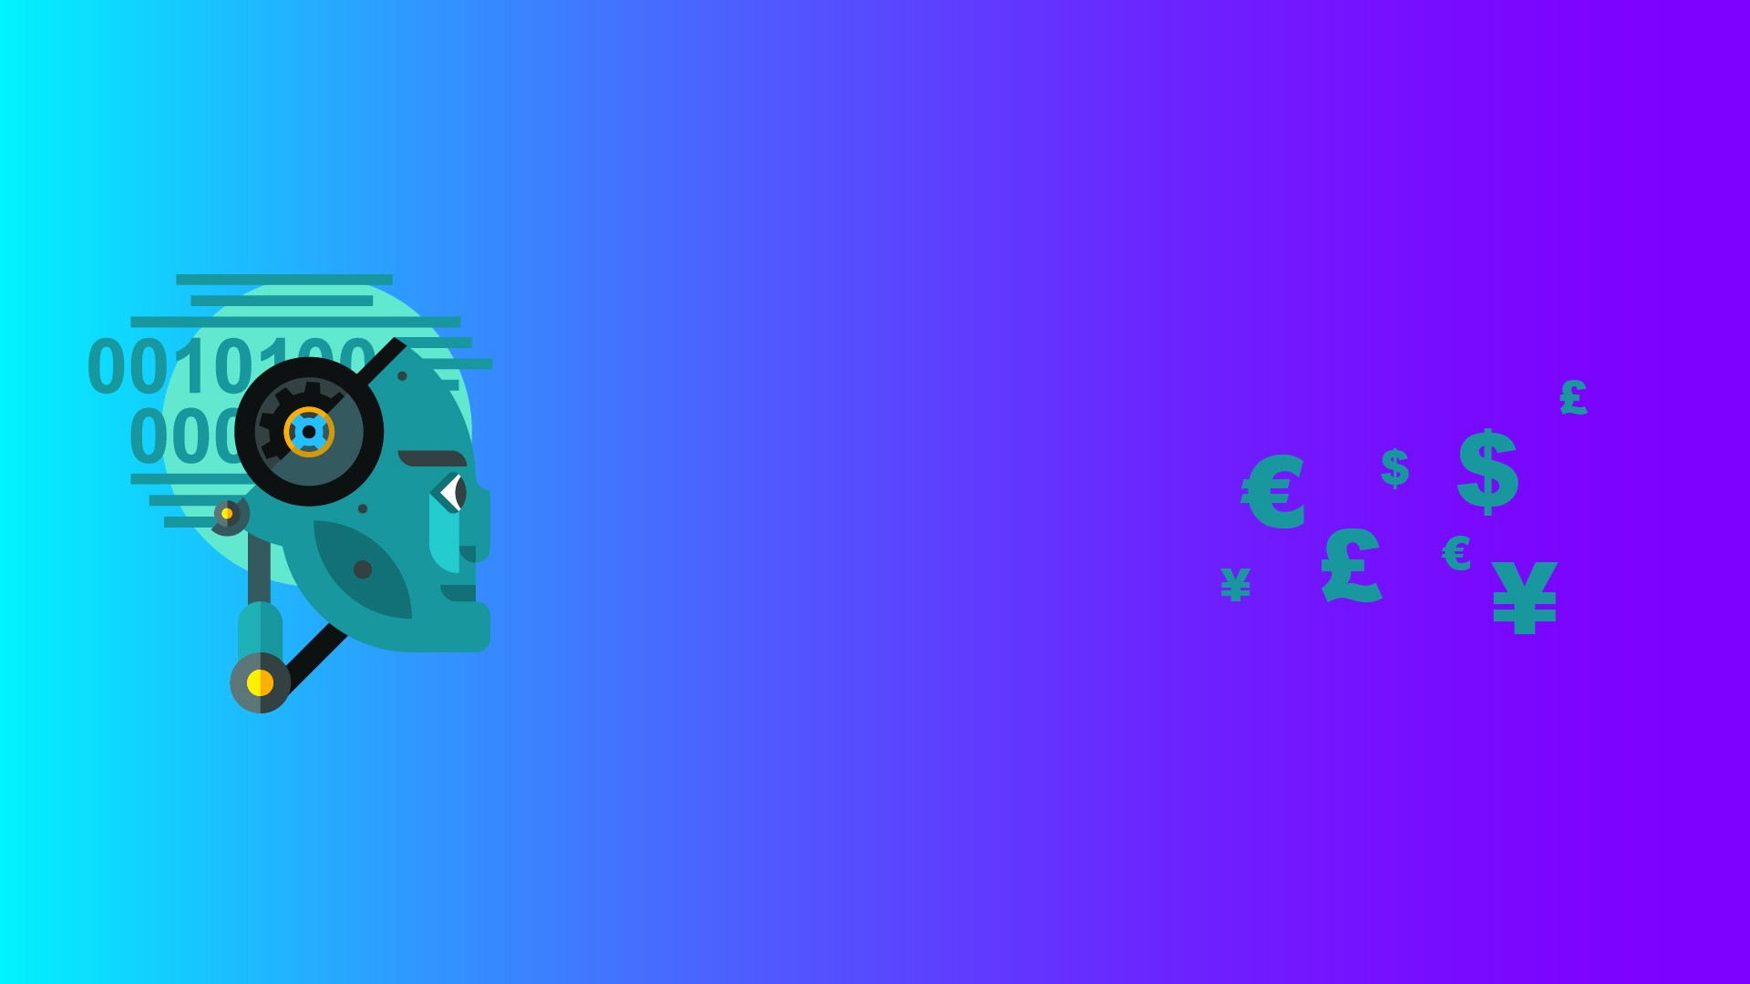
LET’s BUILD A CHATBOT

Slide 2
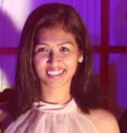
My name is Priya Sarkar
I graduated from IIT Bombay with Btech in Metallurgical Engineering at 2016.
I am working in the field of Machine Learning since the last 3 years.
I started my career as an intern with a startup called Quetzal and since then I have worked with companies like Syntel, HDFC Developers and JP Morgan.

Slide 3
WHAT IS MACHINE LEARNING ??

Slide 4
WHAT IS MACHINE LEARNING ??
Data Visualization + Statistics + Coding

Slide 5
Get Data
Pre Process Data
Create Model
Explore Data
Validation
Accuracy
Understand the problem
Collect Data
Define Objective function
Visualization (EDA)
Missing value handling
Outlier Detection
Feature generation
Prepare Data for model
Feature Selection
Model Selection
Ensemble Model
Cross Validation
Parameter Tuning
R2
Confidence matrix
AUC ROC

Slide 6
What concepts are used to build a Chabot ??

Slide 7
What concepts are used to build a Chabot ??
Text Classification
Text Similarity

Slide 8
Visualizing your data
Univariate Analysis (box plot)
Bivariate Analysis (Scatter plot)
Covariance Matrix
Word Clouds
TSNE matrix

Slide 9
Preprocessing your data
Punctuation removal and change words to lower case
Stop word removal
Stemming
Negation Handling
Synonym Replacer
POS based preprocessing

Slide 10
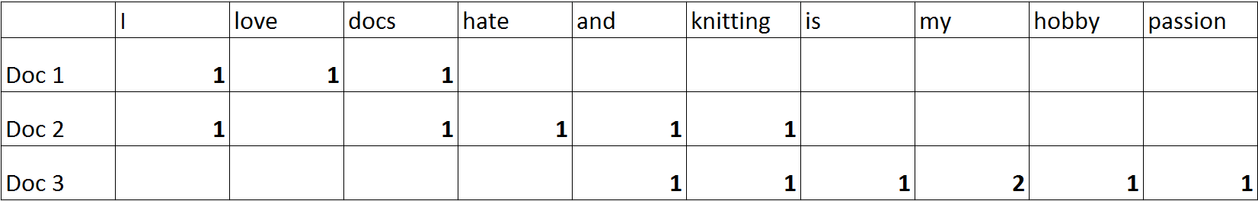
Matrix Creation

Slide 11
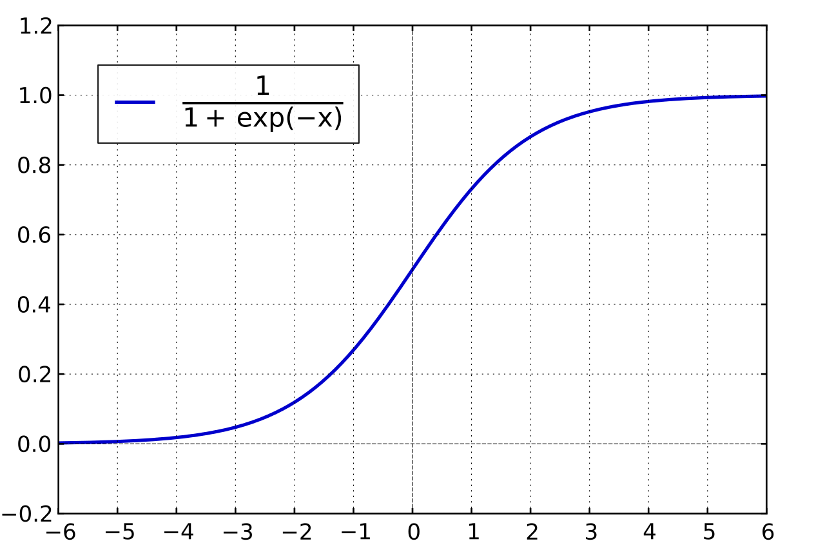
Logistic Regression
Logistic Regression – Estimates the class probability
Also known as a Sigmoid function as it is S shaped
Domain is R, Codomain is [0,1]

Slide 12
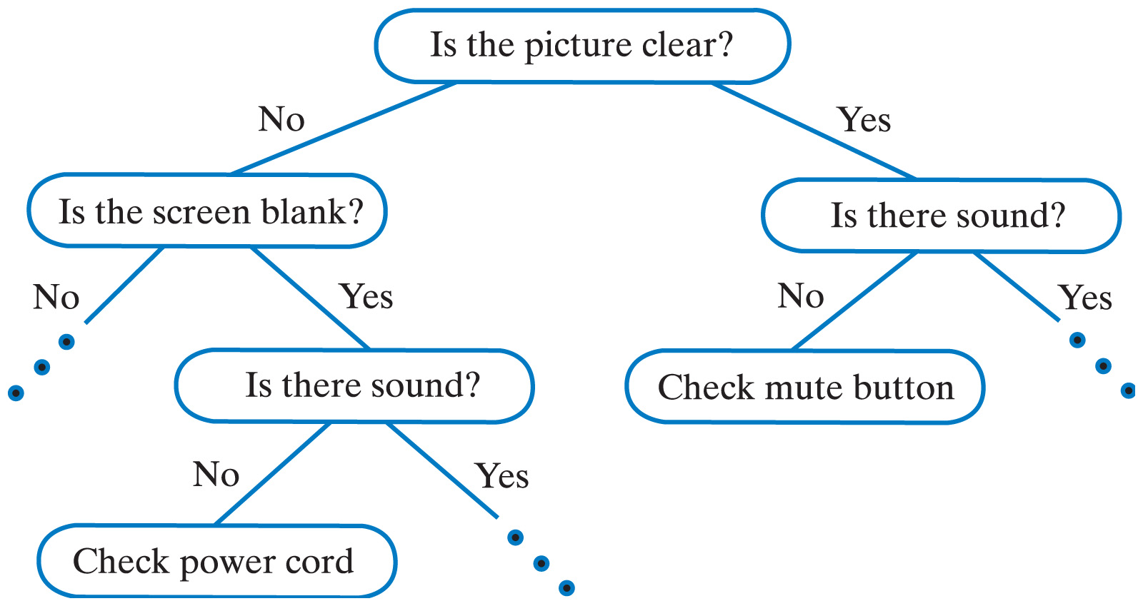
Decision Tree
It splits the population or sample into two or more homogeneous sets
supervised learning algorithm that is mostly used in classification problems

Slide 13
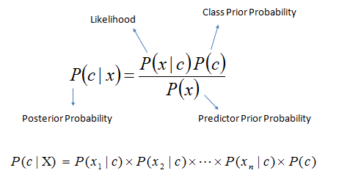
Naïve Bayes Classifier
Naïve Bayes predicts probability of a particular class based on the Bayes theorem

Slide 14
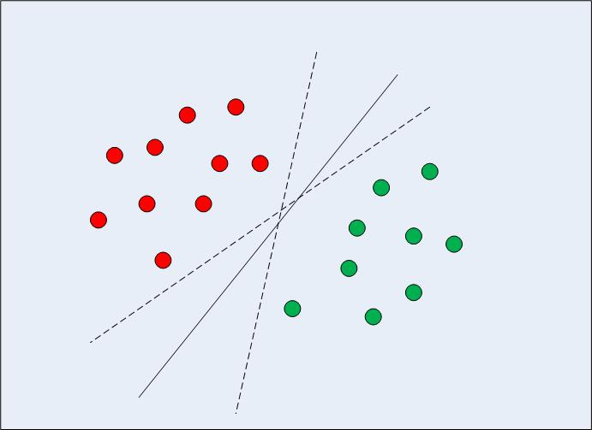
Support Vector Machine

Slide 15
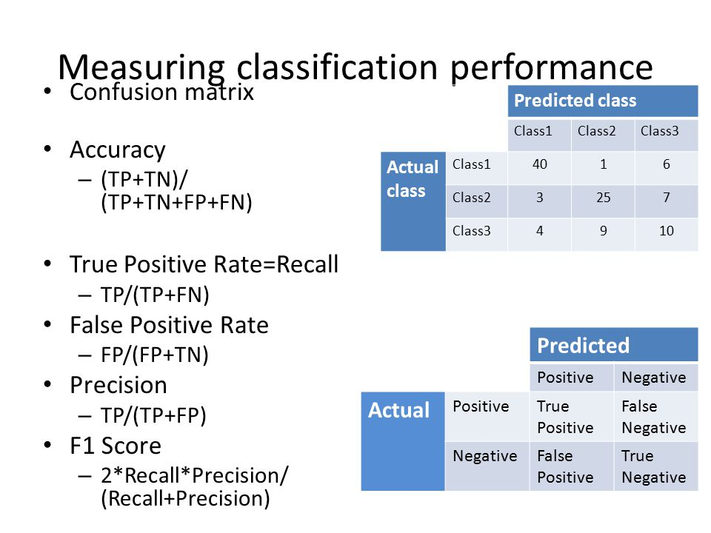
Model Performance - Confusion Matrix

Slide 16
Model Performance - Confusion Matrix

Slide 17
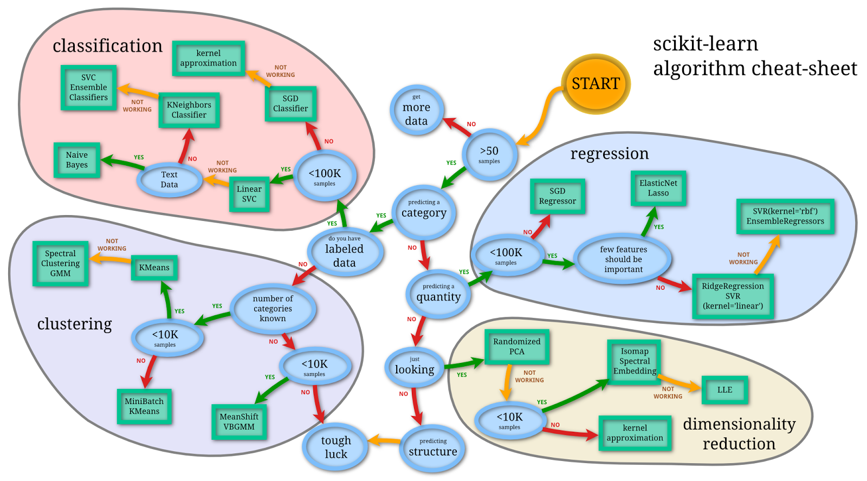
Create any Model

