Slide 1
Project Prediction of Heart Disease using Machine Learning
by
K. Priya Varshitha

Slide 2
Abstract
Cardiovascular Disease (CVD) poses a significant global health concern, often associated with unhealthy lifestyle choices. Timely diagnosis is crucial, especially given its correlation with Coronavirus. To tackle this challenge, we propose using machine learning models to predict CVD based on health data. We evaluated well-known methods like Random Forest Classifier and Support Vector Machine, but found limitations. As a solution, we introduce GradientBoostingClassifier (GBC), an ensemble learning method that combines weak learners to enhance predictive performance. Our study compares GBC, RFC, and SVM, and the results demonstrate GBC's superiority in accuracy, recall, and F1 score. This showcases GBC as a promising technique for effectively predicting cardiovascular diseases, offering potential for significant medical advancements.

Slide 3
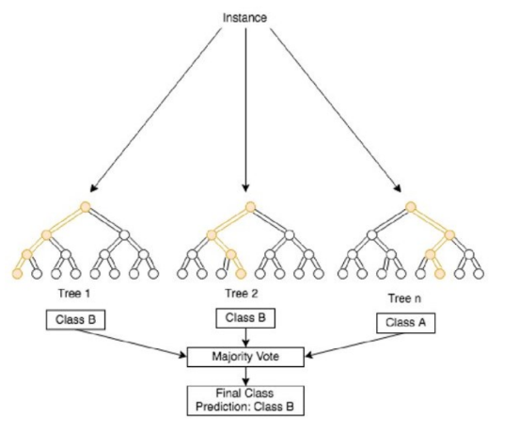
Existing methods
Random forest:
A lot of different decision trees are combined in Random Forest, an ensemble learning technique, to create a model that is precise and dependable for classification tasks. A random subset of the training data and a random subset of the attributes are used to construct each individual decision tree that makes up the Random Forest; this unpredictability contributes to the diversity of the individual trees, which reduces instances of overfitting and enhances the model's ability to generalize.

Slide 4
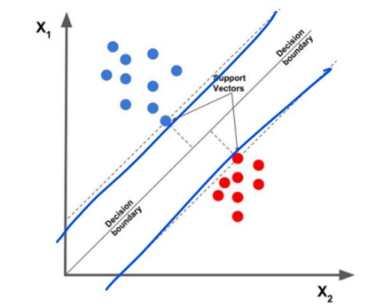
Existing methods
Support Vector Machine:
Support vector machines are a reliable supervised machine learning method that may be used for regression and classification tasks. The graph illustrates the fundamental concept underlying SVM, which is to locate the ideal hyperplane that most effectively differentiates between the two classes in the feature space. The hyperplane serves as a decision boundary by increasing the distance between the two classes data points that are the most similar to one another. Because these data points are considered to be support vectors, the machine in question is referred to as a Support Vector Machine.

Slide 5
Proposed method
Gradient boosting :
We proposed Gradient Boosting Classifier with aim of increasing the model performance. This is because, Gradient Boosting performs well with noisy data and can adapt to such noise through its boosting iterations. Gradient Boosting Classifier is also an ensemble method that builds multiple weak learners (decision trees) sequentially, with each one correcting the errors of the previous one; this leads to improved predictive performance, as it combines the strengths of individual models.

Slide 6
Qualitative and Quantitative Comparative Analysis
Support Vector Machine (SVM):
Strengths:
Versatility with kernel functions for handling non-linear data, making it suitable for complex datasets.
Suitable for situations where the number of features exceeds the number of samples, effective in high-dimensional spaces.
Weakness:
Computationally expensive for large datasets, which may limit scalability.
Interpretability can be challenging due to complex decision boundaries.

Slide 7
Qualitative and Quantitative Comparative Analysis
Random Forest Classifier(RFC):
Strengths:
Robust against overfitting due to ensemble of decision trees, ensuring better generalization
Efficient handling of both categorical and numerical features, reducing preprocessing requirements.
Weakness:
Interpretation can be difficult compared to single decision trees, limiting model transparency.
Prone to overfitting if the number of trees is too large, necessitating careful tuning.

Slide 8
Qualitative and Quantitative Comparative Analysis
Gradient Boosting Classifier (GBC)
Strengths:
Sequential approach improves performance of weak learners, enhancing predictive accuracy.
Effective handling of various data types, reducing data preprocessing efforts.
Weakness:
Sensitive to overfitting, necessitating careful hyperparameter tuning to avoid excessive complexity.
Higher computational cost compared to random forests due to sequential nature.

Slide 9
Results of the Predicted Model before Removing Extreme Outliers
Metric/Model | RFC | SVM | GBC
Accuracy | 77.05% | 75.41% | 80.3%
Precision | 77.27% | 76.19% | 75.8%
Recall | 65.38% | 61.54% | 86.2%
F1 Score | 70.82% | 68.08% | 80.6%

Slide 10
Results of the Predicted Model after Removing Extreme Outliers
To remove extreme outliers, the Interquartile Range(IQR) method was employed. It was calculated for each column by determining the 25th percentile(Q1) and the 75th percentile(Q3) of the data.
Metric/Model | RFC | SVM | GBC
Accuracy | 86.67% | 88.33% | 86.5%
Precision | 95.45% | 95.65% | 80.8%
Recall | 75% | 78.57% | 91.3%
F1 Score | 83.99% | 86.27% | 85.7%

Slide 11
Results of the Predicted Model after applying feature selection:
In the feature selection process, the Gradient Boosting Classifier was selected as the estimator. Recursive Feature Elimination with Cross-Validation (RFECV) was employed, initializing it with the chosen classifier and adopting the Stratified KFold cross-validation strategy. This strategy ensures that the class distribution of the target variable is maintained during data splitting. RFECV then proceeded to iteratively eliminate features while evaluating the classifier's performance using cross-validation. Starting with all features, it recursively removed the least important ones and assessed the performance after each elimination. This iterative process continued until the optimal number of features was determined, ensuring that the final set of features led to the best possible performance for the classifier.

Slide 12
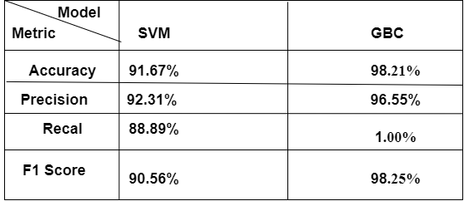

Slide 13




Advantages
GBC achieved a remarkable accuracy of 98.21%, making it a reliable choice for medical diagnosis and decision-making.
With a precision score of 96.55%, GBC accurately predicts patients with cardiovascular disease, reducing false positives and unnecessary interventions.
GBC's recall score of 1.00% means it correctly identified all actual positive cases of cardiovascular disease, ensuring no patients who need medical attention are missed.
GBC achieved an F1 score of 98.25%, striking a balance between precision and recall, making it suitable for tasks where both aspects are crucial.

Slide 14




Limitations
GBC is computationally expensive due to the sequential combination of weak learners, making it more time-consuming and resource-intensive, especially for large datasets.
Model's performance heavily relies on the tuning of its hyperparameters, necessitating expert knowledge and effort to achieve optimal results.
GBC's sensitivity to outliers is another concern, which could lead to suboptimal performance. Preprocessing steps or outlier handling techniques may be necessary to address this issue.
GBC's ensemble nature with decision trees makes it less interpretable compared to simpler models like linear regression, which could be challenging for understanding its decision-making process in critical applications where transparency is essential.

Slide 15




Applications
HEALTHCARE AND MEDICAL DIAGNOSIS
FINANCE AND RISK MANAGEMENT
NATURAL LANGUAGE PROCESSING (NLP)
CUSTOMER RELATIONSHIP MANAGEMENT (CRM)

Slide 16
References
[1] Naghibi, S.A., Pourghasemi, H.R. & Dixon, B. GIS-based groundwater potential mapping using boosted regression tree, classification and regression tree, and random forest machine learning models in Iran. Environ Monit Assess 188, 44 (2016). https://doi.org/10.1007/s10661-015-5049-6
[2] M. Somvanshi, P. Chavan, S. Tambade and S. V. Shinde, "A review of machine learning techniques using decision tree and support vector machine," 2016 International Conference on Computing Communication Control and automation (ICCUBEA), Pune, India, 2016, pp. 1-7, doi: 10.1109/ICCUBEA.2016.7860040.
[3] F. Li, Y. Zuo, H. Lin and J. Wu, "BoostXML: Gradient Boosting for Extreme Multilabel Text Classification With Tail Labels," in IEEE Transactions on Neural Networks and Learning Systems, doi: 10.1109/TNNLS.2023.3285294.
[4] F. Li et al., "A Light Gradient Boosting Machine for Remainning Useful Life Estimation of Aircraft Engines," 2018 21st International Conference on Intelligent Transportation Systems (ITSC), Maui, HI, USA, 2018, pp. 3562-3567, doi: 10.1109/ITSC.2018.8569801.
[5] Pardo, Matteo, and Giorgio Sberveglieri. "Classification of electronic nose data with support vector machines." Sensors and Actuators B: Chemical 107.2 (2005): 730-737. https://doi.org/10.1016/j.snb.2004.12.005

Slide 17


