Slide 1
QUANTUM COMPUTING
Seminar by
K.PRIYA VARSHITHA

Slide 2
ABSTRACT
Quantum computing is the study of non-classical mode of computation.
A quantum computer is a device that could perform such computation

Slide 3
INTRODUCTION
Quantum computers use atoms to perform calculations.
Here, computation depends on principle of quantum theory.
In the quantum scenario, the fundamental unit of memory is called a qubit.

Slide 4
HISTORY
1982-Feynman proposed the idea of creating machines based on the laws of quantum mechanics instead of laws of classical physics.
1994-Peter shor came up with a quantum algorithm to factor very large numbers in polynomial time.

Slide 5
QUBIT-BASED COMPUTING
Qubits are represented through quantum particles such as electrons and photons. These particles have specific properties that can be used to represent data.
For instance, qubits can spin in a specific direction. If it spins upwards, that can be read as 1, while a qubit spinning downward can become a 0.

Slide 6
IMPORTANCE
It allows for real parallel processing, which basically means that several calculations can be carried out at the same time, saving a lot of time, offering superior performance, and allowing for the solution of more complex operations.

Slide 7
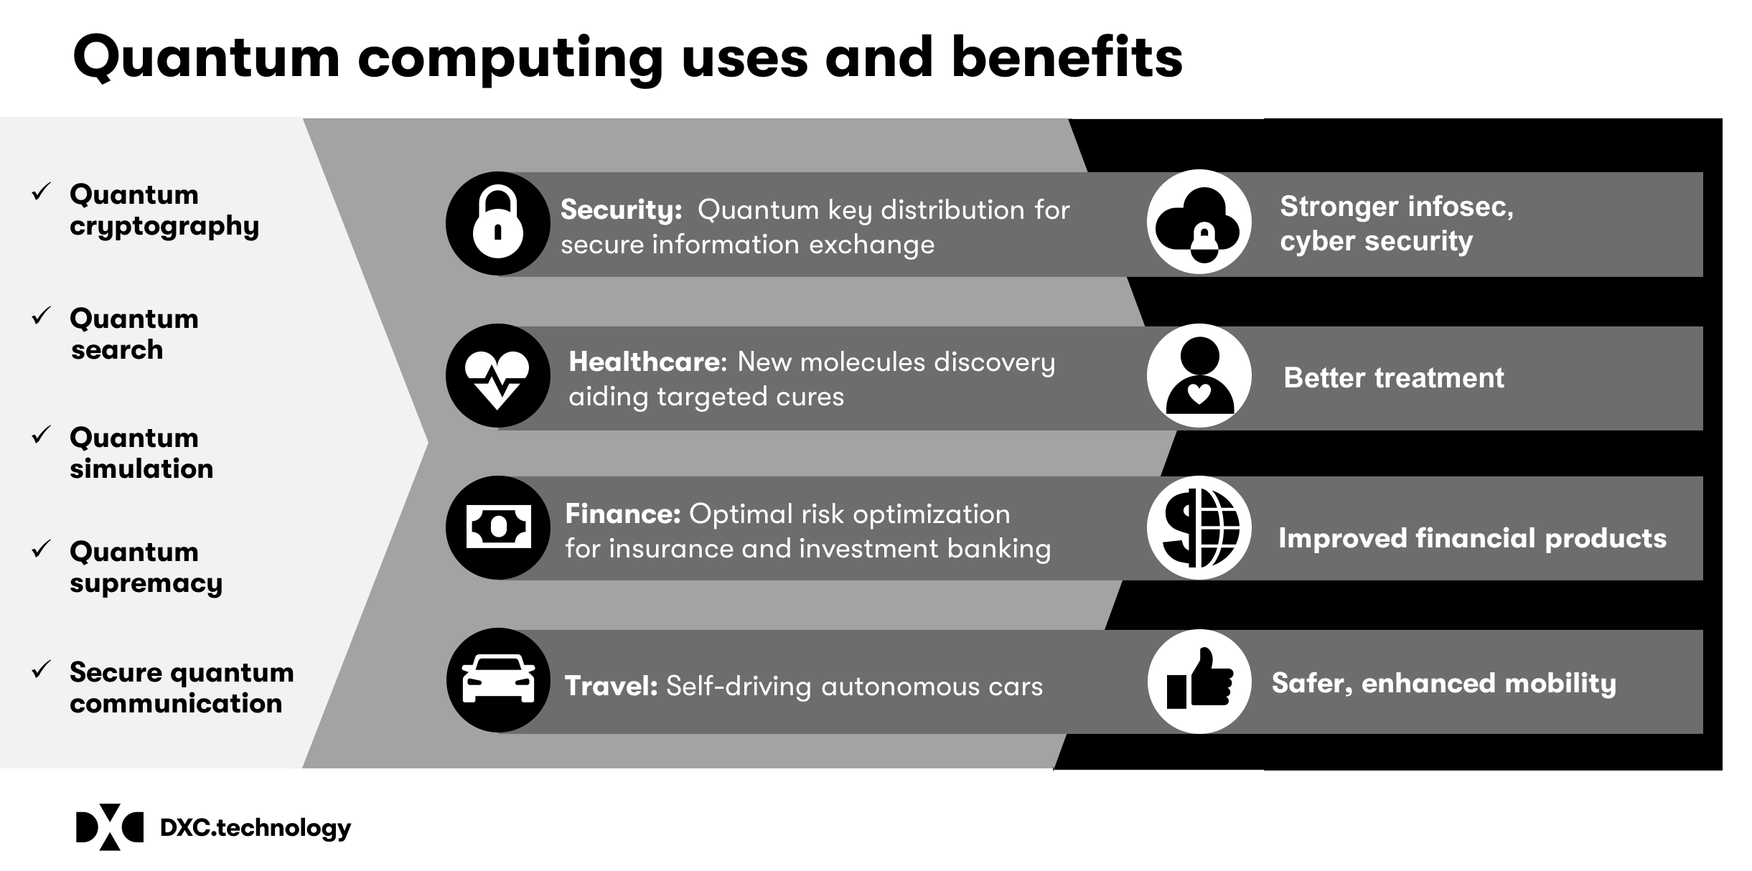
USES AND BENEFITS

Slide 8
APPLICATIONS
Cryptography
Artificial intelligence
Teleportation
Quantum communication

Slide 9
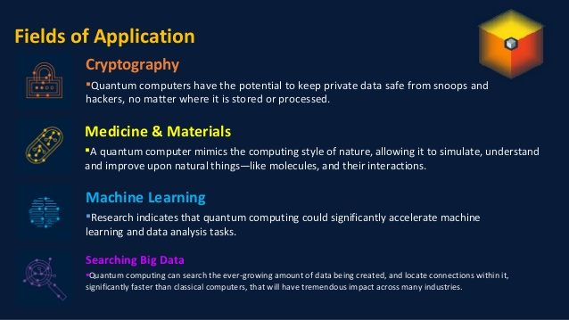
FIELDS OF APPLICATIONS

Slide 10
PROBLEMS
Decoherence
Error correction
Output observance
Cost

Slide 11
CONCLUSION
A quantum computer thus has the theoretical capability of simulating any finite physical system and may even hold the key to creating an artificially intelligent computer.

Slide 12
REFERENCES
www.google.com
www.wikipedia.org
www.studymafia.org

Slide 13
THANK YOU

