Slide 1

CSCE 4560 / 5560
Digital Art &
Print Store
Secure E-Commerce Platform
Denish Adhikari · Garrick McCuller · Priya Dhanne · Jeshnavi Sri Kavitha Dakamarri
Spring 2026

Slide 2




Introduction
PLATFORM
Developed a WordPress-based secure e-commerce website
HOSTING
Hosted on a free platform (InfinityFree / ct.ws)
PLUGINS
Integrated plugins for enhanced functionality and security
FOCUS
Security analysis of a real-world web application scenario

Slide 3
Problem Statement
Core Vulnerabilities Analyzed
1
Security Misconfigurations
Improper server/app settings expose attack surfaces
2
Cross-Site Scripting (XSS)
Injected scripts run in victim browsers, stealing data or sessions
3
SQL Injection
Malicious SQL can bypass auth, expose or corrupt database contents
⚠ Free hosting environments inherently increase risk — paid/secure hosting is recommended for production.

Slide 4




Project Objectives
01
02
Build
Identify
Develop a functional, secure e-commerce website on WordPress
Discover vulnerabilities using industry-standard security tools
03
04
Analyze
Improve
Evaluate security mechanisms and assess their effectiveness
Propose actionable recommendations to harden the application

Slide 5
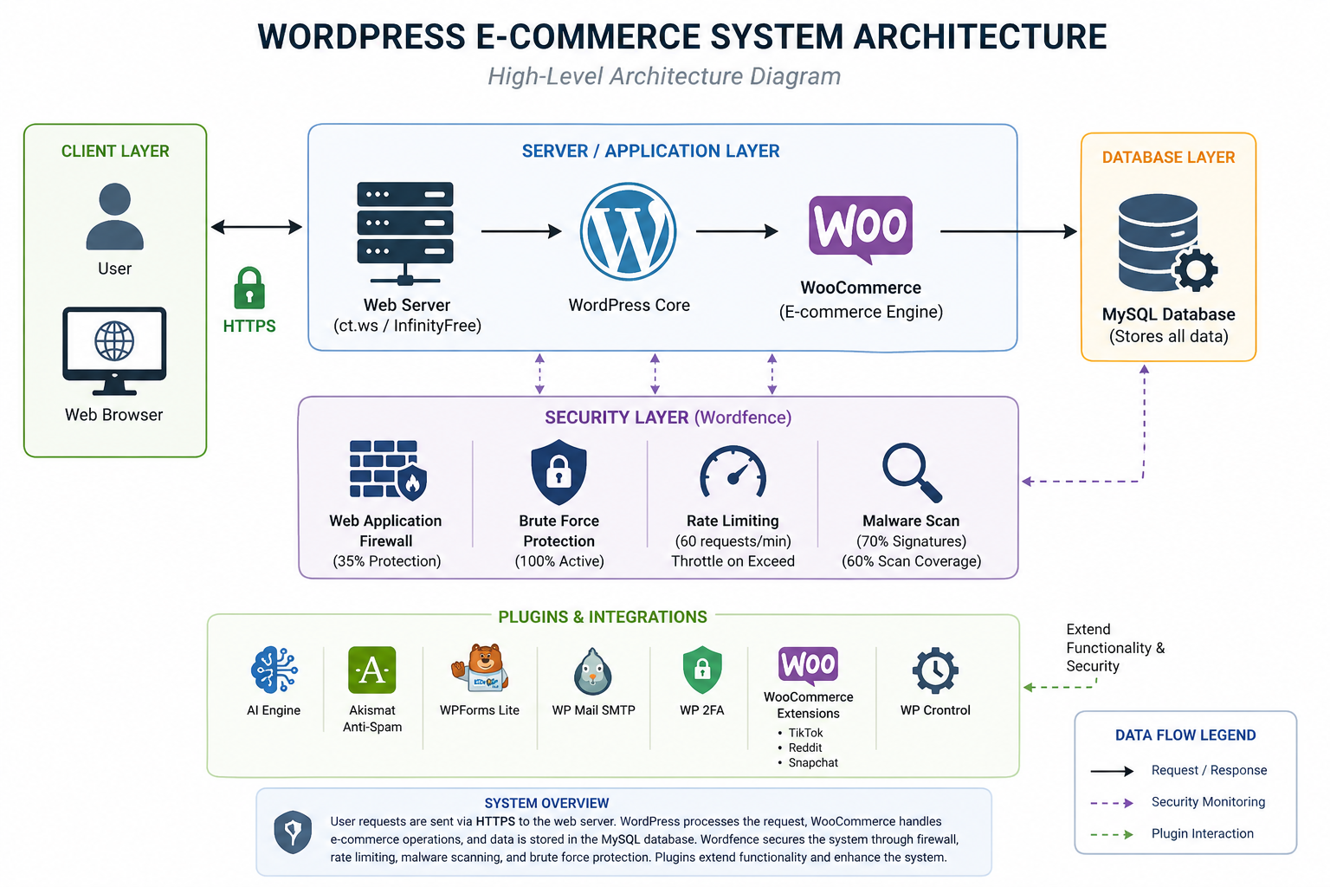





System Architecture
CLIENT
User Browser
↕
WEB SERVER
WordPress Hosting
↕
APPLICATION LAYER
WordPress + WooCommerce
↕
DATABASE
MySQL
↕
SECURITY LAYER
Wordfence + Plugins

Slide 6
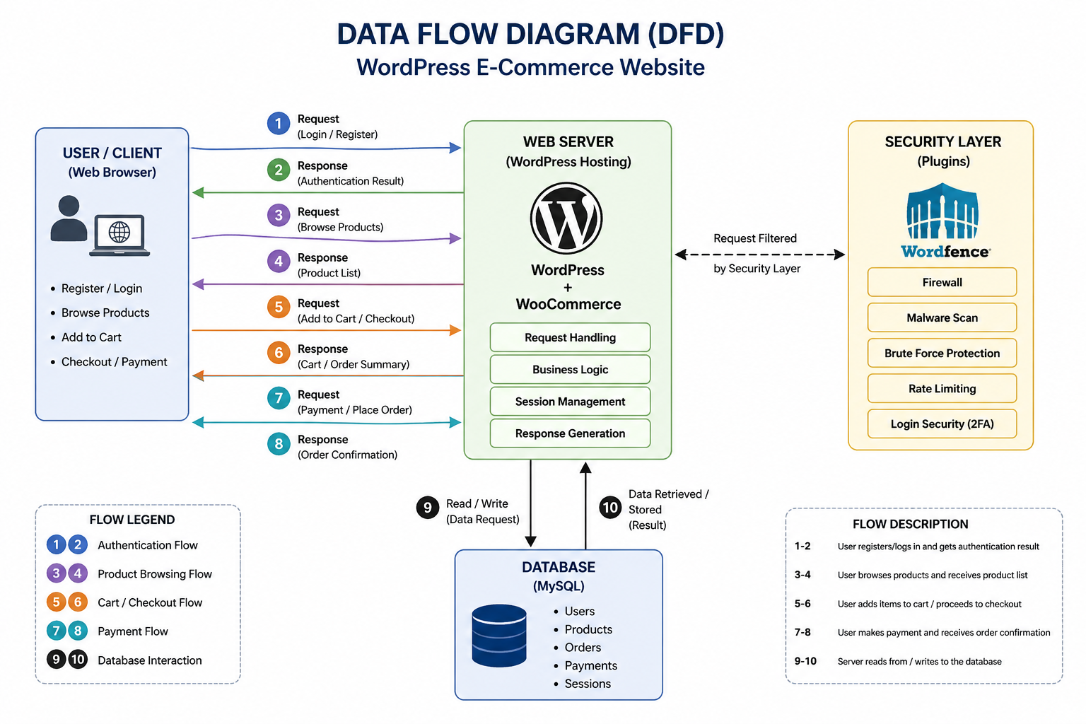
Data Flow Diagram
WordPress Documentation
WooCommerce Documentation
OWASP ZAP Documentation
Wordfence Documentation
OWASP Top 10

Slide 7


Security Tools Used
Primary Scanner
OWASP ZAP
Web vulnerability scanner — automated alerts and findings
Core Hardening
SSL Enforcement
Enable HTTPS via .htaccess 301 redirect
Primary Defense
Wordfence
WordPress firewall, malware scanner, brute-force protection

Slide 8
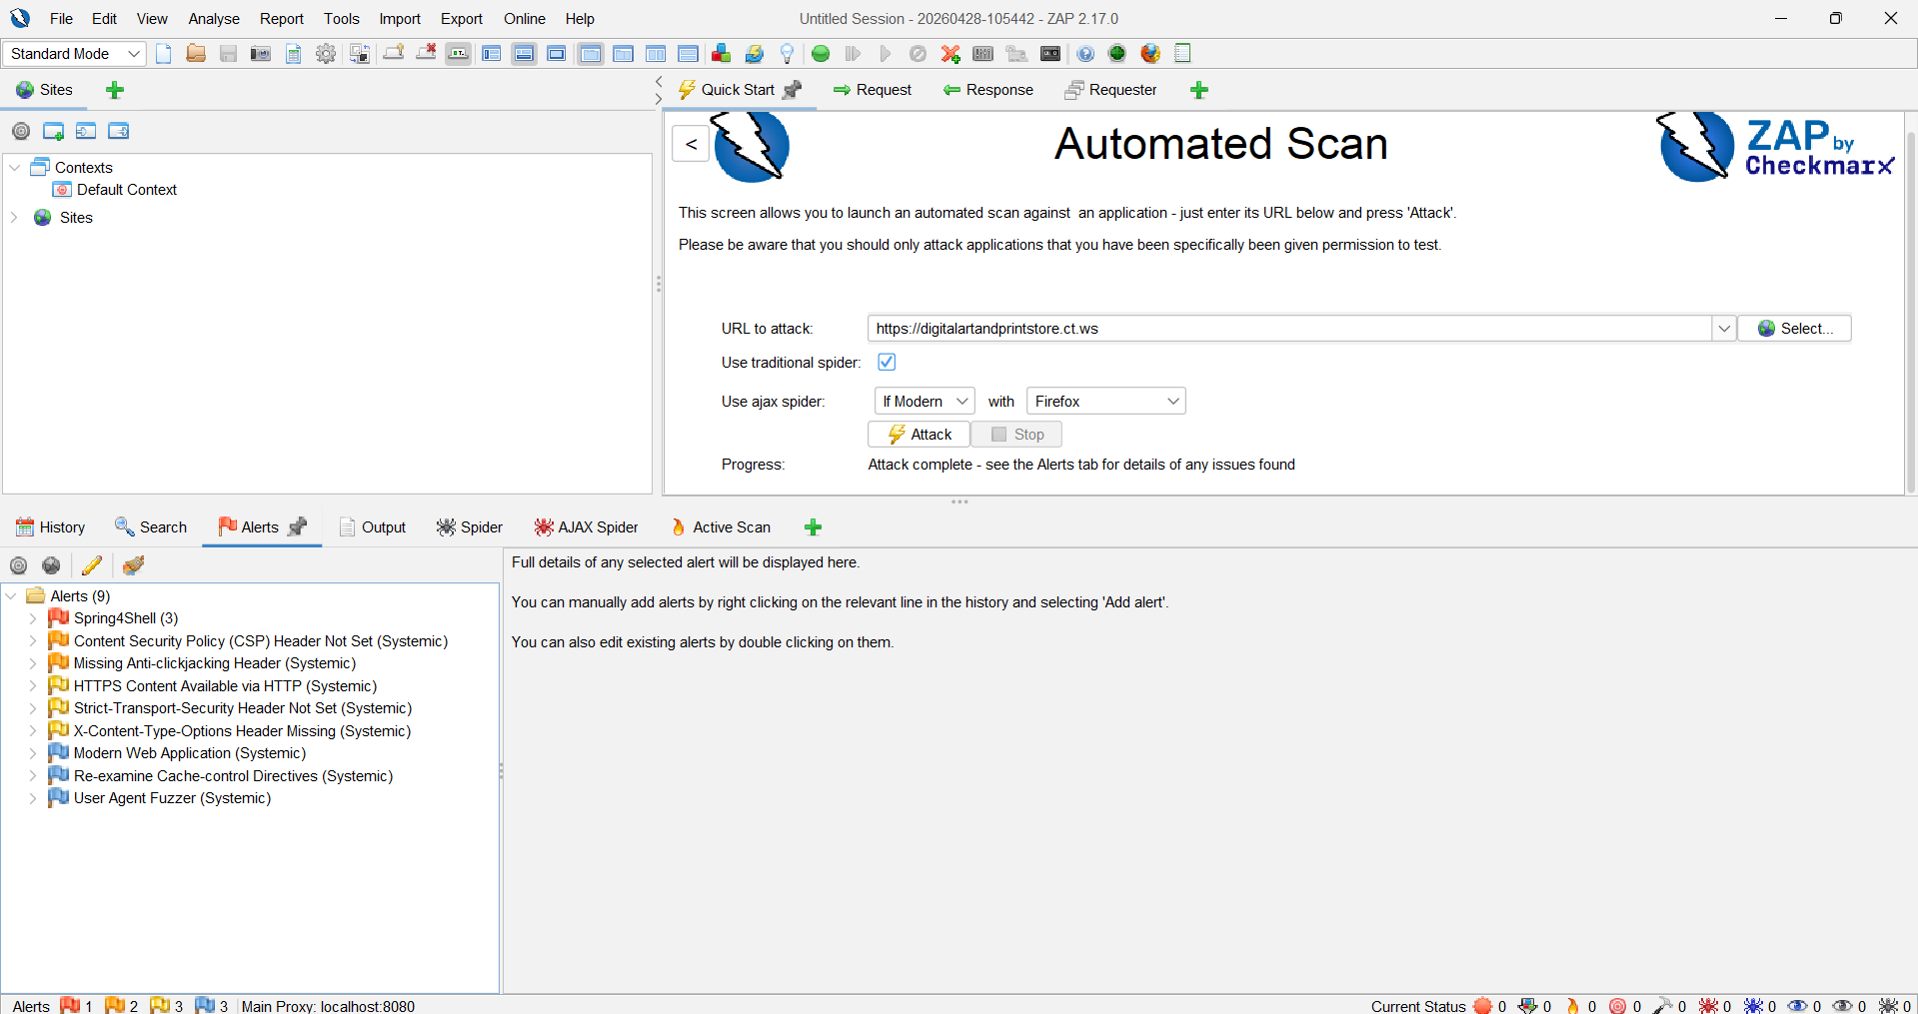
OWASP ZAP Results
Alert Breakdown
TOTAL ALERTS
DETECTED
9
Spring4Shell
HIGH
*3
CSP Header Not Set
MED
*1
Missing Anti-Clickjacking Header
MED
*1
HSTS Not Set
MED
*1
X-Content-Type-Options Missing
MED
*1
HTTPS via HTTP / Cache-Control
MED
*1

Slide 9




ZAP Findings - Analysis
Missing CSP
XSS Risk
⚠ IMPORTANT
No Content Security Policy allows inline scripts to execute, enabling XSS attacks
Spring4Shell is a Java Spring framework vulnerability.
WordPress does not use Java Spring.
These 3 alerts are likely FALSE POSITIVES.
Missing HSTS
MITM Risk
Without HTTP Strict Transport Security, connections can be downgraded to HTTP
No Anti-Clickjacking
UI Redressing
Without X-Frame-Options, malicious sites can embed this site in an iframe
Missing X-Content-Type
MIME Sniffing
Browsers may execute content as a different MIME type than intended

Slide 10
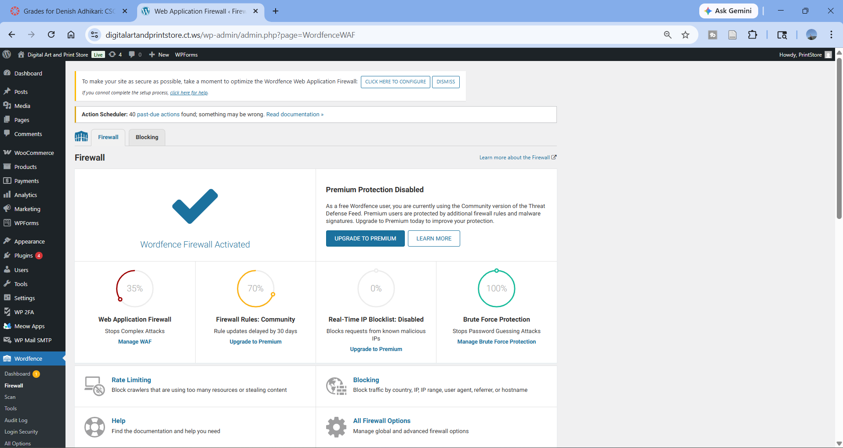
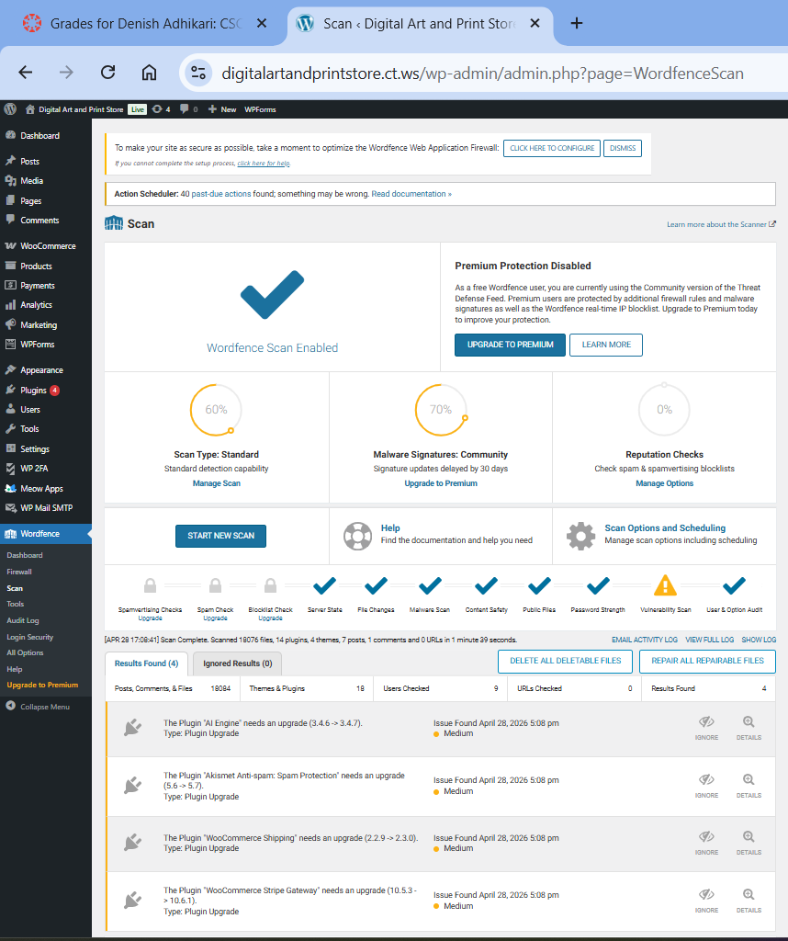
Wordfence Security Results
100
60–70
%
Brute Force Protection
35
%
Malware Scan Coverage
Firewall Protection
%

Slide 11
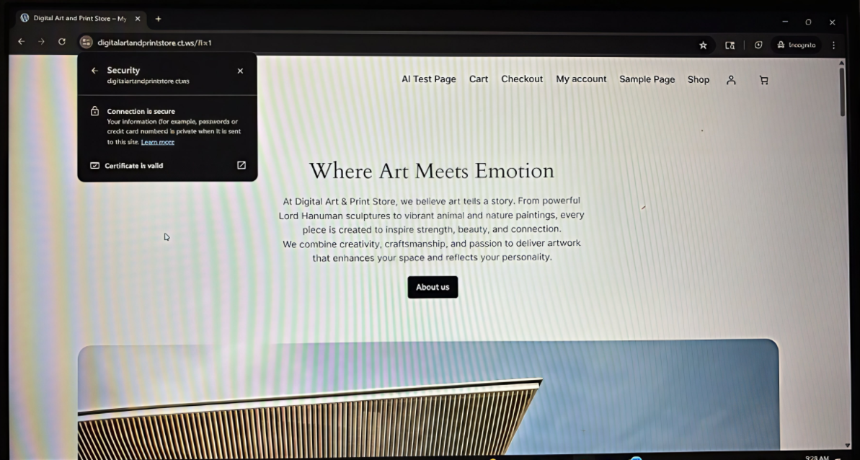
SSL Integration Results
Configuration used:
RewriteEngine On
RewriteCond %{HTTPS} ! = on
RewriteRule^https://%{HTTP HOST}%{REQUEST URI} [L,R=301]

Slide 12
Analysis Summary
ZAP — External Scan
Identifies HTTP-layer vulnerabilities including missing headers and configuration gaps from an external attacker's perspective
Wordfence — Internal Defense
Provides runtime protection via firewall rules, malware scanning, and brute-force prevention from within WordPress
Layered Security
Combining both tools implements a defense-in-depth strategy addressing both external and internal attack vectors
Current Security Posture
System is partially secured — brute-force protection is strong (100%), but firewall coverage (35%) and scan coverage (~65%) need improvement

Slide 13





Recommendations
01
02
03
Enforce HTTPS & HSTS
Configure Security Headers
Update All Plugins
Redirect all HTTP traffic to HTTPS and set HSTS headers to prevent downgrade attacks
Add CSP, X-Frame-Options, and X-Content-Type-Options headers via .htaccess or plugin
Regularly update the 4 outdated plugins — known CVEs in outdated plugins are a top attack vector
04
05
06
Improve Firewall Config
Use Secure/Paid Hosting
Regular Security Scans
Upgrade Wordfence firewall from 35% to full extended protection mode
Migrate from free hosting (InfinityFree) to a reputable, hardened hosting provider
Schedule weekly ZAP scans and Wordfence scans — security is a continuous process

Slide 14



Conclusion
Successfully designed, deployed, and analyzed a live WordPress WooCommerce application
Identified configuration-based vulnerabilities using OWASP ZAP (9 alerts) and Wordfence
Implemented layered security through Wordfence with 100% brute-force protection
System is moderately secure — firewall and scan coverage requires improvement
Security is not a destination but a continuous process — regular audits are essential

Slide 15
References
1) WordPress Documentation. Security Best Practices https://wordpress.org/support/article/hardening-wordpress/
2) WooCommerce Docs. Security & Payment Gateway Integration https://woocommerce.com/document/
3) OWASP ZAP Documentation https://www.zaproxy.org/docs/
4) Wordfence Security Documentation https://www.wordfence.com/help/
5) WP 2FA Plugin Documentation https://wp-2fa.com/documentation/
6) OWASP Top 10 Security Risks https://owasp.org/www-project-top-ten/
7) InfinityFree Hosting Documentation https://forum.infinityfree.com/
OWASP ZAP Documentation
Wordfence Documentation
OWASP Top 10

Slide 16
🙏
Thank You!
for your attention
Any Questions?
Digital Art & Print Store

