Slide 1


 | SILIGURI INSTITUTE OF TECHNOLOGY DEPARTMENT OF ELECTRICAL ENGINEERING
INDUSTRIAL TRAINING PROJECT ON
AUTO CAPTURE SELFIE BY SMILE DETECTION WITH PYTHON AND OPENCV
Industrial Training Project Submitted in Partial Fulfillment of the Requirements for the degree of
BACHELOR OF TECHNOLOGY IN ELECTRICAL ENGINEERING
By
PRIYA CHAKRABORTY[11901620009]
SOURADIP DAS[11901620007]
RANJAN GHOSH[11901621021]
BIDYASAGAR MALLICK[11901621032]
Under The Guidance of
RIPAM KUNDU
Trainer, Python Programming

Slide 2

TOPICS
Introduction
Goal Of the project
Software Requirement Specifications
Snapshots
Future Goals
Acknowledgement
References

Slide 3

INTRODUCTION
“Peace begins with a smile..”-Mother Teresa
Everyone loves a smiling picture, so we have developed a project which will capture images every time you smile, a Python Project to automatically detect and capture selfies.

Slide 4
GOAL OF THE PROJECT
Emotion detectors are used in many industries, one being the media industry where it is important for the companies to determine the public reaction to their products.
Most smartphones these days have a feature that automatically takes a selfie when we smile. It is amazing how accurately it detects smiles for not only one but multiple faces and captures a selfie immediately. If you have wondered how this is possible, it is actually quite simple. Using some of the libraries like OpenCV, it is possible to build a selfie-capturing application with just a few lines of code.
So, the main goal of the project is to analyze how it’s working and try to make it in the real-life application by using OpenCV-Python

Slide 5



SOFTWARE REQUIREMENT
SOFTWARE:
Windows OS 11
        WEB BROWSER:
        Google Chrome
PROJECT PREREQUISITES:
Basic concepts of Python
OpenCV basics

Slide 6
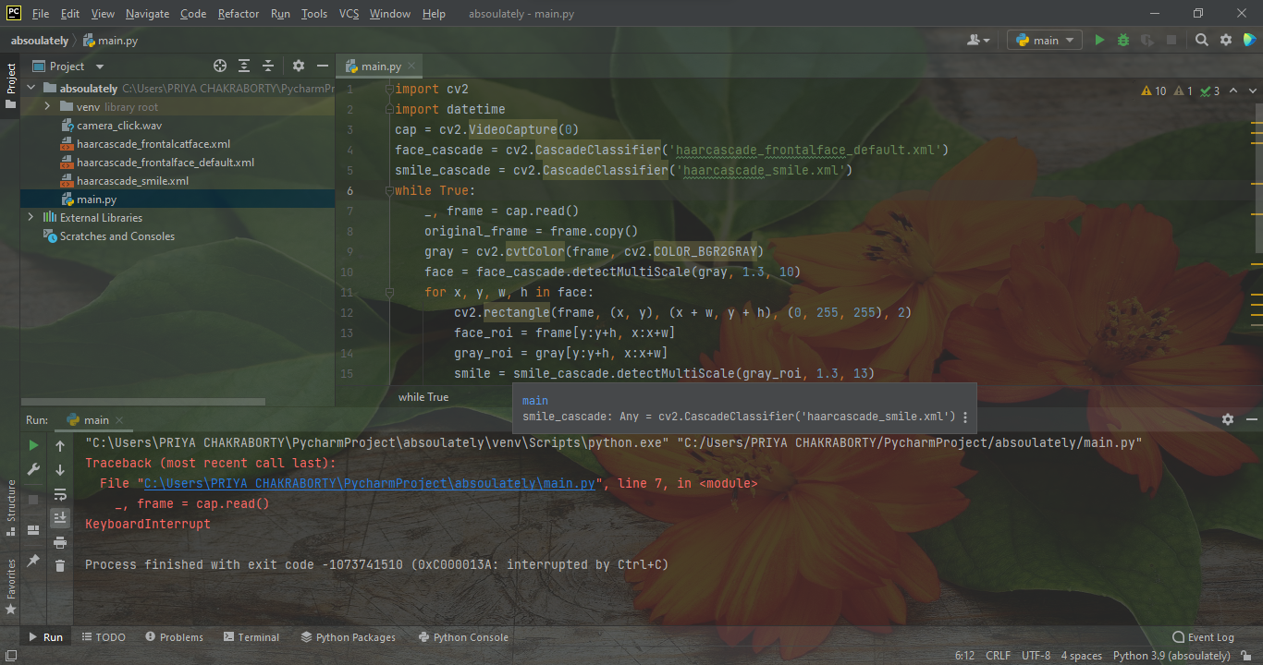
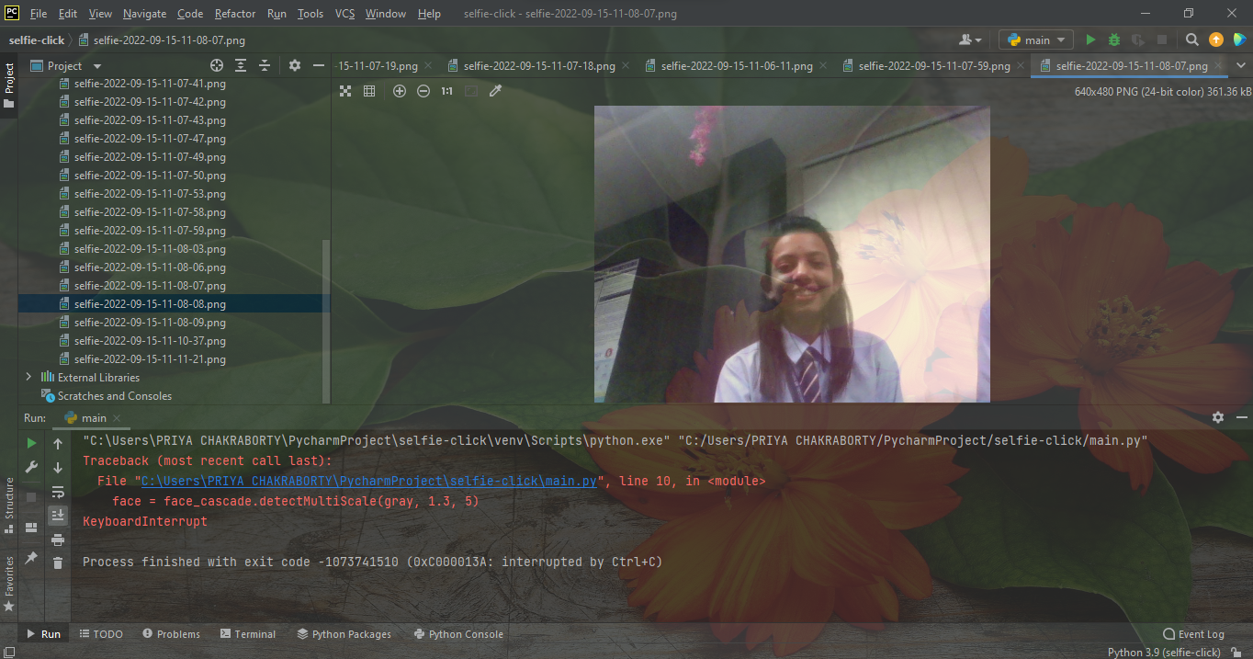
SNAPSHOTS
PROJECT CODE SNAPSHOT
OUTPUT
It is detecting our smile and then automatically clicking our picture by using real-time webcam.

Slide 7
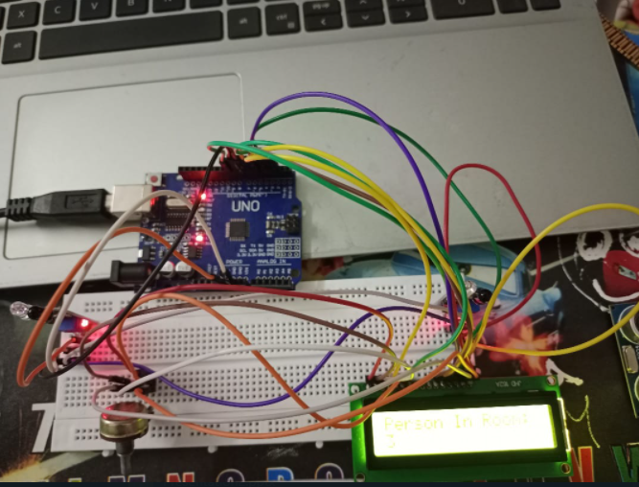
FUTURE GOALS :
This is our project Bidirectional people visitor counter, it’s a hardware-based project, which will count the number of a person entering or leaving the room. We will add this auto-captured selfie clicking system with this hardware project by using ESP8266 instead of Arduino UNO so that it can detect the person and take a selfie at a time. This will be our future goal for this project. So that we can utilize it by installing it in the seminar/conference room.

Slide 8
ACKNOWLEDGEMENT
I would like to express my deep sense of gratitude and convey thanks to everyone who helped me and supported me during the completion of this project. First, I would like to express a deep sense of gratitude to Rupam Kundu Sir for helping, guiding, and supporting me throughout the project completion. I also convey thanks to my all group members for helping me from time to time and for being on my team my thanks and appreciation also go to my friends in developing the project and people who have willingly helped me out with their abilities.

Slide 9
REFERENCES
Books of OpenCV
ttps://analyticsindiamag.com/my-fun-project-using-opencv/

Slide 10


