Slide 1
COMPARATIVE STUDY OF FAKE NEWS DETECTION PERFORMANCE USING MACHINE LEARNING MODELS
BY: KINGSHUK MUKHERJEE (544)
PRIYADARSHI ROY(545)
ARITRO RAKSHIT(556)
SEMESTER IV
CMSM4456
UNDER GUIDANCE OF:
PROF. SONALI SEN

Slide 2
INTRODUCTION
Digital fake news is a real problem plaguing many countries across the world
This project aims to build a number of classifying models using machine learning techniques to identify fake news and to compare the accuracy of one model with another
We have made a comparative study of some of the widely used machine learning models based on their text classification performance

Slide 3
What exactly text classification means
Text classification also known as text tagging or text categorization is the process of categorizing text into organized groups
By using Natural Language Processing (NLP), text classifiers can automatically analyze text and then assign a set of pre-defined tags or categories based on its content
Text classification problems have been widely studied and addressed in many real applications
In this project we have made a comparative study of some of the widely used machine learning models based on their text classification performance

Slide 4
Why we chose fake news
In this project we have taken the example of fake news as text data
We focus on fake news because it is increasingly becoming a menace to our society
We have judged attempts to stop or limit the spread of fake news as an utmost need
We have to assume some news sources as true as we build the models

Slide 5
Fake News Data Sources
The data used for this project was drawn from multiple online datasets
All the datasets we have used are from public domains
Seven different datasets were used
Six of the datasets were from Kaggle and one dataset was downloaded from the ISOT Lab Datasets (University of Victoria)

Slide 6
Text Preprocessing
Data from the datasets cannot be fed directly into ML models
There exist a whole suite of methods to clean and process text data
We have used few text preprocessing methods on each of these datasets-
Url removal
Lowercasing
Removal of all non alphabetic characters
Stopword removal
Each of the datasets were separately preprocessed and then the preprocessed data files were merged to form a single dataset and binary 0 and 1 labels were assigned to the real/fake news articles, respectively

Slide 7
Preparing the Data for Training
Since most of the machine learning and deep learning techniques, work with numeric data, therefore we have to convert text into numbers
Several approaches exist in this regard. We have used word-embeddings

Slide 8
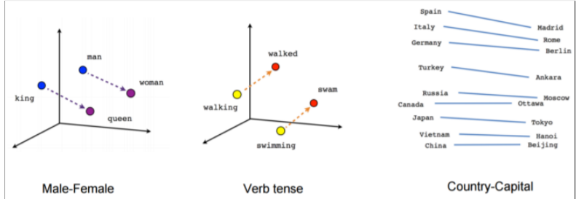
Preparing the Data for Training
Word embedding is a learned representation for text where words that have the same meaning have a similar representation

Slide 9
Preparing the Data for Training
The two famous pre-trained word embeddings used in machine learning are :
Word2Vec
GloVe
All models in this project use pre-trained 100 dimensional GloVe word embeddings

Slide 10
Models Used
Logistic Regression
Neural Network
Vanilla RNN
LSTM
GRU
Bidirectional LSTM
CNN

Slide 11
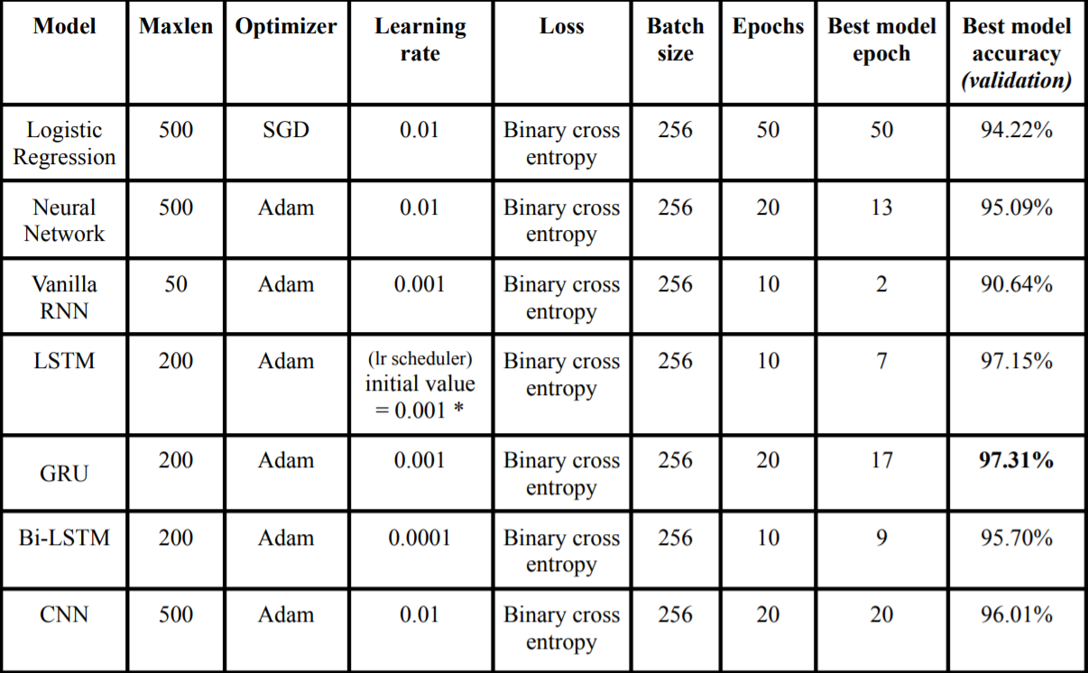

Slide 12
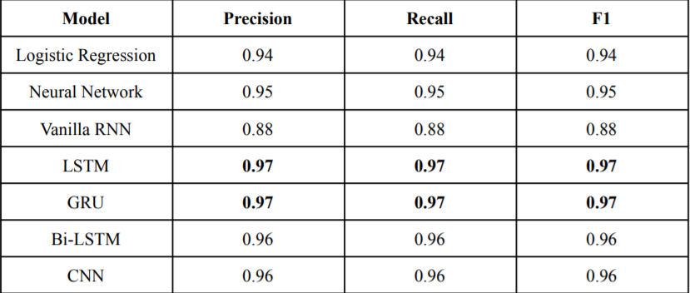
PRECISION, RECALL AND F1-SCORE (MACRO-AVERAGED)

Slide 13
OBSERVATIONS AND INFERENCES
Each model was trained individually to optimize their performance
All the models that were used performed quite well except for the Vanilla RNN
The models which performed the best considering all relevant metrics like accuracy, precision, recall and f1-score are the LSTM and GRU models
Finally the CNN model performed better than expected with text data, although CNN models are rarely used for text-classification purposes

Slide 14
Future Scope
A complete, production-quality classifier for fake news will incorporate many different features beyond the vectors corresponding to the words in the text
we can add as features the source of the news, including any associated URLs, the topic
We also believe that CNNs are a promising avenue worth exploring further

Slide 15
Thank You

