Slide 1

Project Title -Seasonal Agriculture Performance Analysis
Student Name- Priyadarshini L
College Name-Vidyavardhaka College of Engineering
AICTE STU ID : STU6850434db4d0c1750090573

Slide 2

PROBLEM STATEMENT
Analyze seasonal differences in agricultural performance.
Identify patterns, trends, relationships, and variations across seasons.
Examine how environmental conditions and farming practices affect agricultural outcomes.
Compare yield, resource usage, and economic performance across different seasons.
Identify significant or unusual patterns to support better seasonal agricultural planning.
Assess how resource usage and environmental conditions influence agricultural performance.
Develop insights and recommendations for better seasonal crop and resource planning.

Slide 3
Project Description
This project analyzes agricultural performance across different seasons using a real-world agricultural dataset.
The dataset includes information about crops, regions, weather conditions, soil characteristics, farming practices, resource usage, yield, and economic performance.
The data is cleaned and prepared by handling missing values and duplicate records.
Statistical analysis and data visualizations are used to identify seasonal patterns, trends, and relationships.
The project compares yield, profit, water usage, water efficiency, crops, and irrigation methods across seasons.
The analysis identifies key insights and unusual patterns that can help improve agricultural decision-making.
Finally, evidence-based recommendations are provided for better crop selection, irrigation, resource allocation, and seasonal planning.

Slide 4

WHO ARE THE END USERS?
Farmers – for better crop, irrigation, and resource planning.
Agricultural Planners – for seasonal agricultural planning and decision-making.
Agricultural Researchers – to study seasonal patterns and crop performance.
Government & Policy Makers – to support agricultural policies and resource allocation.
Agricultural Organizations – to improve farming practices and manage risks.

Slide 5

Technology Used
Python – Data analysis and processing
Pandas – Data cleaning and manipulation
NumPy – Numerical computations
Matplotlib – Data visualization
Seaborn – Statistical visualizations
SciPy – Statistical analysis
Jupyter Notebook – Analysis and documentation
VS Code – Development environment
Git & GitHub – Version control and project management

Slide 6
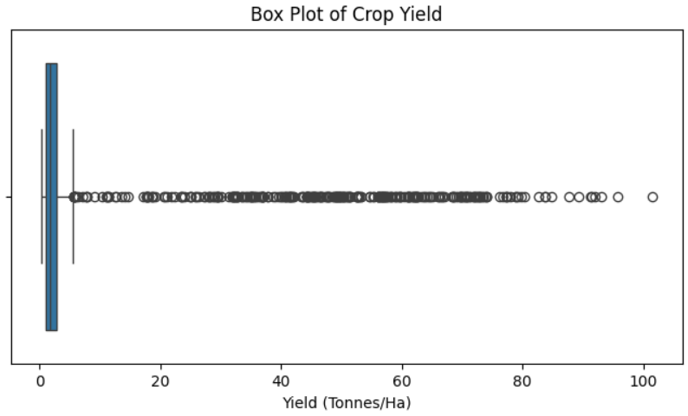
RESULTS
Most crop yields are concentrated in the lower range.
The distribution is highly right-skewed.
Several high-yield outliers are present.
Some outliers reach above 100 tonnes/ha.
This indicates considerable variation in crop yield across the farms.

Slide 7
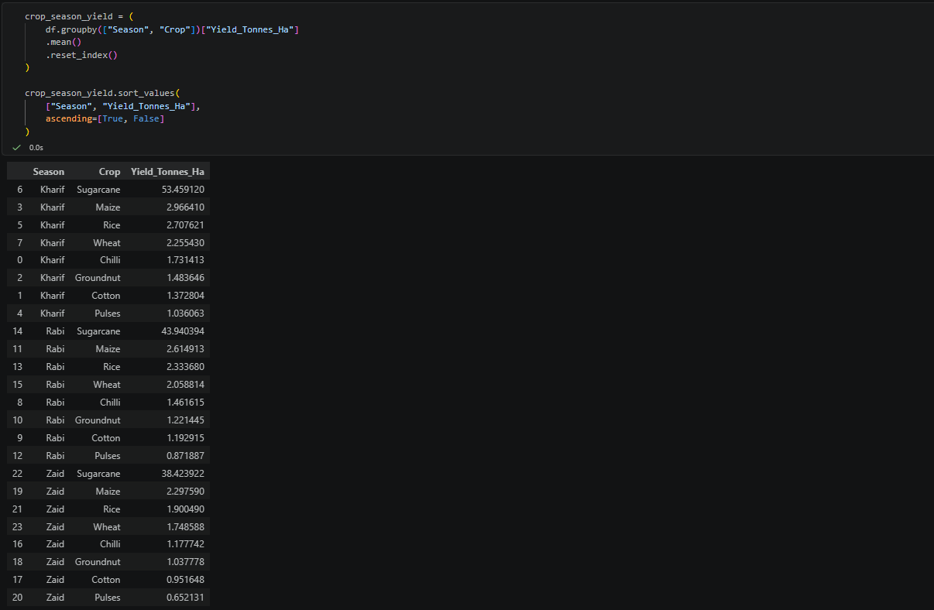
RESULTS
Sugarcane has the highest yield in all three seasons.
Kharif shows the highest Sugarcane yield (53.46 tonnes/ha).
Rabi Sugarcane yield is 43.94 tonnes/ha, while Zaid is 38.42 tonnes/ha.
For other crops, Maize and Rice show relatively higher yields across seasons.
Pulses and Cotton have comparatively lower yields in all seasons.

Slide 8
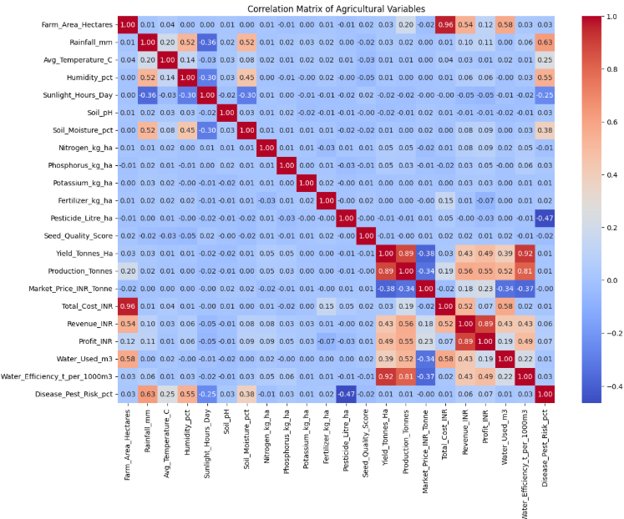
RESULTS
Yield and Water Efficiency show a very strong positive correlation (0.92).
Yield and Production also have a strong positive correlation (0.89).
Revenue and Profit show a strong positive correlation (0.89).
Farm Area and Total Cost have a very strong positive correlation (0.96).

Slide 9
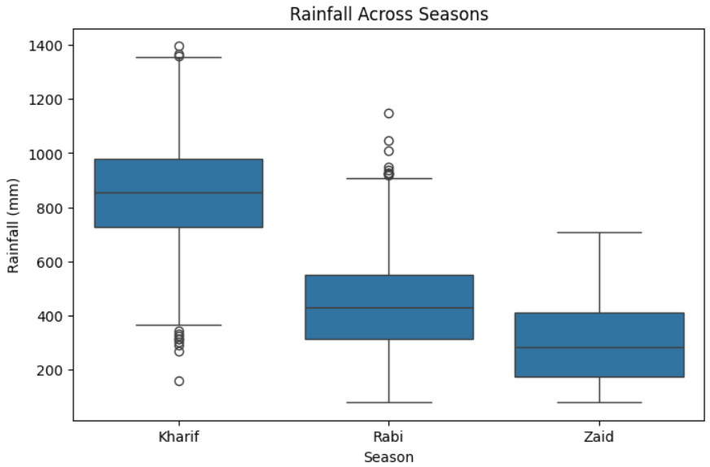
RESULTS
Kharif receives the highest rainfall among all seasons.
Zaid has the lowest rainfall, while Rabi falls in between.
Kharif shows greater rainfall variation across farms.
Several rainfall outliers are visible in Kharif and Rabi.
The results highlight clear seasonal differences in rainfall patterns.

Slide 10
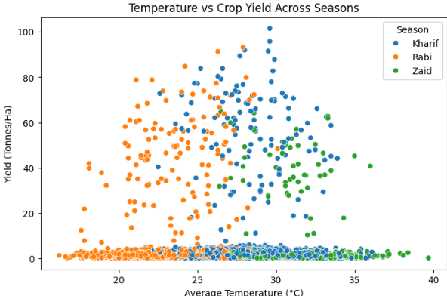
RESULTS
Kharif shows several high-yield observations at temperatures around 25–31°C.
Rabi has high-yield observations mainly around 20–29°C.
Zaid generally occurs at higher temperatures, with many observations around 28–35°C.
Yield varies considerably even at similar temperatures, indicating that temperature alone does not determine yield.
The plot shows different temperature–yield patterns across seasons.

Slide 11
Future scope
Develop predictive models to forecast crop yield and profitability.
Use real-time weather and soil data for more accurate analysis.
Build a dashboard for interactive seasonal performance monitoring.
Extend the analysis to more regions, crops, and multiple years.
Use machine learning to recommend suitable crops, irrigation, and resource allocation.
Develop early warning systems for crop disease and pest risks.
Integrate market price trends to improve farmers’ profitability and crop-selection decisions.

Slide 12
GitHub Link
https://github.com/Priyadarshini-L-215/Seasonal-Agriculture-Performance-Analysis.git

Slide 13
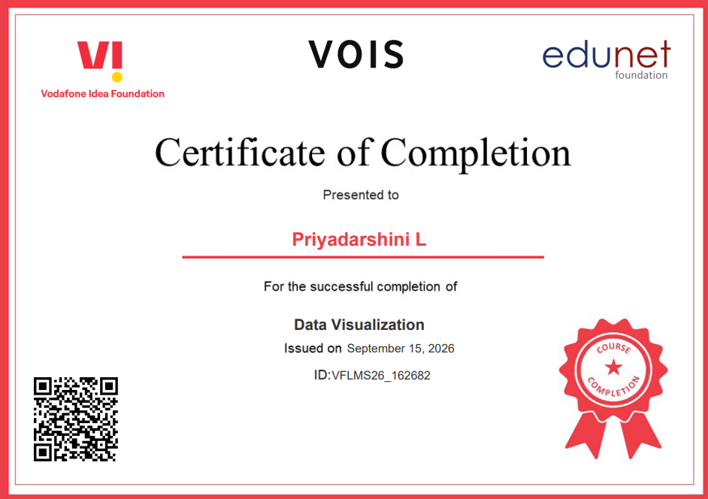
VOIS Course completion certificate -
Course name- Data Visualization

Slide 14
Thank you
.
.

