Slide 1
UNHACK ’25 Die Analyzer

Slide 2
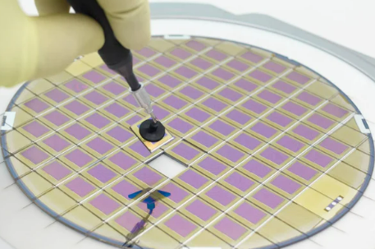
Chip from a wafer

Slide 3
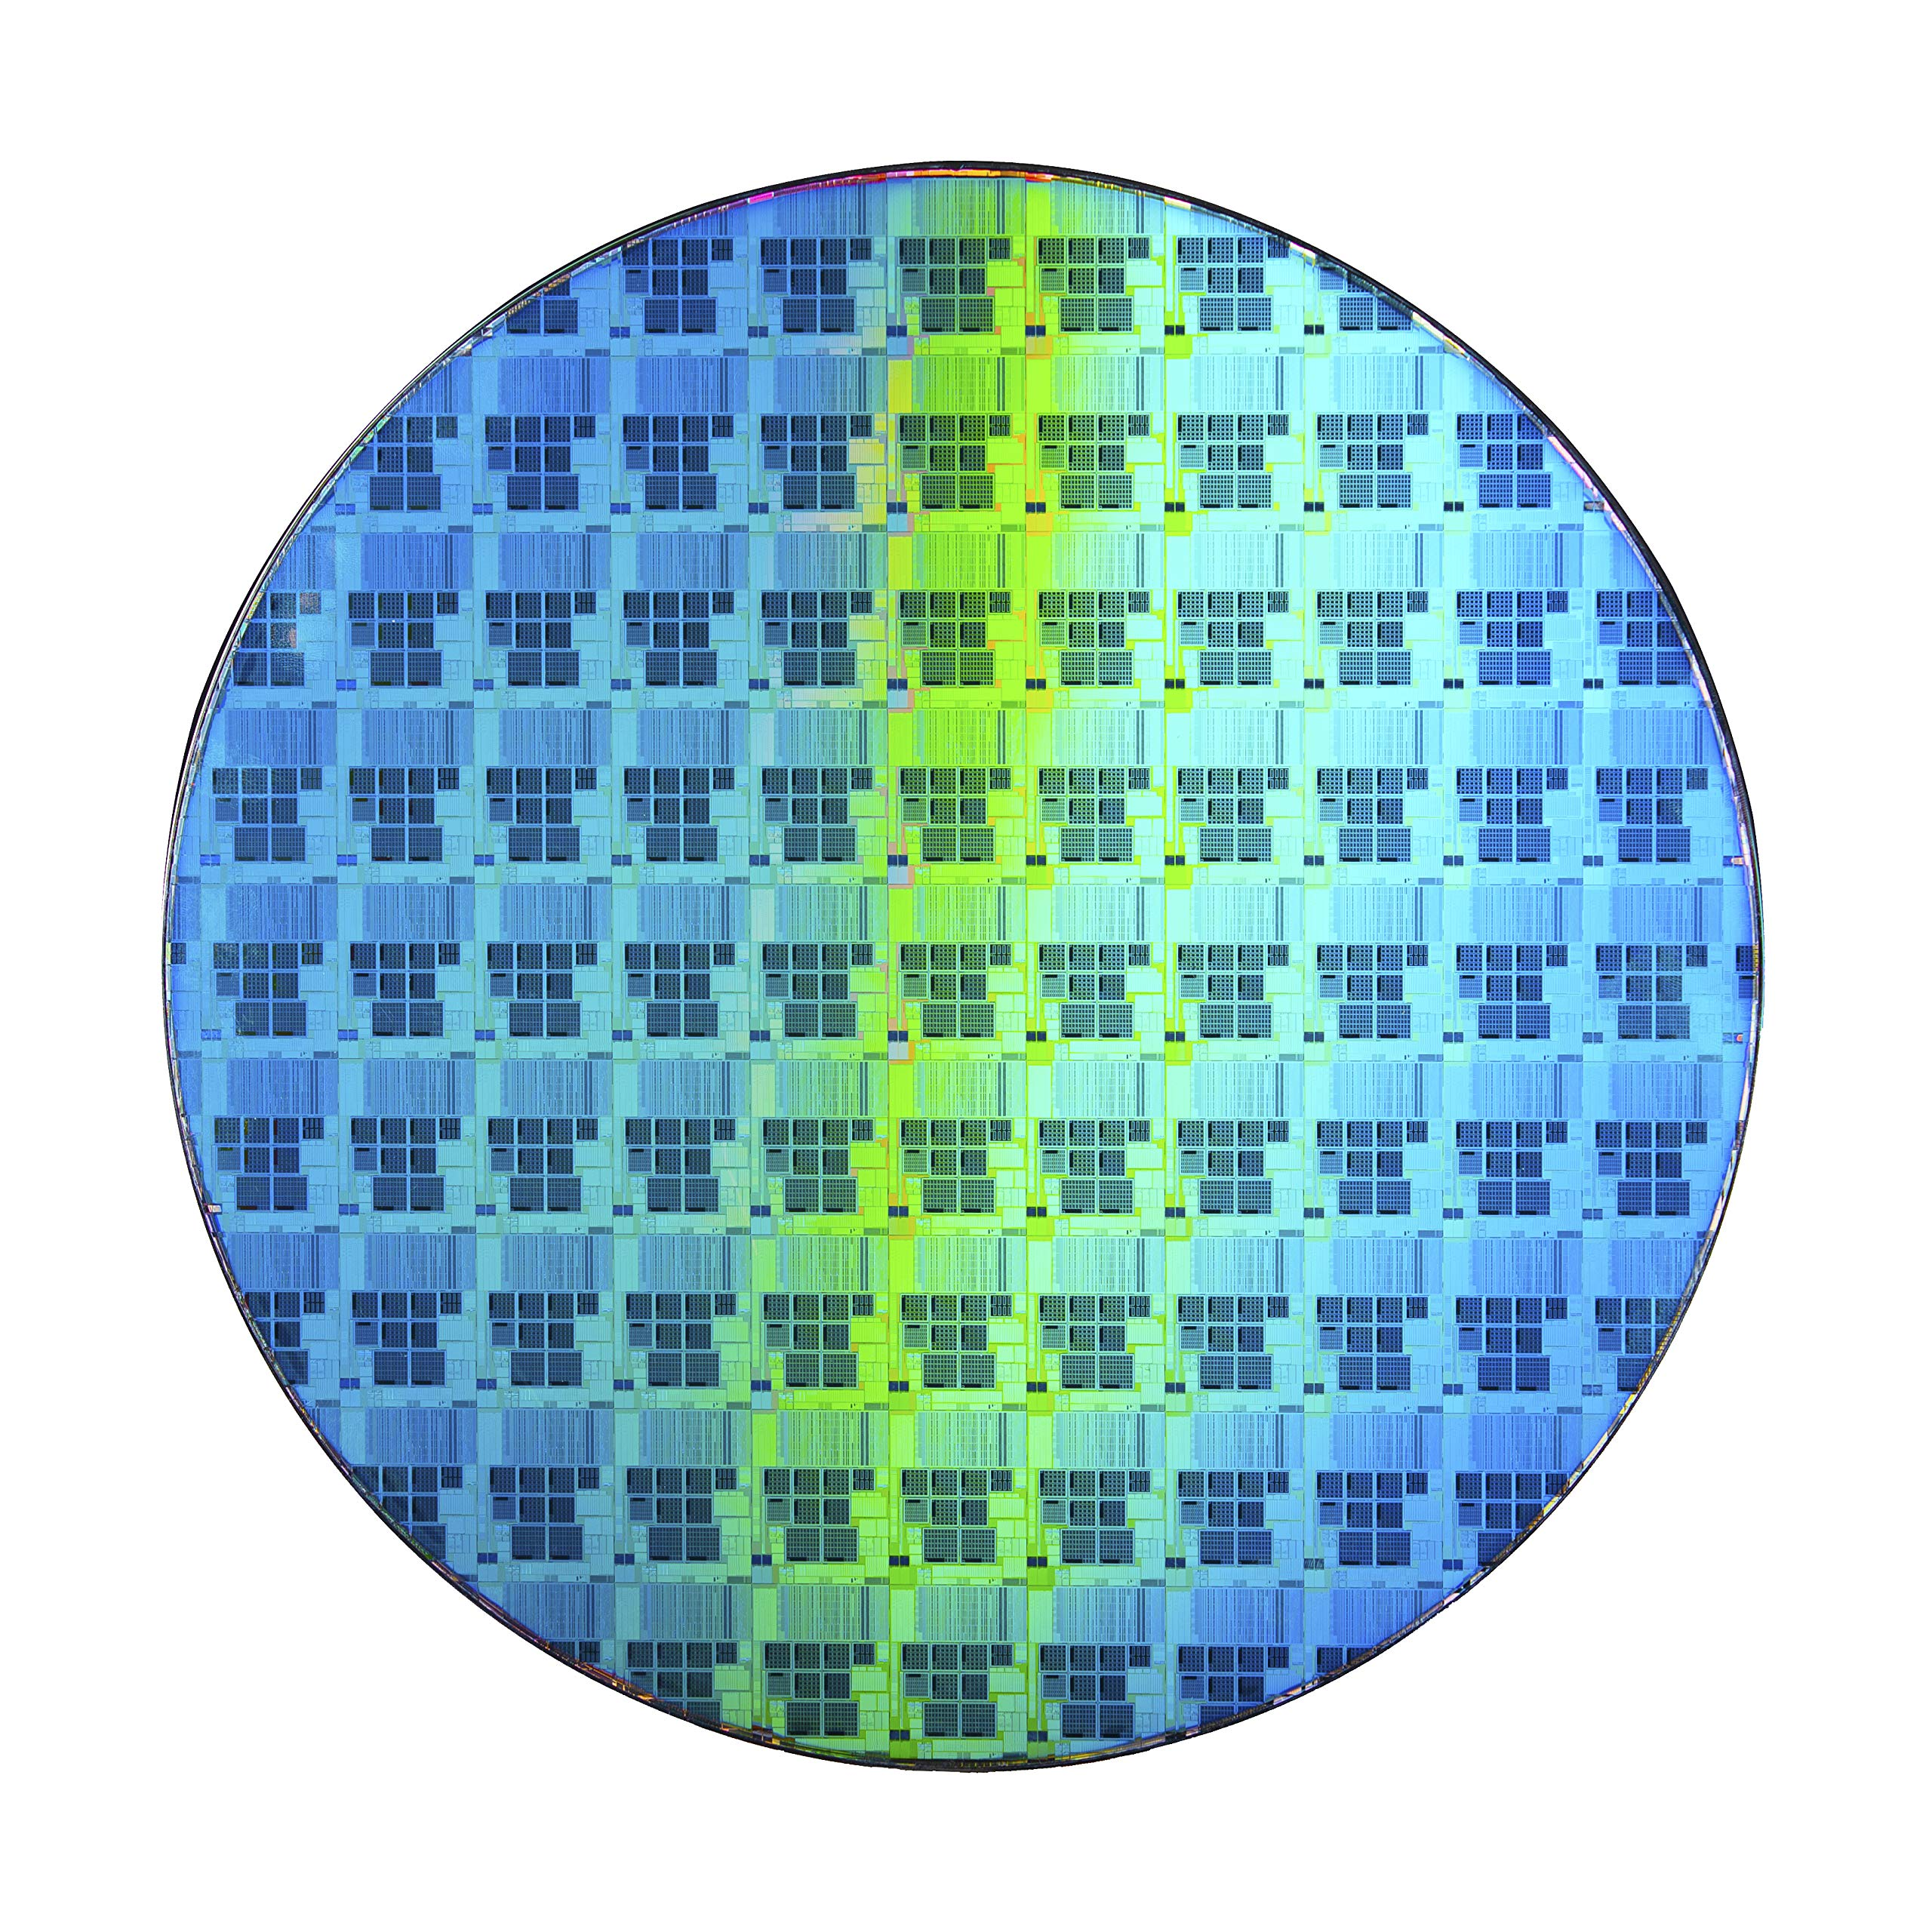
Wafer and Die
Wafer
Die

Slide 4
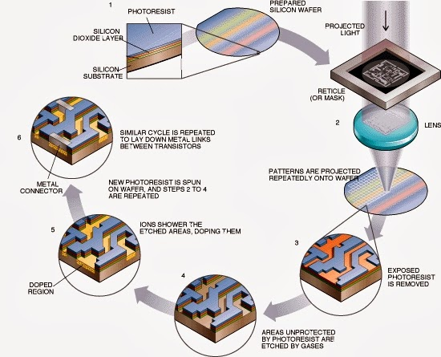
Wafer fabrication process

Slide 5

Inspection Overview
Good Die
Bad Die
Tool #1
Inking
file

Slide 6
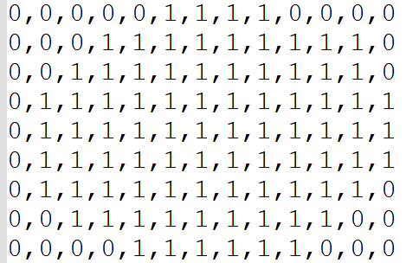
Wafer Map Representation – (Matrix.csv)
9x13
0 | 0 | 0 | 0 | 0 | 1 | 1 | 1 | 1 | 0 | 0 | 0 | 0
0 | 0 | 0 | 1 | 1 | 1 | 1 | 1 | 1 | 1 | 1 | 0 | 0
0 | 0 | 1 | 1 | 1 | 1 | 1 | 1 | 1 | 1 | 1 | 1 | 0
0 | 1 | 1 | 1 | 1 | 1 | 1 | 1 | 1 | 1 | 1 | 1 | 1
0 | 1 | 1 | 1 | 1 | 1 | 1 | 1 | 1 | 1 | 1 | 1 | 1
0 | 1 | 1 | 1 | 1 | 1 | 1 | 1 | 1 | 1 | 1 | 1 | 1
0 | 1 | 1 | 1 | 1 | 1 | 1 | 1 | 1 | 1 | 1 | 1 | 0
0 | 0 | 1 | 1 | 1 | 1 | 1 | 1 | 1 | 1 | 1 | 0 | 0
0 | 0 | 0 | 0 | 1 | 1 | 1 | 1 | 1 | 1 | 0 | 0 | 0
2D Matrix File
1 –> Valid dies 0 –> Invalid dies
Note: MATRIX.csv will always be in 0 orientation

Slide 7
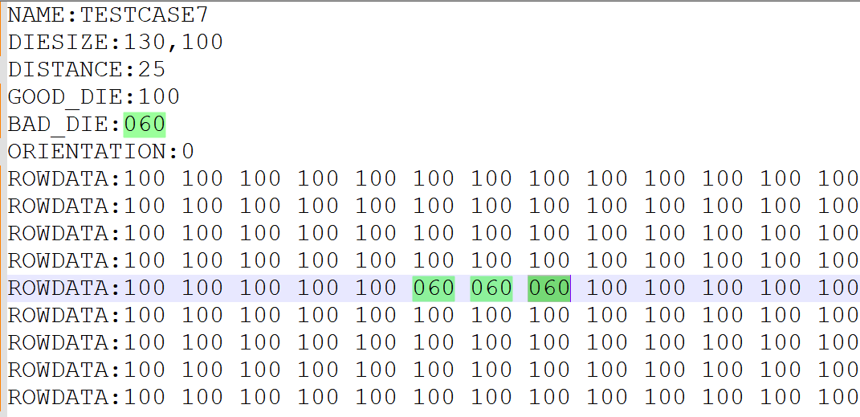
Ink file Overview
9x13
Bad dies
Good dies

Slide 8
Apply Ink file on Wafer map
9x13
9x13
0 | 0 | 0 | 0 | 0 | 1 | 1 | 1 | 1 | 0 | 0 | 0 | 0
0 | 0 | 0 | 1 | 1 | 1 | 1 | 1 | 1 | 1 | 1 | 0 | 0
0 | 0 | 1 | 1 | 1 | 1 | 1 | 1 | 1 | 1 | 1 | 1 | 0
0 | 1 | 1 | 1 | 1 | 1 | 1 | 1 | 1 | 1 | 1 | 1 | 1
0 | 1 | 1 | 1 | 1 | 1 | 1 | 1 | 1 | 1 | 1 | 1 | 1
0 | 1 | 1 | 1 | 1 | 1 | 1 | 1 | 1 | 1 | 1 | 1 | 1
0 | 1 | 1 | 1 | 1 | 1 | 1 | 1 | 1 | 1 | 1 | 1 | 0
0 | 0 | 1 | 1 | 1 | 1 | 1 | 1 | 1 | 1 | 1 | 0 | 0
0 | 0 | 0 | 0 | 1 | 1 | 1 | 1 | 1 | 1 | 0 | 0 | 0
0 | 0 | 0 | 0 | 0 | 1 | 1 | 1 | 1 | 0 | 0 | 0 | 0
0 | 0 | 0 | 1 | 1 | 1 | 1 | 1 | 1 | 1 | 1 | 0 | 0
0 | 0 | 1 | 1 | 1 | 1 | 1 | 1 | 1 | 1 | 1 | 1 | 0
0 | 1 | 1 | 1 | 1 | 1 | 1 | 1 | 1 | 1 | 1 | 1 | 1
0 | 1 | 1 | 1 | 1 | 1 | 1 | 1 | 1 | 1 | 1 | 1 | 1
0 | 1 | 1 | 1 | 1 | 1 | 1 | 1 | 1 | 1 | 1 | 1 | 1
0 | 1 | 1 | 1 | 1 | 1 | 1 | 1 | 1 | 1 | 1 | 1 | 0
0 | 0 | 1 | 1 | 1 | 1 | 1 | 1 | 1 | 1 | 1 | 0 | 0
0 | 0 | 0 | 0 | 1 | 1 | 1 | 1 | 1 | 1 | 0 | 0 | 0
Apply Ink file
1 –> Valid dies 0 –> Invalid dies
Bad dies
Good dies

Slide 9
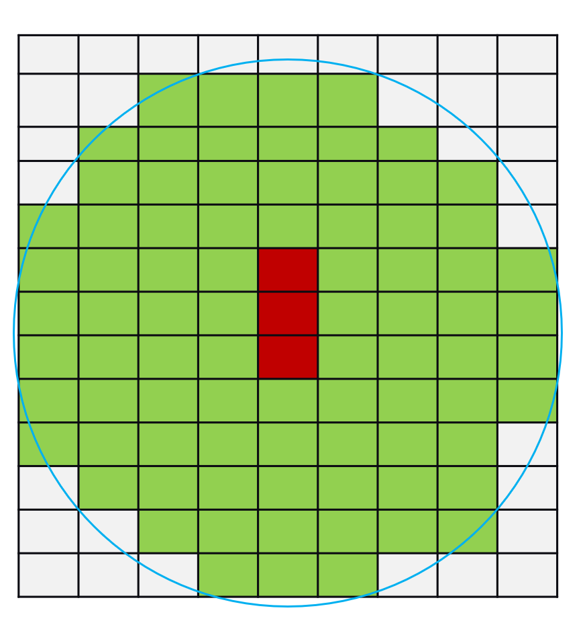
Interpreting Orientation
9x13
13x9
90
Clockwise
0 orientation
90 orientation
When ORIENTATION is 90 in input ink file, it is already rotated at 90 degree clockwise. The output ink file is always expected to be in zero orientation.

Slide 10
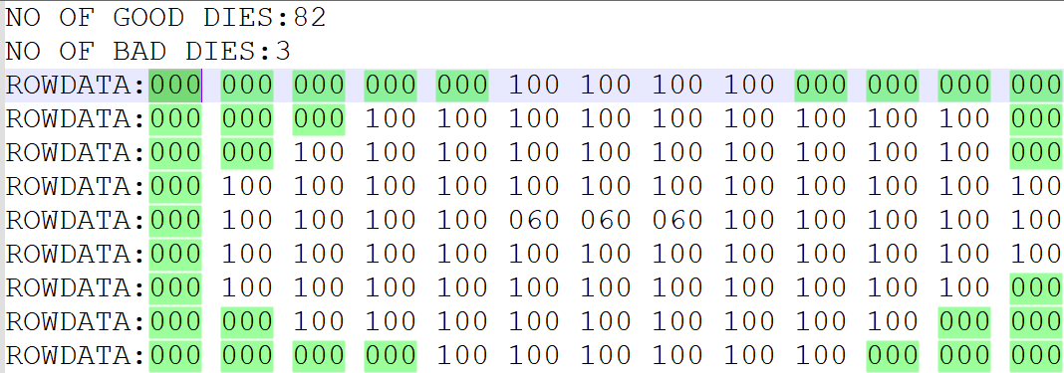
Milestone #1 – Rotate
Input:
2D Matrix File
Ink File
Rotate the ink file based on the orientation and mark the invalid dies(000) on the ink file based on the matrix.
Output:
Generate the output file with number of good dies and bad dies in the below format. The output filename should be M<MilestoneNumber>T<TestcaseNumber>.txt eg: M1T3.txt
Output file format
Notes:
Remove the space in # of good dies

Slide 11
Milestone #1 – Sample
2D Matrix File
Output file
INVALID_DIE:000
Apply Ink file
Change values of Ink file from any value to 000 wherever there is 0 in matrix file

Slide 12
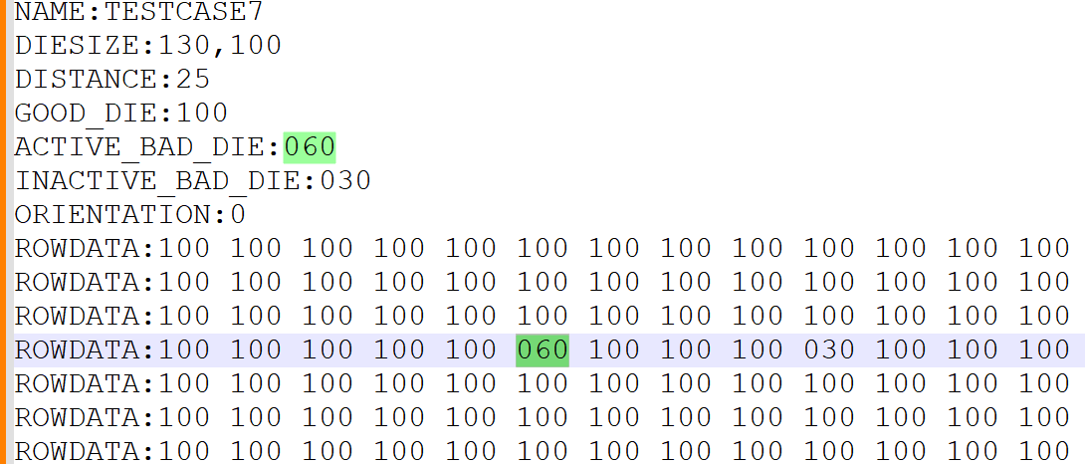
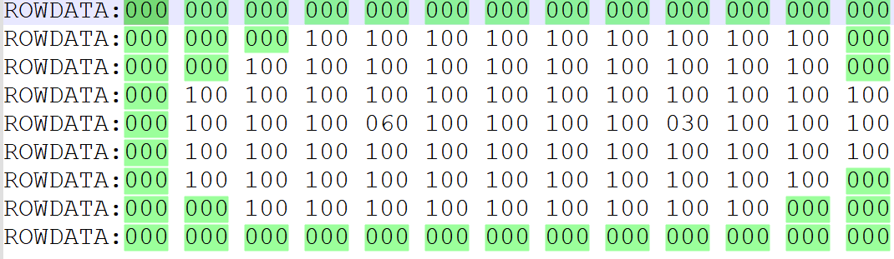
Milestone #2 – Ink file with limited dies
Input matrix file : Base file; will not change for a wafer.
Input Ink File : File with test result; it may have test result for limited dies.
Align Ink File to Matrix Center
Find the center row of the matrix.
If odd rows → align to the middle row.
If even rows → align to the first of the two center rows.
Find the excluded dies from the matrix file and consider it as Invalid dies (000) though it is mentioned as 1 in matrix file.
2D Matrix File
Input Ink File with Limited Dies
Ink File with All Dies

Slide 13
Milestone #2 – Neighborhood Contamination Spread
9x13
9x13
 |  |  |  |  | 1 | 1 | 1 | 1
 |  |  | 1 | 1 | 1 | 1 | 1 | 1 | 1 | 1 | 1
 |  | 1 | 1 | 1 | 1 | 1 | 1 | 1 | 1 | 1 | 1
 | 1 | 1 | 1 | 1 | 1 | 1 | 1 | 1 | 1 | 1 | 1 | 1
 | 1 | 1 | 1 | 1 | 6 | 1 | 1 | 1 | 1 | 3 | 1 | 1
 | 1 | 1 | 1 | 1 | 1 | 3 | 1 | 1 | 1 | 1 | 1 | 1
 | 1 | 1 | 1 | 1 | 1 | 1 | 1 | 1 | 1 | 1 | 1
 |  | 1 | 1 | 1 | 1 | 1 | 1 | 1 | 1 | 1
 |  |  |  | 1 | 1 | 1 | 1 | 1 | 1
 |  |  |  |  | G | G | G | G
 |  |  | G | G | G | G | G | G | G | G | G
 |  | G | G | G | G | G | G | G | G | G | G
 | G | G | G | C | C | C | G | G | G | G | G | G
 | G | G | G | C | B | C | G | G | G | B | G | G
 | G | G | G | C | C | B | G | G | G | G | G | G
 | G | G | G | G | G | G | G | G | G | G | G
 |  | G | G | G | G | G | G | G | G | G
 |  |  |  | G | G | G | G | G | G
Find the contaminated neighborhood good dies around the bad dies.
Bad Die (Active and Inactive Dies)
Active Bad Die can contaminate the neighborhood dies
Inactive Bad Die will not affect the neighborhood dies
Contaminated Die (Output)
Dies affected because of active bad dies (00C)
Note: Inactive bad die can not be marked as contaminated die since it is already bad die.
Good dies
Active bad die
Inactive bad die
Contaminated dies

Slide 14
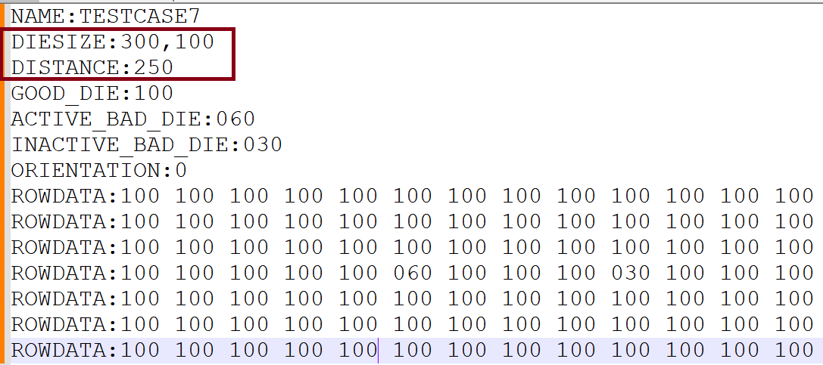
Milestone #2 – Finding contaminated dies
Input
Die Size : Die Height, Die Width
Distance: Distance to find neighborhood dies (from edge of the bad die)
Find the neighborhood dies at row and column level based on Distance, Die Height and Die Width.
Die Height
Distance
Die Width

Slide 15
Milestone #2: Input and Process
Input:
2D Matrix File
Ink File
Process
Rotate the ink file based on the orientation.
Align with center if limited dies are given in input ink file.
Mark the invalid dies(000) on the ink file based on the matrix.
Mark the Contaminated dies (00C) based on active bad dies and distance set on the ink file

Slide 16
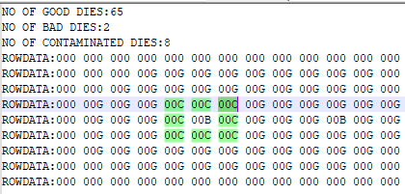
Milestone #2 – Output
Contaminated dies should be represented by 00C in output file
Good dies should be represented by 00G
Active and Inactive bad dies should be represented by 00B
Invalid dies should be represented by 000 in output file
Generate the output file with number of good dies, bad (active and inactive) dies and contaminated in the below format. The output filename should be M<MilestoneNumber>T<TestcaseNumber>.txt eg: M2T3.txt
Output file format

Slide 17
Milestone #2 – Sample
Output Ink file
Apply Ink file
CONTAMINATED_DIE : 00C INVALID_DIE: 000 GOOD_DIE: 00G BAD_DIE: 00B

Slide 18
Milestone #3 – Bad Cluster
A die is connected to neighborhood dies in 4 ways. Goal is to identify the bad cluster.
C | B | C | G
G | B | G | G
G | G | B | G
G | G | G | G
Bad Cluster with 4 dies
Separate Cluster
Both contaminated dies (00C) and bad dies (00B) will be part of bad cluster

Slide 19
Milestone #3 – Find largest bad cluster
Input:
2D Matrix file
Ink File
Rotate and align your Ink file, Mark Invalid dies based on Matrix file. Find the bad clusters. Output:
Total number of clusters and size of the largest cluster
# of clusters, largest cluster size
Eg: (2, 12)
The output filename should be M<MilestoneNumber>T<TestcaseNumber>.txt eg: M3T1.txt
0 | 0 | 0 | 0 | 0 | G | G | G | G | 0 | 0 | 0 | 0
0 | 0 | 0 | G | G | G | G | G | G | G | G | G | 0
0 | 0 | G | C | C | C | G | G | G | G | G | G | 0
0 | G | G | C | B | C | G | G | G | G | C | C | C
0 | G | G | C | C | C | G | G | G | G | C | B | C
0 | G | G | G | G | G | G | G | G | G | C | C | C
0 | G | G | G | G | G | G | G | G | G | C | B | 0
0 | 0 | G | G | G | G | G | G | G | G | C | 0 | 0
0 | 0 | 0 | 0 | G | G | G | G | G | G | 0 | 0 | 0

Slide 20

Milestone #3 – Find largest bad cluster
Output file

Slide 21
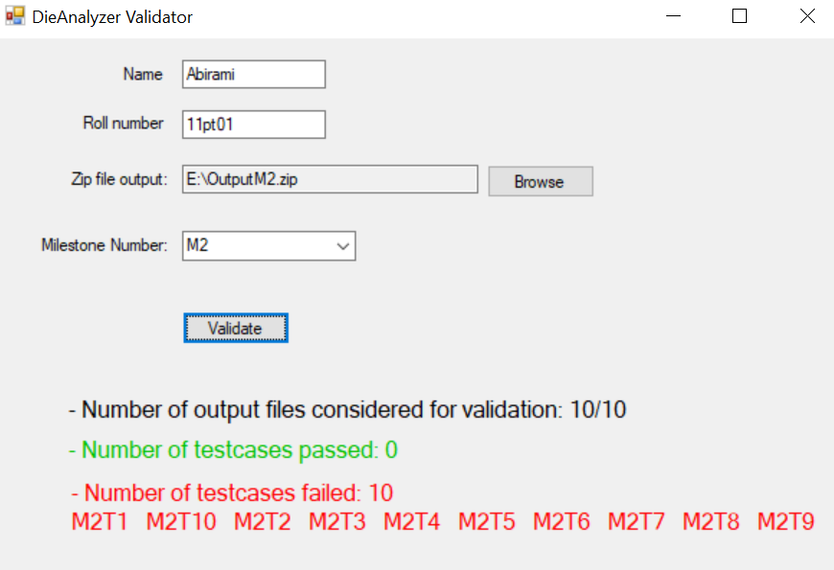
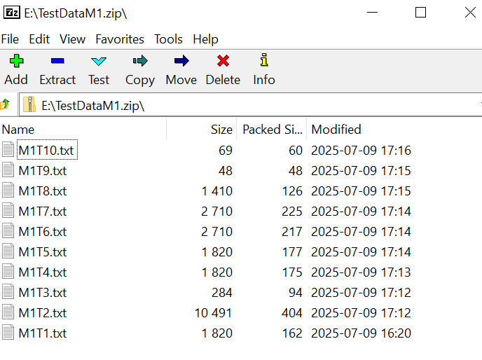
Validator Usage
Create
Create a zip of all the result files
Launch
Launch the DieAnalyzerValidator.exe
Choose
Choose the .zip file path
Select
Select milestone # in the drop down
Click
Click Validate

