Slide 1
Employee Data Analysis using Excel
STUDENT NAME: Priyadharshini.S
REGISTER NO:312200393/
4A074E0BDC29387A03247FD8203BB410
DEPARTMENT: b .com general
COLLEGE :S.I.V.E.T.college

Slide 2
PROJECT TITLE
Employee Performance Analysis using Excel

Slide 3


AGENDA
Problem Statement
Project Overview
End Users
Our Solution and Proposition
Dataset Description
Modelling Approach
Results and Discussion
Conclusion
3/21/2024 Annual Review

Slide 4

PROBLEM STATEMENT
1. validating employee
performance
Based on performance
providing increment the
employee

Slide 5

PROJECT OVERVIEW
Analyzing the performance of employees considering.
Various factors like employee id, gender, performance level,
business unit.

Slide 6

WHO ARE THE END USERS?
• EMPLOYEE
• EMPPLOYER
• MANAGEMENT
• INDUSTRY
• ORGANISATION

Slide 7

OUR SOLUTION AND ITS VALUE PROPOSITION
Conditional formatting-Missing
2. Formula-performance level
3. IF(L2=5,”Very
High”,IF(L2=4,”High”,IF(L2=3,”Med”,IF(L2=2
,”Low”,”Low”)))))
4. Filter-Remove the value
5. Graph-Data visualization

Slide 8
Dataset Description
Employee=kaggle
26-features
13-features
Emp id-num
FirstName
LastName
Emp type
Performance level
Gender-Male,Female
Title
Supervisor

Slide 9

THE "WOW" IN OUR SOLUTION
=IFD(X2=5,”VERYHIGH”,IF(X2=4,”HIGH”,IF(X2=3,”
MED”,IF(X2=2,”LOW”,))))
3/21/2024 Annual Review
9

Slide 10
MODELLING
Data collection :
1.Edunet download
2.Goodwill download
Features:
Identifying features one by one
What features you will identify
Data leaning:
1.Missing values identify
2.Missing values filter out
Performance level:
Calculate which column you will performance
Summary:
1.Pivot table
2. graphs
3.Pp
10

Slide 11
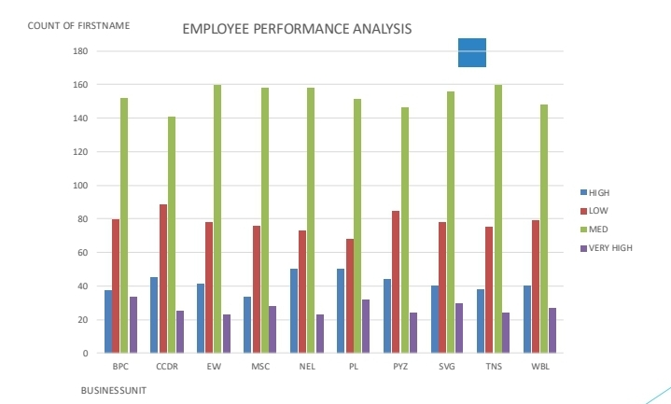
RESULTS
11

Slide 12
conclusion
. 1.Download the data employee form Edunet
Dashboard.2.Filter the employee data3.Created a
performance level using formula.4.In Insert option using
pivot table create a table EMPLOYEE PERFORMANCE
ANALYSIS.5.Also create a pie chart graph

