Slide 1
PRIYADHARHSHINI Y au211521104119
Rock, Paper, Scissors(CNN)

Slide 2
Rock, Paper, Scissors: Predicting Your Move with AI
A Convolutional Neural Networks (CNN)-based Approach

Slide 3

AGENDA
Understanding RPS and the Project Goal
Traditional Rock, Paper, Scissors (RPS)
Project Motivation: Introducing an AI Opponent
Building the AI Opponent
Convolutional Neural Networks (CNNs) for Image Recognition
Designing the CNN Model for RPS
Training the AI Opponent to be Smart
Data Acquisition and Preparation
Training Process and Evaluation
The AI-powered RPS Game in Action
User Interaction and Prediction
Gameplay and Winner Determination
Conclusion
Project Achievements and Future Enhancements

Slide 4

PROBLEM STATEMENT
The Problems of Predictable RPS:
Limited Gameplay: Traditional Rock, Paper, Scissors (RPS) relies solely on random computer choices.
Reduced Engagement: As players become familiar with the game mechanics, the predictability of the computer's choice can lead to a less engaging experience.
Lack of Strategic Depth: The random nature of the game limits opportunities for players to develop and employ strategic thinking.
Solution: Introducing an AI Opponent
This project proposes a solution by developing an AI opponent capable of analyzing user hand gestures and predicting their choices.
We leverage Convolutional Neural Networks (CNNs), a powerful machine learning technique for image recognition.
By training the CNN model on a dataset of hand gestures representing rock, paper, and scissors, the AI opponent learns to identify these gestures from user images.
This enables the AI to predict the user's choice, adding a new layer of strategy and challenge to the game.

Slide 5
Why We Want to Solve This Problem:
We believe that introducing an AI opponent can significantly enhance the RPS experience:
Increased Engagement: The element of surprise and the need to outsmart the AI will make the game more engaging and exciting for players.
Strategic Gameplay: Players will need to develop strategies to deceive the AI and make unpredictable choices, adding a new dimension to the game.
Educational Value: This project demonstrates the practical application of CNNs in a fun and interactive setting, potentially sparking interest in machine learning concepts.

Slide 6

PROJECT OVERVIEW
Building an AI Opponent for Rock, Paper, Scissors
This project tackles the predictability of traditional RPS by introducing a CNN-based AI opponent.
The AI analyzes user's hand gestures captured as images to predict their choice (rock, paper, scissors).
Here's the core workflow:
User plays RPS: The user displays a hand gesture representing their choice (rock, paper, or scissors).
Image capture: The user's hand gesture is captured as a digital image.
AI prediction: The captured image is fed to the trained CNN model.
Prediction output: The model predicts the user's choice based on the analyzed image.
Gameplay and winner determination: The game logic determines the winner based on the user's choice and the AI's prediction (or a random choice if prediction is not used).
This approach creates a more strategic and engaging RPS experience where players need to outsmart the AI.

Slide 7
WHO ARE THE END USERS?
Who Benefits from This AI-powered RPS?
This AI-powered Rock, Paper, Scissors game caters to a range of users who can benefit from its unique features:
General Audience: Anyone who enjoys playing Rock, Paper, Scissors can experience a more engaging and challenging game with the AI opponent. This includes children, families, and casual gamers seeking a fun and lighthearted competition.
Computer Science Students: This project provides a practical example of image recognition and machine learning concepts. Students can understand how CNNs work by studying the model's architecture and training process. This can be valuable for solidifying their theoretical knowledge with a real-world application.
Game Developers: The concept of incorporating AI elements into traditional games can inspire developers. This project demonstrates how AI can be used to enhance gameplay by introducing a new layer of strategy and challenge. It can spark creative ideas for future game development projects.

Slide 8

SOLUTION AND ITS VALUE PROPOSITION
An AI Opponent for a Smarter RPS
The AI-powered Rock, Paper, Scissors Experience
This project introduces a novel approach to Rock, Paper, Scissors by incorporating an AI opponent powered by Convolutional Neural Networks (CNNs).
Key Features and Benefits:
Image Recognition-based Prediction: The AI analyzes user hand gestures captured as images and predicts their choice (rock, paper, scissors).
Strategic Gameplay: Unlike a random computer opponent, the AI injects a layer of strategy, requiring players to think critically and make unpredictable choices to win.
Enhanced Engagement: The challenge of outsmarting the AI creates a more exciting and engaging game experience for players of all ages and skill levels.

Slide 9
Educational Value: This project demonstrates the practical application of CNNs in a fun and interactive setting, potentially sparking interest in AI and machine learning concepts.
A More Fulfilling Game of Rock, Paper, Scissors
This AI-powered RPS offers a significant value proposition compared to the traditional game:
Increased Replay Value: The strategic depth and challenge of the AI opponent encourage users to play more and develop their gameplay skills.
Broader Appeal: The project caters to a wider audience, attracting not only casual gamers but also those interested in AI and machine learning.
Educational Potential: The game can be a fun and engaging way to introduce AI concepts to a broader audience.

Slide 10
THE WOW IN SOLUTION: MODELLING
Outsmarting the Machine in RPS!
Beyond Random Choices: A Strategic AI Opponent
This project's core innovation lies in its ability to create a strategic and engaging opponent for Rock, Paper, Scissors. Unlike traditional random computer choices, the AI opponent analyzes user behavior and makes predictions, forcing players to adapt and develop strategies.
The "Wow" Moment: When AI Reads Your Mind (Almost!)
Imagine the surprise and excitement when the user throws a punch (rock) expecting to win, but the AI cleverly throws paper, having correctly predicted the user's choice based on subtle cues in their hand gesture. This element of surprise and the constant need to outsmart the AI creates a truly "wow" experience that elevates the classic game.

Slide 11

Next Steps: Under the Hood - Building the AI Model
Now that we've explored the "wow" factor of the AI opponent, let's delve deeper into the technical aspects. The next slide will explain how we built this intelligent opponent using Convolutional Neural Networks (CNNs) for image recognition.
This slide structure first highlights the innovative aspect of your solution – the strategic AI opponent – and then builds anticipation for the technical details by mentioning the "wow" moment. By piquing the audience's interest, you can effectively transition into explaining the modeling approach using CNNs in the next slide.

Slide 12
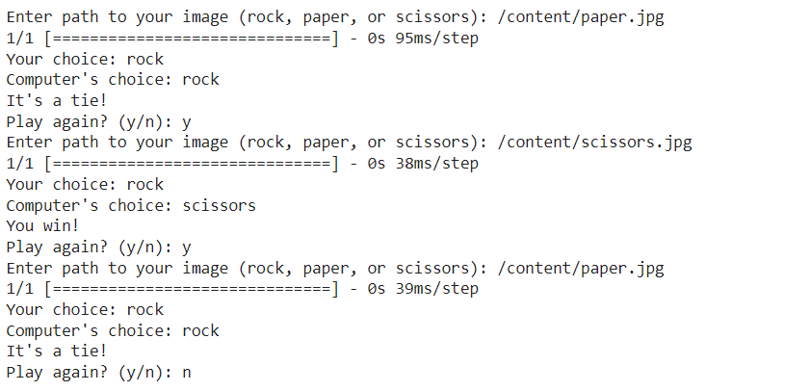
OUTPUT

Slide 13
PROJECT ACHIEVEMENTS
Developed an AI opponent for Rock, Paper, Scissors using Convolutional Neural Networks (CNNs).
Successfully trained the model to predict user's choices from hand gesture images.
Created an interactive game experience with a more challenging and strategic AI opponent.

Slide 14
THANK YOU!!!

