Slide 1

Sign2Connect
“Bridging Communication Between the Deaf and Hearing World”

Slide 2
Table of contents
01
02
03
04
05
06
Introduction
Problem & solution
Proposed Solution
Objectives of the Project
System Flow Overview
Website Architecture

Slide 3
Table of contents
07
08
09
10
11
12
Communication Mode
Input setup & Main presentation Interface
Q&A & Real time interact
Key Features
Online Meeting Integration
Users Journey

Slide 4
Table of contents
13
14
15
16
Technology Stack
Future Scope / Improvements
Impact / Expected Outcomes
Conclusion

Slide 5

01
Introduction

Slide 6

Introduction
Millions of people with hearing or speech impairments face barriers during communication — especially in presentations, classrooms, or meetings. Sign2Connect aims to bridge this gap through real-time Sign ↔ Speech translation.

Slide 7


Problem Statement
Deaf and mute individuals struggle to communicate fluently with others.
Most people don’t understand sign language.
Existing tools are either slow, expensive, or require special setup.
Communication barriers exist especially in presentations, meetings, and daily interactions.

Slide 8

🧩 Proposed Solution
We propose Sign2Connect, a web platform that converts:
Sign → Speech for presenters
Speech → Sign for listeners
Uses webcam sign detection, speech recognition, and AI translation.
Works online and offline, with real-time processing.

Slide 9
466 million+
2-Way Communication
120+ languages
People worldwide live with hearing loss (WHO, 2024)
Can be integrated with our sign-to-speech system
Between normal speakers and Deaf/Mute individuals made possible in real time

Slide 10

Objectives
✅ Enable inclusive, two-way communication
✅ Simplify real-time sign-to-speech translation.
✅ Provide an accessible, multi-language platform.
✅ Help deaf presenters share ideas easily.

Slide 11

Key Features
👋Real-time sign detection & speech synthesis
🎤 Multi-language support (English, Tamil, Chinese, etc.)
🌐 PPT/Meeting integration
📽️ Recording & replay
🔤Accessibility settings (captions, font size, contrast)
📱Mobile sync via QR

Slide 12
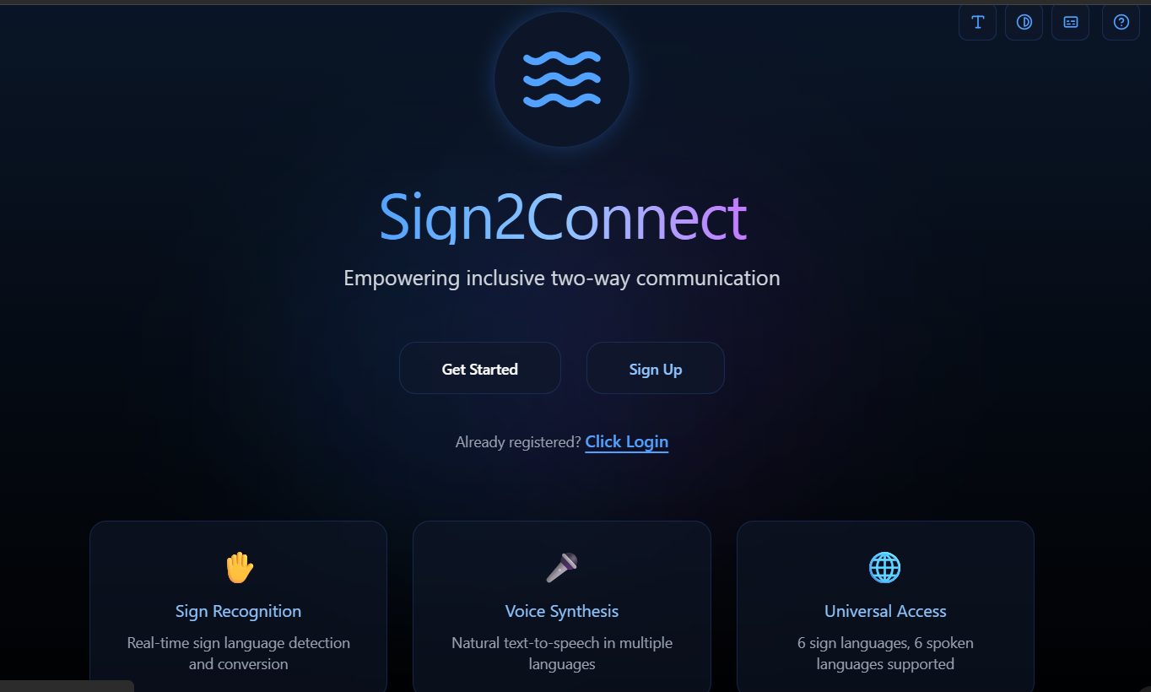
Product infographic
Interface Demo
Features
Showcase the design of our web platform, including live translation screen, avatar display, and multilingual text output.
*Converts signs ↔ speech in real time.
*PPT sharing + multilingual TTS.
*Dual-use: presentation & online meeting mode.
*Session recording + companion mobile sync.
Accessibility Scope
Users
it’s a free educational prototype with potential for institutional deployment in schools and online meeting tools.
*Deaf/Mute individuals
*Teachers, presenters
*Colleges & inclusivity workshops
Updates
Development Stage
Currently in prototype stage (Figma + front-end design) and planned for deployment testing in future versions.
*AI accuracy improvement
*Avatar personalization
*Secure cloud-based data sync

Slide 13
Competition comparison
Feature | Existing Tools | Sign2Connect
Real-time Sign ↔ Speech | ❌ Partial (Only one-way) | ✅ Two-way full duplex
Multi-language support | ❌ Limited | ✅ 6 Languages
Online meeting integration | ❌ No | ✅ Built-in meeting option
Avatar-based sign output | ❌ None | ✅ 3D Male/Female avatars
Accessibility features | ⚠️ Basic | ✅ Text size, contrast, subtitles

Slide 14






Conclusion
“Sign2Connect transforms how people communicate — making voices visible and signs audible.”

Slide 15
Thanks!
Do you have any questions?
priyaselvan0605@gmail.com rajeshwarismdu@gmail.com

Slide 16
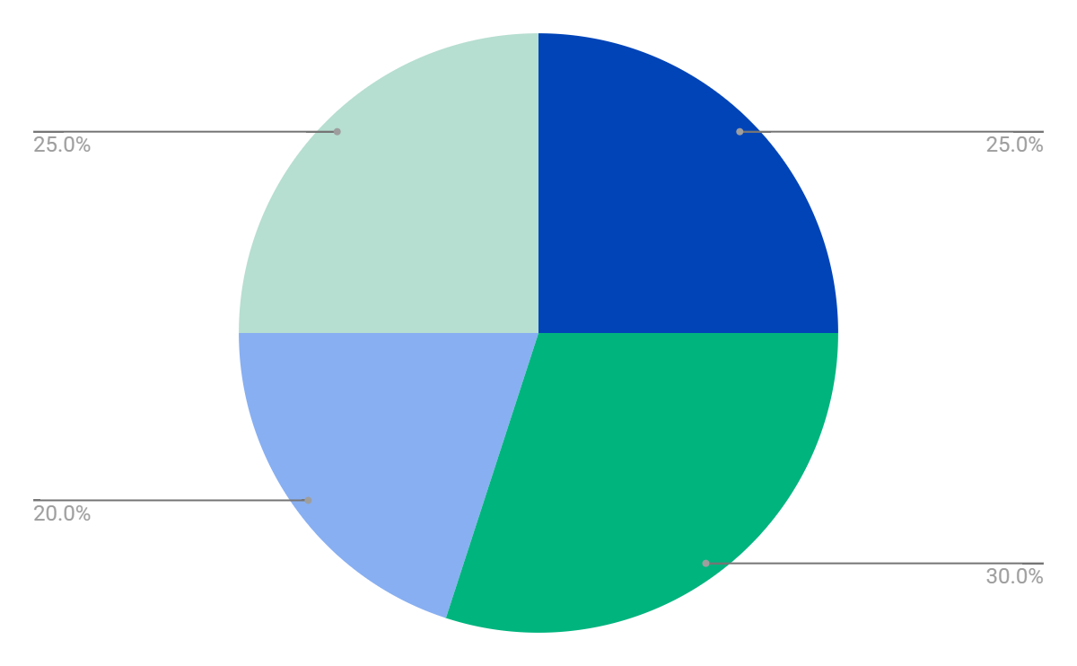
Revenue by quarter
Q1
Q2
Q3
Q4
January - March
April - June
July - September
October - December

Slide 17

Introduction
Our company
Our idea
The introduction of your company in the pitch deck should include a brief overview of who you are and what you do. It should also include a brief description of why your product or service is unique and the value it provides to customers
The “our idea” part of a pitch deck should include an explanation of your product/service, how it works, and what the customer value is. You should also explain the market opportunity for your product/service

Slide 18
Market size overview
Outer circle
$100M
Include the total size of the market, which represents the entire potential customer base for the product or service
$20M
Middle circle
Identify the target market for the product or service, which may be a subset of the total market. This could be based on factors such as demographics, geography, or specific needs
$5M
Inner circle
Indicate the current market size, which represents the portion of the target market that the company has successfully captured

Slide 19
Resources
Did you like the resources on this template? Get them for free at our other websites:
Vectors:
Background with colourful northern lights
Photos:
Office workers using finance graphs I
Office workers using finance graphs II
Office workers using finance graphs III

Slide 20
Instructions for use
If you have a free account, in order to use this template, you must credit Slidesgo by keeping the Thanks slide. Please refer to the next slide to read the instructions for premium users.
As a Free user, you are allowed to:
Modify this template.
Use it for both personal and commercial projects.
You are not allowed to:
Sublicense, sell or rent any of Slidesgo Content (or a modified version of Slidesgo Content).
Distribute Slidesgo Content unless it has been expressly authorized by Slidesgo.
Include Slidesgo Content in an online or offline database or file.
Offer Slidesgo templates (or modified versions of Slidesgo templates) for download.
Acquire the copyright of Slidesgo Content.
For more information about editing slides, please read our FAQs or visit our blog:
https://slidesgo.com/faqs and https://slidesgo.com/slidesgo-school

Slide 21
Instructions for use (premium users)
As a Premium user, you can use this template without attributing Slidesgo or keeping the "Thanks" slide.
You are allowed to:
Modify this template.
Use it for both personal and commercial purposes.
Hide or delete the “Thanks” slide and the mention to Slidesgo in the credits.
Share this template in an editable format with people who are not part of your team.
You are not allowed to:
Sublicense, sell or rent this Slidesgo Template (or a modified version of this Slidesgo Template).
Distribute this Slidesgo Template (or a modified version of this Slidesgo Template) or include it in a database or in any other product or service that offers downloadable images, icons or presentations that may be subject to distribution or resale.
Use any of the elements that are part of this Slidesgo Template in an isolated and separated way from this Template.
Register any of the elements that are part of this template as a trademark or logo, or register it as a work in an intellectual property registry or similar.
For more information about editing slides, please read our FAQs or visit our blog:
https://slidesgo.com/faqs and https://slidesgo.com/slidesgo-school

Slide 22
Fonts & colors used
This presentation has been made using the following fonts:
Inter
(https://fonts.google.com/specimen/Inter)
Raleway
(https://fonts.google.com/specimen/Raleway)
#ffffff
#191919
#0044b8
#00b47e
#88aff1
#b6ded1

Slide 23





Storyset
Create your Story with our illustrated concepts. Choose the style you like the most, edit its colors, pick the background and layers you want to show and bring them to life with the animator panel! It will boost your presentation. Check out how it works.
Pana
Amico
Bro
Rafiki
Cuate

Slide 24
Use our editable graphic resources...
You can easily resize these resources without losing quality. To change the color, just ungroup the resource and click on the object you want to change. Then, click on the paint bucket and select the color you want. Group the resource again when you’re done. You can also look for more infographics on Slidesgo.

Slide 27
JANUARY
FEBRUARY
MARCH
APRIL
MAY
JUNE
PHASE 1
Task 1
Task 2
PHASE 2
Task 1
Task 2
JANUARY
FEBRUARY
MARCH
APRIL
PHASE 1
Task 1
Task 2

Slide 30
...and our sets of editable icons
You can resize these icons without losing quality.
You can change the stroke and fill color; just select the icon and click on the paint bucket/pen.
In Google Slides, you can also use Flaticon’s extension, allowing you to customize and add even more icons.

Slide 31
Educational Icons
Medical Icons

Slide 32
Business Icons
Teamwork Icons

Slide 33
Help & Support Icons
Avatar Icons

Slide 34
Creative Process Icons
Performing Arts Icons

Slide 35
Nature Icons

Slide 36
SEO & Marketing Icons

Slide 37


