Slide 1
Software Engineering Project
Powerpoint

Slide 2
Team members
Aparna M-18BCS017
Anuvrinda R -18BCS077
Pavithra N -18BCS082
Taarini V-18BCS089
Priyadharshini T-18BCS090

Slide 3
Problem Name
Online Voting System
The Online Voting system is made for the students of the school to elect their School Pupil Leader(SPL).
The online voting system is done by the internet so it can be called the Internet Voting.
Students from class VI to class XII are allowed to vote in this online voting system.
This system provides an online tool for the students to vote on different questions posted by admin.
According to the login credentials the system will determine if the user is valid or invalid.

Slide 4
Team Roles and Responsibility
Problem Selection -Anuvrinda.R,Priyadharshini.T
Literature Survey and Comparative Analysis-Pavithra N,Taarini V
Design -Aparna.M,Anuvrinda R
Coding-Priyadharshini T,Aparna M,Pavithra N
Testing-Taarini V,Anuvrinda R

Slide 5
Survey of Existing Solutions
In the existing system,
Eligibility and Authentication: Authorized voters are
only able to vote.
• Uniqueness: One voter is allowed to vote to once.
• Accuracy: Voted should be recorded correctly.
• Integrity: Modification or loss of voting data should
not be happened that may lead to the failure of system.

Slide 6
Survey of Existing Solutions
• Reliability: System must be designed such that it can
be stable even after failures and loss of internet.

Slide 7
Survey of literature about the algorithms.
Some of the web applications follow:
1.RSA algorithm
2.Mixnet algorithm
3.Blowfish algorithm
4.AES algorithm.

Slide 8
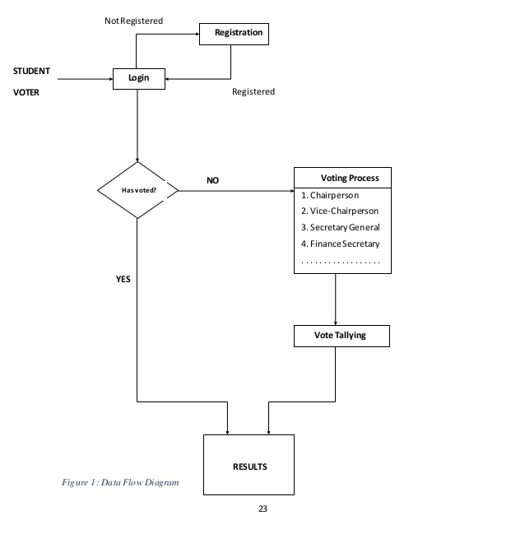
Algorithm

Slide 9
References
1.https://www.phptpoint.com/projects/online-voting-system/
2.https://nevonprojects.com/online-election-system-project/
3.https://www.slideshare.net/nitinbhasin3/online-voting-system-project-file
4.https://1000projects.org/online-voting-system-project-documentation.html

