Slide 1
Digital Portfolio
STUDENT NAME: Priyadharshini K
REGISTER NO AND NMID: 222402627 and asunm161222402627
DEPARTMENT: Computer Science With Data Science
COLLEGE: Prince Shri Venkateshwara Arts And Science College/ Madras University

Slide 2


PROJECT TITLE
Title: Digital Portfolio Website Subtitle: A simple personal portfolio using HTML, CSS, and JavaScript

Slide 3




AGENDA
Problem Statement
Project Overview
End Users
Tools and Technologies 5.Portfolio design and Layout
6.Features and Functionality
7.Results and Screenshots 8.Conclusion
9.Github Link
3/21/2024 Annual Review

Slide 4

PROBLEM STATEMENT
Students and job seekers often rely only on resumes to showcase skills. Traditional resumes lack interactivity and creativity. Recruiters struggle to accurately assess true potential. A digital portfolio can effectively bridge this gap.

Slide 5

PROJECT OVERVIEW
Academic Journey Portfolio This highlights my educational path, starting from schooling to my Data Science degree. It includes About Me, Education, Skills, Hobbies, Contact, and my profile image to present a complete academic journey.

Slide 6

WHO ARE THE END USERS?
The end users of my digital portfolio are
recruiters and hiring managers who can
easily access
my profile, skills, and to evaluate me for
achievements
internships or job opportunities.

Slide 7

TOOLS AND TECHNIQUES
HTML → For webpage layout and adding sections like About, Skills, and Contact.
CSS → For improving the look with colors, borders, and font styles.
Images/Links → To add my profile picture and clickable contact details.
GitHub → To host my portfolio website and share it with others.

Slide 8
POTFOLIO DESIGN AND LAYOUT
Home → Profile image and welcome text at the top.
About Me → A paragraph in plain text.
Skills → Simple text list (example: Python, HTML, CSS).
Education → Written like a timeline (Year – Course – Institution).
Hobbies → Written as a short list.
Contact → Details written in separate lines (Name, Phone, Email).
Responsive → Sections stack vertically for smaller devices.

Slide 9
FEATURES AND FUNCTIONALITY
Smooth scrolling – provides a clean transition while browsing. Profile image – adds a personal touch to the portfolio. Education section – displays my academic background. Simple hover effects – make interaction lively. Responsive design – works well on mobile and desktop.

Slide 10
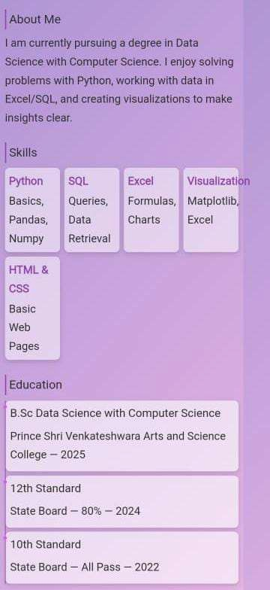
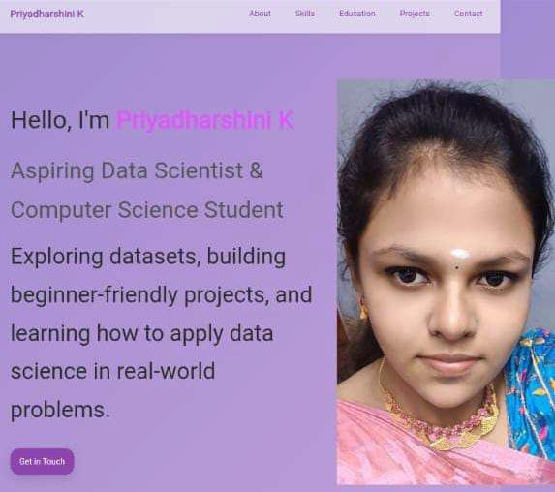

RESULTS AND SCREENSHOTS
3/21/2024 Annual Revie
w
10

Slide 11
CONCLUSION
I created this portfolio to share my details. It highlights my personal, academic, and skill areas. Navigation and scrolling make it easy to use. The design is not complex but clear. It helps me digitally present myself.
github link:https://priyadharshini3161.github.io/TNSDC-FWD-DP/
NM ID:73D39991C916182887D4A84C185B3072
11

