Slide 1

PROJECT-TRAFFIC SIGN RECOGNITION
PRIYADHARSHINI MASILAMANI
DATA ANALYST
K RAMAKRISHNAN COLLEGE OF ENGINEERING

Slide 2
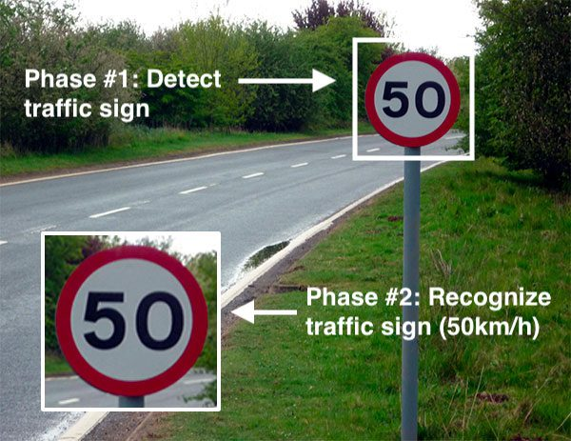
TRAFFIC SIGN CLASSIFICATION USING DEEP LEARNING
we will build a model for the classification of traffic signs available in the image into many categories using a convolutional neural network(CNN) and Keras library.

Slide 3
WORKFLOW
We need to follow the below 4 steps to build our traffic sign classification model:
Dataset exploration
CNN model building
Model training and validation
Model testing
Code :https://github.com/PriyadharshiniMasilamani/CAPSTONE-PROJECT-TRAFFIC-SIGN-RECOGNITION/blob/main/TRAFFIC_SIGN_RECOGNITION-PROJECT.ipynb

Slide 4
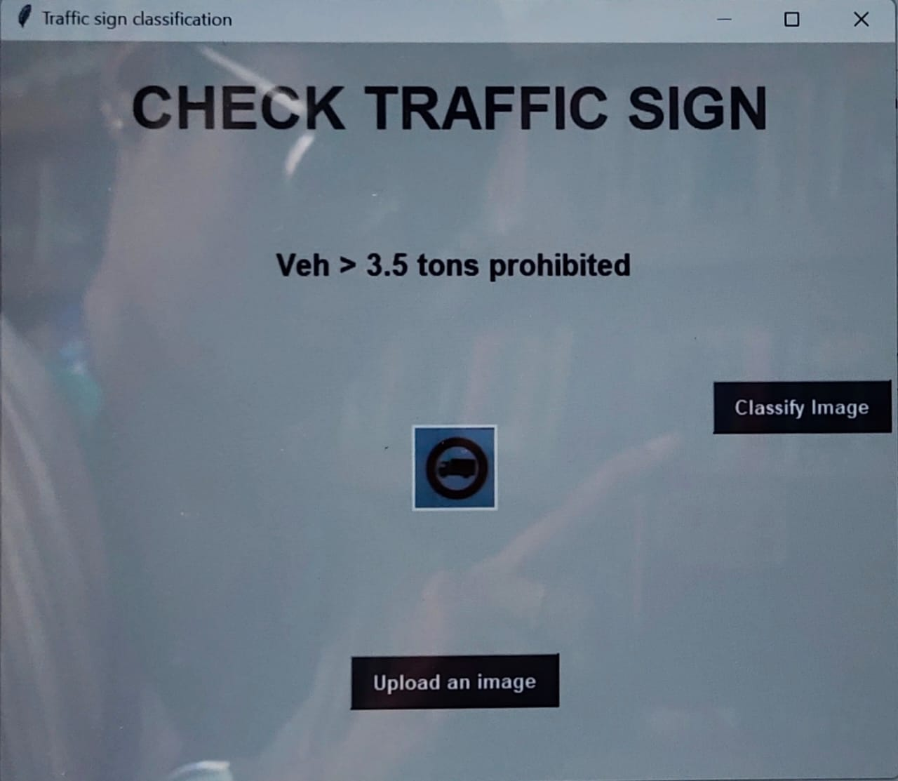
GUI FOR TRAFFIC SIGN RECOGNITION
We will use a standard python library called Tkinter to build a graphical user interface(GUI) for our traffic signs recognizer.
To predict the traffic sign, we need to provide the same resolutions of shape we used at the model training time.

Slide 5
REFERENCE
Dataset :https://www.kaggle.com/datasets/meowmeowmeowmeowmeow/gtsrb-german-traffic-sign
Code :https://www.machinelearninghub.net/post/traffic-signs-classification-using-deep-learning-flask
Youtube :https://www.youtube.com/watch?v=qahpZkPlTRM&t=1735s

Slide 6
Hurray! Now you got an understanding of how autonomous vehicles can take advantage of Computer vision and Deep Learning techniques to automatically recognize the traffic signs. Moreover, we have to build a nice interface to ease up our interaction with traffic sign recognition.
Hope you enjoyed and learned a lot with this project.
Thank you!

