Slide 1

JavaScript Project Presentation
Project Title : Comment and Reply Thread System – MERN Stack
Course : React.js / Web Development Project
Student Name : S R PRIYADHARSHINI
Roll No : 24BIT136
Department : B.Sc - IT
Mentor : Aravind

Slide 2
Project Overview & Objectives
The Concept: A high-performance full-stack MERN stack application designed to provide a structured and real-time comment discussion platform.
Core Goal: To replace static, non-interactive comment sections with a modern, event-driven real-time system where users can post comments, reply in threads, like, and dislike instantly without page refreshes.
Learning Focus: Mastering React for dynamic frontend development, Node.js with Express for backend APIs, MongoDB for data persistence, and Socket.IO (WebSockets) for live bidirectional data streaming and real-time updates.

Slide 3
Real-World Problem & Solution
The Problem: Traditional comment sections are static and non-interactive, causing users to miss new replies and leading to fragmented, delayed discussions.
The Solution: A dedicated real-time comment platform with threaded replies and instant updates, allowing users to post, reply, like, and dislike seamlessly in a clean, structured interface.
Efficiency: Real-time notifications and live status updates ensure every new comment or reply is instantly visible to all participants without refreshing the page.

Slide 4
System Architecture
Frontend: Built with React and Vite, utilizing Environment Variables (VITE_API_URL) to handle different hosting links.
Backend: A Node.js and Express server hosted on Render, communicating with a MongoDB database.
Live Sync: Powered by Socket.IO, which allows the server to "push" new comments and replies instantly to all connected users without requiring any page refresh.

Slide 5
Key Modules & Functionality
Authentication: Role-Based Access Control (RBAC) that detects if a user is logged in and provides secure access to the comment platform with JWT token validation.
Comment Posting: A clean and intuitive input form that allows users to post new comments or reply to existing threads with real-time updates visible to all participants.
Threaded Discussions: A live nested reply system that organizes comments into proper threads, making conversations structured and easy to follow without page refreshes.

Slide 6
Technical Challenges & Solutions
The "401 Unauthorized" Issue: Encountered during deployment; resolved by synchronizing the JWT_SECRET key across the Render production environment.
State Persistence: Used localStorage and JWT tokens to keep users logged in even after they close the browser or refresh the page.
CORS Management: Configured backend headers to allow secure communication only from the verified frontend URL (Vercel deployment).

Slide 7
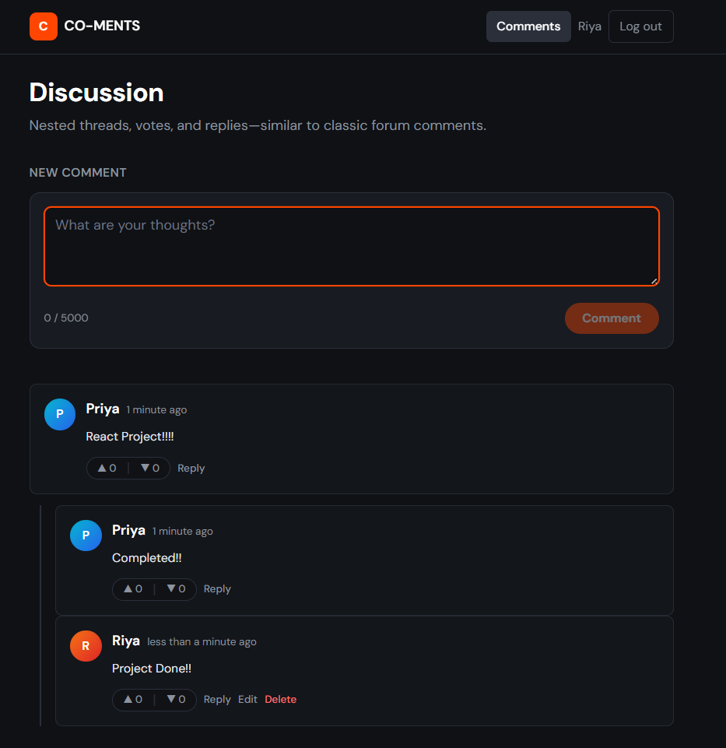
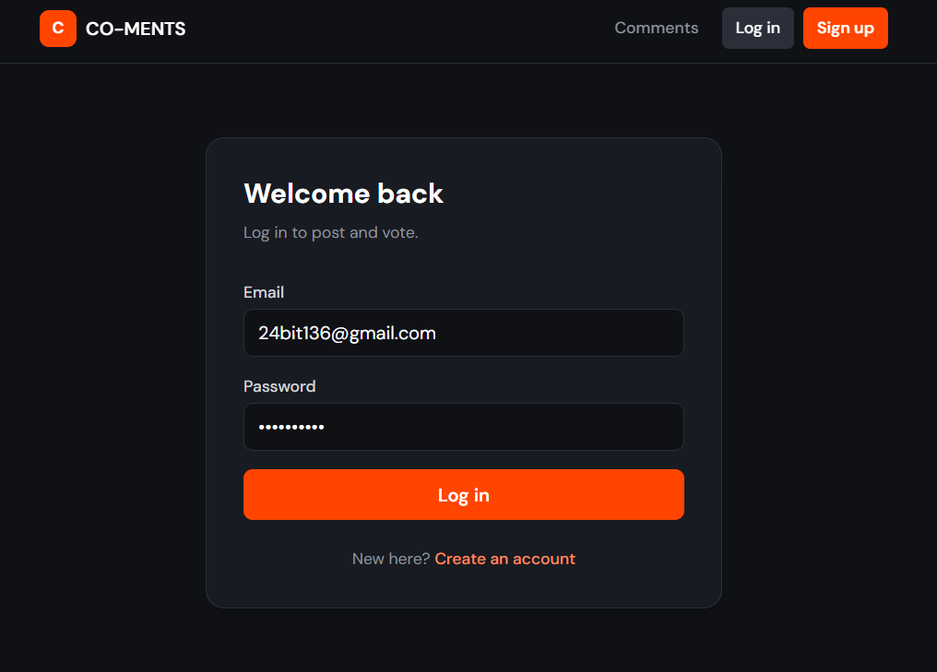
Output/Screenshot
.

Slide 8
Thank You

