Slide 1
Predicting Customer Churn with IBM Watson Studio
PHASE 3 Development of Ibm waston

Slide 2
INTRODUCTION
Business leaders understand the advantage of using the power of artificial intelligence and machine learning to stay ahead of their competitors. However, understanding the power of AI is a lot different than actually successfully implementing it in companies. For example, in 2017, Gartner estimated that Big Data projects have a success rate of only 15%. While organizational factors may be a primary reason for this poor success rate, another reason for such a high failure rate could be due to a lack of AI / Machine Learning talent needed to successfully pursue these types of projects. Specifically, it’s been shown that there is a lack of advanced machine learning talent among data professionals; less than 20% of surveyed data professionals said they were competent in such areas as Natural Language Processing (19%), Recommendation Engines (14%), Reinforcement Learning (6%), Adversarial Learning (4%) and Neural Networks – RNNs (15%).

Slide 3
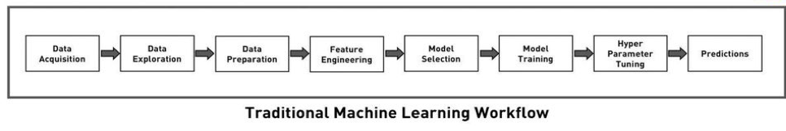
DIAGRAM

Slide 4
Acquire Data
Explore Data
Prepare Data
Create Features/Predictors (Feature Engineering)
Select Model
Train Model
Tune Hyperparameters
Make Predictions

Slide 5
Acquire Data
The first step is to acquire and load the data into Watson Studio. I found a free data source from Kaggle regarding the churn status of mobile users. Additionally, the data set included other information about the user, including type of plan, number of minutes on the phone and location.

Slide 6
Explore Data
After you have connected your data set to Watson Studio, the next step is to explore the data set to better understand the variables with which we are working. Watson Studio has a Dashboards feature that will help you accomplish this task.

Slide 7
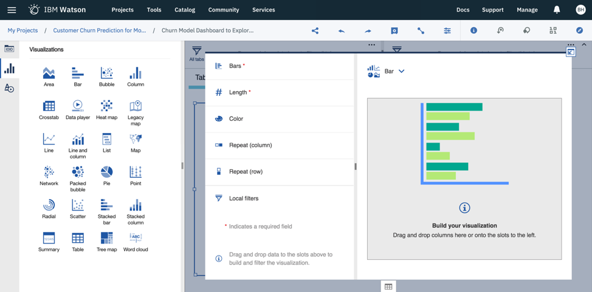
The dashboard includes three broad templates, including a single page, a tabbed page and an infographic. I have selected the tabbed template (free form) for this example.
First, connect your data source to the dashboard (data asset).

Slide 8
As you can see, there are many different chart options to visualize your data. Chart types include bar (column) graphs, pie charts, maps, I’ll take a look at a few of the variables in our data set. I will first take a look at the length of accounts.

Slide 9
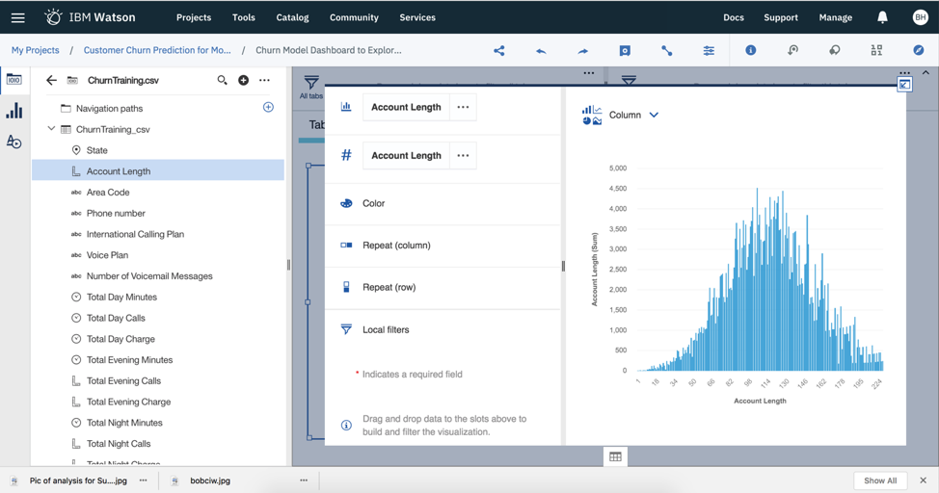

Slide 10
Preparing your Data
The data
The code computations that process the data
Visualizations of the results
Text and rich media to enhance understanding
With IBM Watson Studio, you can create Python, Scala, and R notebooks to analyze your data. In the image below, you can see both the code that was generated to upload the data. After running the code, you will see your data in the window below it.

Slide 11
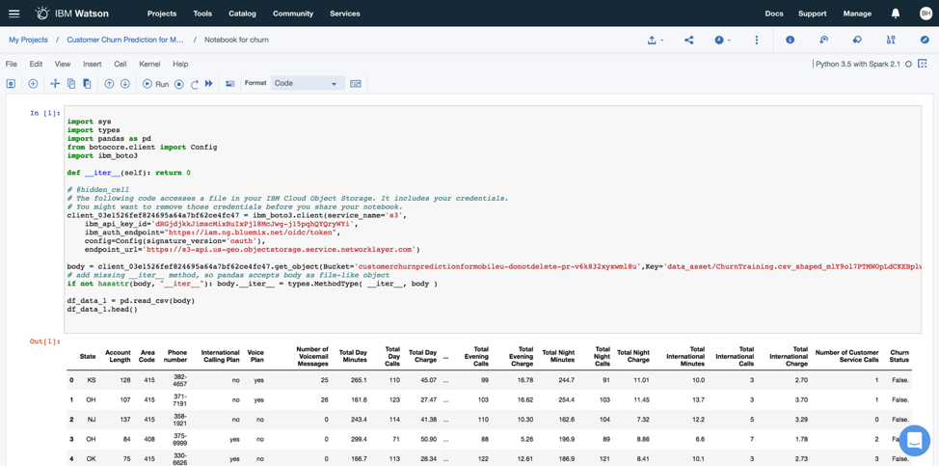

Slide 12
. Feature Engineering
Using the Data Refinery option, you will be able to create new variables (or features) to use as predictors of your outcome variable of interest (in this case, customer churn). Domain expertise is required for this step. Understanding the content domain can help you create commonly used variables/features that are known to predict customer churn. For the curious souls, you can also use your imagination to think of possible features that could contribute to the prediction of your outcome.

Slide 13
Train your Model
Building your machine learning model in Watson Studio is pretty easy. The two-step process of building your model includes selecting your model and training your model. The first step is to add a Model to your project. You have two options to developing your model: 1) automatic and 2) manual. I will try the automatic modeling first.

Slide 14
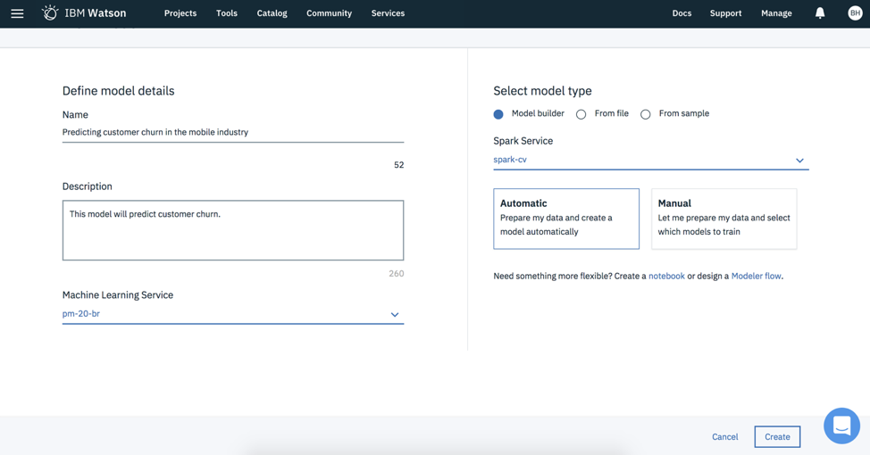
Automatic Modeling

Slide 15
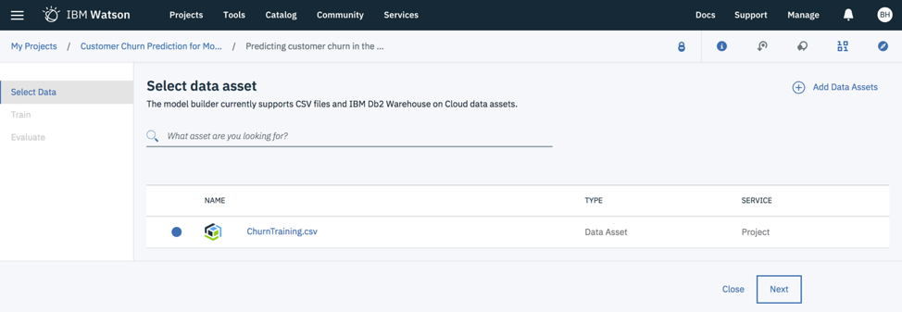
After you hit the “Create” button, you will be asked to select the data set of interest on which you want to build the model.
For the Customer Status variable that I want to predict, it’s important to know that this variable has two values; a value of “True” indicates the customer churned. A value of “False” indicates the customer did not churn. So, an appropriate modeling technique is binary classification. In fact, Watson Studio even suggested this technique to use for the analysis. For the “Feature columns,” you have the option of selecting all variables or a subset of variables. I selected all variables except for telephone number.

Slide 16
Manual Modeling
Next, I will use the Manual modeling approach so that I can select the modeling technique. Once you have selected the Manual modeling approach, you will be asked to select the outcome you want to predict (Column value to predict) and the features (Feature columns) to predict that outcome. I selected the same features as before.
You will also need to select the estimators (see upper right).

Slide 17
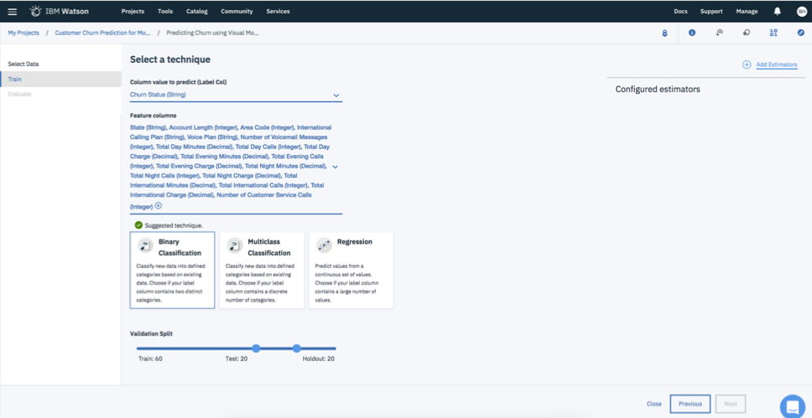

Slide 18
Phase 3 Project
Name:V.Priyadharshini
Year:3rd (5th)
Dept:cse
College: University College Of Engineering Thirukkuvalai

