Slide 1

E-COMMERCE WEBSITE
Task - 1

Slide 2
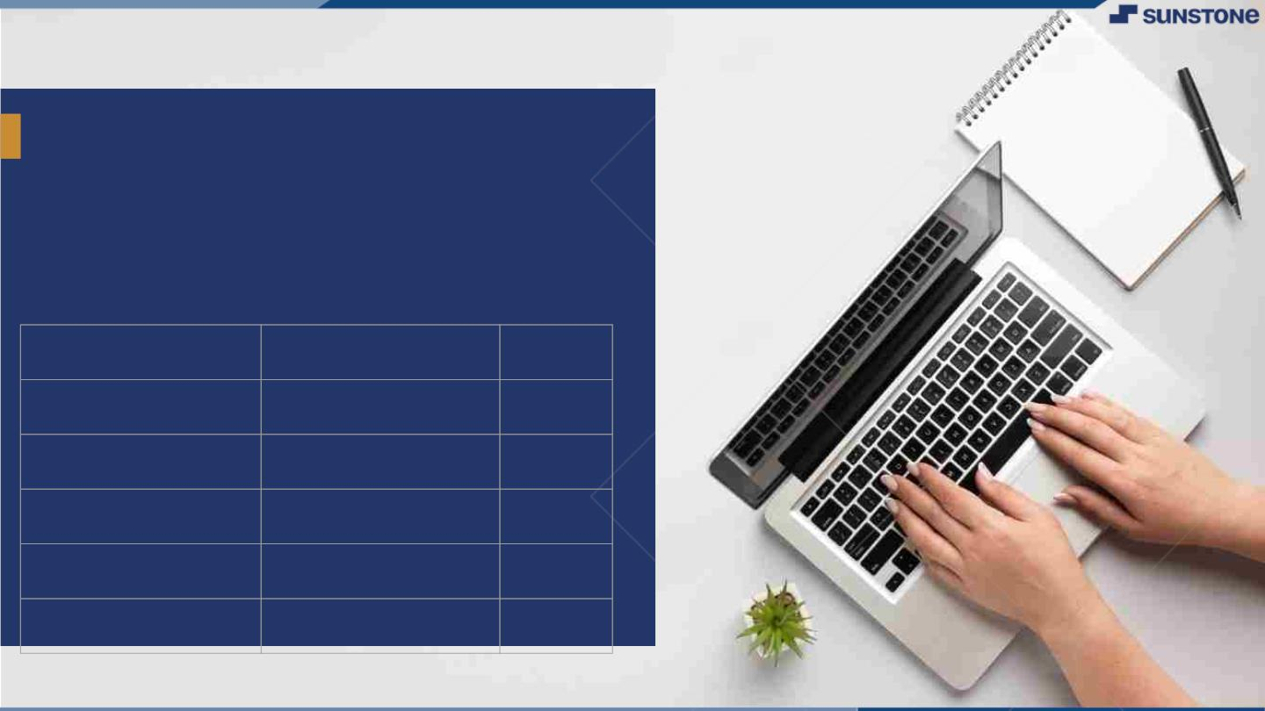
E-Commerce Website
▪
An e-commerce website serves as a digital platform for businesses to showcase and sell their products or services online.
LMS Username | Name | Group
 | JOTHI. P | 1
 | BOWSHIYA. S | 1
 | PRIYADHARSHINI. K | 1
 | SRINIVAS. M.B | 1
LMS Username
Name
Batch

Slide 3
Introduction Purpose:
An e-commerce website serves as a digital platform for businesses to showcase and sell their products or services online. It enables consumers to browse, select, and purchase items conveniently from the comfort of their homes. E-commerce websites facilitate secure online transactions, offer a wide range of products, and often provide customer reviews and ratings to assist in decision-making. They play a crucial role in expanding businesses' reach to a global audience and streamlining the buying process for both buyers and sellers.

Slide 4
Document Conversions:
Entire document should be justified.
Convention for Main title
Font face: Times New Roman
Font style: Bold
Font Size: 14
Convention for Sub title
Font face: Times New Roman
Font style: Bold
Font Size: 12
Convention for body
Font face: Times New Roman
Font Size: 12

Slide 5
Scope of Development Project:
The scope of an e-commerce website includes showcasing products or services, facilitating secure online transactions, optimizing for search engines, implementing marketing strategies, and ensuring legal compliance.
It serves as a digital storefront for businesses to reach a global audience, manage inventory, and provide customer support.
E-commerce websites play a pivotal role in the modern retail landscape, offering convenience and accessibility to both consumers and businesses.
They must adapt to evolving technology and consumer preferences to remain competitive.
The scope extends beyond just selling products; it encompasses the entire online shopping experience.

Slide 6
Definitions, Acronyms and Abbreviations:
JAVA -> platform independence
SQL-> Structured query Language
ER-> Entity Relationship
UML -> Unified Modeling Language
IDE-> Integrated Development Environment
SRS-> Software Requirement Specification

Slide 7
References:
Books:
Software Requirements and Specifications: A Lexicon of Practice, Principles and Prejudices (ACM Press) by Michael Jackson
Software Requirements (Microsoft) Second Edition By Karl E. Wiegers
Software Engineering: A Practitioner’s Approach Fifth Edition By Roger S. Pressman
Websites:
http://www.slideshare.net/
http://code.google.com/p/cse435-group4/

Slide 8
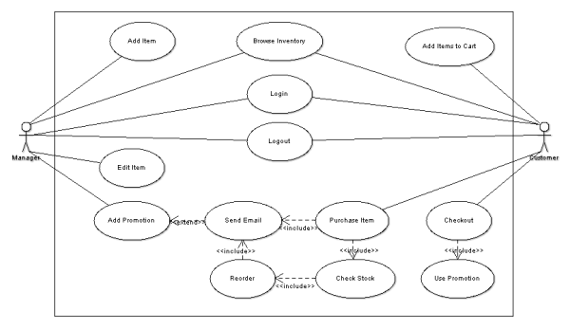
Overall Descriptions Product Perspective: Use diagram of E-commerce website

Slide 9
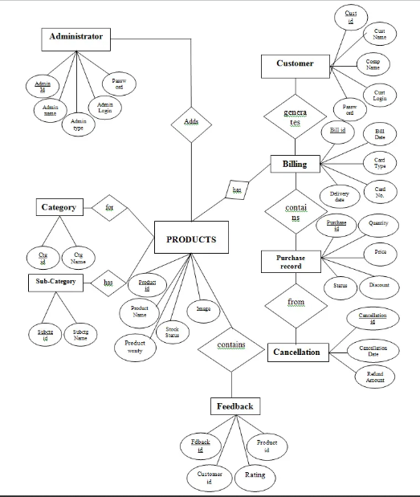
Product Function:

Slide 10
User Classes and Characteristics:
User characteristics of e-commerce websites refer to the traits and behaviors of the individuals who interact with and make purchases on these platforms.
Some key user characteristics include:
1. Demographics
2. Online Behavior
3. Device Preference
4. Purchase History
5. Payment Preferences
6. Shopping Habits
7. Customer Loyalty
8. Reviews and Ratings
9. Social Media Engagement
10. Customer Feedback

Slide 11
Operating Environment:
The product will be operating in windows environment. The Library Management System is a website and shall operate in all famous browsers, for a model we are taking Microsoft Internet Explorer, Google Chrome ,& Mozilla Firefox.
Also it will be compatible with the IE 6.0. Most of the features will be compatible with the Mozilla Firefox & Opera 7.0 or higher version.
The only requirement to use this online product would be the internet connection.
The hardware configuration include Hard Disk: 40 GB, Monitor: 15” Color monitor, Keyboard: 122 keys.
The basic input devices required are keyboard, mouse and output devices are monitor, printer etc.

Slide 12
Assumptions and Dependencies: The assumptions are: * The coding should be error free. * The system should be user-friendly so that it is easy to use for the users. * The information of all users, books and libraries must be stored in a database that is accessible by the website. * The system should have more storage capacity and provide fast access to the database. * The system should provide search facility and support quick transactions. * The Library System is running 24 hours a day. * Users may access from any computer that has Internet browsing capabilities & a Pillai Institute of Information Technology, Engineering, Media Studies & Research Department of Information Technology Internet connection. * Users must have their correct usernames and passwords to enter into their online accounts and do actions.

Slide 13
Software Configuration: This software package is developed using java as front end which is supported by sun micro system. Microsoft SQL Server as the back end to store the database. Operating System: Windows 10 Language: Java, HTML, CSS, React JS, JavaScript, (front end). Database: My SQL Server (back end). Hardware Configuration: Processor: Pentium(R) Dual-core CPU. Hard Disk: 40GB. RAM: 256 MB or more.

Slide 14
Data Requirement: In this project Product Data collect's detailed information about products, including names, descriptions, prices, images, and availability. Customer Data Gather’s customer details such as names, addresses, contact information, and purchase history for order processing and customer management. Transaction Data Record order details, payment information, and shipping status to track and fulfill orders. Inventory Data Maintains real-time data on product stock levels to prevent overselling and manage restocking. Analytics Data Capture user interactions and behavior on the website to analyze and improve the user experience and marketing strategies. External Interface Requirement: GUI: The software provides good graphical interface for the customer and the administrator can operate on the system, performing the required task such as purchasing, update, viewing the details of the products. * It allows user to purchase different types of products. * It provides product verification and search facility based on different criteria. * All the modules provided with the software must fit into this graphical user interface and accomplish to the standard defined. * The design should be simple and all the different interfaces should follow a standard template.

Slide 15
System Features: 1. User Registration and Authentication: - Allow users to create accounts and log in securely. 2. Product Catalog: - Display products with images, descriptions, and prices. - Organize products into categories and subcategories. 3. Shopping Cart: - Enable users to add and remove items from their cart. - Show the total cost of items in the cart. 4. Product Search and Filtering: - Implement a search bar to find products. - Provide filters for sorting and narrowing down product choices. 5. Product Details: - Show detailed product information, including reviews and ratings. 6. User Profiles: - Allow users to manage their profiles and shipping information. 7. Checkout and Payment Processing: - Enable secure payment options (credit/debit cards, PayPal, etc.). - Calculate taxes and shipping costs.

Slide 16
Other Non-Functional Requirements: 1. Performance and Scalability: - Ensure fast page load times to enhance user experience. - Design for scalability to handle increased traffic during peak periods. 2. Reliability and Availability: - Aim for high uptime (e.g., 99.9% availability). - Implement redundancy and failover mechanisms to minimize downtime. 3. Security: - Protect user data and transactions with strong encryption (HTTPS). - Regularly update and patch software to address security vulnerabilities. - Implement user authentication and authorization controls. 4. Data Backup and Recovery: - Regularly back up user data and system configurations. - Establish a disaster recovery plan to restore data in case of failure. 5. Compliance: - Ensure compliance with relevant regulations (e.g., PCI DSS for payment data, GDPR for user privacy). - Maintain records of compliance audits and certifications. 6. Scalable Database: - Choose a database system capable of handling increasing data volumes. - Optimize database queries and indexing for efficient data retrieval. 7. Load Testing: - Perform load testing to simulate heavy traffic and identify performance bottlenecks. - Optimize server configurations and resources accordingly.

Slide 17
Other Requirements: 1. Payment Gateway Integration: - Integrate with multiple payment gateways to offer customers various payment options (credit cards, digital wallets, etc.). 2. Inventory Management: - Implement real-time inventory tracking to prevent overselling and out-of-stock issues. 3. Product Recommendations: - Provide personalized product recommendations based on user browsing and purchase history. 4. User Reviews and Ratings: - Allow users to leave reviews and ratings for products, helping others make informed decisions. 5. Guest Checkout: - Offer a guest checkout option to streamline the purchase process for users who don't want to create an account. 6. Abandoned Cart Recovery: - Implement strategies to recover abandoned carts through email reminders and incentives. 7. Cross-Selling and Upselling: - Suggest related or higher-priced products during the checkout process to increase sales.

Slide 18
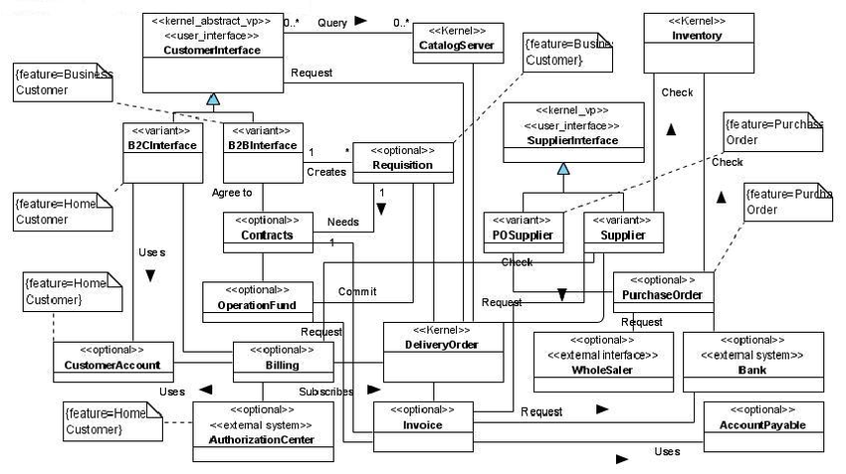
CLASS DIADRAM

Slide 19
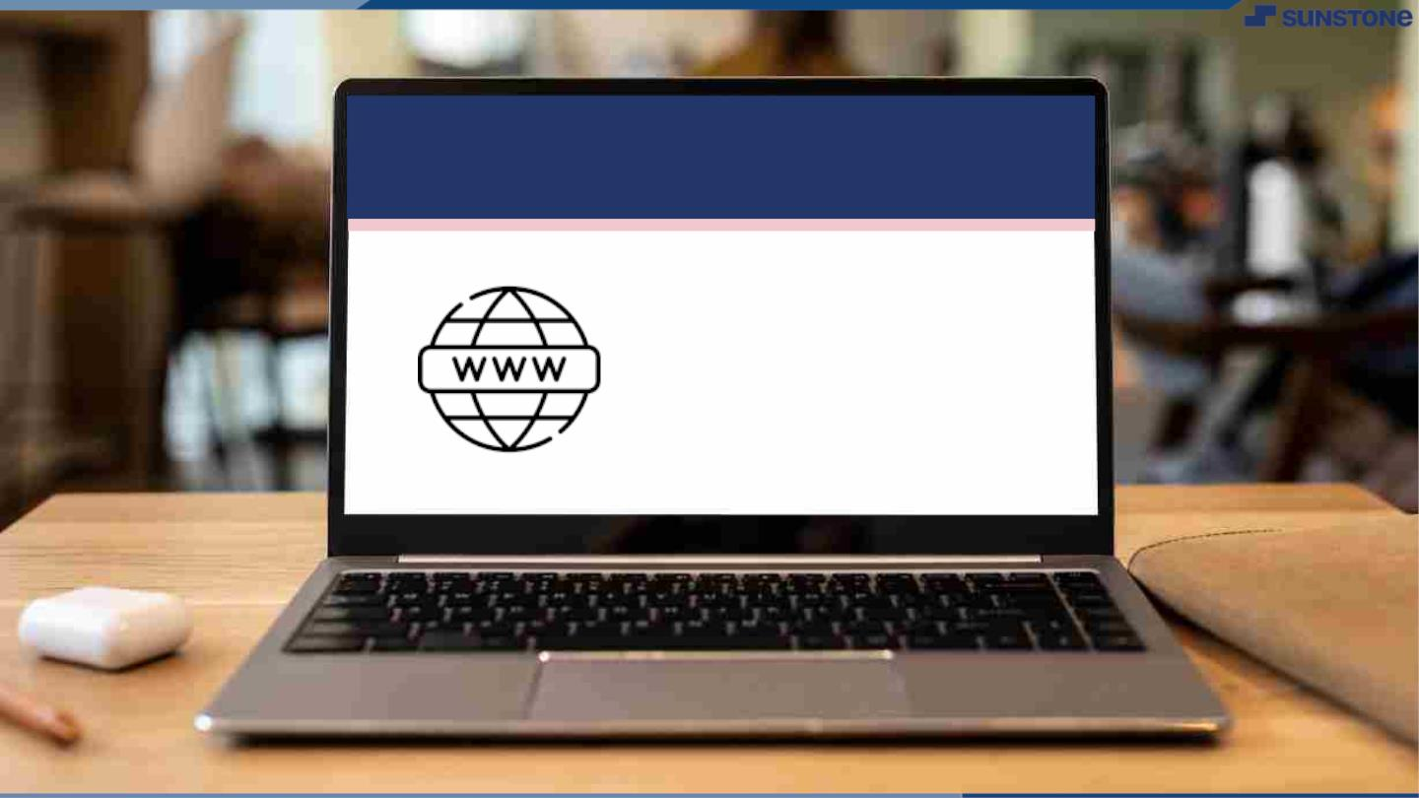
Submission Github
https://github.com/Priyaitdepart/NM-SPCET-IT-GROUP1

Slide 20


