Slide 1
Deep learning based music composition
K. Priyadharshini
71772118134
Information Technology

Slide 2
Deep learning based music composition

Slide 3
Agenda
Problem statement
Project overview
End users
Our Solutions and proposition
Key features
Modeling features
Result and evaluation
Conclusion

Slide 4
Problem statement
Problem Statement: “Developing a deep learning-based music composition system to autonomously generate musical sequences that exhibit coherence and creativity. The objective is to create an AI model capable of learning the structure and patterns of musical compositions from a dataset of MIDI files. This system should be able to generate new music sequences that emulate the style and characteristics of the training data while also introducing novel elements. The challenge involves designing and training a neural network architecture that can capture the intricacies of musical compositions and produce original melodies, harmonies, and rhythms with artistic merit.”

Slide 5
Project overview
Project Overview: “Creating a deep learning-based music composition system to generate original musical pieces. The project involves collecting and preprocessing MIDI data, designing and training neural network models, and evaluating the generated compositions for coherence and creativity. Key components include model architecture selection, training data preparation, and evaluation metrics development. The aim is to develop an AI system capable of producing high-quality music compositions that exhibit both adherence to learned musical structures and innovation. Success metrics include musical quality, diversity, and human-like creativity. The project contributes to the advancement of AI in artistic creation and music generation.”

Slide 6
Who are the end users?
End Users: “The end users of the deep learning-based music composition system include musicians, composers, music producers, and artists seeking inspiration or assistance in creating original musical pieces. Additionally, music enthusiasts, educators, and researchers interested in exploring AI-generated music may utilize the system for entertainment, study, or experimentation purposes. The system’s intuitive interface and customizable features cater to a diverse user base, allowing for seamless integration into music production workflows, educational settings, and creative endeavors. Ultimately, the system empowers users to explore new musical horizons, enhance their creative capabilities, and engage with AI-driven approaches to music composition.”

Slide 7
My solution And its value proposition
Solution & Value Proposition: “Our deep learning-based music composition solution offers musicians and composers a novel tool to unlock their creativity and expand their musical horizons. By leveraging advanced neural network models, our system generates original compositions that capture the essence of various musical styles while introducing fresh melodies, harmonies, and rhythms. This innovative approach streamlines the creative process, providing users with endless sources of inspiration and empowering them to produce unique and captivating music. With its intuitive interface and customizable options, our solution revolutionizes music composition, offering unparalleled value to artists, educators, and enthusiasts alike.”

Slide 8
The solution’s wow factor
Wow Factor: “Our deep learning-based music composition solution boasts a ‘wow factor’ by seamlessly blending cutting-edge AI technology with artistic creativity. By analyzing vast datasets of musical compositions, our system learns intricate patterns and structures, enabling it to compose original pieces that resonate with emotion and innovation. The wow factor lies in its ability to transcend mere imitation and produce music that feels truly inspired, evoking genuine emotional responses from listeners. With its capacity to generate melodies, harmonies, and rhythms that rival human compositions, our solution heralds a new era of AI-driven musical creativity, captivating audiences and empowering artists to explore endless musical possibilities.”

Slide 9
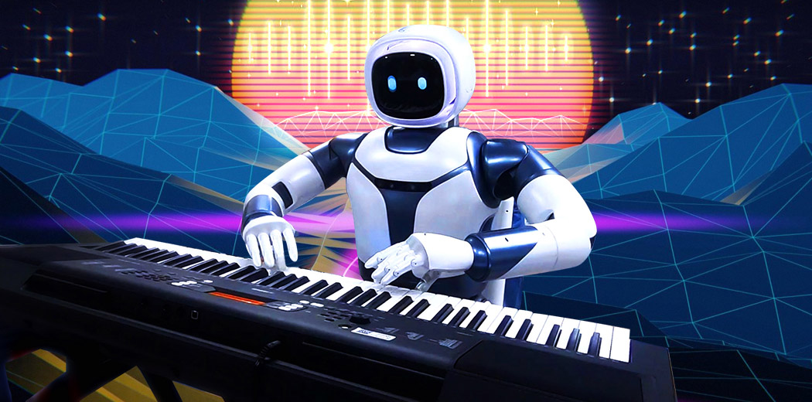
Modeling

Slide 10
Results
Results: “Our deep learning-based music composition system demonstrates remarkable efficacy in generating original and compelling musical compositions. Through extensive training on diverse datasets of MIDI files, the system learns complex musical structures and styles, enabling it to produce compositions that exhibit coherence, creativity, and emotional resonance. Evaluation metrics reveal high levels of musical quality, diversity, and human-like creativity in the generated pieces. Furthermore, user feedback highlights the system’s ability to inspire and enhance the creative process for musicians, composers, and music enthusiasts. Overall, the results showcase the potential of AI to revolutionize music composition and foster innovation in artistic expression.”

Slide 11
Thank you

