Slide 2
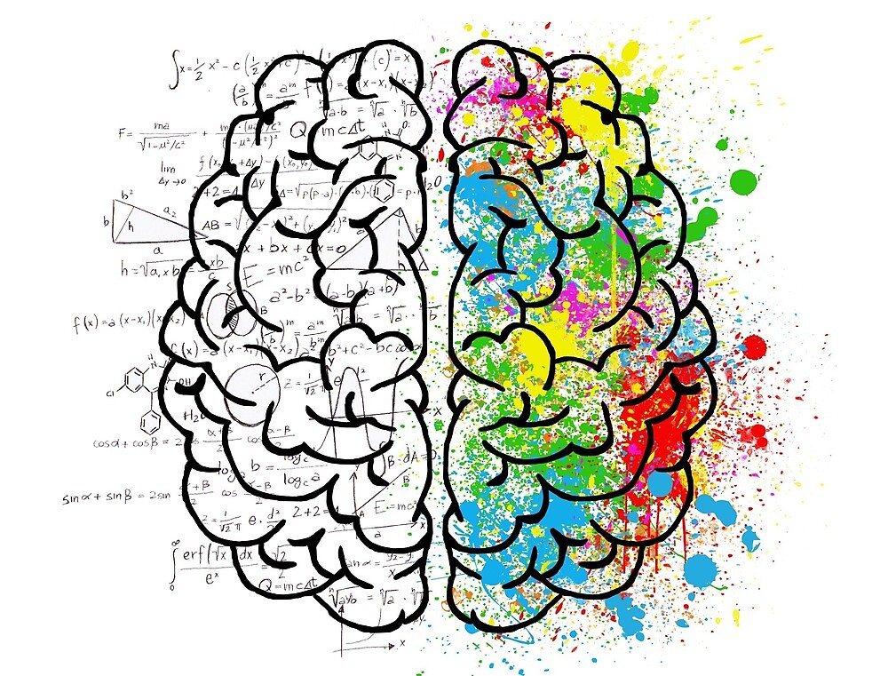
Clustering

Slide 3
Unsupervised modelling

Slide 4


How human brain works??

Slide 5
Principle behind clustering
A. High intra cluster similarity
B. Low inter cluster similarity
B
A

Slide 6
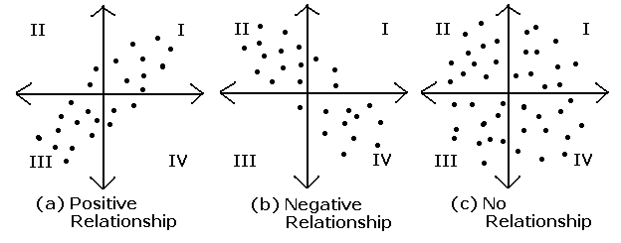
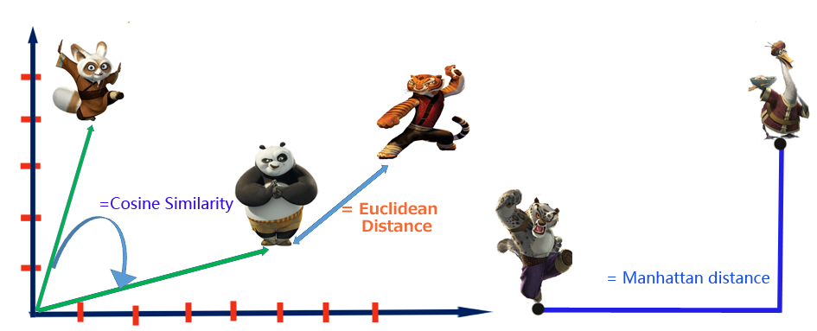
Similarity by correlation
Similarity measurement techniques
Similarity by Distance

Slide 7
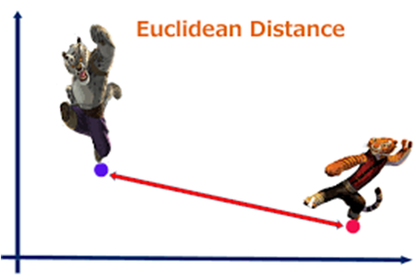
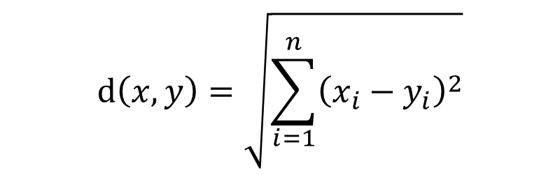
$$ⅆ\left(x,y\right)=\sqrt{\sum_{i=1}^{n}{{\left(x_{i}−y_{i}\right)}^{2}}}$$

Slide 8

Manhattan distance

Slide 9
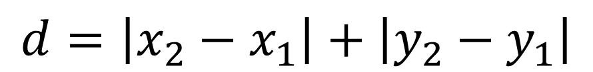
$$d=\left|x_{2}−x_{1}\right|+\left|y_{2}−y_{1}\right|$$

Slide 10
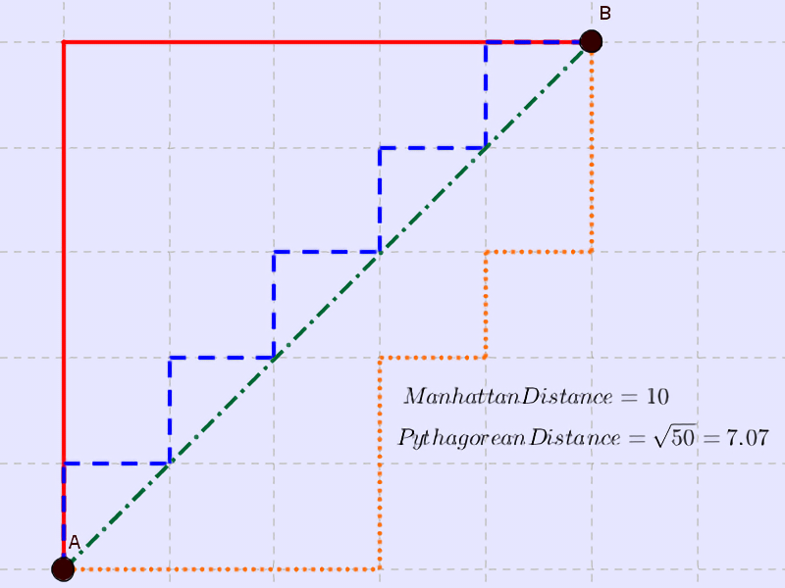
Difference of Euclidean and Manhattan distance

Slide 11
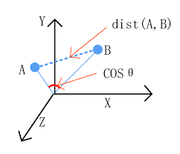
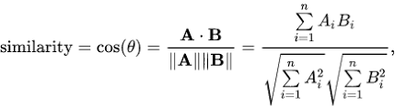
Cosine similarity

Slide 12
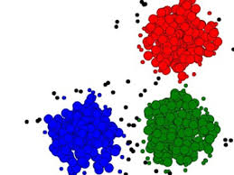
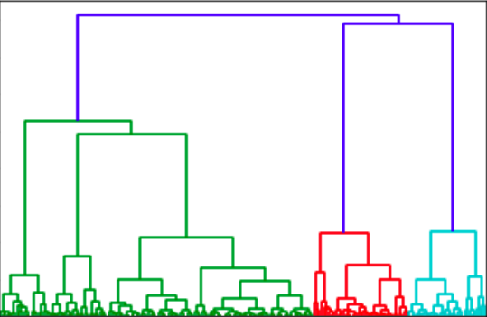
Different clustering techniques
K-Means
K-Medoid clustering
Hierarchical clustering

Slide 13
K-Means Clustering

Slide 14
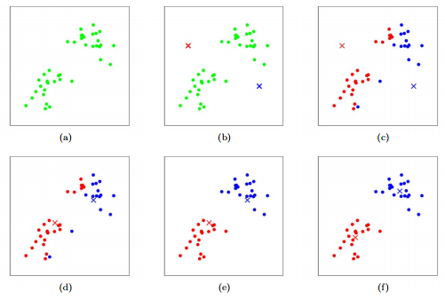

Slide 15
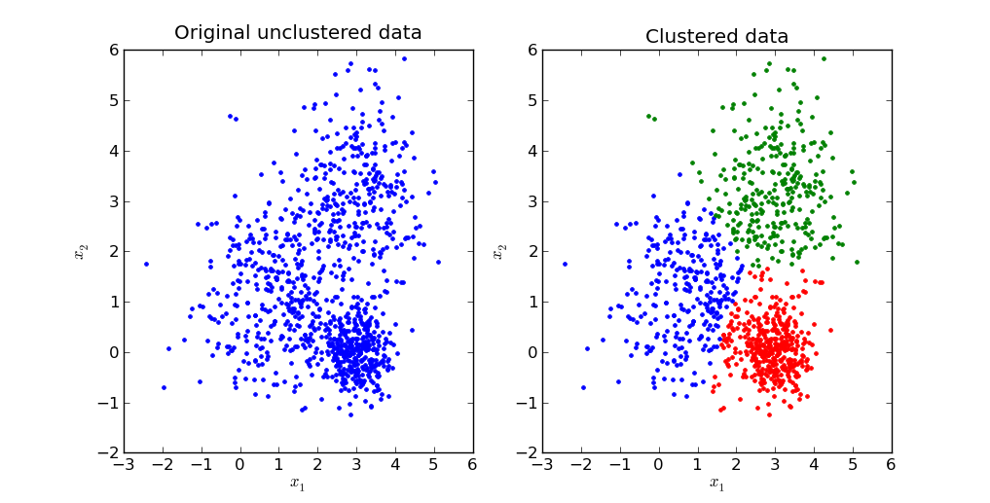

Slide 17
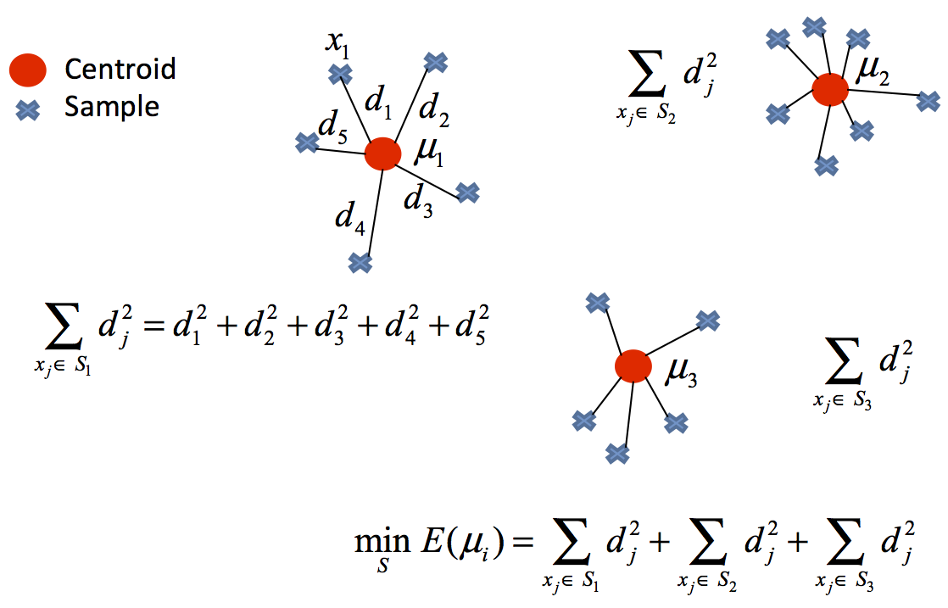
Calculation of Distortion
Distortion is minimum for a well clustered data

Slide 18
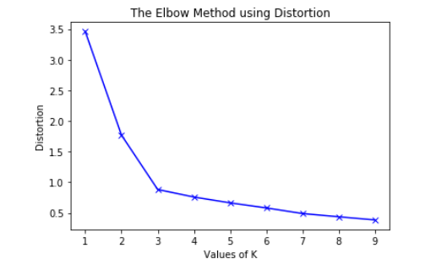
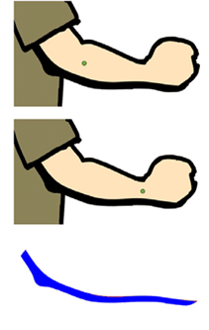
How to decide the number of clusters??

Slide 19
Advantages
Easy to implement
Scales to large data sets
Disadvantages
Works only with numerical variables
Problem with identifying global minima

Slide 20
Assumptions of K-Means Clustering
The distortion/variance of the distribution of each variable is spherical.
All variables have the same variance.
The prior probability for all k clusters are the same.

