Slide 1
Customer Segmentation
Group No : 6
Done By
Mr. Hiren Suresh Murjani
Mr. Deshpande Bhanuprasad
Mr. Aftab Sayeed Naik
Mr. Mohd Abdul Aleem
Ms.Naraharisetti Venkata Rishitha
Mr. Khaja Ziauddin

Slide 2
Brief Overview Of Project Progress
Objective
To segregate the customers as per their buying behavior so we can easily market our new product to targeted customers.
Create a cluster of the customers as per there buying pattern and trends to increase the revenue.
Notes:
section 1

Slide 3
Understanding of dataset
Total 29 columns and 2240 rows in which 2 columns are categorical which are education and marital status, and the rest 27 are numerical.
This dataset contains data of the last 3 months of purchases. And customer data is from last 2 years.
If the customers recency is <100 days, the data of that customer is not available.
Three platforms to make a purchases

Slide 4
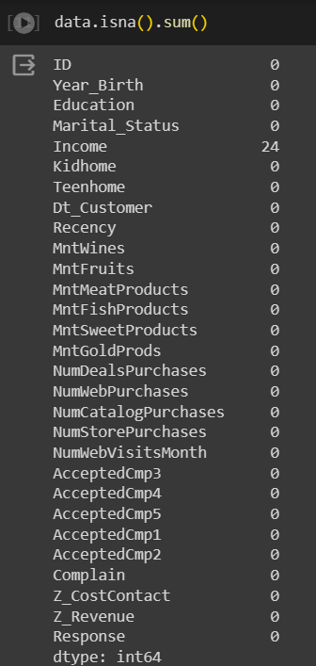
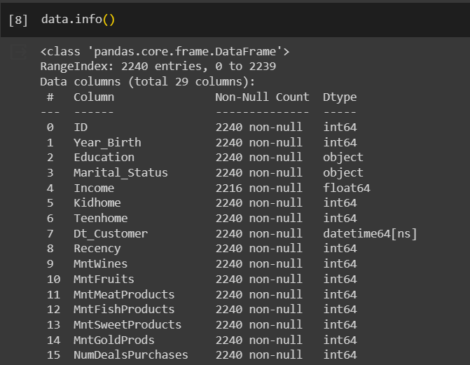
Basic Overview of Data
The dataset contains 2240 entries with 29 columns.
Income has 24 missing values.
No duplicated values are available in the data

Slide 5
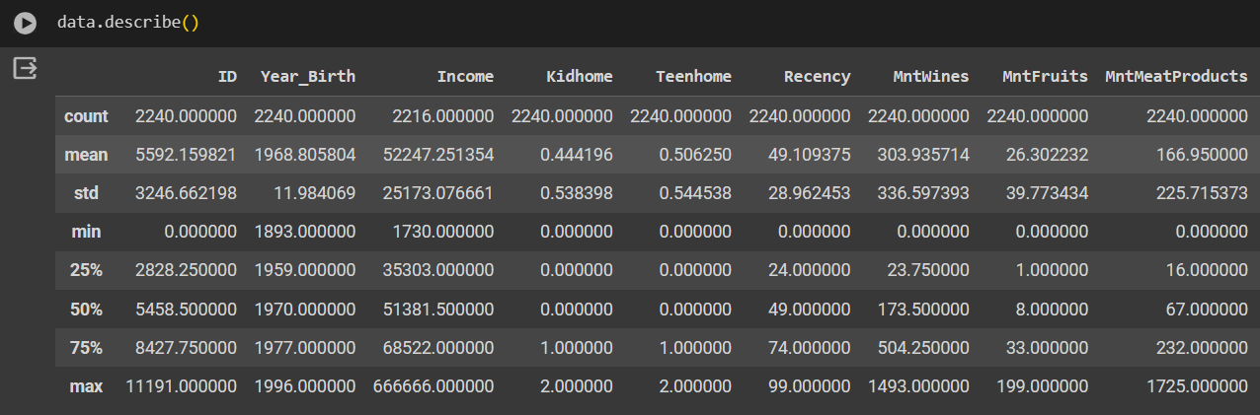
Median DOB of customers is 1970.
A customer visited the company's website 5.3 times on an average in last month.
The mean Income of customers is $52247.
A customer on an average makes purchases in about 49 days.

Slide 6
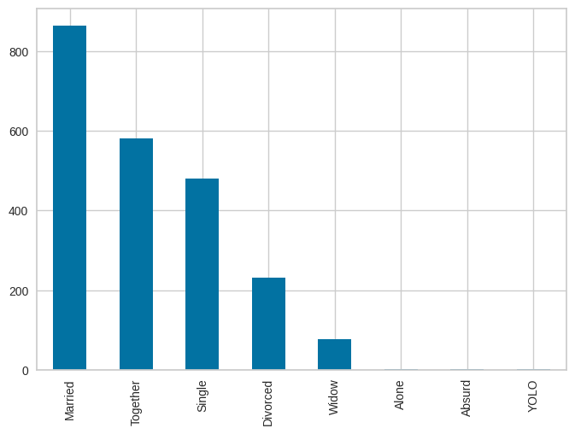
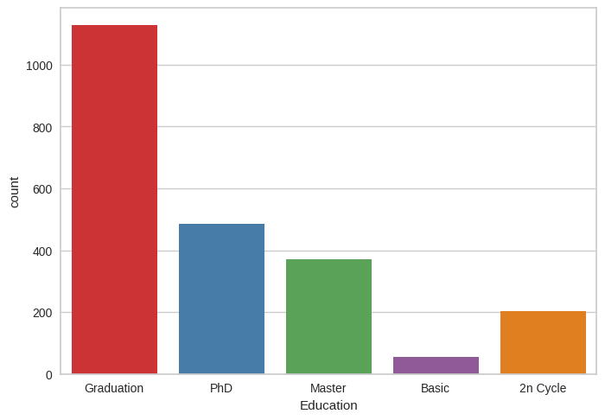
EDA And Visualization
8 types of marital status with Married being the most
All the customers having minimum education and customers with Graduation degree are more and basic being least

Slide 7
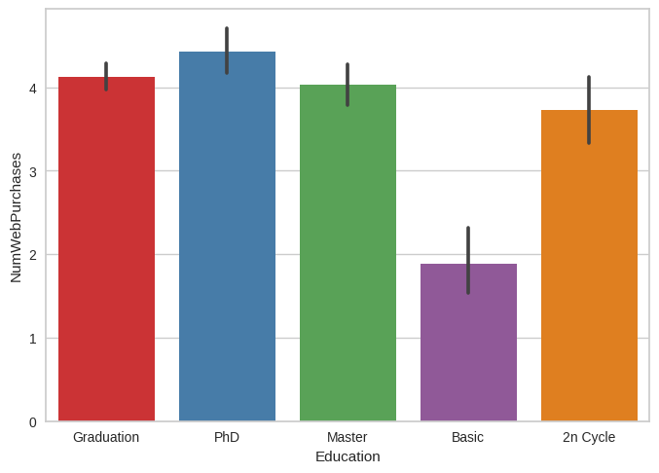
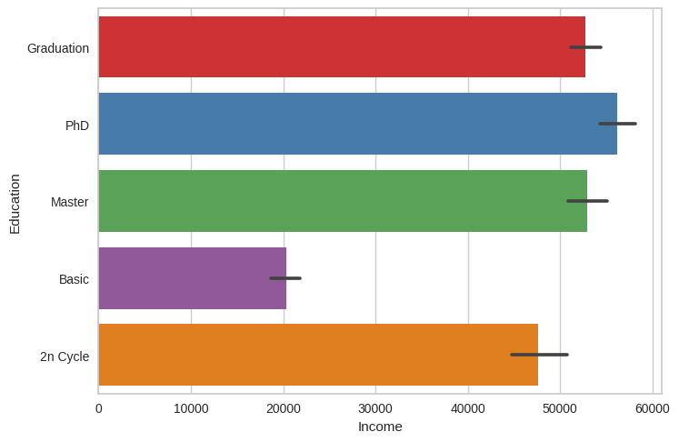
Income is directly proportional to the customer Education
Customer with higher education is having higher income
Customers with Higher education prefer to buy from Web when compared with basic education

Slide 8
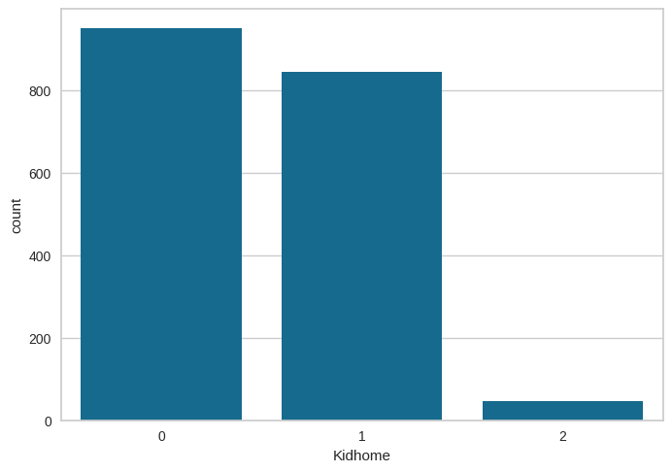
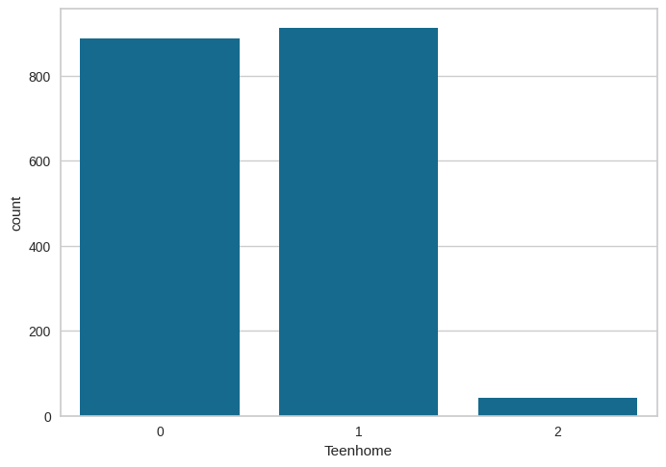
There are Maximum of 2 and minimum of zero kids and teens in the house

Slide 9
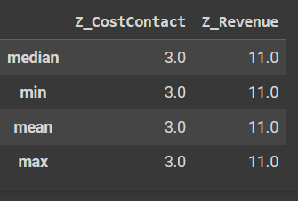
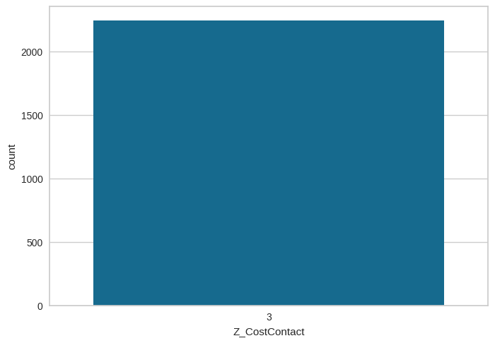
Data Cleaning and Preprocessing
Dropping irrelevant columns from the dataframe
1. Id Column – As the each customer is having different and unique ID it is not useful for our analysis
2. Z_CostContact and Z_Revenue – both columns have constant values for all the customers so it will have no impact on data

Slide 10
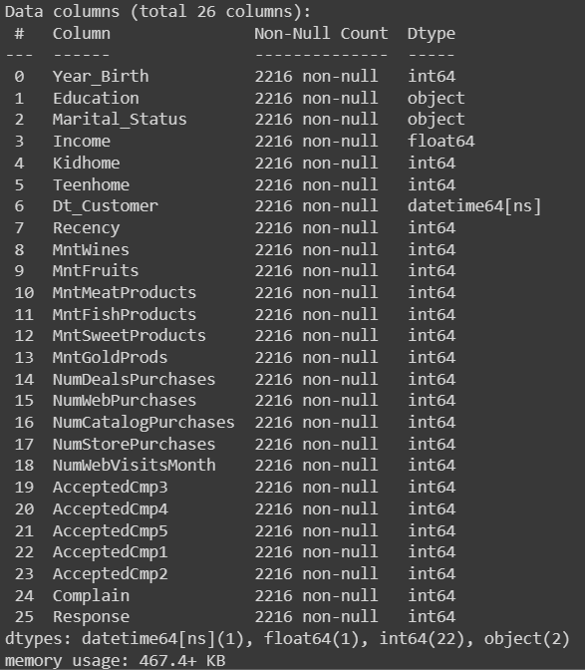
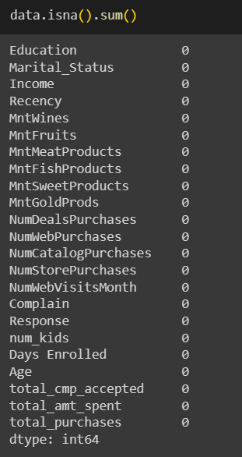
Handling Missing values
From the data we found that Income column having some missing values
There are 24 null values in the data which is 1% of the given data
So we are deleting the deleting the rows having null values
After removing the null values we are having 2216 customers data

Slide 11
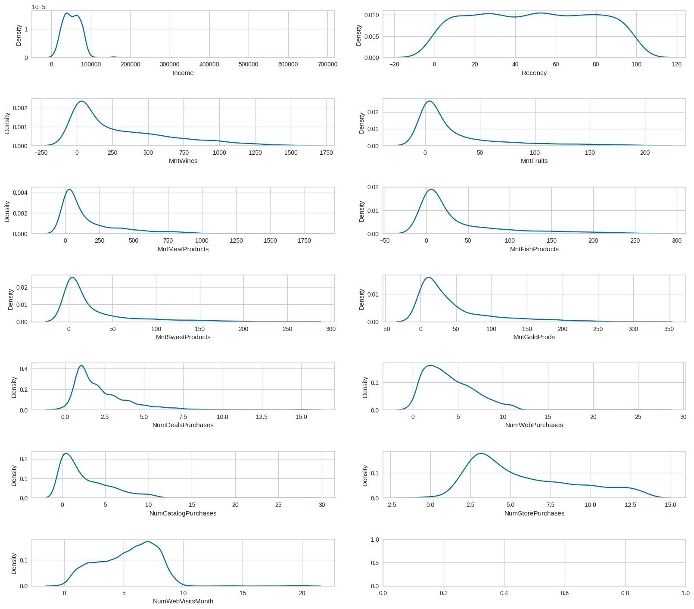
Handling Outliers
With help of Kernal density plot we can find that given data
Is not normally distributed as we can we can see the graphs
Are skewed to the left
we have assigned a threshold with the help of Z-score range
From -3 to 3
The extreme values of the features are treated as outliers
and are excluded.

Slide 12
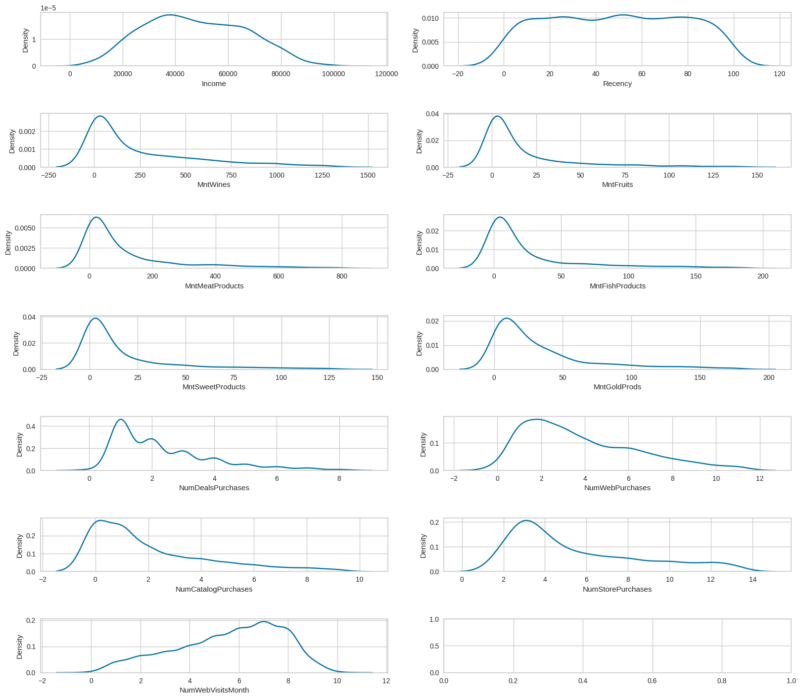
After removing the outliers from the data we can find the change
In KDE plots as shown
The outliers are removed from the data
This has reduced our num of rows to 1838

Slide 13
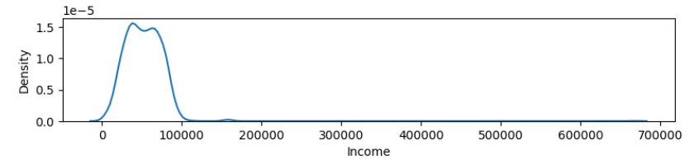
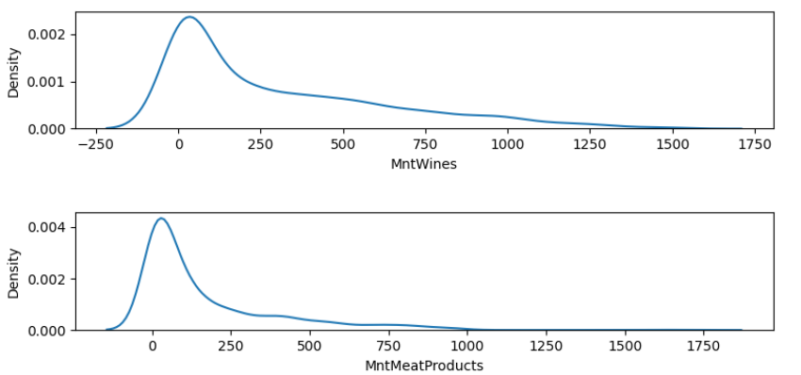
There are outliers present in the higher side of the dataset.

Slide 14
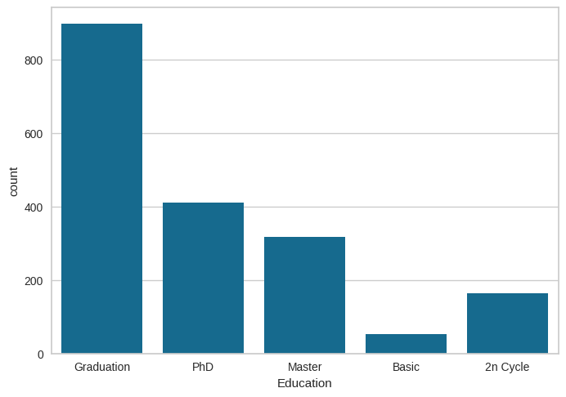
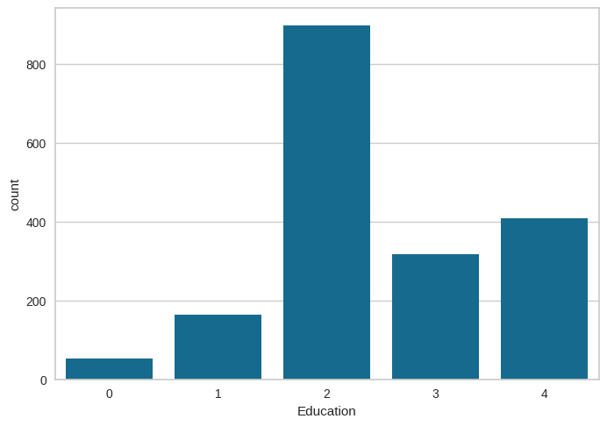
As the education column is in Categorical we will change it into numerical
data['Education'].replace({'Basic':0,'2n Cycle':1,'Graduation':2,'Master':3,'PhD':4},inplace=True)

Slide 15
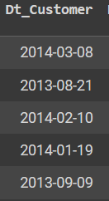
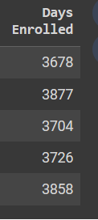
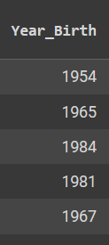

From the given data the Customer enrolment is date time format which is difficult for the analysis
We have made it into enrolment days
And From Year of birth column we have calculate the age of the customer
And drop the Dt_Customer and Year of birth columns from the data

Slide 16
Feature Engineering
5 columns represents if a customer accepted a particular campaign
we'll merge these to make total campaigns accepted
There are 6 products customers have spent
we will merge all the amt spent on different items into total_amt_spent
There are three platforms for purchasing the products
So we will merge all the purchase from different platforms into single columns as total_purchases
Converting categorical feature 'Marital Status' string values to dummy variables since there is no order for this feature
['Married,Together’] as 'Together’,
(['Single,Alone’] as 'Single'
(['Divorced,Widow’] as 'Was_married’
since absurd and yolo types don't go with any one of the above categories, and since they are very small in number, we can drop them

Slide 17
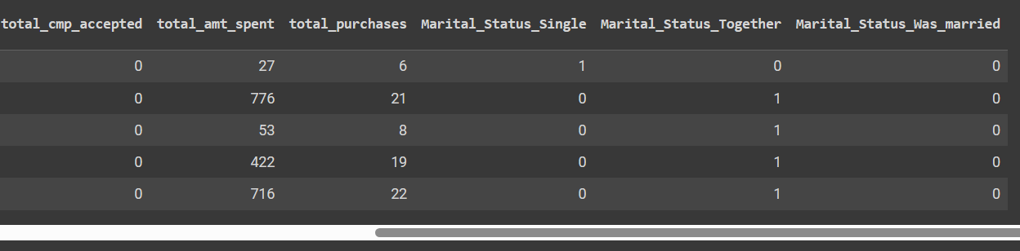
New columns after Feature engineering
Now drop the old columns from the data set

Slide 18
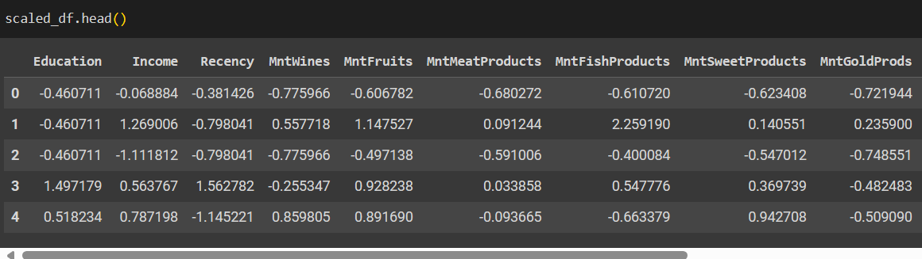
Standardization Of Data
Transforming raw data into standardized format, so that all features would be on a similar scale
With the help of StandardScalar, transformed data ;

Slide 19
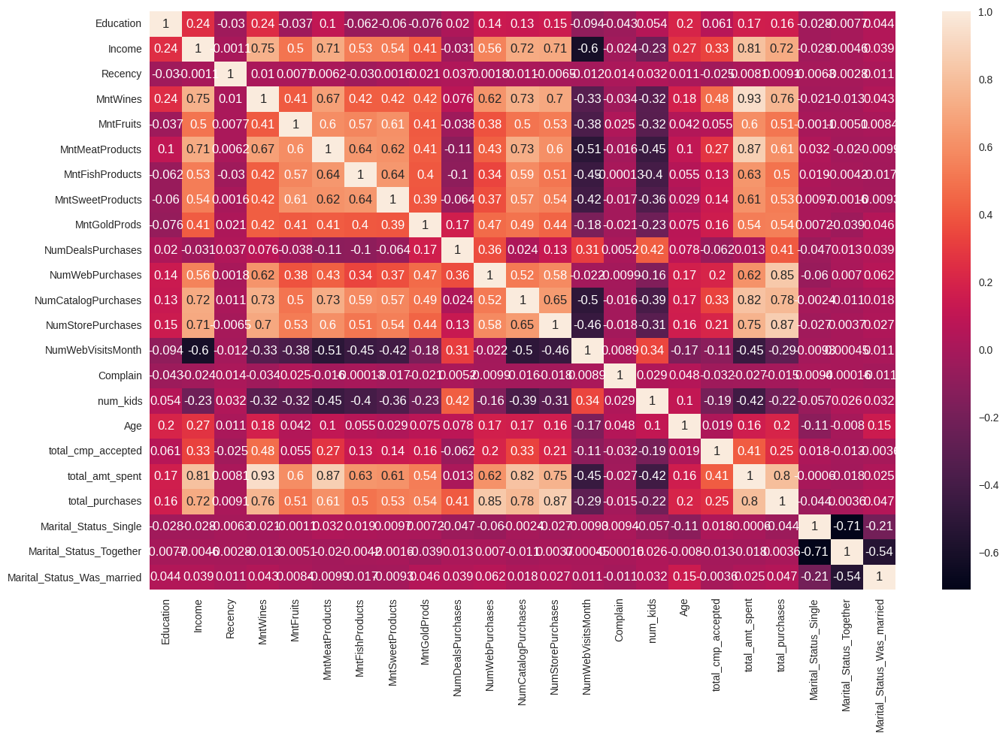

Slide 20
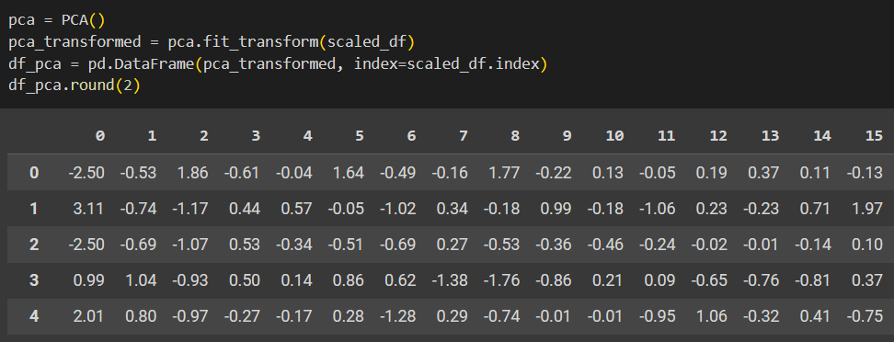
PCA
Dimensionality Reduction: In datasets with many features, especially when some features might be correlated, PCA can reduce the number of dimensions while preserving most of the information.

Slide 21
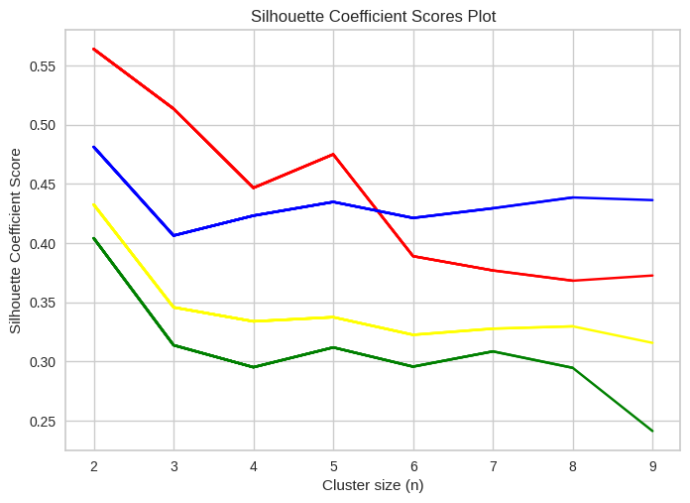
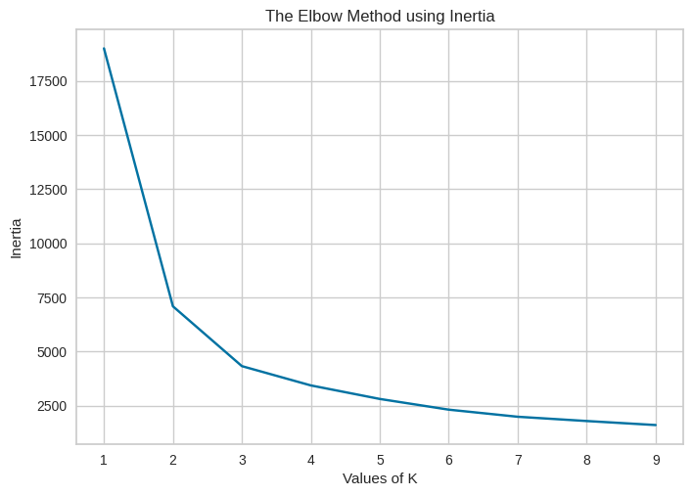
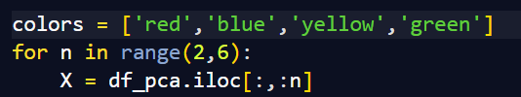
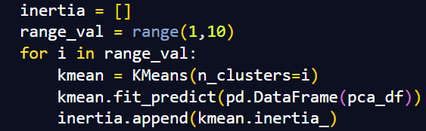
K-Means
Performed k-means clustering using different number of features and different values of K-Values.

Slide 22
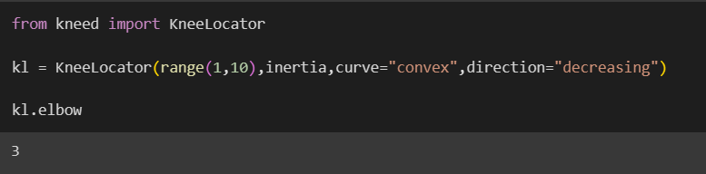
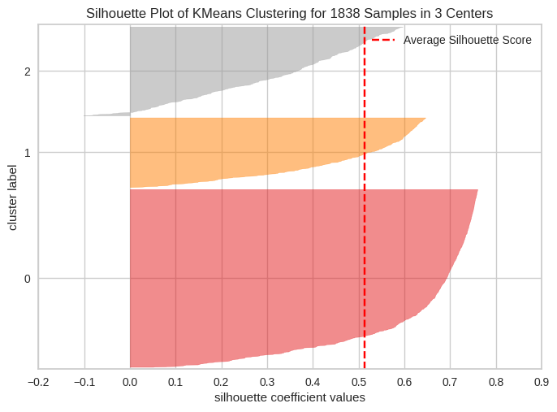
From the elbow curve and based on silhouette score
K value = 3
Performed PCA for 3 clusters
Clusters: The graph represents three different clusters labeled as 0, 1, and 2 on the y-axis.
Silhouette Coefficient Values: These values measure how similar an object is to its own cluster compared to other clusters.
Cluster 0: Most samples in this cluster have higher silhouette scores, indicating good clustering.
Cluster 1 and 2: These clusters have lower average silhouette coefficients compared to cluster 0.
Average Silhouette Score: The dashed red line indicates the average silhouette score.

Slide 23
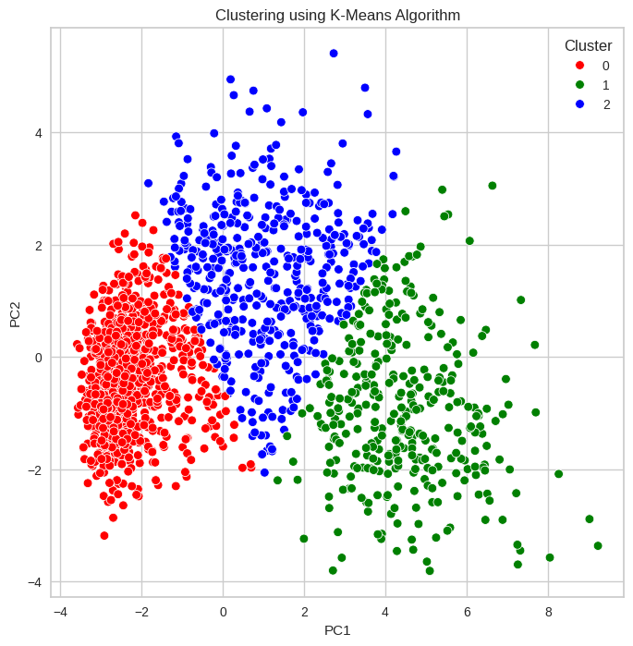
0.5625564902371988 0.7265655257465662
calinski_harabasz_score-- 0.7265655257465662
davies_bouldin_score-- 3394.6118903296006 silhouette_score -- 0.5625564902371988

Slide 24
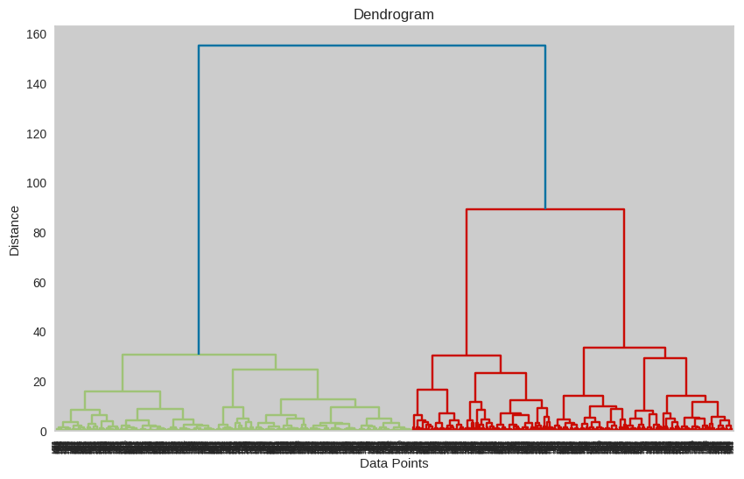
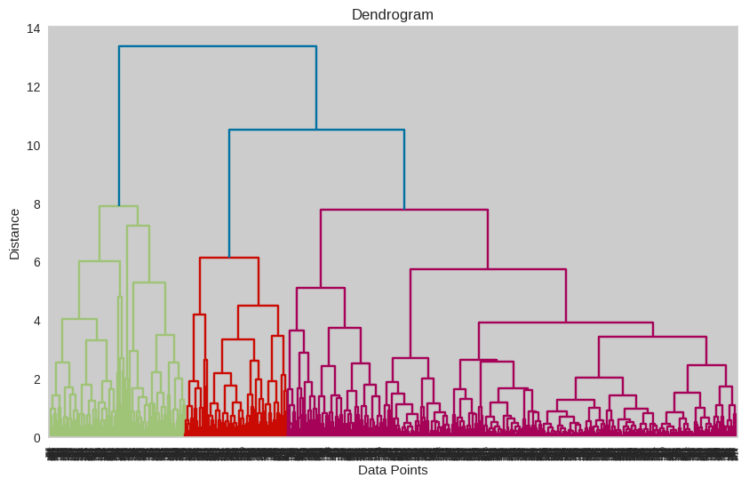
Agglomerative Clustering
Linkage Method -WARD
Linkage Method - COMPLETE

Slide 25
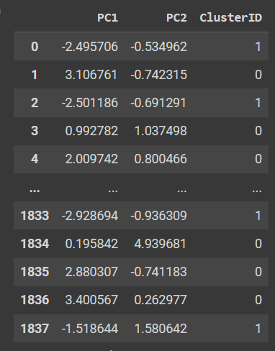
Taking k-means as reference considered k=2
Classified the data into 2 clusters 0 & 1

Slide 26
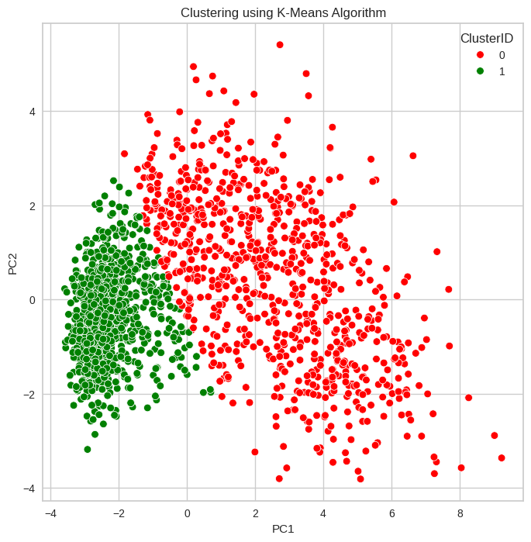
calinski_harabasz_score-- 0.6934510208232418
davies_bouldin_score-- 2765.034157397482 silhouette_score -- 0.5587951412382077

Slide 27
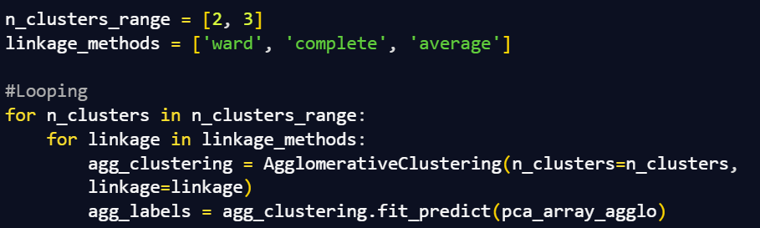
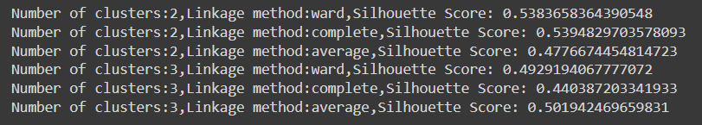
Similarly,

Slide 28
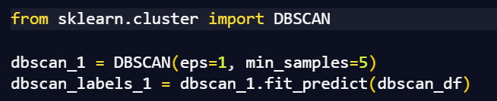
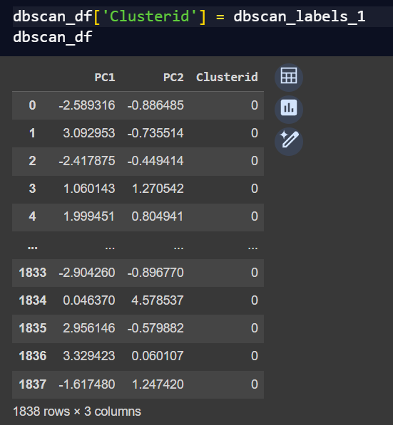
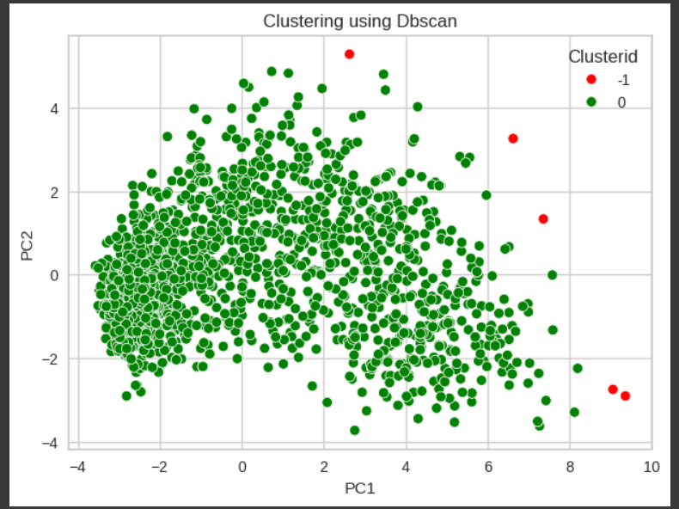
DBSCAN

Slide 29
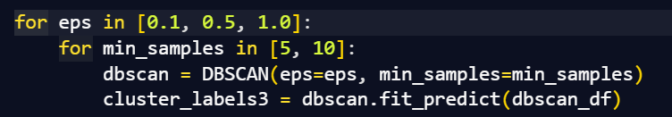
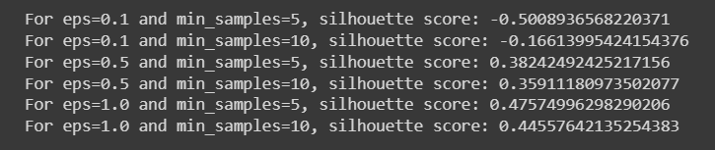
Similarly,

Slide 30
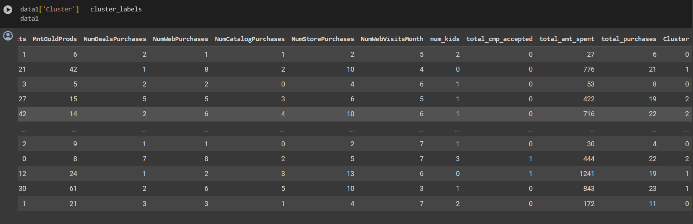
Classification Models
Created a new column in the dataset represent the cluster number the data belongs to

Slide 31
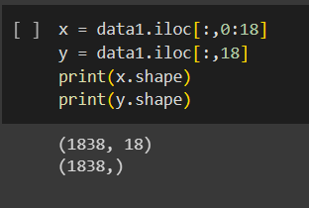
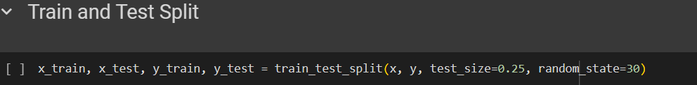
X= Represent the whole data
Y = Variable value or target value(y=cluster coloumn)
Splitted the data into training and testing models as shown above

Slide 32
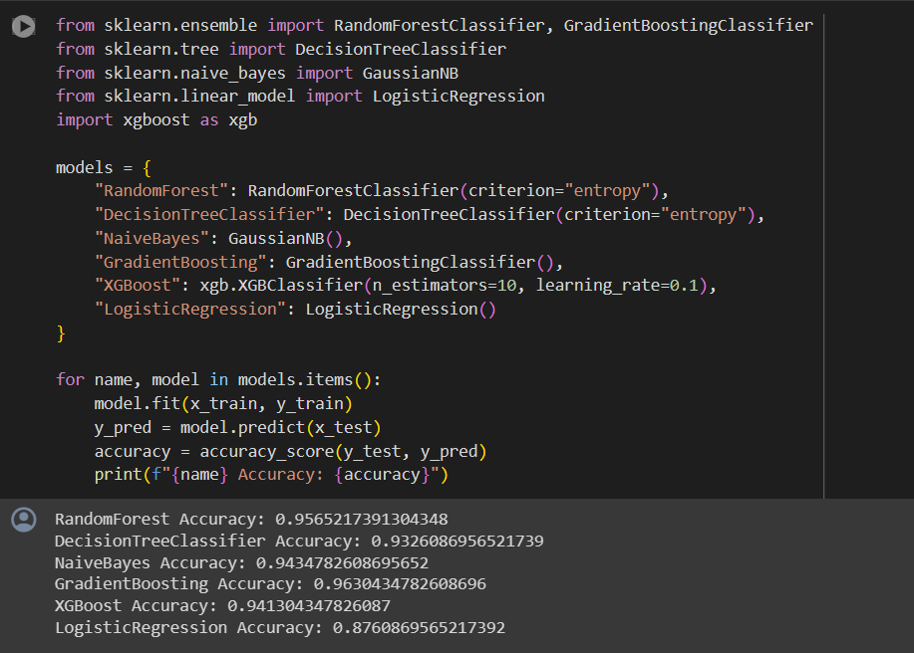
Performed multiple classification model on train & test data
The Accuracy of different Classification models are
1.Random forest Accuracy : 0.9565217391304348
2.DecisionTressClassifier Accuracy : 0.9434782608695652
3.NaiveBayes Accuracy : 0.9434782608695652
4.GradientBoosting Accuracy :0.9630434782608696
4.XGBoost Accuracy :0.941304347826087
5.Logistics Regression Accuracy : 0.876086956521792
Among all the Classification models accuracy
Gradient Boosting is having higher Accuracy so we build
deployment model on it

Slide 33
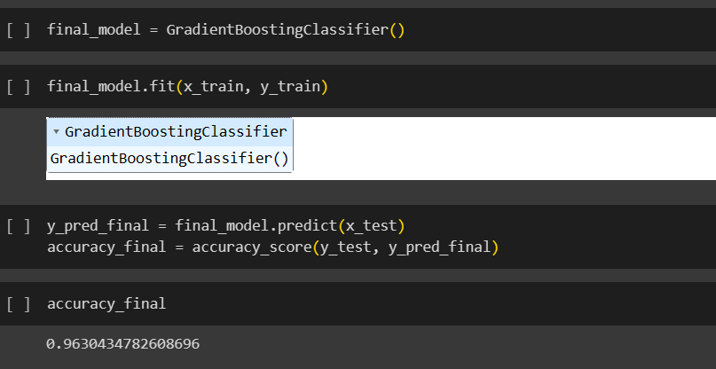
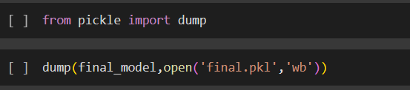
Among the all other classification models we have finalized GradientBoostingClassifier model for deployment
Saving the Model
With the help of Pickle function saved the data into .pkl file

Slide 34

Deployment using Streamlit
Imported the Streamlit
With the help of Streamlit inbuilt functions created the title block ,Sliders ,radio button etc

Slide 35



After saving the .py in local location
Using anaconda prompt run the Streamlit for .py file
Output

Slide 36

Deployment Working
Case - 1
Model predicting cluster -1
Add snip of model predicting cluster - 1

Slide 37

Case - 2
Model predicting cluster -2
Add snip of model predicting cluster - 2

Slide 38

Case - 3
Model predicting cluster -0
Add snip of model predicting cluster - 0

Slide 39
Conclusion
Successfully clustered data into segments using K-Means clustering with a silhouette score of 0.574.
Used GradientBoostClassifier as the classification model with a accuracy score of 96% for predicting clusters on streamlit web application.
To segregated the customers as per their buying behavior into different types of clusters
Based on cluster type we can easily market our new product to targeted customers which increases the revenue of the company

Slide 40
Challenges faced and potential solutions
There are 24 null values in the income column which will effect the accuracy of model
Sol : As data consists of 2240 rows the missing values is of only 1 % so we drop the null values from the data set
There are outliers present in the data which will impact model building
Sol :we have assigned a threshold with the help of Z-score range From -3 to 3 the extreme values of the features are treated as outliers and are excluded.
The Education and Marital status column is having the data in categorical format finding relations with numerical data is difficult,
Sol: converted the data into numerical format
data['Education'].replace({'Basic':0,'2n Cycle’:1,
'Graduation':2,'Master':3,'PhD':4},inplace=True)
In the deployment, cluster value was not changing, this was due to the range set in the deployment(py) file, the model had been trained with a particular scale of values, so the predicted data should also be in the same range.
Finding optimum number of clusters, solved using scree plot.

Slide 41
Thank You

