Slide 1
Automated Service Case Management using Salesforce, OCR & AI
BY: PRIYAL BAHETY(EN22IT301072)

Slide 2

Project Overview
Customer Service Automation
Multi-format Handling
Processes incoming emails with images and PDF attachments.
Streamlining service requests for appliance issues.
Integrated Technologies
Efficiency Boost
Leveraging Salesforce, Optical Character Recognition (OCR), and Artificial Intelligence (AI).
Significantly reduces manual effort in case management.

Slide 3

THE BUSINESS PROBLEM
Manual Case Creation: Inefficient process for converting emails into service cases.
Manual Document Review: Time-consuming review of images and PDFs for critical information
Lack of Auto-Classification:Absence of automated systems to categorize cases effectively.
Delayed Responses & Risks:Increased response times leading to potential Service Level Agreement (SLA) breaches.

Slide 4
PROJECT OBJECTIVE
Automated Case Creation : Implement Email-to-Case for seamless case generation.
OCR-Powered Data Extraction: Extract relevant text from various document formats (images, PDFs).
Salesforce Data Integration: Store all extracted OCR data directly within Salesforce records.
AI-Driven Classification: Utilize AI for accurate case categorization and priority assignment.
Reduced Manual Effort: Minimize human intervention in routine case management task.

Slide 5
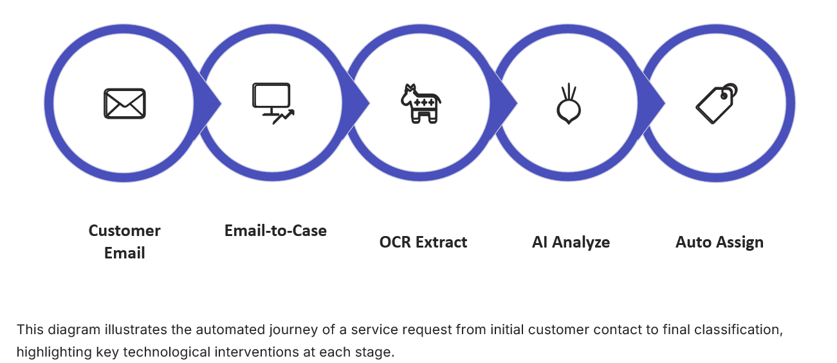
END TO END ARCHITECTURAL FLOW

Slide 6
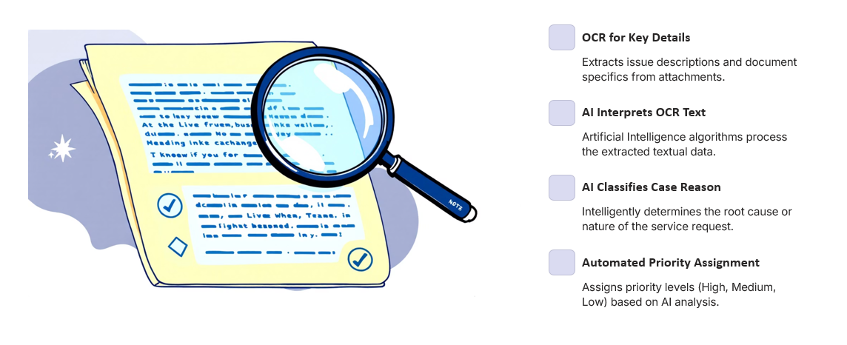
AI AND OCR WORKING

Slide 7
EXAMPLE USE CASE

Slide 8
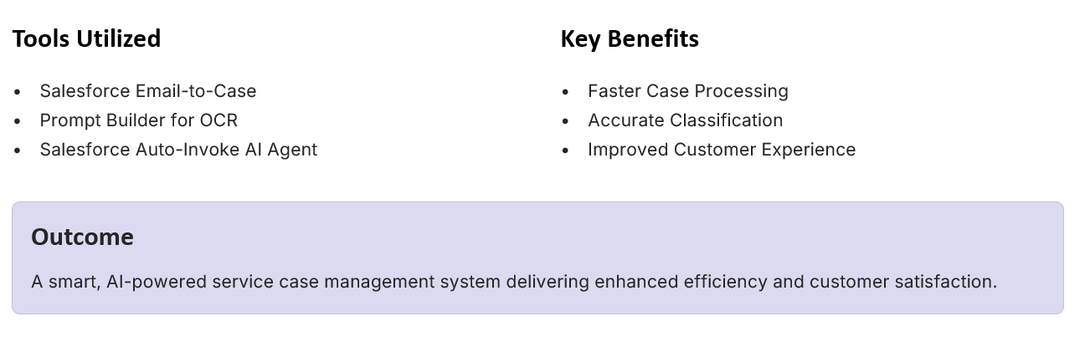
TOOLS BENIFITS AND OUTCOME

Slide 9
Thank You!
For any query/suggestions pls mail us at
en22it301072@medicaps.ac.in

