Slide 1
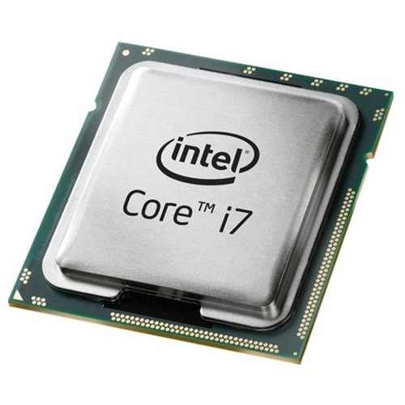
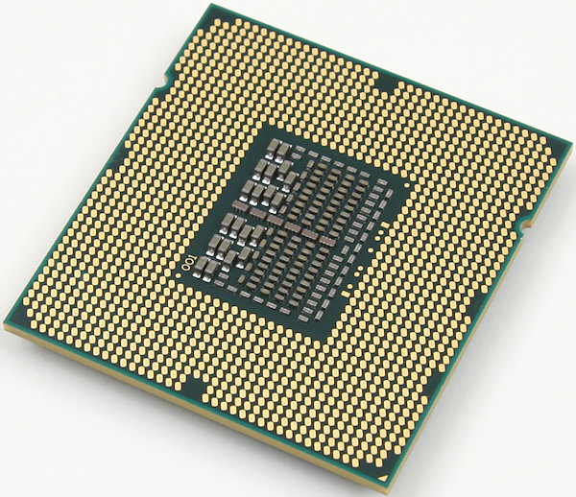
CPU
A central processing unit (CPU) is an important part of every computer.
The CPU sends signals to control the other parts of the computer, almost like how a brain controls a body.
The CPU is an electronic machine that works on a list of computer things to do, called instructions.

Slide 2
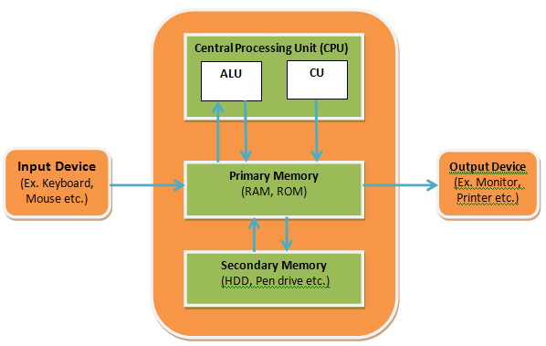
BLOCK DIAGRAM OF CPU

Slide 3
CPU BLOCKS
Clock
The clock speed typically refers to the frequency at which a chip like CPU is running and is used as an indicator of the processor's speed
Accumulator
In a computer's CPU, an accumulator is a register in which intermediate arithmetic and logic results are stored.
Program Counter
A program counter is a register in a computer processor that contains the address (location) of the instruction being executed at the current time.

Slide 4
PROCESSOR FAMILIES
First Generation Processors
Second Generation Processors
Third Generation Processors
Fourth Generation Processors
Fifth Generation Processors

Slide 5
PARALLELISM

Slide 6
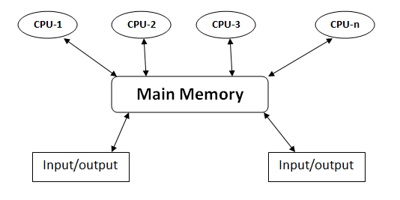
MULTIPROCESSING
Multiprocessing is the use of two or more central processing units (CPUs) within a single computer system.
Ability of a system to support more than one processor or the ability to allocate tasks between them.

Slide 7
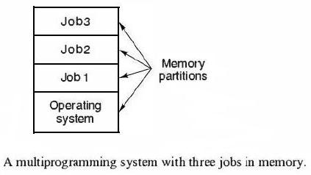
MULTIPROGRAMMING
Multiprogramming means parallel processing in which several programs are run at the same time on a uniprocessor.

Slide 8

MULTITASKING
Multitasking, in an operating system, is allowing a user to perform more than one computer task (such as the operation of an application program) at a time.
When you open your Web browser and then open Word at the same time, you are causing the operating system to do multitasking.

Slide 9
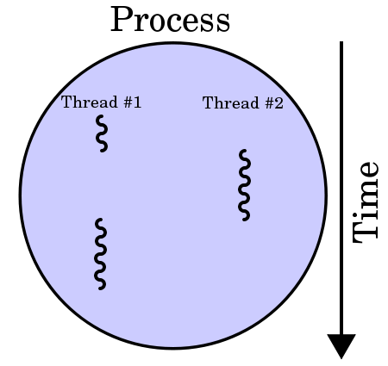
MULTITHREADING
In computer architecture, multithreading is the ability of a CPU to execute multiple processes or threads concurrently, appropriately supported by the operating system.

Slide 10
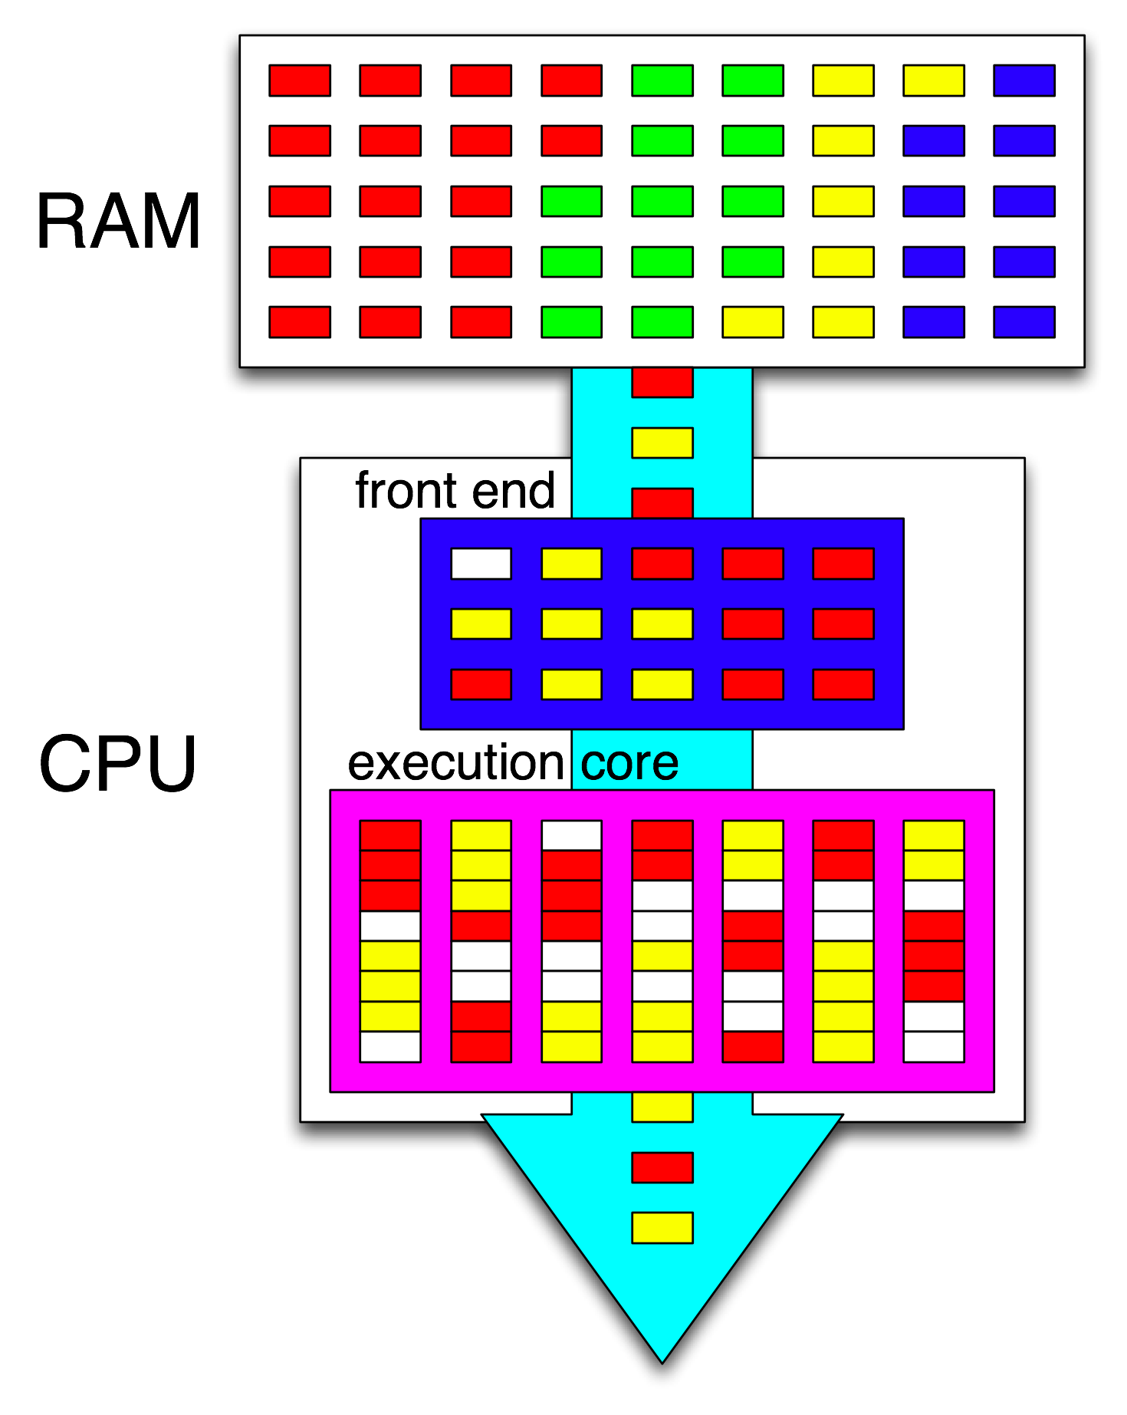
HYPER-THREADING
Hyper-Threading is a technology used by some Intel microprocessor.
It allows a single microprocessor to act like two separate processors to the operating system and the application programs that use it.

