Slide 1
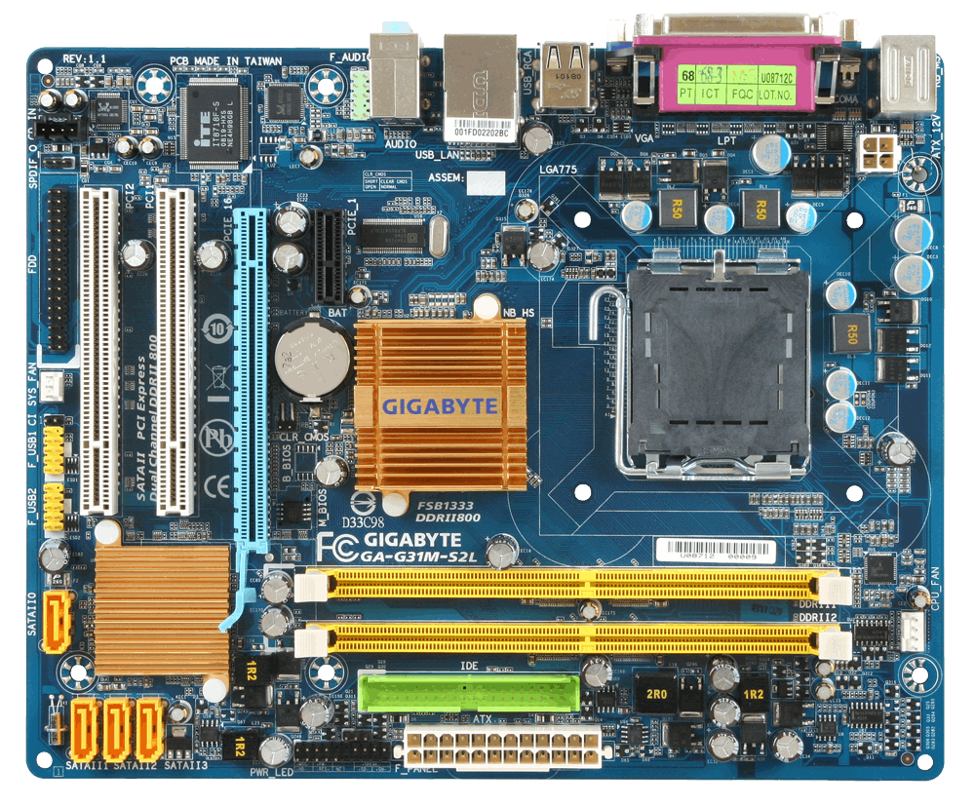
MOTHERBOARD

Slide 2
MOTHERBOARD
Motherboard is a main (PCB) printed circuit board.
Where are all the components and devices are connected directly and indirectly

Slide 3
COMPONENTS OF MOTHERBOARD
RAM Slot
CPU Socket
BIOS
CMOS Battery
Expansion Slot (PCI)
AGP Port
SATA connector

