Slide 1
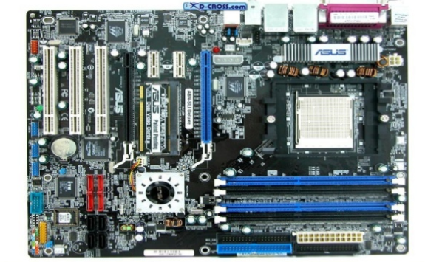
MOTHERBOARD
Main circuit board inside your computer is called motherboard.

Slide 4
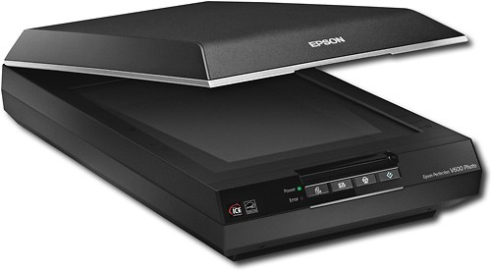
SCANNERS
A scanner is an input device that scans documents such as photographs and pages of text.
When a document is scanned, it is converted into a digital format.

Slide 5
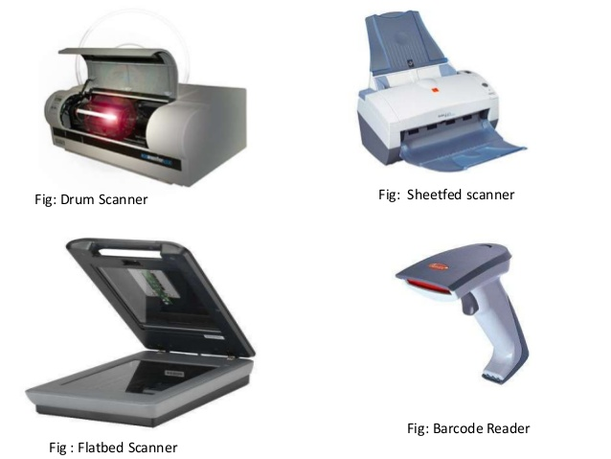
TYPES OF SCANNERS

Slide 6
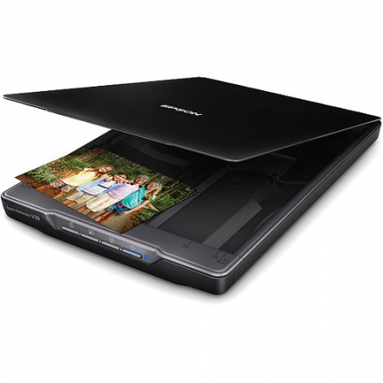
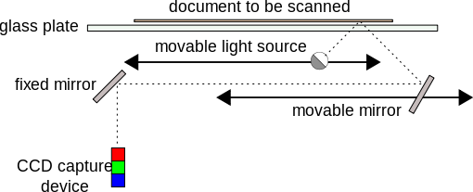
FLATBED SCANNER
Scan documents, photos, flat object from PC or laptop.
Flatbed is made up of glass pane and moving CCD array and two mirrors.

Slide 7

HANDHELD SCANNER
Handheld scanner is used to scan physical documents into their digital forms that can be stored, edited, transferred and emailed digitally.
This device is especially useful when space is a concern, as flatbed scanners tend to take up a large amount of space.
This scanning will be effective only if with a steady hand technique, or else the image may seem distorted.

Slide 8

SHEET-FED SCANNER
Item to be scanned is to be pulled into a stationary scanning mechanism.
A scanner that allows only paper to be scanned rather than books or other thick objects.
Smaller and less expensive than flatbed scanner.

Slide 9
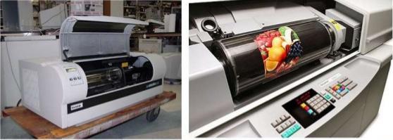
DRUM SCANNER
A type of scanner used to capture the highest resolution from an image.
Photographs and transparencies are taped, fitted into a clear cylinder (drum) that is spun at speeds exceeding 1000 RPM during the scanning operation.
Very large and expensive.

Slide 10
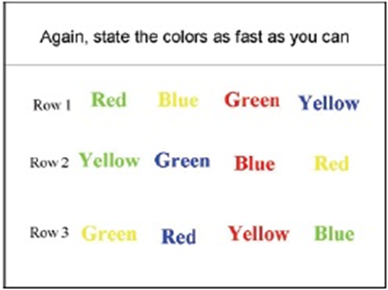
MULTITASKING

Slide 11

MULTITASKING
Multitasking, in an operating system, is allowing a user to perform more than one computer task (such as the operation of an application program) at a time.
The operating system is able to keep track of where you are in these tasks and go from one to the other without losing information.
When you open your Web browser and then open Word at the same time, you are causing the operating system to do multitasking.

Slide 12
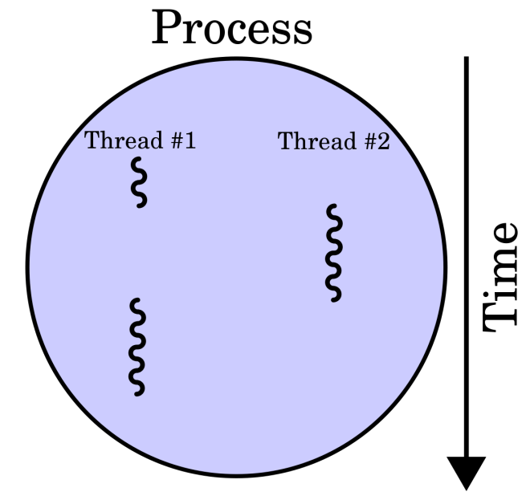
MULTITHREADING
Multithreading means in any single process, multiple threads is allowed and again, can run simultaneously.
Multithreading is the ability of a CPU to execute multiple processes or threads concurrently, supported by OS.

Slide 13
MULTIPROCESSING

