Slide 1
DNS ZONES

Slide 2
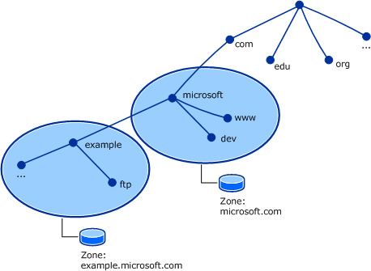
What is a DNS Zone ?
Every domain name, which is a
part of the DNS system, has
several DNS settings, also known
as DNS records ,to keep this DNS
records in order, the DNS zone
was created.
Each DNS zone represents a
boundary of authority subject to
management by certain entities.

Slide 3
Types of DNS Zones
There are 3 types of DNS Zone.
Primary DNS Zone
Secondary DNS Zone
Stub DNS Zone

Slide 4
Primary DNS Zone
Primary DNS Zone contain a read/write copy of the zone data.
All the DNS records added manually or automatically, are written in
this Primary zone of the DNS server
The data is stored in a standard text file – .txt.
Something essential is that to be able to make changes to the DNS
zone, the Primary zone must be available.

Slide 5
Secondary DNS Zone
The Slave zone is a read-only copy of the zone data.
The secondary DNS zone can receive the updated records only from
the primary DNS zone of the DNS server.
Secondary DNS zone can be used as a back up.

Slide 6
Stub DNS Zone
A stub zone is also read-only like a secondary zone, so
administrators can't manually add, remove, or modify resource records on it.
But the differences end here, as stub zones are quite different from secondary
zones in a couple of significant ways.
First, while secondary zones contain copies of all the resource records in the corresponding zone on the master name server, stub zones contain only three kinds of resource records:
A copy of the SOA record for the zone.
Copies of NS records for all name servers authoritative for the zone.
Copies of A records for all name servers authoritative for the zone.

Slide 7
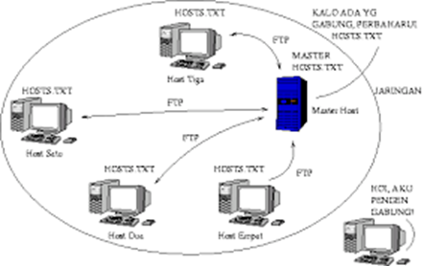
DNS History
APARANET utilized a central file HOST.txt.
Contains name’s to address mapping.
Maintained by SRI’s NIC (Stanford-Research-Institute: Network –
Information -Center)
Administrators email changes to NIC.
NIC updates HOSTS.txt periodically.
Administrators FTP (Download) HOSTS.txt.

Slide 8
DNS HISTORY Cont….
As the system grew, HOSTS.txt had problems with
Scalability ( Traffic and load)
Name collisions
Consistency.
In 1984, Paul Mockapetris released the first version (RFCs882 and 883,
superseded by 1034 and 1035….)

