Slide 1
Proxy server
SLIDE NO: 1

Slide 2
TEAM MEMBERS
NANDINI N
ARVETHI NAVEEN 093939
DIVYASHREE V 093950
MAHANTHESH KUMBAR 093957
SANDEEP N V S DIVVELA 093949
SAI KRISHNA
MONISHA S M 093952
SLIDE NO: 2

Slide 3
SLIDE NO: 3
Proxy Server
A proxy server is a dedicated computer or a software system running on a computer that acts as an intermediary between an endpoint device, such as a computer, and another server from which a user or client is requesting a service.
Functionalities:
Firewall and network data filtering.
Network connection sharing.
Data caching.
Types of proxies :
Forward proxy.
Open proxy.
Reverse proxy.

Slide 4
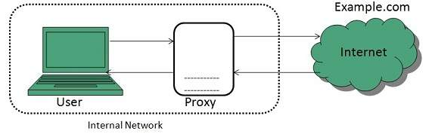
Forward Proxy
SLIDE NO: 4

Slide 5
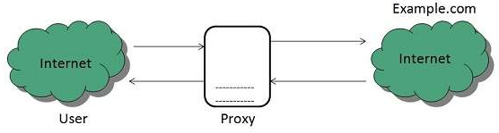
Open Proxy
SLIDE NO: 5

Slide 6
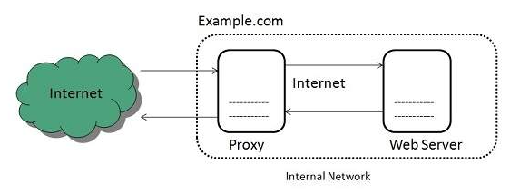
Reverse Proxy
SLIDE NO: 6

Slide 7
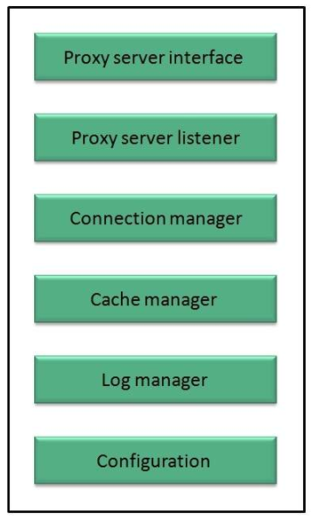
Architecture
SLIDE NO: 7

Slide 8
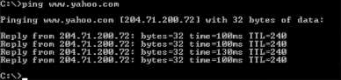
PING (Packet Internet Groper)
It is TCP/IP utility used to troubleshoot the Network issues.
You can run the ping command on a Windows computer by opening an MSDOS window and then typing "ping" followed by the domain name or IP address of the computer you wish to ping. You can list the available options for the Windows ping command with "ping -?".
SLIDE NO: 8

Slide 9
Ping Results
Successful Ping Results:
PING www.asite.com (135.9.4.93) from 135.9.77.30 : 56 (84) bytes of data.
64 bytes from www.asite.com (135.9.4.93): icmp_seq=0 ttl=245 time=6.3 ms
64 bytes from www.asite.com (135.9.4.93): icmp_seq-1 ttl=245 time=6.3 ms
2 packets transmitted, 2 packets received, 0% loss
round-trip min/avg/max = 0.3/3.3/6.3 ms
SLIDE NO: 9

Slide 10
Unsuccessful Ping Results:
The network or the network host is down.
The host is denying the packets.
The ping was sent to the wrong address.
Packets are rejected. The host may have been optioned not to respond to incoming ICMP packets.
Packets did not reach the host. A network problem is preventing the ping packets from reaching the host.
SLIDE NO: 10

Slide 11
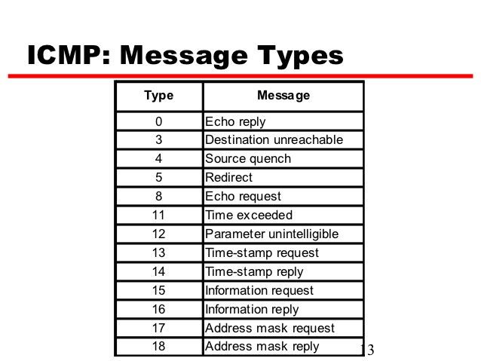
ICMP
The Internet Control Message Protocol (ICMP) is a supporting protocol
in the Internet protocol suite.
It is used by network devices, including routers, to send error messages.
ICMP Types:
The type field identifies the type of the message sent by the host or gateway.
Many of the type fields contain more specific information about the error
condition.
SLIDE NO: 11

Slide 12
Trace route
SLIDE NO: 12

Slide 13
Trace Route
Traceroute is a network diagnostic tool.
Used to track the pathway taken by a packet on an IP network from
source to destination.
Traceroute also records the time taken for each hop the packet makes
during its route to the destination.
A traceroute is also known as a tracert.
SLIDE NO: 13

Slide 14
Objectives of Traceroute
Traceroute determines the how packets are being routed to a particular Host.
Determines the entire path that a packet travels through.
It determines the names and identifies the devices in your path.
Used to determine the time taken by packet to reach destination.
SLIDE NO: 14

Slide 15
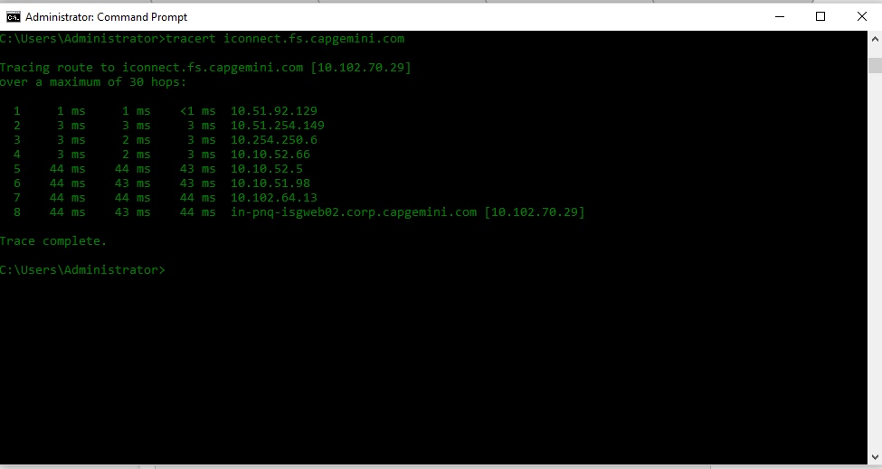
How Traceroute works?
SLIDE NO: 15

Slide 16
Installation And Configuration Of Proxy Server
SLIDE NO: 16

Slide 17
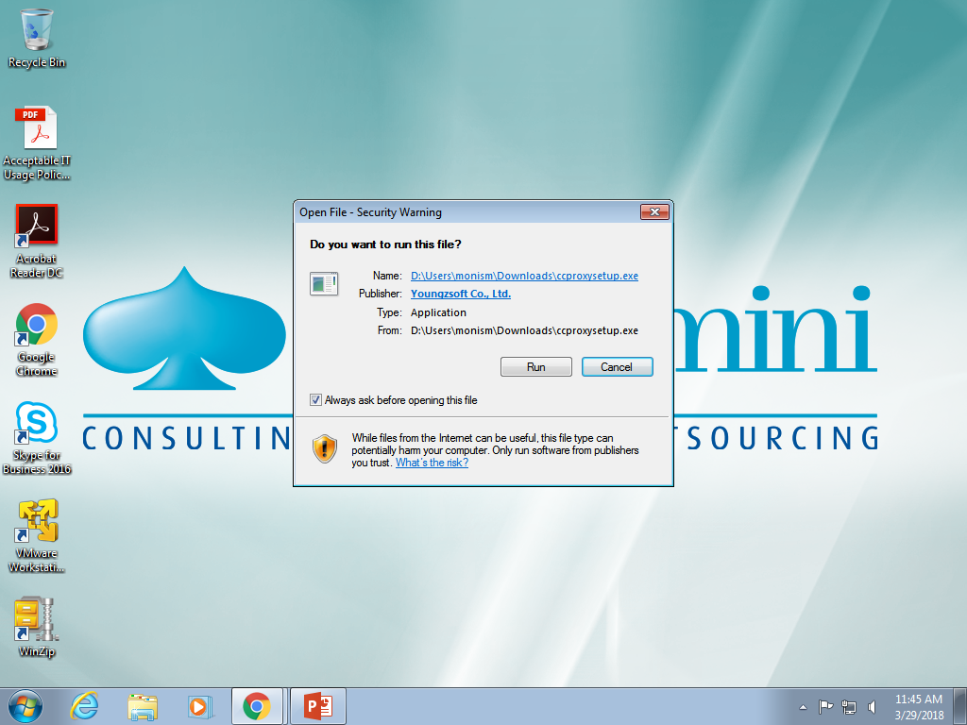
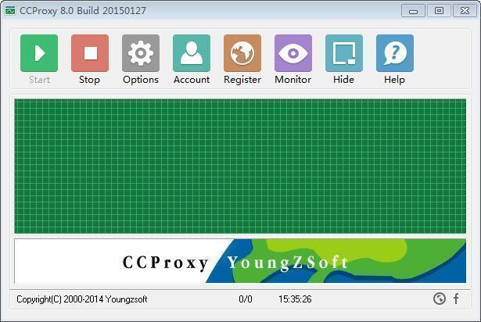
Setting Up Proxy Server with CC Proxy Software
1. Choose a computer which is connected to both the LAN and the Internet. 2. Download the latest version of CCProxy from it's download center. 3. Launch "ccproxysetup.exe" and keep clicking the "Next" button to finish installation. 4. You do not need to make any additional configuration, CCProxy will work automatically.
SLIDE NO: 17

Slide 18
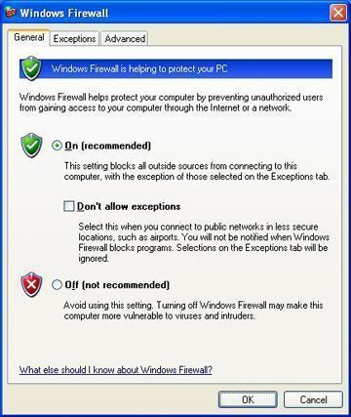
If you have set up proxy server on Windows XP, to make the proxy server work well, you need to turn off the system firewall or create an exception rule for CCProxy.
Click Windows "Start"
-> "Control Panel"
-> "Security Center“
-> "Windows Firwall"
-> you can click "Off“
Check box to turn off Windows Firewall.
SLIDE NO: 18

Slide 19
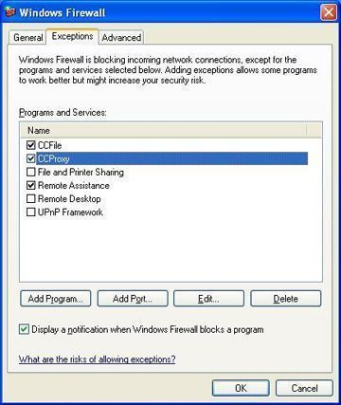
If you keep the Windows Firewall on, you need to create exception rule for CCProxy:
Click the "Exceptions" tab
→ "Add Program"
→ Select CCProxy
→ "OK" to save
SLIDE NO: 19

Slide 20
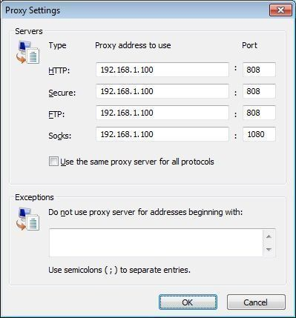
Proxy Settings In IE
Click "Tools"
→ "Internet Options“
→ "Connections“
→ "LAN Settings"
→ Select "Use a proxy server for your LAN"
"Advanced", configure.
SLIDE NO: 20

Slide 21
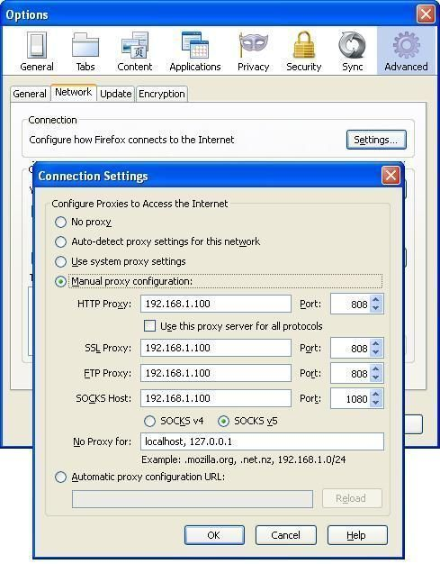
Proxy Settings in Firefox
Click "Tools“
→ "Options“
→ "Advanced"
→ "Network“
→ "Connections“
→ "Settings"
→ "Manual proxy configuration", Configure
SLIDE NO: 21

Slide 22
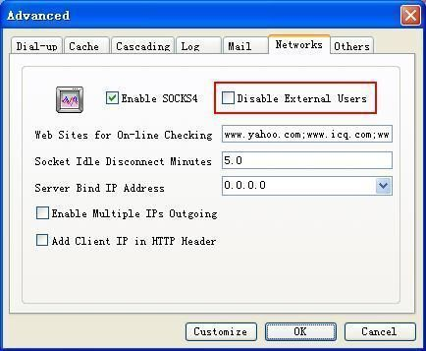
Click "Options"
→ "Advanced"
→ "Networks",
Click to not select the "Disable External Users" check box, then keep clicking the "OK" button to save.
SLIDE NO: 22

Slide 23
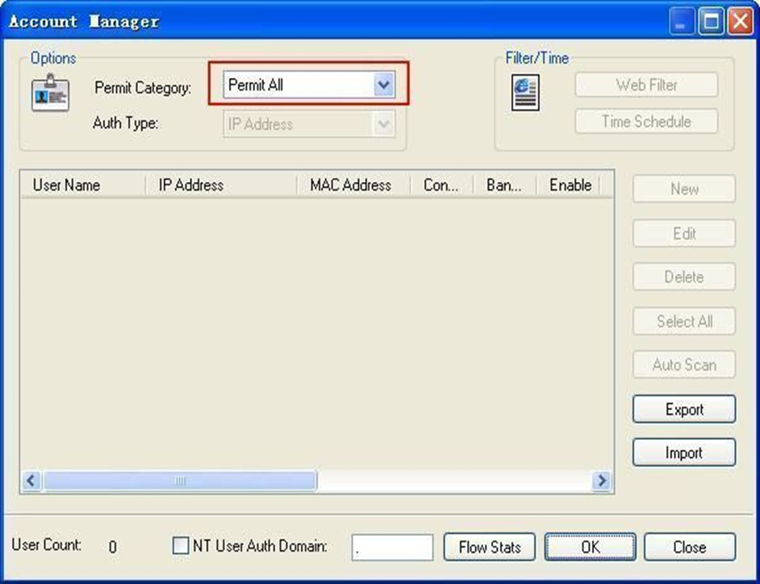
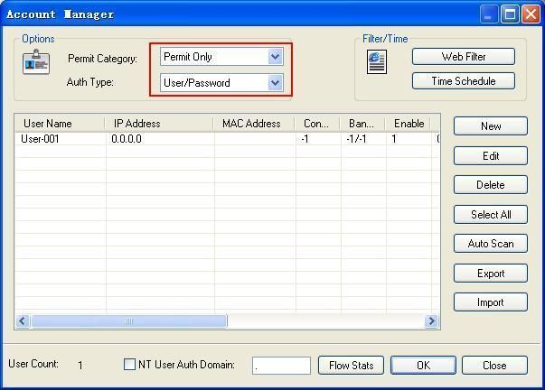
Step 2 - Internet Proxy Server Authentication Management
There are 2 authentication types for you to select:
→Permit All.
→Permit Only.
SLIDE NO: 23

Slide 24
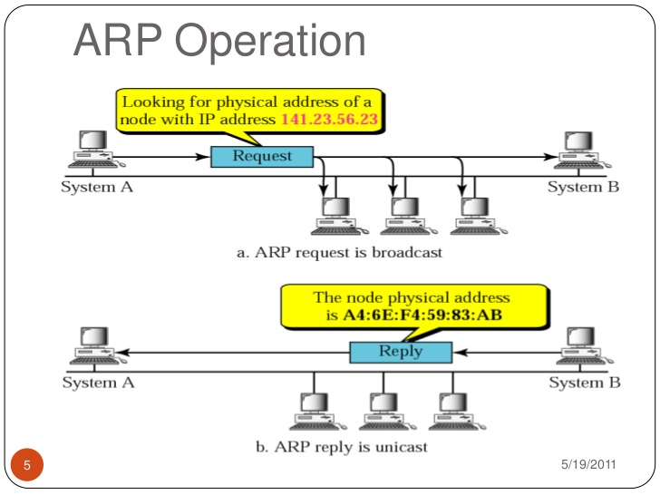
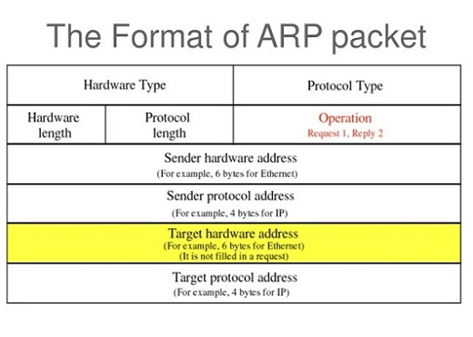
ARP (Address Resolution protocol)
ARP is a protocol used to match a IP address with its corresponding
MAC address on a local area network(LAN).
SLIDE NO: 24

Slide 25
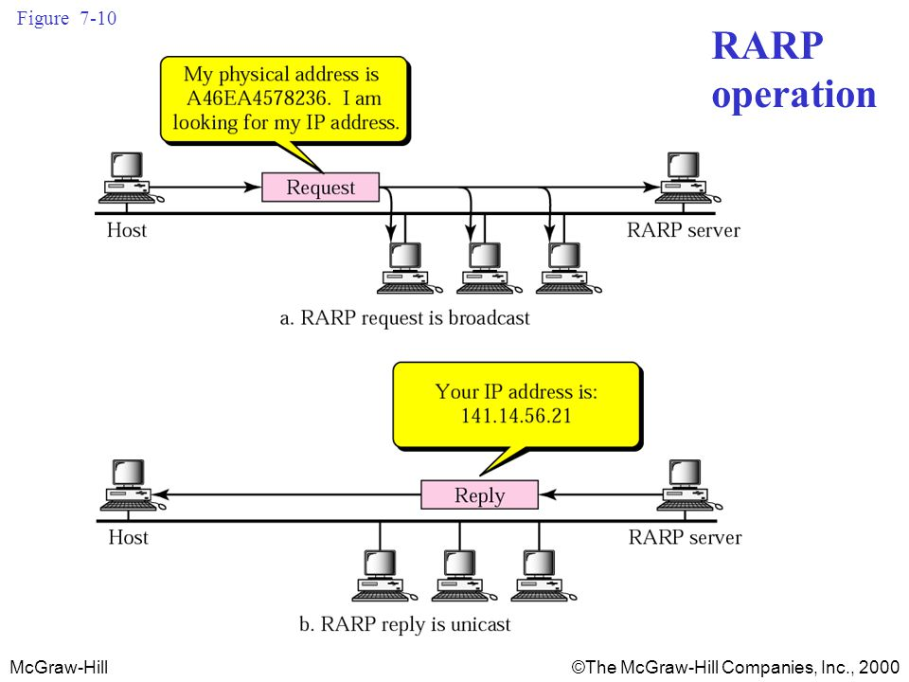
Reverse Address Resolution Protocol (RARP)
RARP (Reverse Address Resolution Protocol) is a protocol by which a
physical machine in a local area network can request to learn its IP
address from a gateway server's Address Resolution Protocol (ARP) table.
SLIDE NO: 25

Slide 26

SLIDE NO: 26

