Slide 1
NETWORK SERVICES

Slide 2
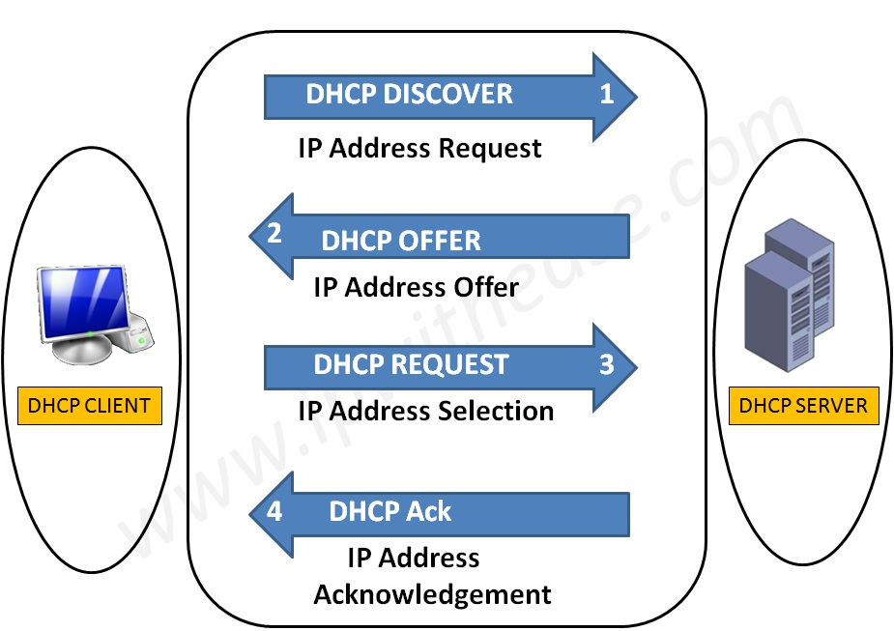
What is DHCP?
Logical Address
Used to dynamically assign an IP address to any node
ARP
Physical Address
Logical Address
RARP
Physical Address

Slide 3
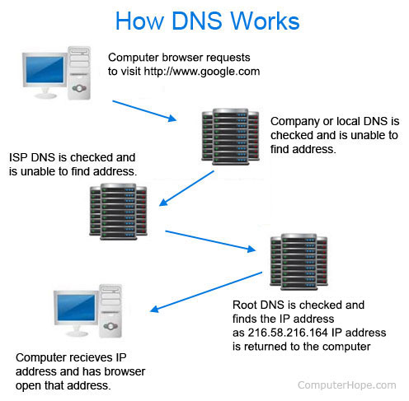
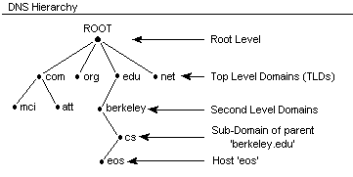
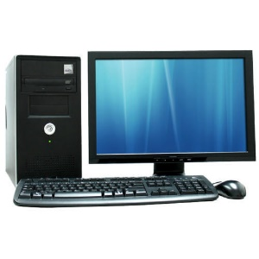
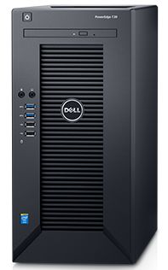

DNS
It converts a computer's host name into an IP address on the Internet.
What is ip of xyz.com
Client
Here is 156.x.x.x
Server
DNS CACHE
OS cache

Slide 4

LDAP (Lightweight Directory Access Protocol)
Lightweight Directory Access Protocol uses client-server architecture.
Directory services contain data and metadata.
X.500 formed the basis of a standard that is widely deployed known as LDAP.
ID | Name | Email
1 | John Doe | a@xyz.com
dc=org, dc=com
ou=finance
ou=eng
Cn=Sam Carter
Cn=Harry Milter

Slide 5



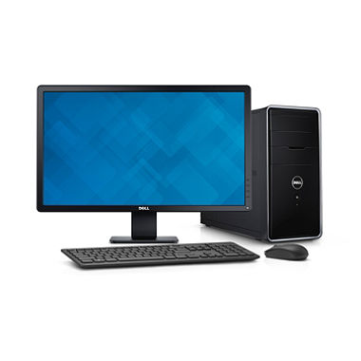

Mail Services
Mail Delivery Agent (MDA)
SMTP
SMTP
SMTP
Internet/Intranet
Mail Transfer Agent (MTA)
Mail Transfer Agent (MTA)
Pop / IMAP
Mail User Agent (MUA)
Mail User Agent (MUA)

Slide 6
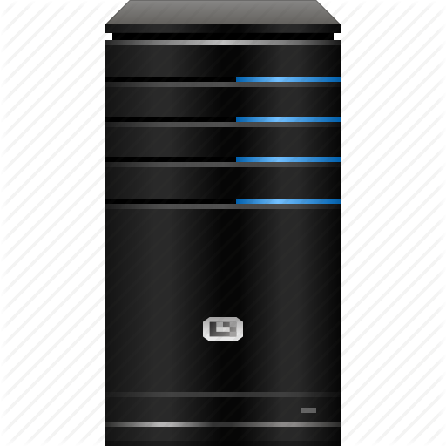
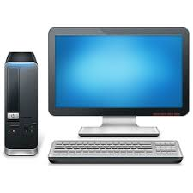


Proxy Server
Proxy Caching
Acts as an intermediary between the user's computer and the Internet.
Forward and Reverse Proxy are two types of proxy server.
Proxy Server
www.abc.com
Document Request
Up to Date
Document sent from cache
www.abc.com
CLIENT
CLIENT
ISP
Remote Server
Proxy Server
CACHE

Slide 7
Web Service
A web service is a method of communication between two electronic devices over a network.
REQUEST
WEB
SERVICE PROVIDER
RESPONSE
CLIENT
SERVER

