Slide 1
Microprocessors

Slide 2
What it is………….?
Micro processor is an integrated circuit that contains all the functions of a central processing unit of a computer.
microprocessor incorporates the functions of a computer's central processing unit (CPU) on a single integrated circuit (IC) or at most a few integrated circuits.
It is engine that goes into motion when your computer on.
It is multipurpose, clock driven, register based integrated circuit which accept binary data as input and process it and provides appropriate output.
Microprocessor has both combinational and sequential digital data.
Made up of silicon(semi conductor)

Slide 3
Manufactures of Microprocessor
Intel
AMD(Advanced Micro Devices)
Qualcomm
NVIDIA
IBM
Samsung
Motorola
Hewlett-Packard (HP)

Slide 4
First Indian Microprocessor
First Microprocessor intel 4004 was released in the year 1971.
Invented by Tedd Hoff.
It was used in Calculators.
First Indian Microprocessor was released on Sep 17, 2008.
The latest Microprocessor – intel i9 of (2.6 GHz speed).

Slide 5
Version of Microprocessors
MICROPROCESSOR | PRODUCTION YEAR
INTEL 4004 | 1971
INTEL 8008 | 1972
INTEL 8080 | 1973
INTEL 8085 | 1975
INTEL 8088 | 1979
INTEL 80186 | 1982
INTEL 80286 | 1983
INTEL 80386 | 1986
INTEL 80486 | 1989
PENTIUM | 1993
PENTIUM PRO | 1995
PENTIUM II | 1997
PENTIUM III | 1999
PENTIUM IV | 2000
...

Slide 6
Multiprocessing

Slide 7
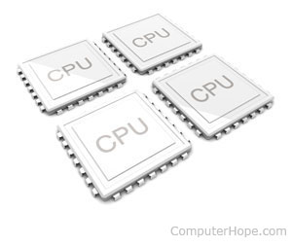
Multiprocessing
Multiprocessing is the use of two or more central processing units (CPUs) within a single computer system.
ability of a system to support more than one processor or the ability to allocate tasks between them.

Slide 8
Multiprogramming

Slide 9
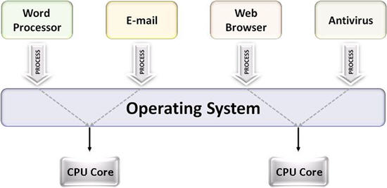
Multiprogramming
Multiprogramming means parallel processing in which several programs are run at the same time on a uniprocessor.

Slide 10
Multithreading

Slide 11
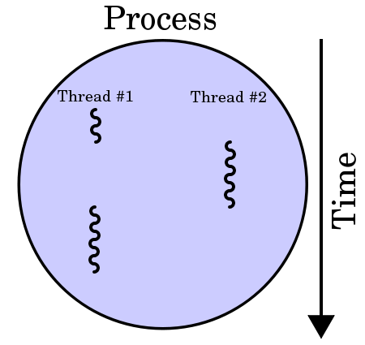
Multithreading

Slide 12
Hyper threading

Slide 13
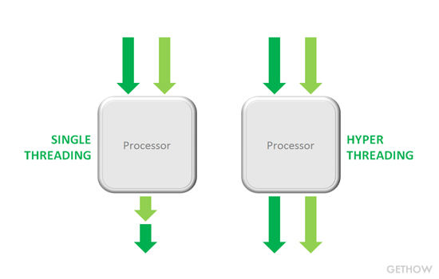
Hyper threading
Hyper-Threading is a technology used by some Intel microprocessor.
it allows a single microprocessor to act like two separate processors to the operating system and the application programs that use it.

Slide 14
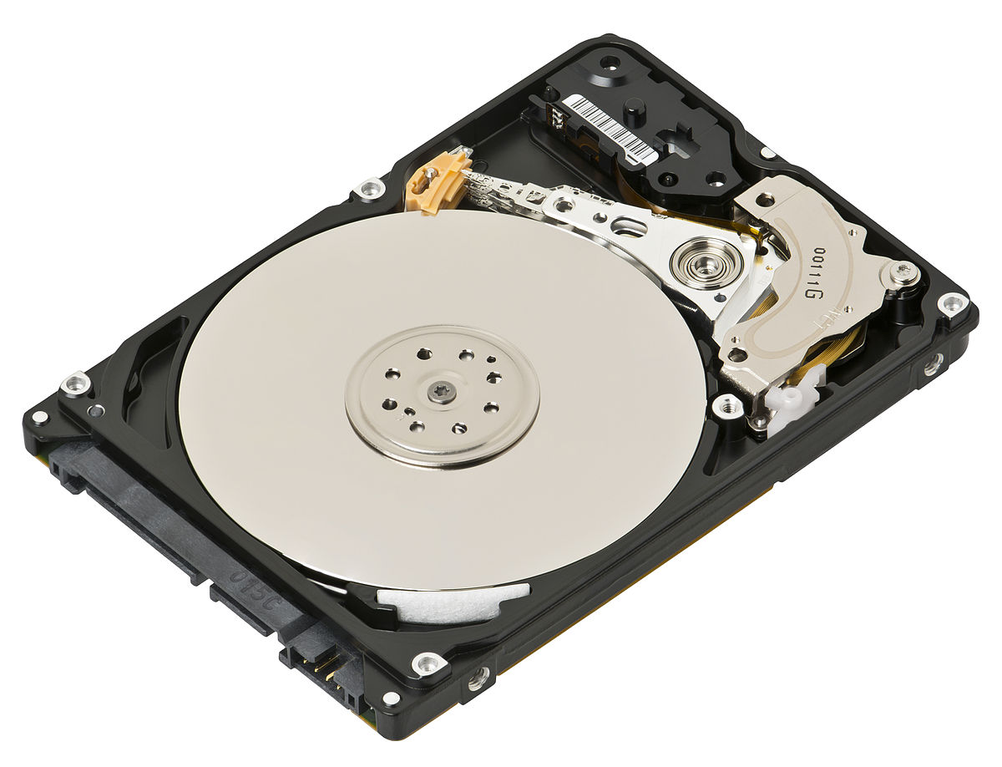
Hard Disk
A hard disk is a data storage device.
that uses magnetic storage to store and retrieve digital information using one or more rigid rapidly rotating disks coated with magnetic material.

Slide 15
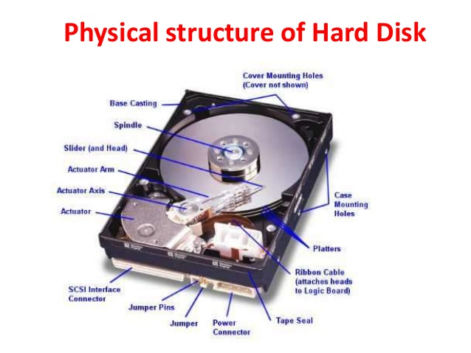
Internal View of Hard Disk

Slide 16
Manufactures of Hard Disks

Slide 17
Solid State Drives

Slide 18
Partitioning in Hard Disk
Creation of one or more regions on a Hard Disk.
Also known as Hard Disk Slicing.
There are two types of partitioning methods
1. Simple Partition
2. Dynamic Partition

Slide 19
Simple Partition Method
MBR – Master Boot Record
GPT – GUID Partition Table
(Globally Unique Identification)

Slide 20
Dynamic Partition
Simple Volume
Spanned Volume
Stripped Volume
Mirrored Volume
RAID - 5

