Slide 1
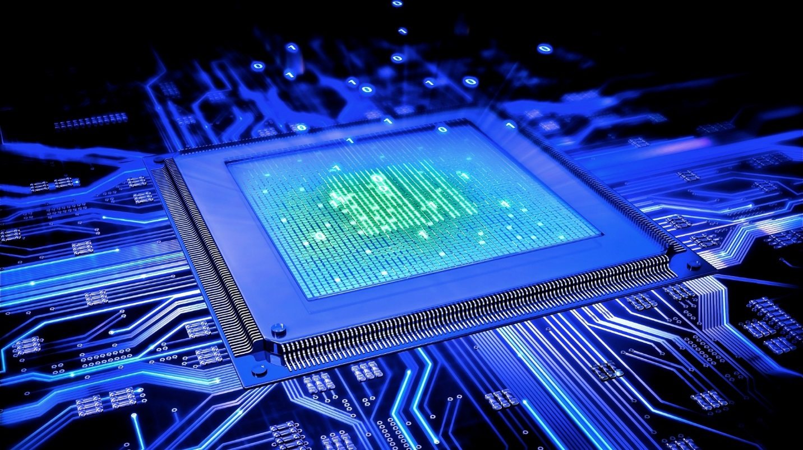
MICROPROCESSOR

Slide 2
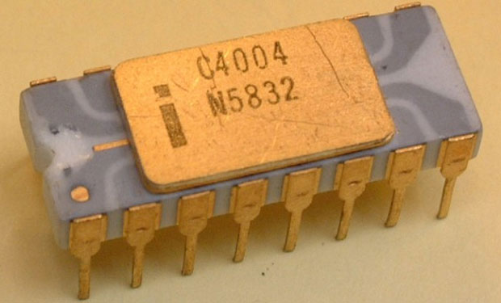
EVOLUTION OF MICROPROCESSOR
INTEL 4004 microprocessor
Released in 1971
1st commercially available microprocessor
4 bit Central Processing Unit (CPU)

Slide 3
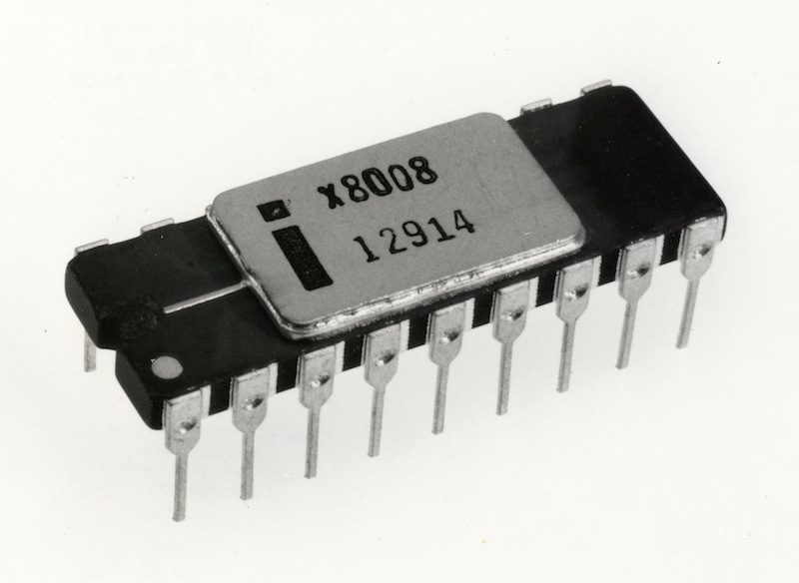
INTEL 8008 Microprocessor
Released in 1972
World’s first 8-bit Microprocessor
8 bit data bus
16 bit address bus

Slide 4
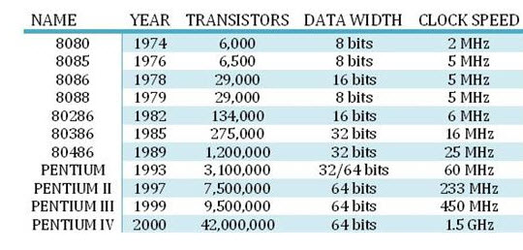
EVOLUTION THROUGH YEARS

Slide 5
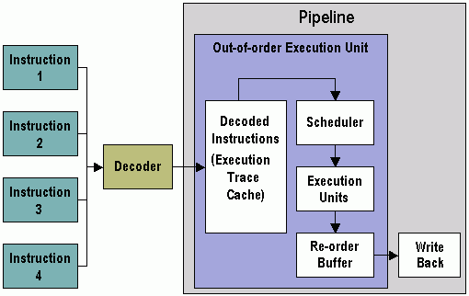
Microprocessor Architecture
Pentium IV
Released on 2000
64 bit processor

