Slide 1
NETWORK FUNDAMENTALS

Slide 2
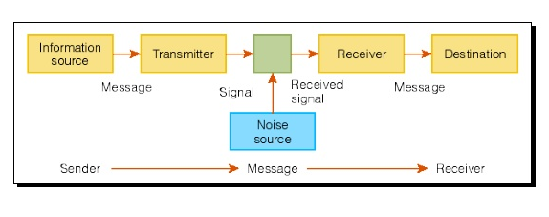
Components Of Communication

Slide 3
Network Characteristics
There are four types of network characteristics are there:
Fault Tolerance
Scalability
Quality of Service
Security

Slide 4
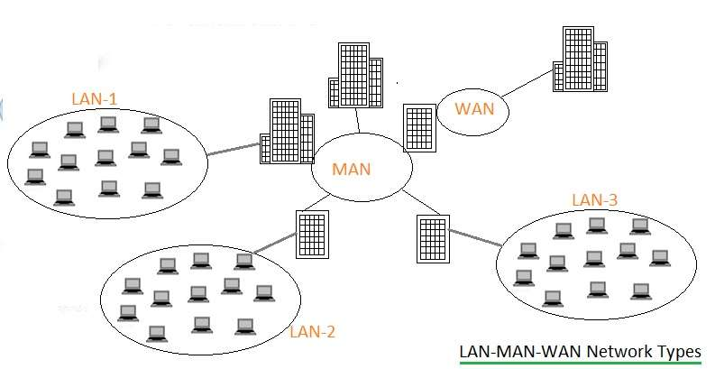
Network Types
LAN
MAN
WAN

Slide 5
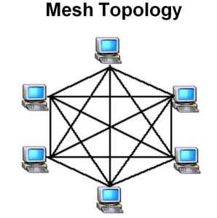
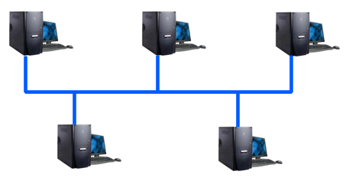

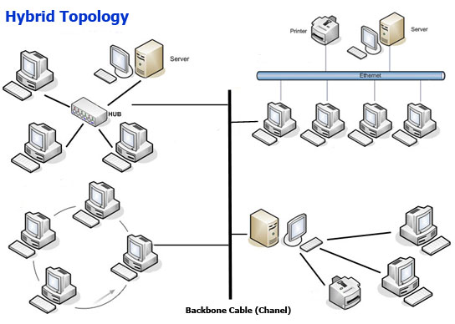
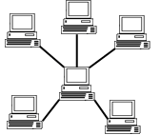
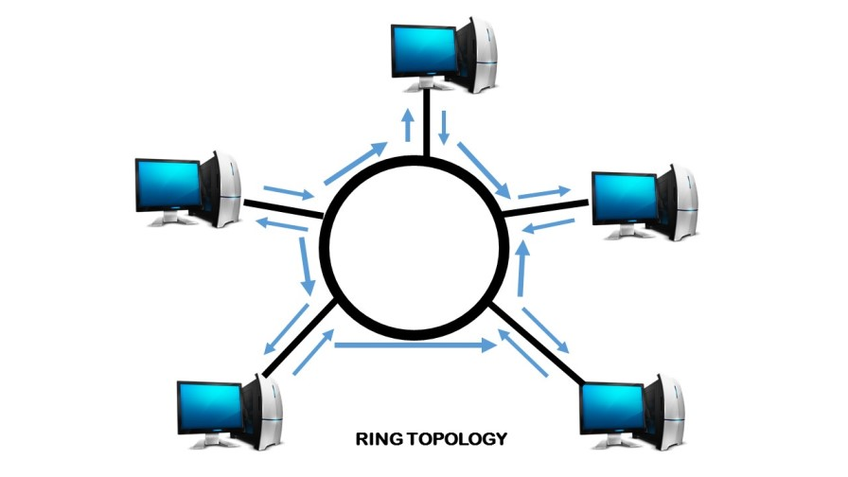
Network Topologies
Point–To-Point
Bus Topology
Mesh Topology
Star Topology
Ring Topology
Hybrid Topology

Slide 6
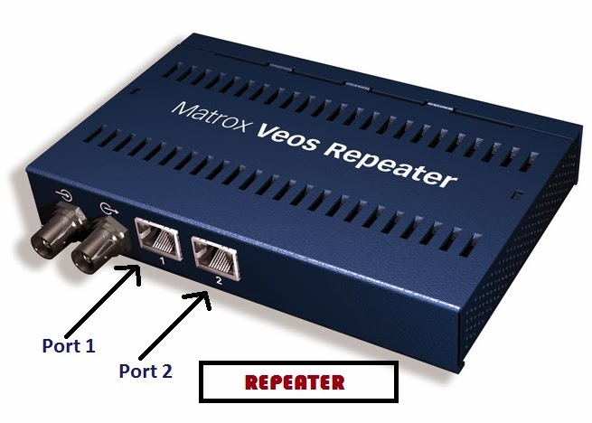
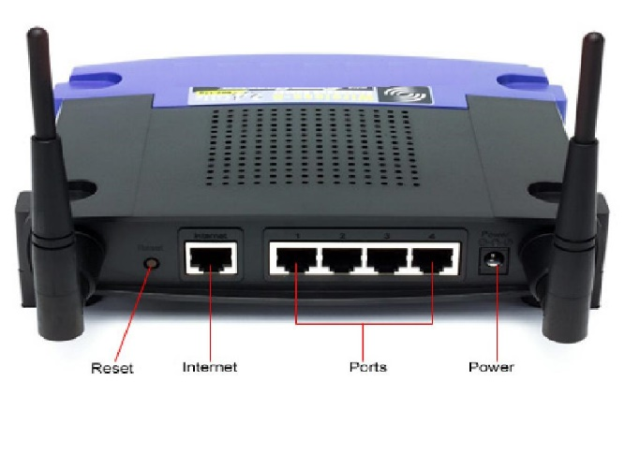
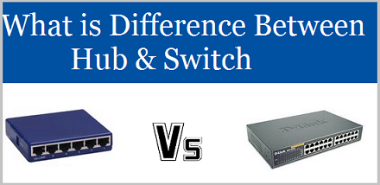
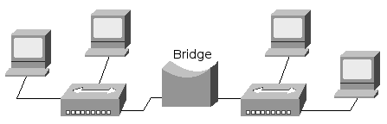
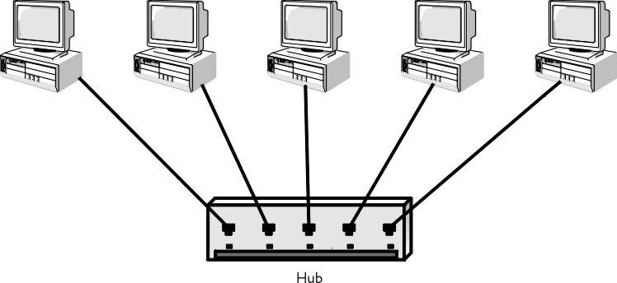
Network Devices
Repeater
Router
Switch
Hub
Bridge

Slide 7
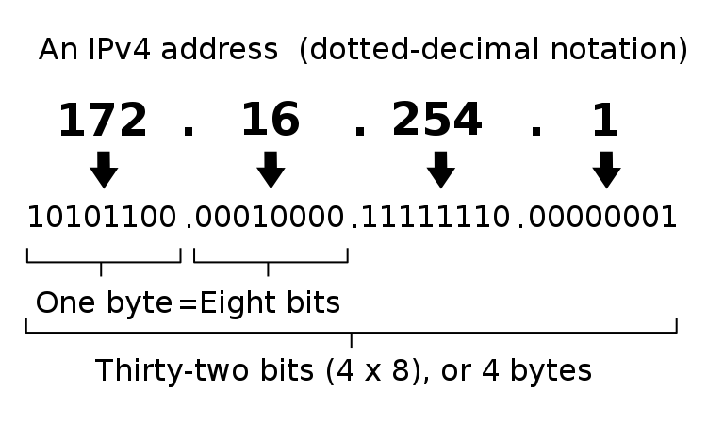
IP Addressing
IPv4

Slide 8
IPv6
The 128 bit IPV6 address is written as Eight 16 bit integer.(Using decimal digits foe each integer)
Ex: CEDF : BF76 : 0000 : 0000 : 009E : FACE : 3025 : DF12
1100 1110 1101 1111 : 1011 1111 0111 0110 : 0000 0000 0000 0000 : 0000 0000 0000 0000 : 0000 0000 1001 1110 : 1111 1010 1100 1110 : 0011 0000 0010 0101 : 1101 1111 0001 0010
Abbreviations of leading Zeros:
CEDF : BF76 : 0 : 0 : 9E : FACE : 3025 : DF12
“ 0000 : 0000” can be written as “ :: ”
CEDF : BF76 : : 9E : FACE : 3025 : DF12
SLIDE NO: 23

Slide 9
Subnetting:
Subnetting is a way of splitting a network into smaller, more manageable pieces.
purpose of subnetting is to help relieve network congestion.
Reserved Address
Link-local Addresses
169.254.1.0 to 169.254.254.255
Loopback IP Addresses
127.0.0.1 to 127.255.255.254
Private IP Address
10.0.0.0 to 10.255.255.255.
172.16.0.0 to 172.31.255.255.
192.168.0.0 to 192.168.255.255.

Slide 10
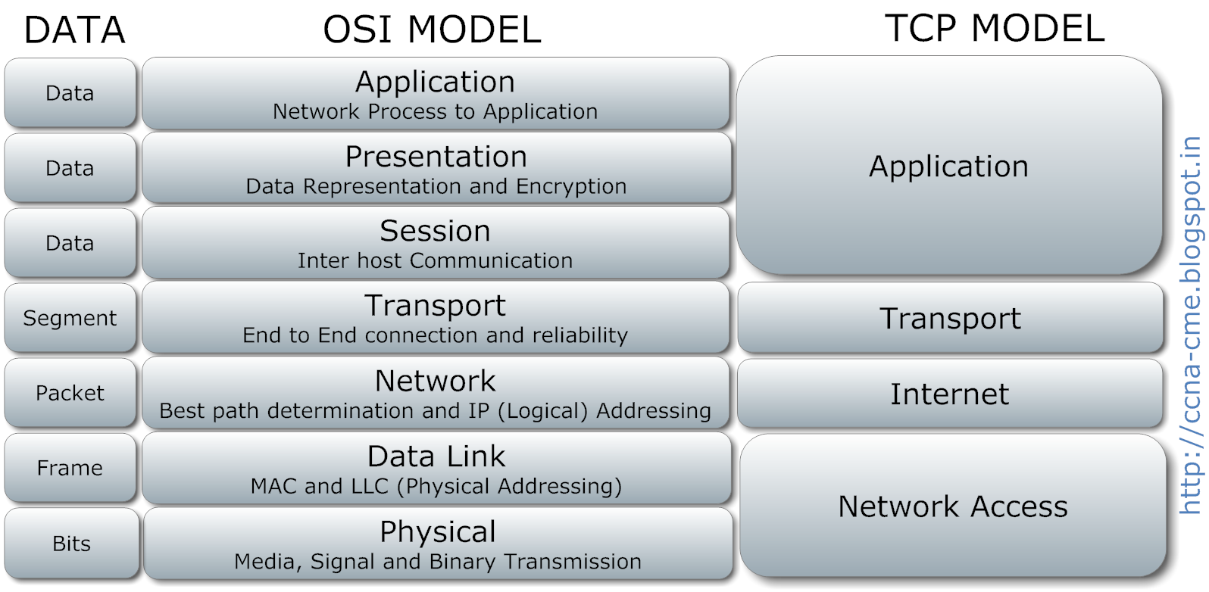
Complete OSI layer Protocol

Slide 11
NETWORK SERVICES

Slide 12
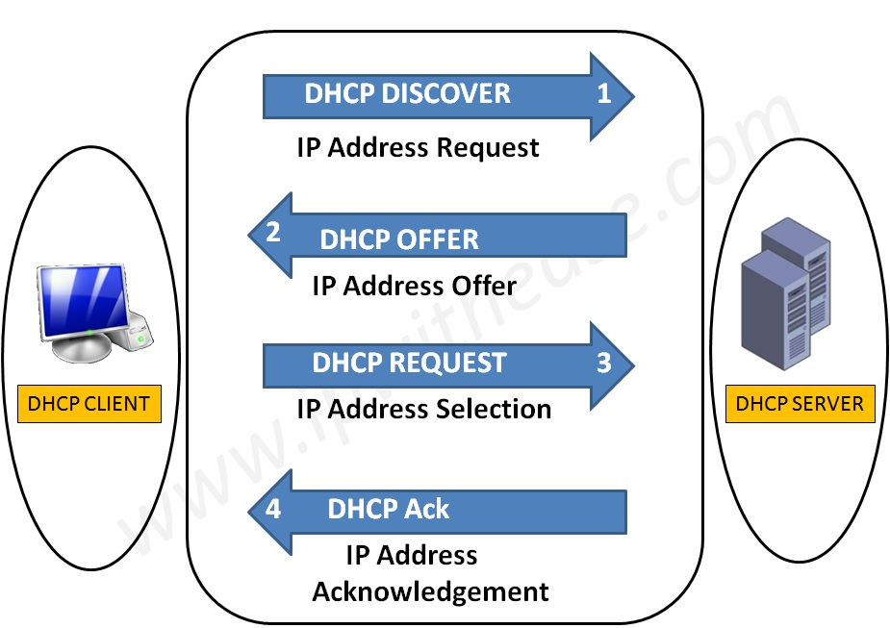
What is DHCP?
Logical Address
Used to dynamically assign an IP address to any node
DHCP Allocation Mechanism:
Manual allocation
Automatic allocation
Dynamic allocation
ARP
Physical Address
Logical Address
RARP
Physical Address

Slide 13
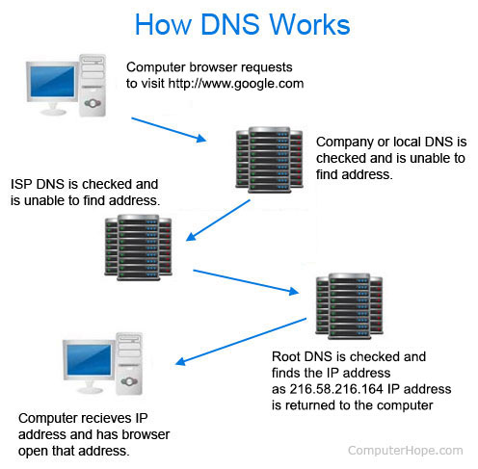
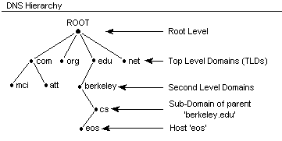
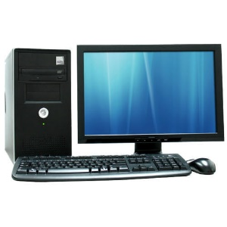
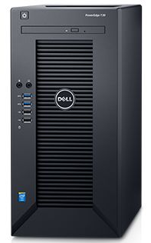

DNS
It converts a computer's host name into an IP address on the Internet.
What is ip of xyz.com
Client
Here is 156.x.x.x
Server
DNS CACHE
OS cache

Slide 14
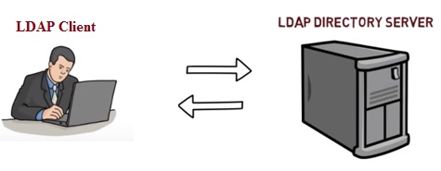
LDAP (Lightweight Directory Access Protocol)
Lightweight Directory Access Protocol uses client-server architecture.
Directory services contain data and metadata.
X.500 formed the basis of a standard that is widely deployed known as LDAP.
ID | Name | Email
1 | John Doe | a@xyz.com
dc=org, dc=com
ou=finance
ou=eng
Cn=Sam Carter
Cn=Harry Milter

Slide 15



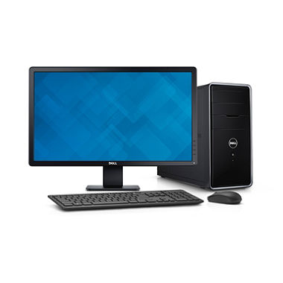
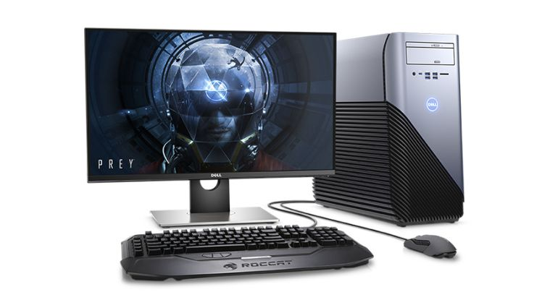
Mail Services
Mail Delivery Agent (MDA)
SMTP
SMTP
SMTP
Internet/Intranet
Mail Transfer Agent (MTA)
Mail Transfer Agent (MTA)
Pop / IMAP
Master User Agent (MUA)
Master User Agent (MUA)

Slide 16
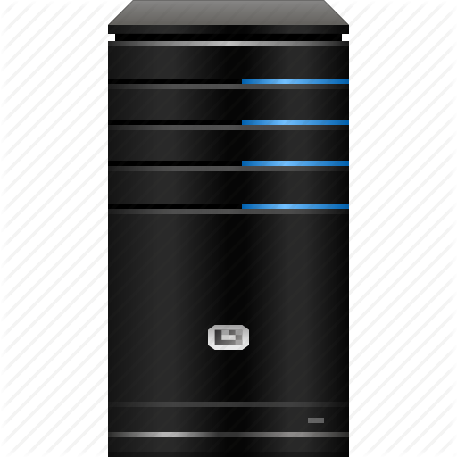
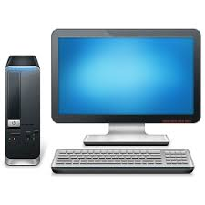


Proxy Server
Proxy Caching
Acts as an intermediary between the user's computer and the Internet.
Forward and Reverse Proxy are two types of proxy server.
Proxy Server
www.abc.com
Document Request
Up to Date
Document sent from cache
www.abc.com
CLIENT
CLIENT
ISP
Remote Server
Proxy Server
CACHE

